Slide 1
E-commerce User Behavior
Data exploration, preprocessing & sequence modelling (Task B)
Katia Louanas — Deep Learning Project

Slide 2
Project pipeline
Raw Kaggle data → exploratory analysis → preprocessing → artifacts.pkl
Task B: predict the next event in a synthetic session sequence
Models: vanilla RNN vs LSTM (PyTorch), 12 hyperparameter configs each
Selection criterion: lowest validation loss; final comparison on test set

Slide 3
1. The data

Slide 4
Dataset
Source: Kaggle — e-commerce user behavior (~8 000 users, 14 columns)
One row = one browsing session (aggregated features, not a click-by-click log)
Features: demographics, device, engagement (time, pages, bounce), commerce flags
Target (tabular): purchase (0/1) — extreme imbalance (~99.8% class 1)

Slide 5
Data quality & limitations
After cleaning: 6 138 sessions (missing values dropped, mainly ad_clicked)
No native event log → sequences are built from session aggregates (important caveat)
Event vocabulary: view, discount, click_ad, cart, purchase (+ padding token)
Exploration: redundant avg_session_time vs time_on_site; user_id dropped for modelling

Slide 6
2. Data exploration (summary)

Slide 7
EDA highlights
Structure: dtypes, missing values, duplicates, univariate distributions
Target purchase: severe class imbalance; few non-purchase sessions
Numerical features: skew, outliers (IQR), correlation heatmap
Categorical / flags: gender, device, discount, ad click vs purchase patterns
Outcome: preprocessing plan (clean, encode, scale, stratified split)

Slide 8
3. Data preprocessing

Slide 9
Tabular pipeline (Task A & shared splits)
Drop missing rows → separate X / y (purchase)
Drop user_id and avg_session_time; one-hot gender & device_type
Outliers → median replacement (IQR rule on numeric columns)
Stratified split 70% / 15% / 15% (random_state=42)
MinMaxScaler fit on train only; saved with splits in processed/artifacts.pkl

Slide 10
Sequence construction (Task B)
From each session: pages_viewed → repeated view; optional discount & click_ad
cart_items → cart events; purchase flag → purchase at end if applicable
Keep sessions with length ≥ 2; same train/val/test indices as tabular data
Sequences — train: 4 296 | val: 921 | test: 921
Vocabulary: <pad>, cart, click_ad, discount, purchase, view (6 types incl. pad)

Slide 11
4. Task B — problem & architecture

Slide 12
Next-event prediction
Input: variable-length event ID sequence (padded batches)
Output: logits over event types for the next token at each step
Loss: CrossEntropyLoss (ignore padding index)
Metrics: validation loss (model selection), top-1 next-event accuracy

Slide 13
Model architecture & training
Embedding(embed_dim) → RNN or LSTM(hidden_size, num_layers, dropout) → Linear(num_events)
Optimizer: Adam, lr = 0.001 | batch_size = 32 | max 40 epochs
Early stopping on validation loss (patience = 6)
Same random seed (42) for every configuration run

Slide 14
5. Hyperparameter search

Slide 15
Hyperparameter grid (what we varied)
Hyperparameter | Values tested | Fixed in all runs
hidden_size | 64, 128, 256 | —
num_layers | 1, 2 | —
dropout | 0.0, 0.2 | —
embed_dim | 64 | 64
learning_rate | 0.001 | 0.001
batch_size | 32 | 32

Slide 16
All 12 configurations tested (same grid for RNN and LSTM)
Run | hidden | layers | dropout | embed | lr | batch
1 | 64 | 1 | 0.0 | 64 | 0.001 | 32
2 | 64 | 1 | 0.2 | 64 | 0.001 | 32
3 | 64 | 2 | 0.0 | 64 | 0.001 | 32
4 | 64 | 2 | 0.2 | 64 | 0.001 | 32
5 | 128 | 1 | 0.0 | 64 | 0.001 | 32
6 | 128 | 1 | 0.2 | 64 | 0.001 | 32
7 | 128 | 2 | 0.0 | 64 | 0.001 | 32
8 | 128 | 2 | 0.2 | 64 | 0.001 | 32
9 | 256 | 1 | 0.0 | 64 | 0.001 | 32
10 | 256 | 1 | 0.2 | 64 | 0.001 | 32
11 | 256 | 2 | 0.0 | 64 | 0.001 | 32
12 | 256 | 2 | 0.2 | 64 | 0.001 | 32

Slide 17
Search design
3 × 2 × 2 = 12 combinations per architecture (RNN and LSTM each trained on all 12)
Run numbers match the notebook enumeration order (run 1 = first grid point)
Best model selected by lowest validation loss per architecture
In combined results: R = best RNN | L = best LSTM (by validation loss)

Slide 18
Results — all configurations (RNN vs LSTM)
Run | hidden | L | drop | RNN loss | RNN acc | LSTM loss | LSTM acc | Best
1 | 64 | 1 | 0.0 | — | — | 0.3743 | 0.891
2 | 64 | 1 | 0.2 | — | — | 0.3744 | 0.891
3 | 64 | 2 | 0.0 | 0.3740 | 0.891 | 0.3744 | 0.891
4 | 64 | 2 | 0.2 | 0.3755 | 0.891 | 0.3741 | 0.891 | L
5 | 128 | 1 | 0.0 | 0.3736 | 0.892 | — | — | R
6 | 128 | 1 | 0.2 | 0.3769 | 0.891 | — | —
7 | 128 | 2 | 0.0 | 0.3743 | 0.891 | 0.3750 | 0.890
8 | 128 | 2 | 0.2 | 0.3748 | 0.891 | 0.3743 | 0.891
9 | 256 | 1 | 0.0 | 0.3747 | 0.891 | 0.3742 | 0.890
10 | 256 | 1 | 0.2 | 0.3759 | 0.892 | 0.3754 | 0.890
11 | 256 | 2 | 0.0 | 0.3754 | 0.891 | 0.3745 | 0.890
12 | 256 | 2 | 0.2 | 0.3745 | 0.891 | 0.3744 | 0.891

Slide 19
6. RNN — results

Slide 20
RNN — all 12 configurations (metrics per run)
Run | hidden | layers | dropout | val loss | val acc | epochs
1 | 64 | 1 | 0.0 | — | — | —
2 | 64 | 1 | 0.2 | — | — | —
3 | 64 | 2 | 0.0 | 0.3740 | 0.891 | 31
4 | 64 | 2 | 0.2 | 0.3755 | 0.891 | 33
5 | 128 | 1 | 0.0 | 0.3736 | 0.892 | 26 | ★
6 | 128 | 1 | 0.2 | 0.3769 | 0.891 | 15
7 | 128 | 2 | 0.0 | 0.3743 | 0.891 | 23
8 | 128 | 2 | 0.2 | 0.3748 | 0.891 | 26
9 | 256 | 1 | 0.0 | 0.3747 | 0.891 | 26
10 | 256 | 1 | 0.2 | 0.3759 | 0.892 | 13
11 | 256 | 2 | 0.0 | 0.3754 | 0.891 | 14
12 | 256 | 2 | 0.2 | 0.3745 | 0.891 | 15

Slide 21
Best RNN configuration
hidden_size = 128 | num_layers = 1 | dropout = 0.0 | embed_dim = 64
Validation loss = 0.3736 | Validation accuracy = 89.16%
Test loss = 0.3810 | Test accuracy = 88.71%
Training stopped at epoch 26 (early stopping)

Slide 22
7. LSTM — results

Slide 23
LSTM — all 12 configurations (metrics per run)
Run | hidden | layers | dropout | val loss | val acc | epochs
1 | 64 | 1 | 0.0 | 0.3743 | 0.891 | 28
2 | 64 | 1 | 0.2 | 0.3744 | 0.891 | 39
3 | 64 | 2 | 0.0 | 0.3744 | 0.891 | 22
4 | 64 | 2 | 0.2 | 0.3741 | 0.891 | 34 | ★
5 | 128 | 1 | 0.0 | — | — | —
6 | 128 | 1 | 0.2 | — | — | —
7 | 128 | 2 | 0.0 | 0.3750 | 0.890 | 20
8 | 128 | 2 | 0.2 | 0.3743 | 0.891 | 23
9 | 256 | 1 | 0.0 | 0.3742 | 0.890 | 14
10 | 256 | 1 | 0.2 | 0.3754 | 0.890 | 15
11 | 256 | 2 | 0.0 | 0.3745 | 0.890 | 17
12 | 256 | 2 | 0.2 | 0.3744 | 0.891 | 15

Slide 24
Best LSTM configuration
hidden_size = 64 | num_layers = 2 | dropout = 0.2 | embed_dim = 64
Validation loss = 0.3741 | Validation accuracy = 89.09%
Test loss = 0.3811 | Test accuracy = 88.82%
Training stopped at epoch 34 (early stopping)

Slide 25
8. Analysis & comparison

Slide 26
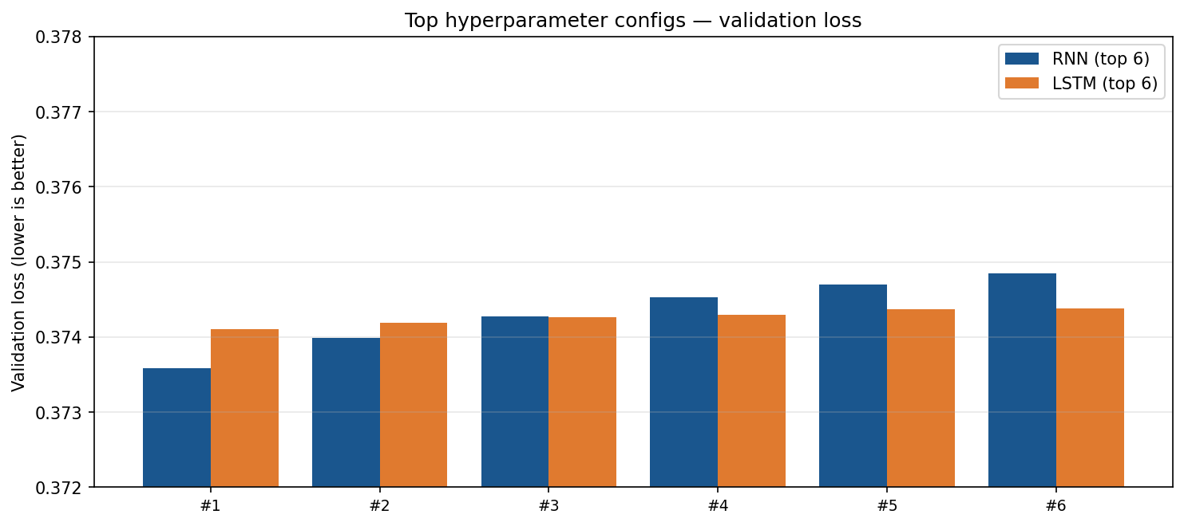
Hyperparameter search — validation loss (top 6 per model)

Slide 27
What we learn from the grid
All configs reach ~89% val accuracy — task is partly easy (many view → view steps)
Larger hidden size (256) does not consistently beat 64 or 128
Dropout 0.2 helps some LSTM runs; best RNN uses no dropout
Val losses are very close (0.373–0.376); differences are small but systematic

Slide 28
Best RNN vs best LSTM (validation + test)
Model | Config | Val loss | Val acc | Test loss | Test acc
RNN | h128, L1, d0 | 0.3736 | 89.16% | 0.3810 | 88.71%
LSTM | h64, L2, d0.2 | 0.3741 | 89.09% | 0.3811 | 88.82%

Slide 29
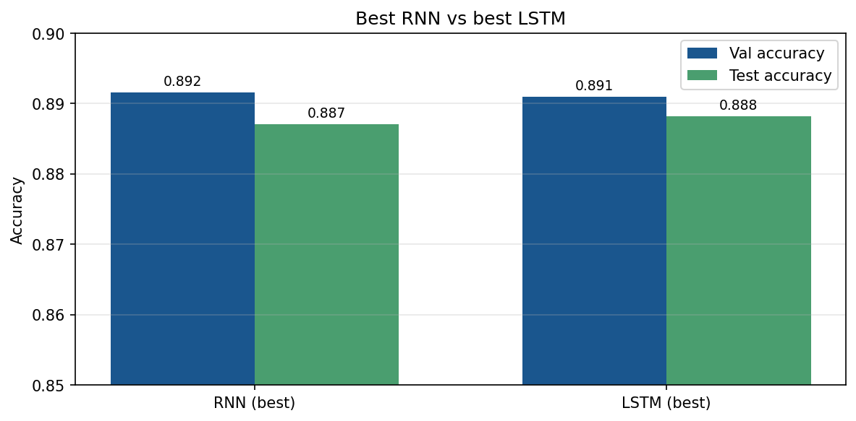
Accuracy comparison — best models

Slide 30
Head-to-head interpretation
Performance is nearly identical: ~0.1 percentage point on test accuracy
LSTM wins on test accuracy in this run; RNN has slightly lower validation loss
LSTM best: deeper (2 layers) + dropout — more regularization for sequences
RNN best: wider hidden state (128) — sufficient for synthetic funnel data
See notebook for confusion matrices and qualitative prediction examples

Slide 31
9. Conclusion

Slide 32
Summary & takeaways
Cleaned 6 138 sessions; reusable preprocessing in processed/artifacts.pkl
Synthetic sequences enable next-event modelling without raw clickstream data
Systematic search: 12 RNN + 12 LSTM configs; best ~89% next-event accuracy
RNN and LSTM are comparable on this dataset; choice can be based on stability or runtime
Future work: real event logs, class weights, richer hyperparameter search, Transformer baseline

Slide 33
Thank you
Questions?
Notebooks: data_exploration.ipynb | data_preprocessing.ipynb | task_b_sequence_modelling.ipynb

