Slide 1



Pulse-level quantum computing of collective neutrino oscillations
Presented by Kaytlin Harrison
In close collaboration with;
Pooja Siwach, Baha Balantekin, Peter Zlatev, Anna Suliga,
Daniel Heimsoth, Caroline Laber-Smith
Notes:
Take a breath, click to the next slide :)

Slide 2

Supernovas are one of the largest sources of energy known to exist
An artist's conception of SN2016aps, the most powerful supernova we have ever found Credit: M. Weiss​​
Notes:
Supernovas are one of the largest sources of energy know to exist.
Producing in 100 seconds the same amount of energy our sun would need 10 billion years to produce
And yet, we know shockingly little about these energy giants.

Slide 3

Neutrinos describe supernovas
Supernova
Neutrinos
Hamiltonian
Quantum
Notes:
What we do know is that neutrinos are a great way to learn more.
The first reason is because of their abundance. supernovas are 570 billion times brighter than our sun, and yet only 1% of a supernovas total energy goes into producing visible light, the other 99% is converted into neutrinos.
But more important than their quantity, is a neutrino's behavior. Essentially massless and with a neutral charge, means neutrinos Interact so weakly with their environment, that they manage to escape the supernova's radius
Thus, by modeling the time evolution of neutrino energy we can get a glimpse of a supernova’s inner core.
However, even though neutrinos have a weak interaction with their environment, this does not mean neutrino energy remains unchanged. Neutrinos themselves oscillate between what we call flavors states, where each flavor has its own energy. The state of a neutrino is dependent on the flavors of the neutrinos around it. Thus, we end up with a mess of collective neutrino oscillations, or in terms of quantum, we end up with entanglement.

Slide 4
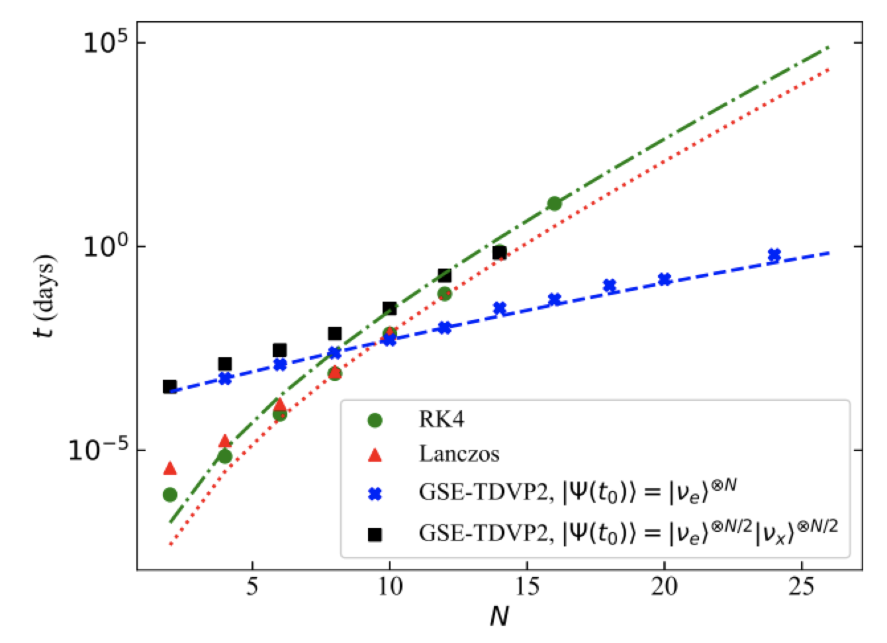
Neutrino-Neutrino interactions are a challenge to study
N neutrinos vs Time to calculate energy
Quantum computing can help!
¹Cervia, Michael, et al. “Collective Neutrino Oscillations with Tensor Networks Using a
Time-Dependent Variational Principle.” ArXiv.org, American Physical Society (APS), arxiv.org/abs/2202.01865.
Notes:
Entanglement makes calculating neutrino energies incredibly difficult though not impossible to solve on a classical computer because of
the many, nonlinear terms you need to solve for. This graph compares the current classical methods for computing collective neutrino oscillations and the time it takes them to calculate the energy of N neutrinos .
As the number of neutrinos in our environment increases, the challenge of computing their total energy scales exponentially, requiring so much time and so many resources,
we’ve mostly given up trying to compute any sizable problem classically.

Slide 5
Where Quantum comes in
Notes:
This is where quantum comes in.
Quantum computing is a fundamentally different approach to tough questions and can potentially solve problems too large and time-consuming for classical computers. How it works is by basing calculations on probabilities rather than measured solutions. Doing this allows us to explore multiple outcomes simultaneously which theoretically, can reduce the amount of time and resources needed to solve a problem.

Slide 6
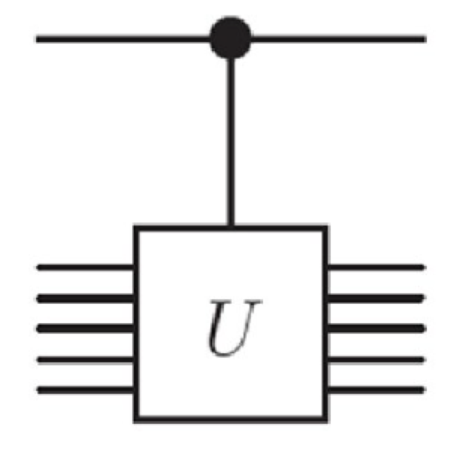
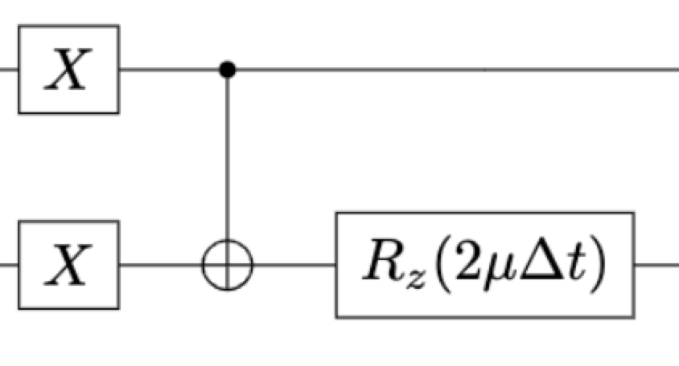

Quantum computing uses trotterization to effectively model the time evolution of neutrinos
Hamiltonian
Unitary matrix form
Trotterize into gates
Notes:
It does this by applying a method called trotterization which is the breakdown of entangled neutrino oscillations in smaller operations such as a rotation or flip, when these so-called gate manipulations are applied to qubits, a circuit is created that can then be used to calculate the probability of the desired outcome.
So to recap, neutrinos give us information about supernovas, but it’s difficult and expensive to calculate their energy using classical means, due to the collective neutrino oscillations. Quantum offers an alternate, potentially faster method of achieving the same results as classical means.

Slide 7
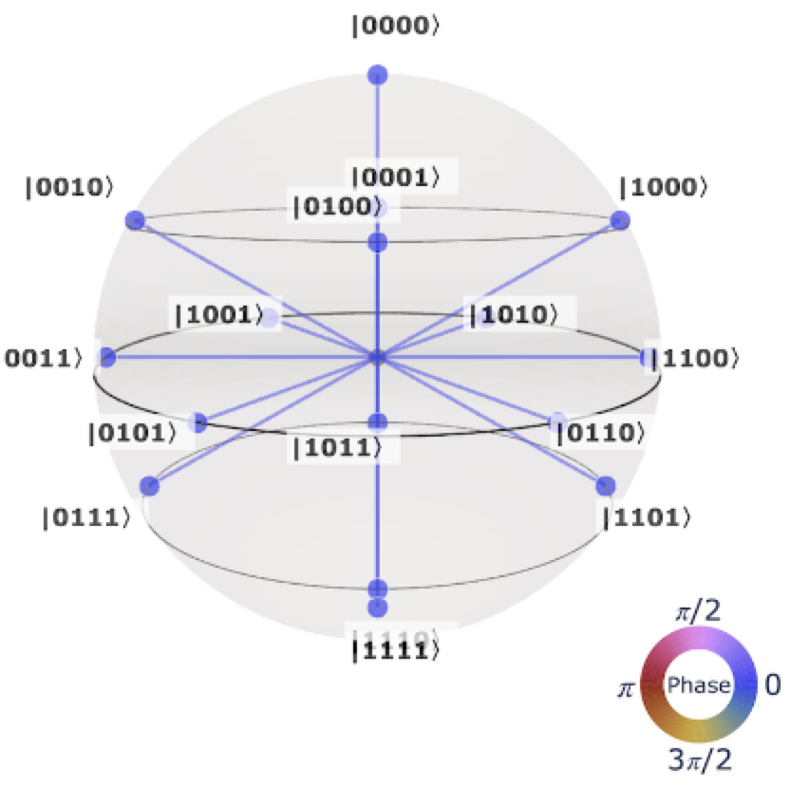
Current quantum computers are error prone
Methods of error correction considered in tandem as a means of decreasing noise in our quantum circuit.
Gate Reduction
Pulse-level quantum
© Copyright image 2021, Qiskit Development Team.
Notes:
However, quantum computers currently have limitations and we're still trying to get them to work well enough to compete with classical methods.
the struggle is that qubit states are super fragile and easily influenced by even the tiniest bit of error in a gate calibration or leak of input from the outside Enviromint. This means that as we increase the number of qubits and consequently gate operations, in our system. The amount of error due to partially unaligned elements cause our probabilities to deviate significantly from the correct value calculated on a classical computer.
To improve quantum computers, I focused my efforts on implementing two methods to reduce error.
Gate Reduction
Implementation of pulse-based quantum

Slide 8
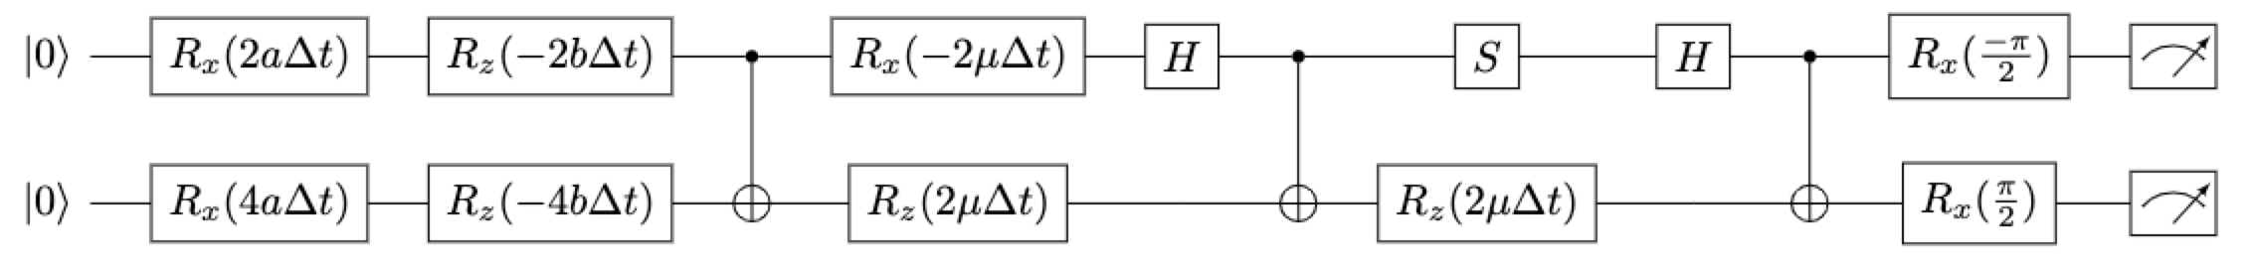
Reducing the number of gates reduces the amount of error in quantum computers
Standard method
Improved method ²
2Vidal, G, and C.M. Dawson. “Universal Quantum Circuit for Two-Qubit Transformations with Three Controlled-NOT Gates.” American Physical Society, link.aps.org/doi/10.1103/PhysRevA.69.010301.
Notes:
the first METHOD is gate reduction.
Quantum circuits use predefined microwave pulse signals as a means to apply gates. This means that the gates themselves are not tailored to individual qubits and are therefore are a significant sources of noise.
In general, when you transform a Hamiltonian or energy equation, the straightforward standard method is to break your system into its base gates, to create something like the first circuit. This works for a few qubits but scales poorly.
To decrease the number of gates needed to represent our neutrino energy I took a transformation method created by vidal and dawson in 2004, for two qubits and modified it fit a four-qubit system modeling our neutrino oscillations.

Slide 9
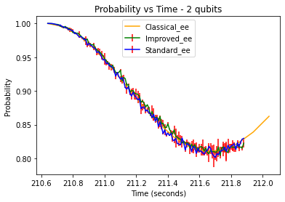
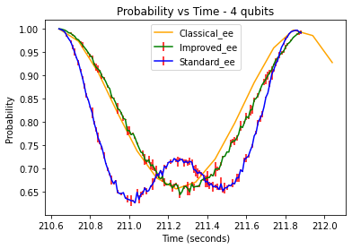
Simulated probability all neutrinos remain electron-neutrinos
Notes:
Here are the results as run-on IBM’s Qasm_simulatior.
On the left is a graph comparing the probability our two neutrinos remain in the electron-neutrino state as a function of time. It compares the results from the classical to the standard and improved quantum circuit models. As you can see, there’s not much of a difference between the three methods. early on they all give about the same probability. Though the quantum methods will get worse while the classical will stay the same as time goes by.
On the other hand, we have the graph for a 4-neutrino system on the right which shows a significant improvement when you compare the standard method and the improved method
The reason we see so much error in the 4-qubit standard method is because it has a lot of gate yes, but more specifically it has a lot of C-NOT gates which is a gate that is directly responsible for entangling qubits. This gate produces the most error because it has to accept input from two different sources. The improved method greatly reduces the number of C-NOT gates and thus has a much better probability. While we’ve only applied this method to 2 and 4 qubit examples due to a limitation of our available resources, these results, indicate we can scale this method to any N-neutrino system and effectively reduce the number of needed gates by nearly.

Slide 10

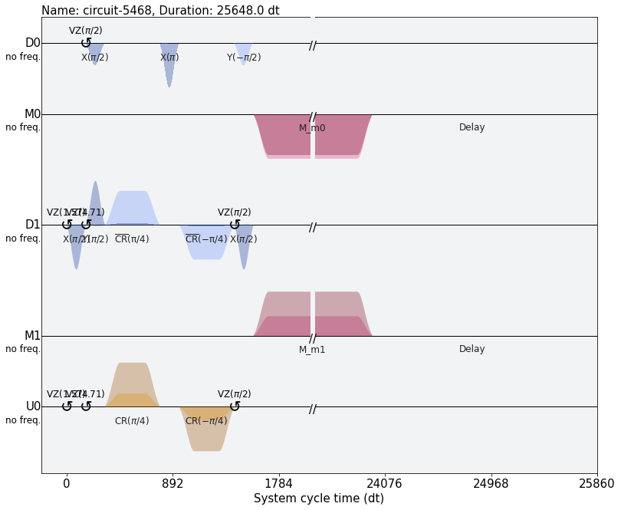
Pulse-level quantum has potential to reduce error in quantum computers
From a Circuit of Gates, to a Schedule of Pulses
Pulse Schedule
Notes:
After we reduced the number of gates, we introduced a 2nd method of reducing errors.
The Implementation of pulse-level quantum
As I mentioned previously, what we call circuit quantum is based on the foundation that all qubits are the same and therefore incorrectly assumes that they require the same preprogrammed microwave pulse for a given gate manipulation to be performed. This leads to additional noise in our circuit.
On the other hand, Pulse-based quantum computing allows for precise control of real quantum hardware. Rather than use a preprogrammed gate as in the case of circuit-based quantum, we instead perform a series of tests to determine which precise amplitude and frequency to send our microwave signal at so the exact operation we require is performed.
Thus, we end up with a schedule of pulses rather than a circuit of gates

Slide 11
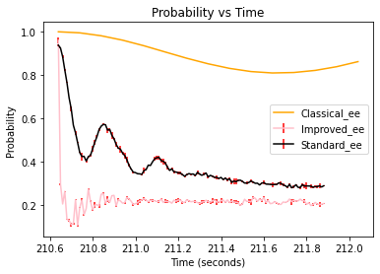
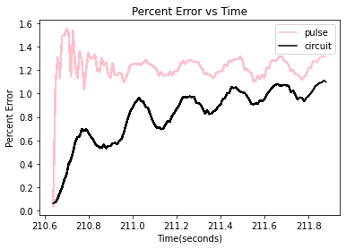
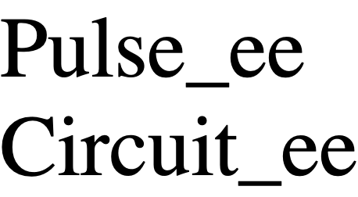
Comparison of Real pulse and circuit quantum computers to known probability achieved by a classical computer
Notes:
As of now here are our results using pulse-based quantum
The graph on the left shows the probability of finding 2 neutrinos both in the electron neutrino state as calculated by classical, circuit, and pulse level methods.
You can see that comparably speaking, the probabilities calculated using quantum are much lower than the classical and much different than what we saw in the previous graph. This is because this calculation was run on one of IBM’s actual quantum computers. Previously we were using simulations of quantum computers since it’s much faster and we only needed to know if the reduction of gates made a difference which could easily be seen on both a simulation and an actual quantum computer. However, when comparing two quantum methods it was necessary to run experiments on a real quantum computer, one with a lot more noise and error. So, while our results for the pulse level method are worse them the results for the circuit-based method, while this isn’t ideal, it is expected. Because pulse-based quantum is tailored to each qubit, a lot of steps need to be done before we achieve good results. We haven’t had enough time yet to make all the necessary adjustments.

Slide 12
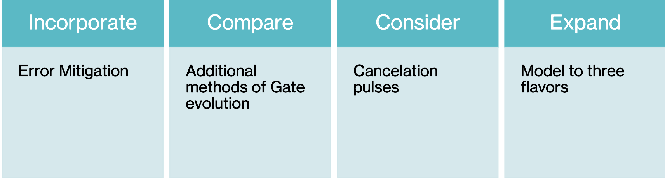

Future Goals
Thank you for your time​ and special thanks to the following for their support!
Notes:
remedy this, Future research will expand to include;
The Incorporate of error Mitigation
A more indepth Comparison of Additional methods of Gate evolution
Consideration of Cancelation pulses before and after pulse schedules
And the Expansion of our Model to three flavors as is applicable in real world analysis
So, there is still a LOT work to be done, but we’re optimistic our results set us on the path to one day achieving the necessary number of low error qubits needed to efficiently calculate the energy of collective neutrino oscillations.
THANK YOU

