Slide 1
“What are my chances of success?”
Notes:
Thank you Dave for that kind introduction,
Hello everyone, I'm here to tell you a little bit about my journey through the field of quantum physics.
( Because Admittedly, it's a bit odd and at times unexpected.)
My hope is that by sharing a bit of myself, someone hear today will gain the confidence to try their own way of doing things, and find they're happy "pace" as you continue in your own journey through Quantum physics

Slide 2
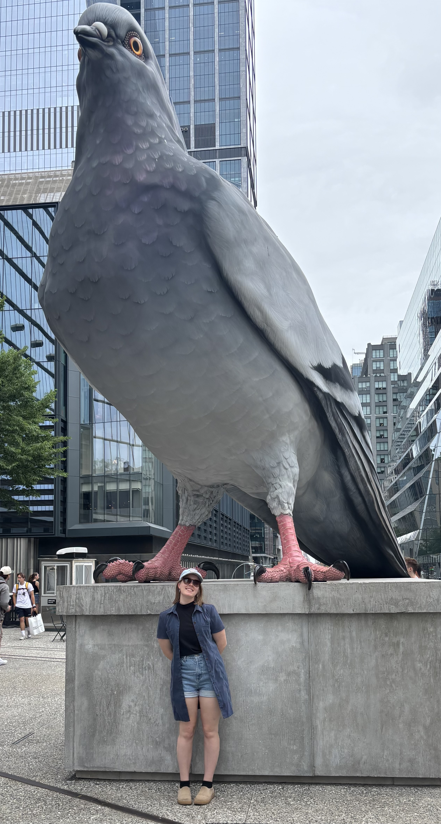
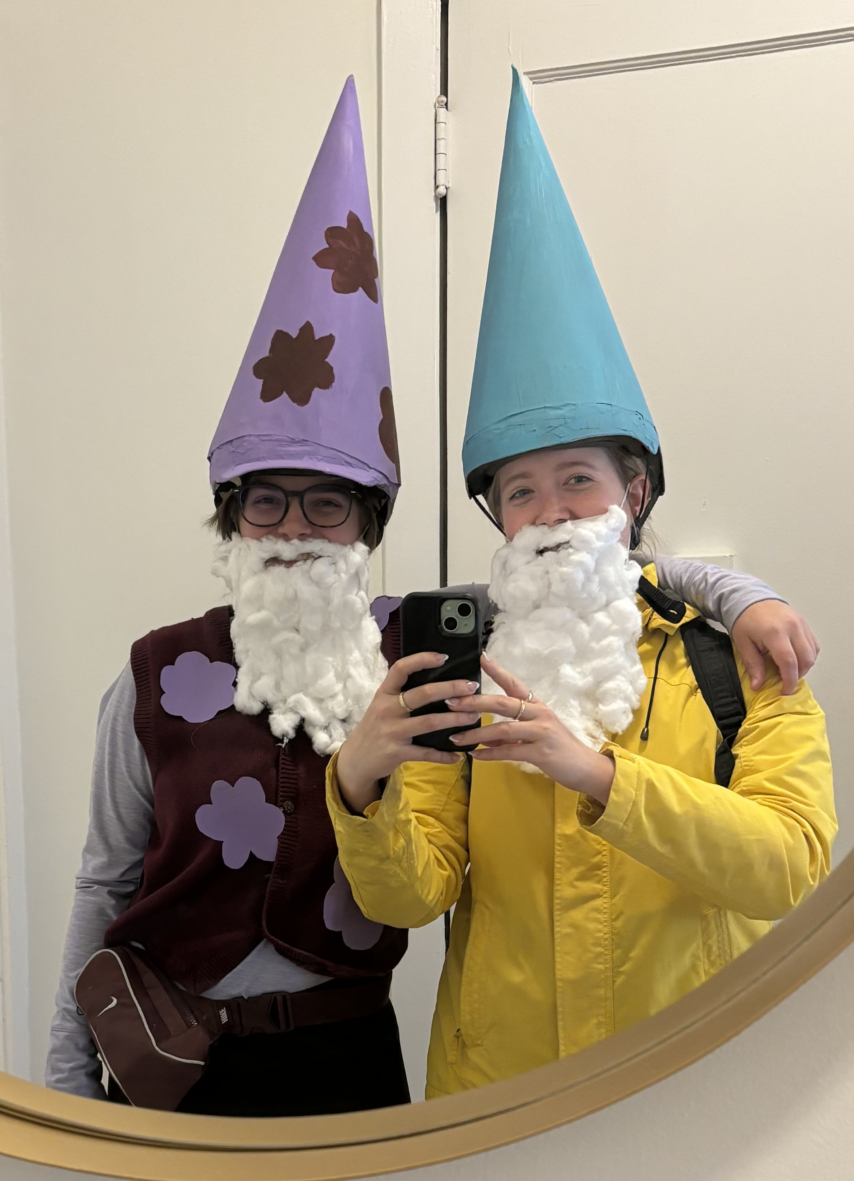
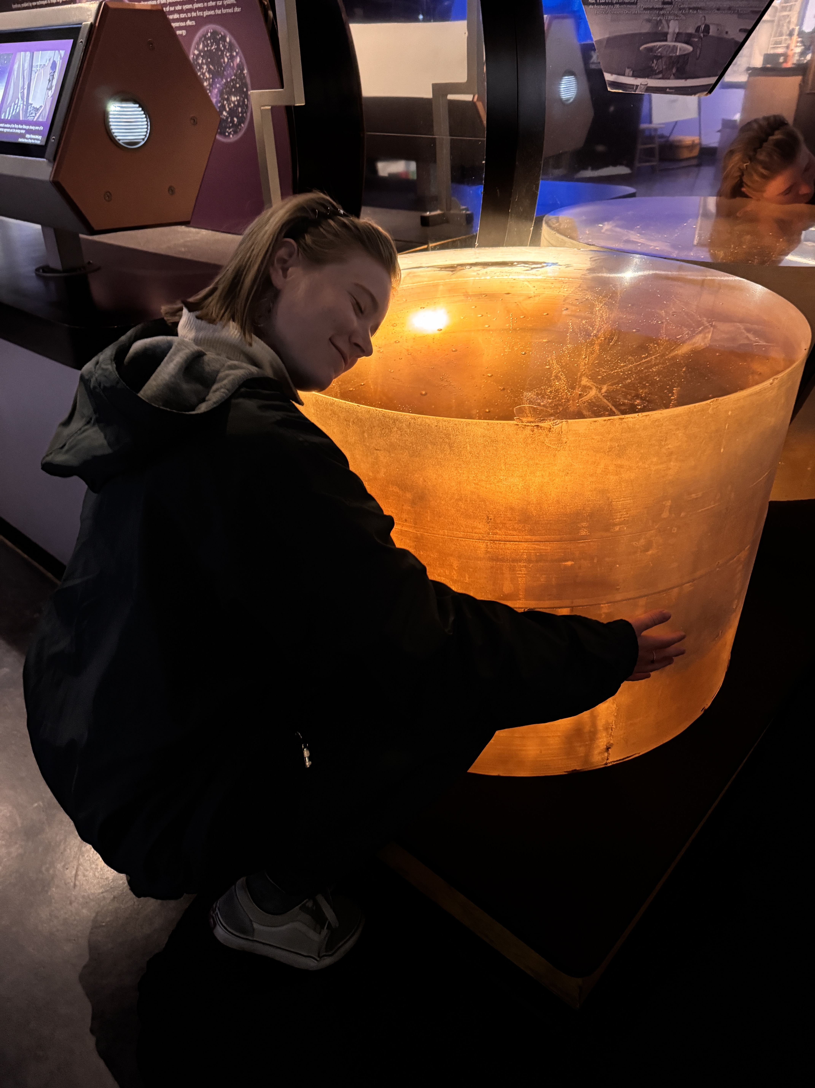
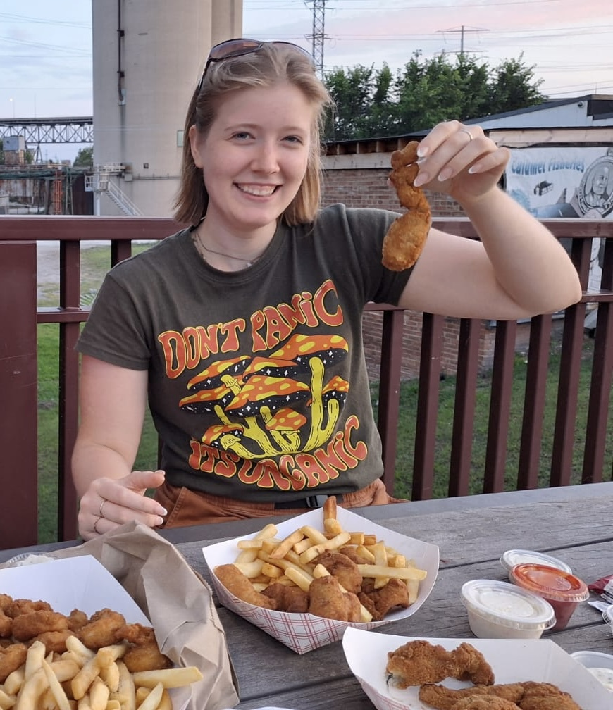
This is me
Eating fried frog legs
Notes:
A little bit about me,
I am first generation college student, which just means my parents didn't go to college
My first year of college I spent at a community college

Slide 3




Start where you can
Ask for help
Learning what the next step to take, is just as important as taking it
It might surprise you just how many people are willing to help if you ask nicely
Come prepared
Remember success is a slide
Plan ahead which questions you want to ask, and a mental list of topics you would like to be asked about
It takes a lot of hard work to achieve your goal, keep the prize in mind when it gets tough to continue
Notes:
As I talk about my joureny through quantum, I going to cover 4 mentalities that have increased my chances of success. We'll look at one mentality and then I'll share an example of how I applied it in my life. I'll save a lot of time for questions at the end so that my time is tailored to what you all want to talk about.

Slide 4
Start where you can
Choose projects that progress the goal
Search for accessible opportunities
Look to be challenged, not overwhelmed
Example:
QRISE Hackathon
Notes:
Starting point: Program Administrator for the CQE (non Technical role adjacent to quantum)
?
End Goal: Graduate student researching Quantum computing

Slide 5
Start!
Finish!
May 2023
Aug 2023
Nov 2023
Feb 2024
May 2024
Aug 2024
Nov 2024
Feb 2025
May 2025
Aug 2025
6 months
1.5 years
2.25 years
Madison
BNL
Chicago Quantum Exchange
Cafe Code
QRISE
Milestones
Researching Quantum Computing full time
Notes:
1. Got rejected from all grad programs I applied to
2. Thought I would never again be allowed to work a technical job
3. Wanted to do research but didn’t think I was smart enough
4. Seriously wondered if any of the work I was doing would get me anywhere
5. Quit my full time job for an underpaid internship, hoping it would help me get into grad school
6. Got rejected from the GRFP award
7. Lost the GEM fellowship because of Northwestern funding

Slide 6
Ask for help
Becky Durst
Mohammad Ramadan
Jeffrey Larson
Ji Liu
Siby Jose
Evan Toler
Wandi Ding
Sam Smiley
Emily Easton
Baha Balentekin
Matthew Tremba
Corrina Callahan
Bruce Lindvall
Josh Myers-dean
Amy Trethaway
Sridhar Tayur
Abhishek Aggarwal
Be proactive; find people who will help you
Own up if you don't understand; people who act smart get less help
Example:
GRFP application

Slide 7
Start!
Finish!
May 2023
Aug 2023
Nov 2023
Feb 2024
May 2024
Aug 2024
Nov 2024
Feb 2025
May 2025
Aug 2025
6 months
1.5 years
2.25 years
Madison
BNL
Chicago Quantum Exchange
Cafe Code
QRISE
GRFP
Milestones
GEM
Argonne
Grad school applications
Researching Quantum Computing full time
Notes:
1. Got rejected from all grad programs I applied to
2. Thought I would never again be allowed to work a technical job
3. Wanted to do research but didn’t think I was smart enough
4. Seriously wondered if any of the work I was doing would get me anywhere
5. Quit my full time job for an underpaid internship, hoping it would help me get into grad school
6. Got rejected from the GRFP award
7. Lost the GEM fellowship because of Northwestern funding

Slide 8
Come prepared
Come with questions about their research
Memorize your elevator pitch
Scout and research people you want to talk with
Follow up
Example:
SIAM conference
Notes:
Scout BEFORE making eye contact
society for industrial and applied mathematics

Slide 9
Start!
Finish! (Sorta)
May 2023
Aug 2023
Nov 2023
Feb 2024
May 2024
Aug 2024
Nov 2024
Feb 2025
May 2025
Aug 2025
6 months
1.5 years
2.25 years
Madison
BNL
Chicago Quantum Exchange
Cafe Code
QRISE
GRFP
Milestones
GEM
Argonne
Grad school applications
IBM
SIAM
Northwestern
Notes:
1. Got rejected from all grad programs I applied to
2. Thought I would never again be allowed to work a technical job
3. Wanted to do research but didn’t think I was smart enough
4. Seriously wondered if any of the work I was doing would get me anywhere
5. Quit my full time job for an underpaid internship, hoping it would help me get into grad school
6. Got rejected from the GRFP award
7. Lost the GEM fellowship because of Northwestern funding

Slide 10

Remember success is a slide
Sucks
Yes!

Slide 11
The many moments of doubt
1. Got rejected from all grad programs I applied to
2. Believed I would never again be allowed to work in a STEM research role
3. Wanted to do research but didn’t think I was smart enough
4. Seriously wondered if any of the work I did was getting me closer to my goal
5. Quit my full-time job for an internship, on the belief it would help me get into grad school
6. Application to GRFP rejected
7. Lost the GEM fellowship because of Northwestern’s political landscape

Slide 12
Start!
Finish! (Sorta)
May 2023
Aug 2023
Nov 2023
Feb 2024
May 2024
Aug 2024
Nov 2024
Feb 2025
May 2025
Aug 2025
6 months
1.5 years
2.25 years
Madison
BNL
Chicago Quantum Exchange
Cafe Code
QRISE
GRFP
Milestones
GEM
Argonne
Grad school applications
All that to say, sometimes your journey will take you up hills and maintaining your happy “pace” will get much harder, but if you're starting where you can, asking for help, and showing up prepared, the sucks will be worth the yes!
IBM
Northwestern
Notes:
1. Got rejected from all grad programs I applied to
2. Believed I would never again be allowed to work in a STEM research role
3. Wanted to do research but didn’t think I was smart enough
4. Seriously wondered if any of the work I was doing would get me anywhere
5. Quit my full time job for an underpaid internship, hoping it would help me get into grad school
6. Got rejected from the GRFP award
7. Lost the GEM fellowship because of Northwestern funding cuts
All that to say, sometimes your journey will take you up hills and maintaining your happy “pace” will get much harder, but if you're starting where you can, asking for help, and showing up prepared, the sucks will be worth the yes!

Slide 13
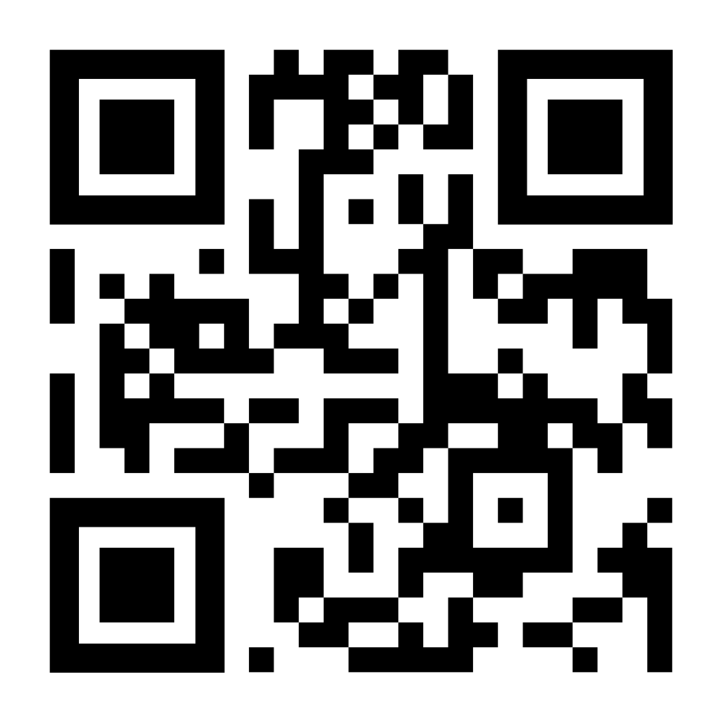
Email me at:
Kaytlin.harrison@gmail.com
Thank You
Happy to connect on LinkedIn

Slide 14
Some example topics to ask about
What is research in a National Lab is like
How to get into university research
Where to find Scholarships and Grant funds
Research in Quantum Optimization (specifically QAOA)
Transferring from a Community College
Which Quantum Stocks to buy (just kidding!)
Applying for the GRFP
Applying STEM skills in a STEM adjacent role

Slide 15
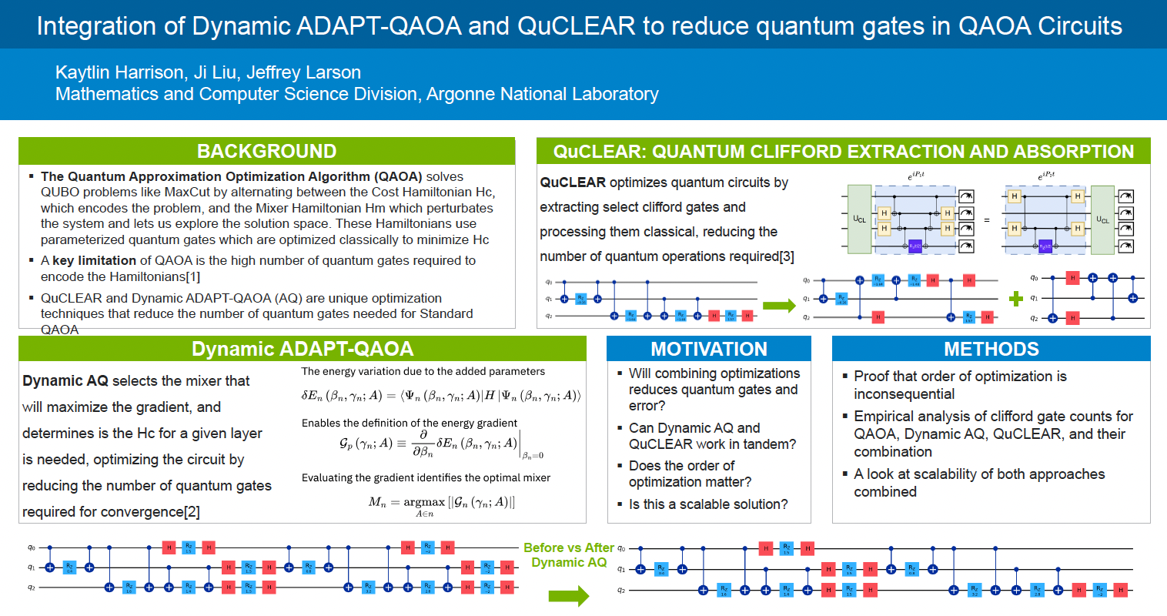
Research at Argonne

Slide 16
