Slide 1
ItHappens Technical Review
Celina Bekins, Katie Butler,
Emily Kohler, Linnea Laux

Slide 2
The Idea
Mapping sexual assaults on college campuses in the US
Why?
Raise awareness
Education on the topic
Our goals
Data visualization on a US map
Points among the states
Click to view more data
Stretch goals
Website for education and awareness
More information!

Slide 3
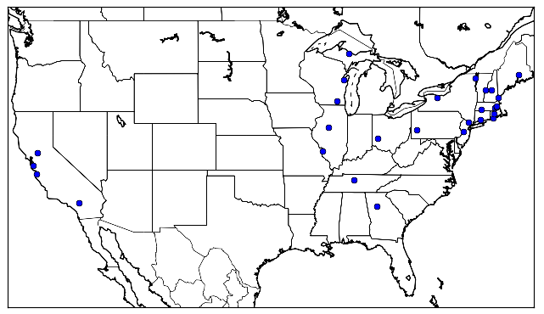
Current Progress
Matplotlib Mercator Basemap
Colleges plotted as blue points
Looking forward:
Include interactivity
Click point to view data about the specific college
Other types of maps/visualizations

Slide 4
Ideation & Discussion

