Slide 1
Getting Started With PySense

Slide 2
Set up Python and PySense
Install Python and an IDE of your choice. (PySense was developed on PyCharm).
Install the PySense library through pip
pip install PySenseSDK
Include PySense in all your scripts:
from PySense import PySense

Slide 3
Python Tip!
When calling functions in python we have required arguments and optional arguments.
Required arguments come first and order matters
Optional arguments come after the required ones. You can add as many optional arguments as are supported.
Look at the call
Email address and role are required and must come first in that order
first_name and last_name are optional and thus are added at the end and can be in any order.
The PySense documentation lists which arguments are required and which are optional
py_client.add_user('user@email.com', 'Data Designer', first_name='John', last_name='Doe')

Slide 4
Hands On
Authenticate with our Sisense server
Create a user and add a security rule
Download our dashboards
https://github.com/nathangiusti/PySense/tree/master/Snippets

Slide 5
Authentication
We must log in to Sisense via API as we would if we were logging in to the web.
Authentication returns us a PySense object which we name py_client
We can do this two ways
Inline:
From file:
SampleConfig.yaml:
py_client = PySense.PySense(‘localhost’, ‘myusername’, ‘mypassword')
py_client = PySense.authenticate_by_file('SampleConfig.yaml')
host: 'your_host' username: 'your_username@sample.com' password: 'your_password'

Slide 6
Exercise One
Authenticate with your Sisense server.
Call the get_role_id method and print the role id for any role (Viewer, Admin, etc).

Slide 7

Exercise One Solution

Slide 8
The PySense object
The object created by authentication (py_client) in our example is our connection to our Sisense instance.
The py_client object is where we do things that involve the whole server, for example, adding users or retrieving dashboards and elasticubes.
See documentation for full list of features

Slide 9
Users
To add a user we call the add_user method on our PySense object with the user’s email and role.
Email and role are required but there are additional details we can set like so:
We can also use our PySense object to query for specific users or delete users.
To delete a user, we pass the user to our delete_users method.
py_client.add_user('user@email.com', 'Viewer')
py_client.add_user('user@email.com', 'Data Designer', first_name='John', last_name='Doe')

Slide 10
Exercise Two
Create three new users in your Sisense.
Print out the user’s username.
Delete the users.

Slide 11
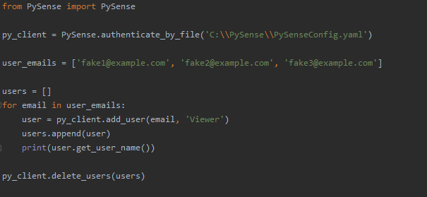
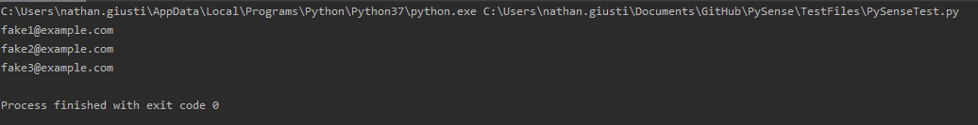
Exercise Two Solution

Slide 12
Data Security Pt 1 (The Elasticube)
Data Security is applied to an elasticube so first we need to use our PySense object to get that cube.
The elasticube variable is the PySense representation of your elasticube.
From elasticube you can do things like export your model, run sql, and of course apply data security.
See documentation for full list of features
elasticube = py_client.get_elasticube_by_name('CubeTitle')

Slide 13
Data Security Pt 2 (Default rule)
Create the default rule:
Default rule of Nothing (recommended)
Default rule for some values
The default_rule contains the rule created. You can check the properties of the rule to ensure everything was created correctly.
If you don’t need to do anything with the rule, you can ignore the return.
default_rule = elasticube.add_default_rule('Dim_Dates', 'BusinessDay', 'numeric')
default_rule = elasticube.add_default_rule('Colors', 'Name', 'text’, members=['Red', 'Blue'])

Slide 14
Data Security Pt. 3 (Creating user/group rules)
We need to get all the users and groups that we need to add to this security rule. The first argument in add security rule is a list of all the users and groups to apply to.
In the following snippet we get our desired users and groups, make them into a list and pass that list to our method
Members is optional, if not there, a Nothing rule is created (unless all members is set).
all_members and exclusionary are optional arguments that can be set to True or False
users = py_client.get_users(first_name=‘Steve') groups = py_client.get_groups(name='PySense’) shares = shares.append(groups).append(users) rule = elasticube.add_security_rule(shares, 'Dim_Dates', 'BusinessDay', 'numeric', members=[1])

Slide 15
Exercise Three
Add a default security rule
Add a security rule for a user on your system.
Print out the table, column, and datatype of your new rules.
Delete the rules

Slide 16
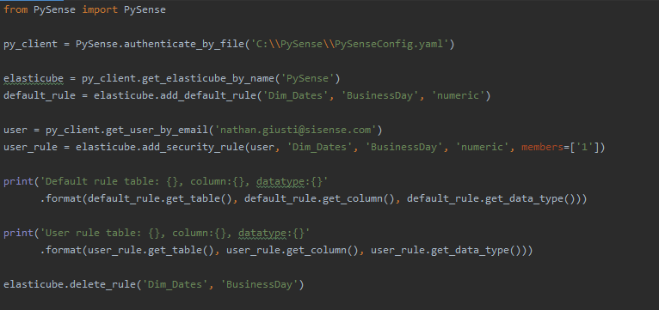
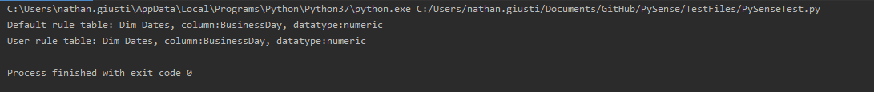
Exercise Three Solution

Slide 17
Downloading our Dashboards
We can get a dashboard by its dashboard id and then download the dash file to a folder.
We could also do this for all our dashboards
Here we get a list of all our dashboards. get_dashboards has optional arguments for filtering by name, folder, etc. See documentation for full list.
For every dashboard in our list, we call the export to dash method and pass in the optional path parameter to tell PySense to save this file to our disk.
If path is left out, the method returns the raw file contents, otherwise, path is returned
dashboard = py_client.get_dashboard_by_id('mydashboardid') dashboard.export_to_dash(path='C:\\MyBackUps\\dashboard.pdf')
dashboards = py_client.get_dashboards() for dashboard in dashboards: dashboard.export_to_dash(path='C:\\MyBackUps\\{}.dash'.format(dashboard.get_id()))

Slide 18
Exercise Four
Get all your dashboards dash files
Save them to a folder
Print the paths to all the dashboards

Slide 19
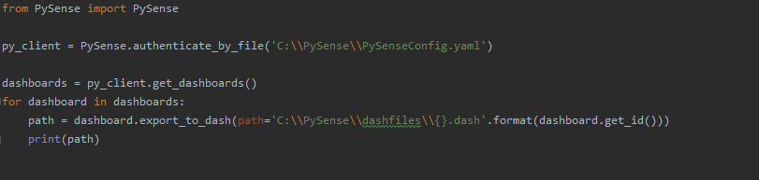
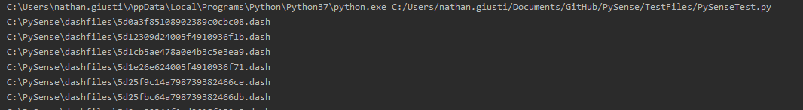
Exercise Four Solution

Slide 20
PySense Tips!
Some methods return arrays, some methods return a single object. This information should be in the documentation, but if you look at function names:
Plural nouns (get_dashboards) always return arrays
Singular nouns (get_elasticube_by_name) always return a single object.
Authenticate via file. You can set up a program to run very easily for multiple servers/clients by just pointing to a different config file.
Use the debug parameter to get a full log of what API calls are being made, along with their contents. You can turn this on and off between individual calls so you only log what you need.
All unsuccessful rest calls throw a PySenseException. You can catch and handle these exceptions to do retries or set up graceful failure conditions.
You can use this for troubleshooting with clients.
Write a program that runs a sql query for every dim table and ensure that the key is unique.
Write a program that delivers a report of what elasticubes are being used by number of dashboards

Slide 21
Fin

