Slide 2
Toy 2
Cos(w0 t) for the whole square
And cos(w1 *t + alpha) for the small square (width 8, over 16)

Slide 3
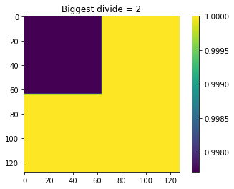
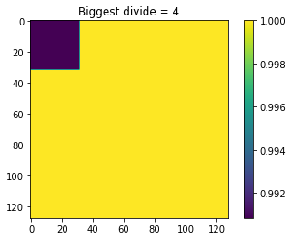
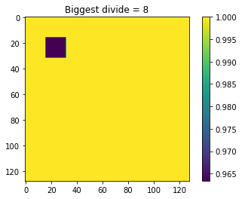
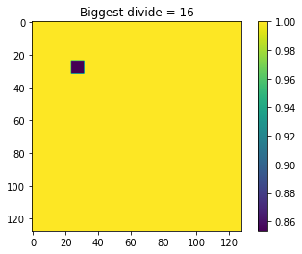
Using averages and keep dividing
Exactly the truth

