Slide 2
Toy 2
Cos(w0 t) for the whole square
And cos(w1 *t + alpha) for the small square (width 8, over 16)

Slide 3
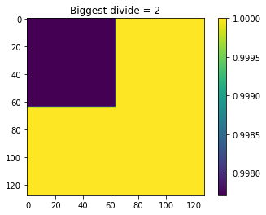
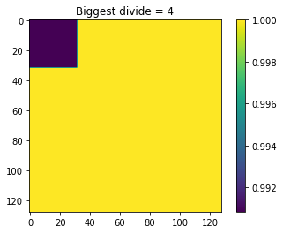
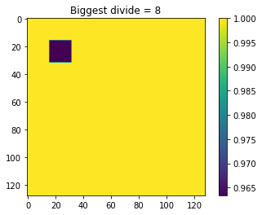
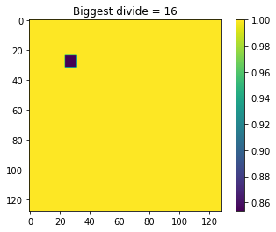
Using averages and keep dividing
Exactly the truth

Slide 4
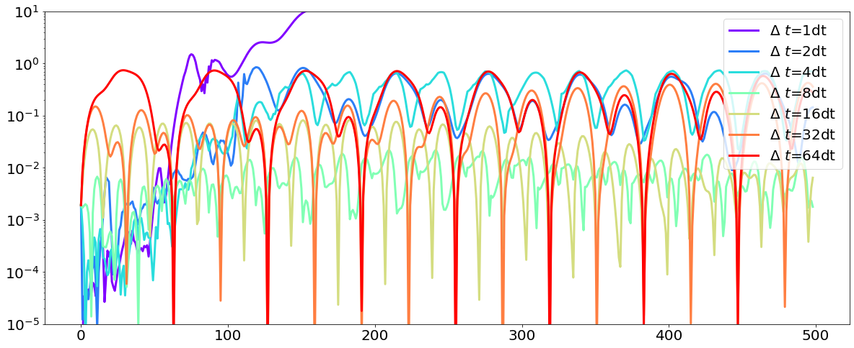
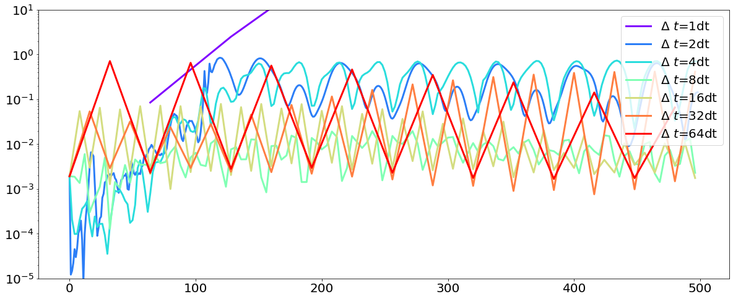
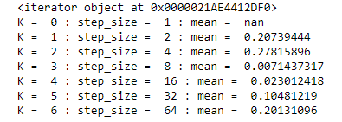
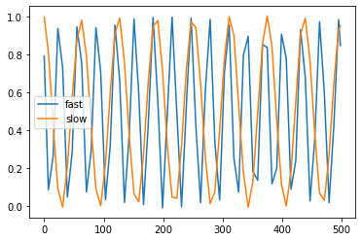
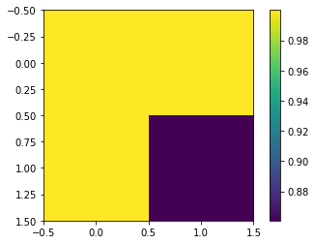
Time stuff on 2x2 square of 16x16
All time scales with interpolating
All time scales predicting on scale of 2^(k-1)
Value on k = 3, step_size = 8
Fast is blue square, slow is one of the yellows
How should I go on from here??
Picking up both timescales. Fast is double frequency of slow
If I train, starting with biggest, on next refinments, I can check if I have low enough error, and if not, refine.
How should I pick for small to large?

Slide 5
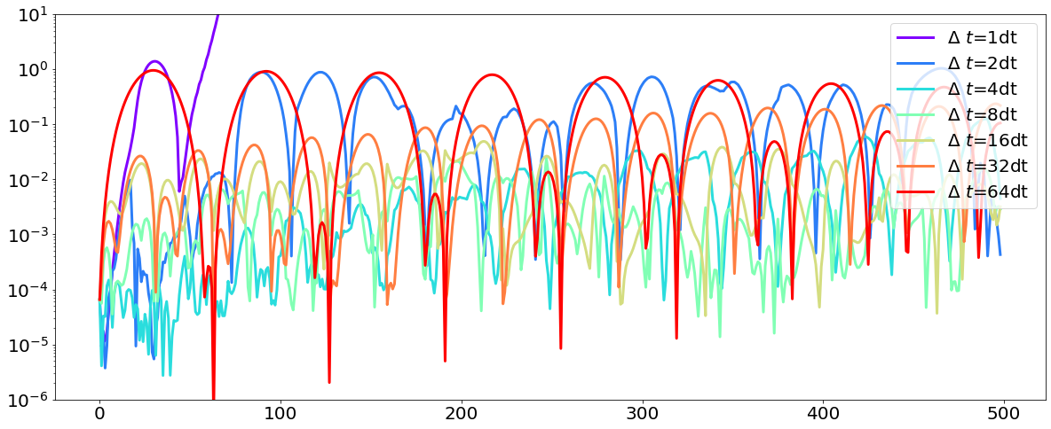
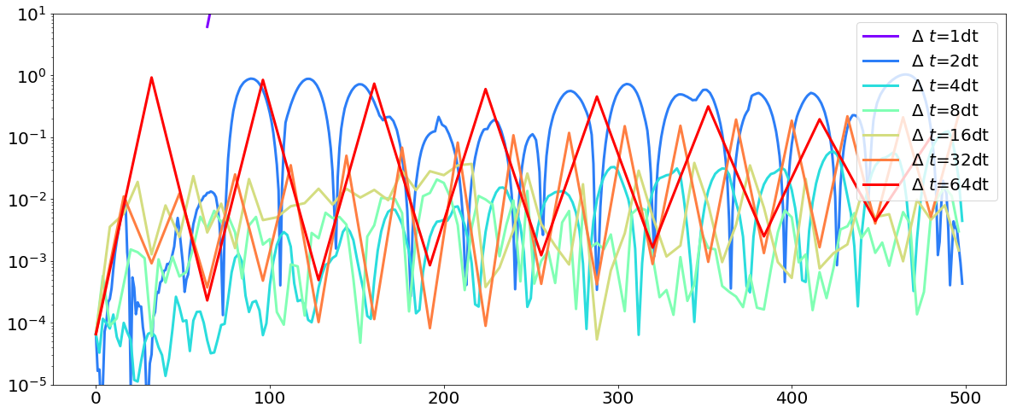
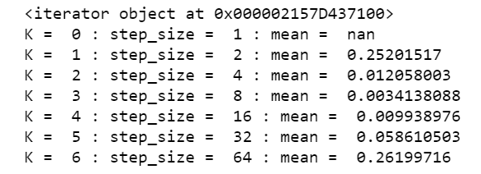
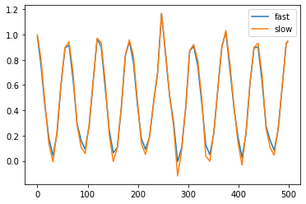
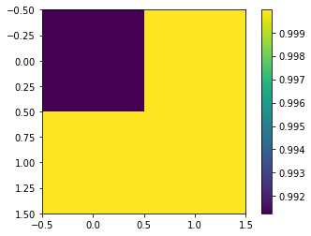
Fitting on the coarsest scale
Get space model at 2x2
Train in smallest time scale.
Find error and save
Keep making step size bigger until error increases
Refine space and repeat on areas as needed
Start with timestep of previous and see if next timestep is better
If yes, check next. If no, stay at timestep
This assumes scale get smaller
When refining the model, should I make any assumptions about blocks being the same next work?
Picking up the 1 timescale

Slide 6
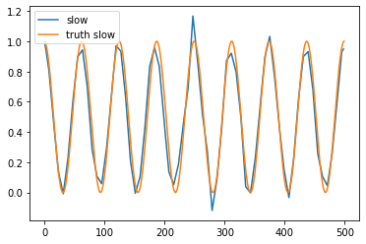
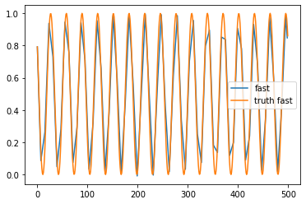
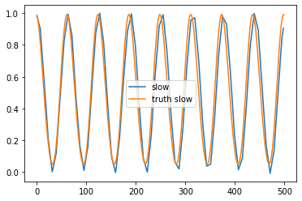
2x2 predicted
2x2 truth
16x16 predicted
16x16 slow truth
16x16 fast truth

Slide 7
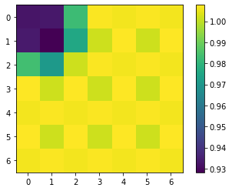
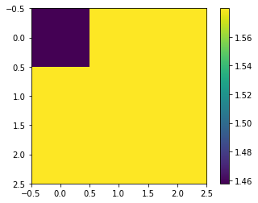
Toy2 through the cnn
Based on our structure of the cnn, we need data 2^n – 1 (original data 127x127, smallest is 3x3)
encoded
Autoencoder (final decoded)

Slide 8
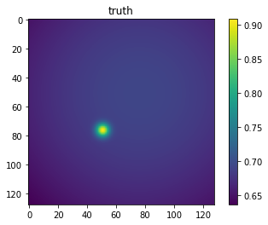
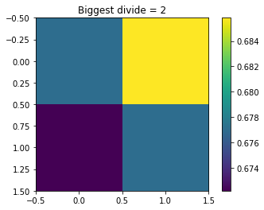
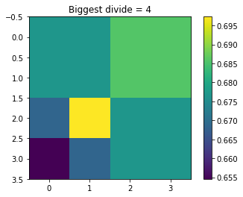
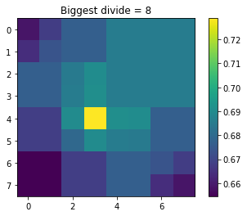
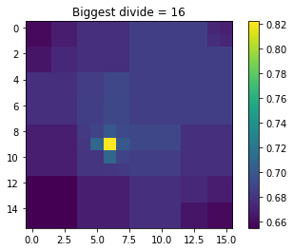

Slide 9
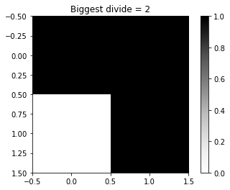
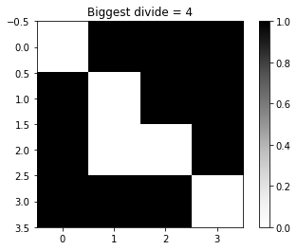
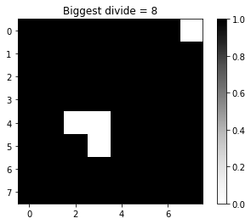
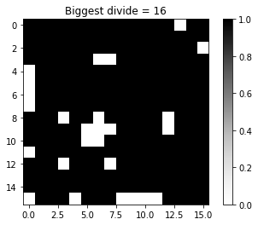
Resolved maps
When refining the model, should I make any assumptions about blocks being the same next work?

