Slide 2
Toy 2
Cos(w0 t) for the whole square
And cos(w1 *t + alpha) for the small square (width 8, over 16)

Slide 3
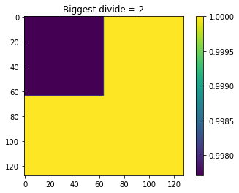
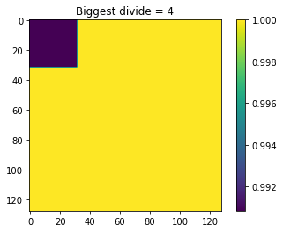
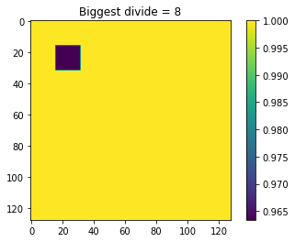
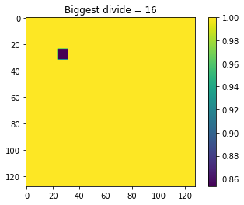
Using averages and keep dividing
Exactly the truth

Slide 4
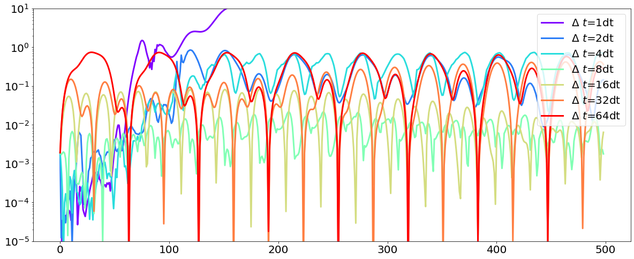
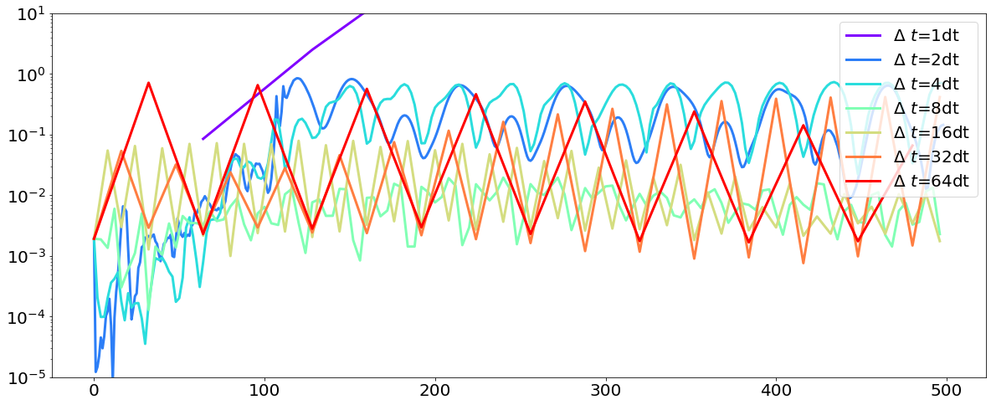
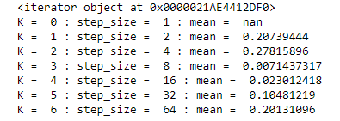
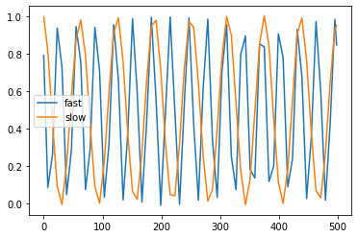
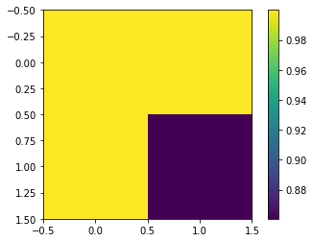
Time stuff on 2x2 square of 16x16
All time scales with interpolating
All time scales predicting on scale of 2^(k-1)
Value on k = 3, step_size = 8
Fast is blue square, slow is one of the yellows
How should I go on from here??
Picking up both timescales. Fast is double frequency of slow
If I train, starting with biggest, on next refinments, I can check if I have low enough error, and if not, refine.
How should I pick for small to large?

Slide 5
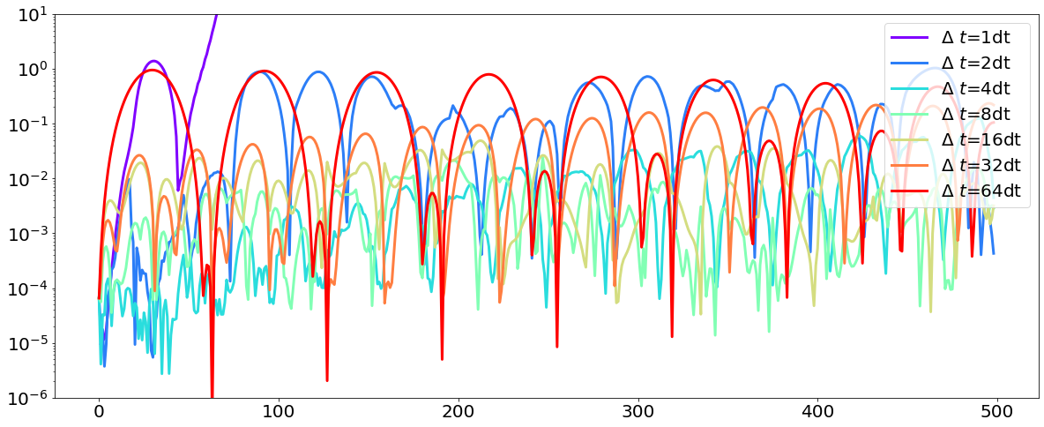
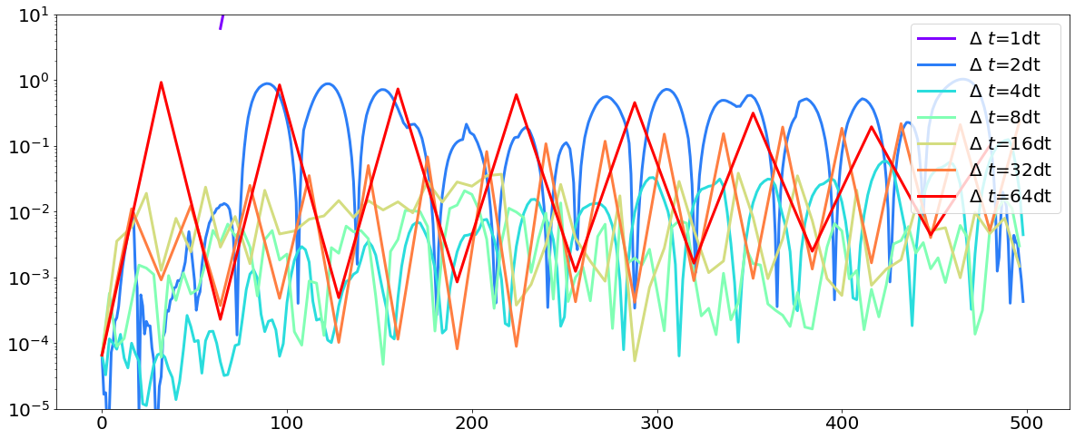
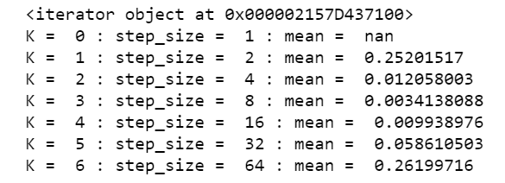
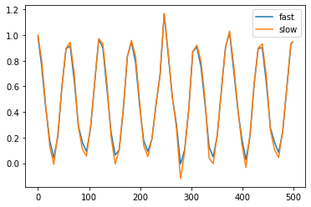
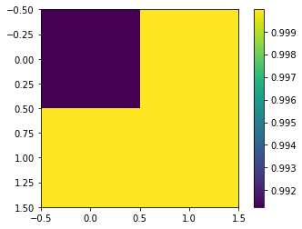
Fitting on the coarsest scale
Get space model at 2x2
Train in smallest time scale.
Find error and save
Keep making step size bigger until error increases
Refine space and repeat on areas as needed
Start with timestep of previous and see if next timestep is better
If yes, check next. If no, stay at timestep
This assumes scale get smaller
When refining the model, should I make any assumptions about blocks being the same next work?
Picking up the 1 timescale

Slide 6
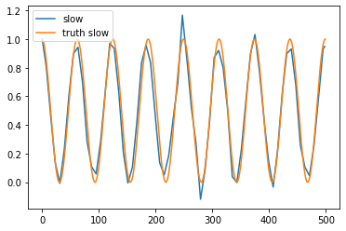
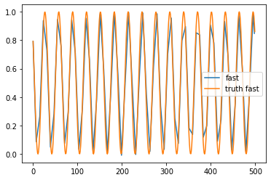
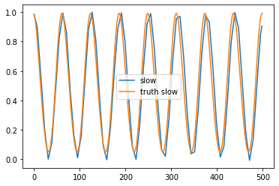
2x2 predicted
2x2 truth
16x16 predicted
16x16 slow truth
16x16 fast truth

Slide 7
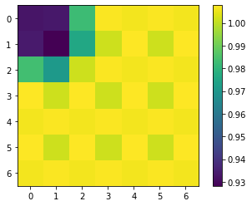
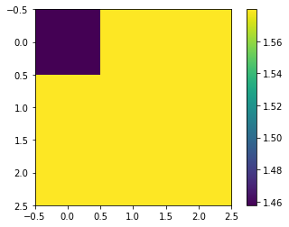
Toy2 through the cnn
Based on our structure of the cnn, we need data 2^n – 1 (original data 127x127, smallest is 3x3)
encoded
Autoencoder (final decoded)

Slide 8
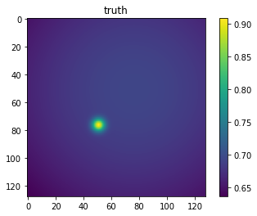
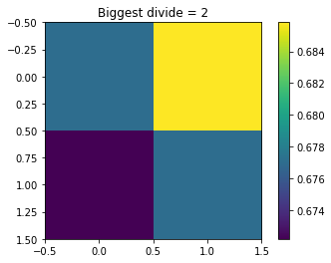
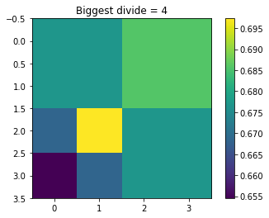
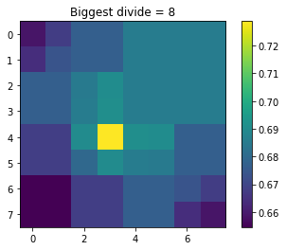
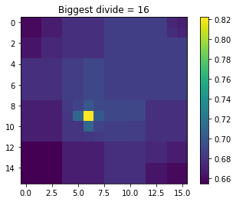

Slide 9
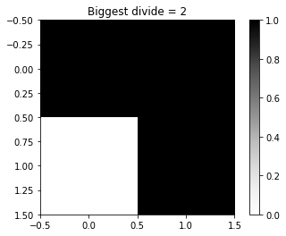
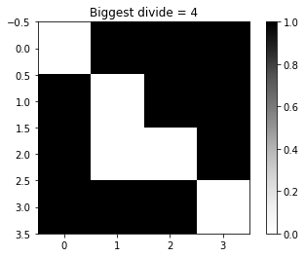
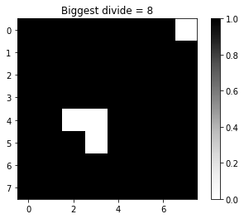
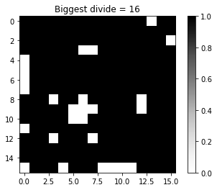
Resolved maps
When refining the model, should I make any assumptions about blocks being the same next work?

Slide 11
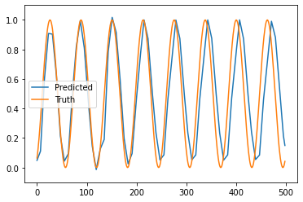
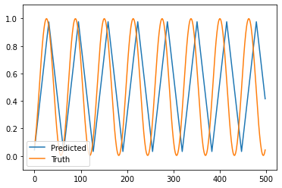
When fitting with just 1 input, it doesn’t seem to find as good of a fit
When trying to fit with 4 inputs, three are cos(w0*t)
And 4th is average of two scales
When trying to fit with one input cos(w0*t)
Using 2x2 square
Using section of 16x16

Slide 12



When trying to fit with one input cos(w0*t)
When trying to fit with four input cos(w0*t)
Picked timestep 32
Picked timestep 8
I’m pretty sure that the only thing different here than
Last weeks is that I have more validation points.
1 before, and now 10. this is 1 of those 10.
When refined, getting even larger errors. This is refining into one of the quadrant that will be exactly it’s average

Slide 13
Reduce to 1 (or maybe 4)
Right now using averages, but will make better later
Will have array (100, 500,1) (100 training points, 500 timesteps)
Fit in time and find best time step
Train over multiple timesteps (currently 1-64 (powers of 2))
Find timestep size with lowest validation error
Find error over the 4 parts
Example predicted to (100,500,4) (all 4 will have sample value) and find mse over the 4 parts, averaged over all timesteps and validation points
For parts with high error, refine and repeat
Pick some threshold
Right now, refine means divide into 4 (2 per dim)
Test models that are already in use, if still high error, train new
We now have 4, so will have to check/train on all 4 independently
I think can use same threshold as when to refine
Keep repeating until all areas are below threshold or cannot refine anymore

Slide 14
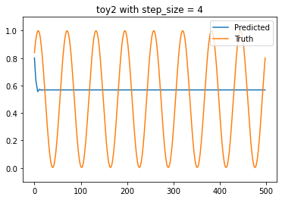
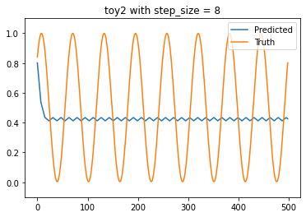
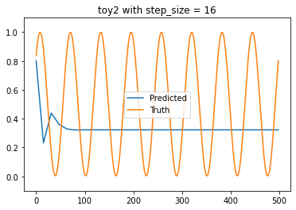
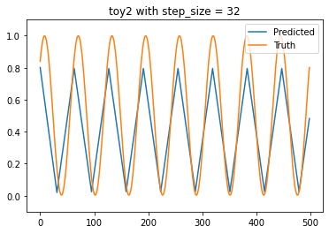
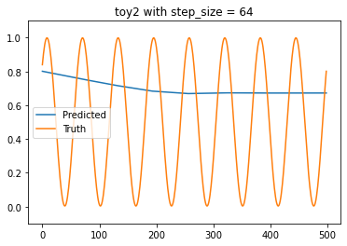
With Yuying’s nn structure:
1 input and predicts next 5 steps in loss

Slide 15
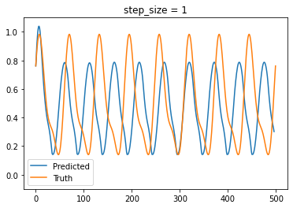
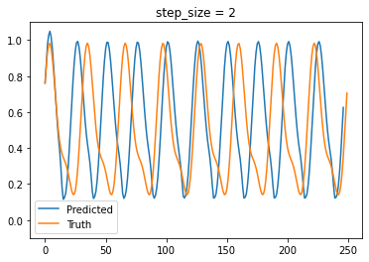
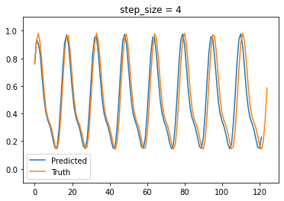
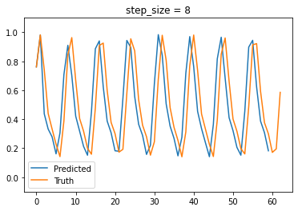
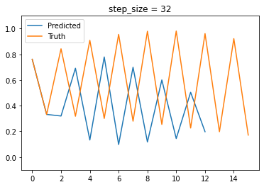
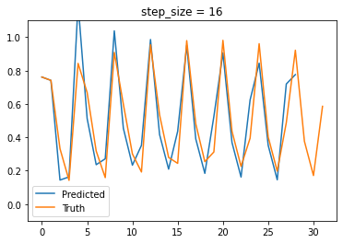
Using 3 timesteps as inputs,
Predicts next 1 timestep in loss

