Slide 2
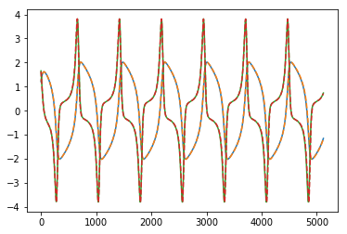
Van der pol with 4dt. (just 1 time step and it’s fitting pretty well.)

Slide 3
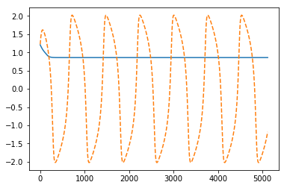
When only using the x, (so we get a single time series), we don’t get good fitting at all

Slide 4
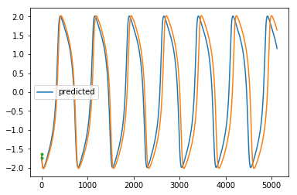
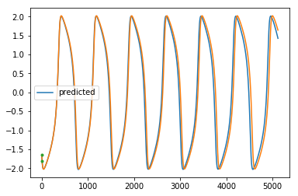
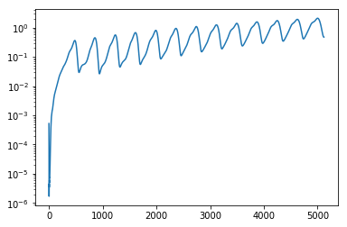
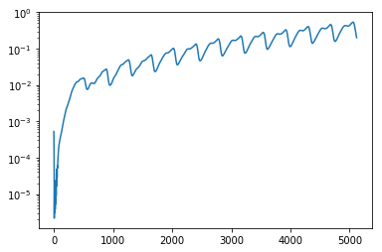
When we do time delay embed with 2 dim, we get pretty good fitting. (probably just not trained enough here or something) Slowing getting off, but finding pattern
This is with 4 steps
This is with 8 steps. Does a little better

Slide 5
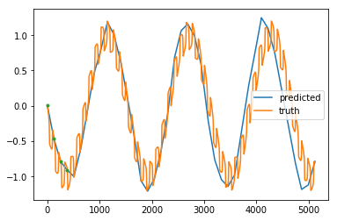
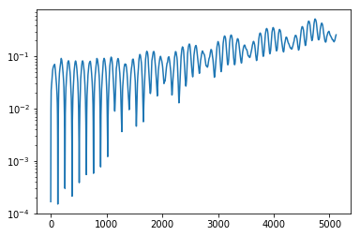
How I want to add in a cosine part. Making the cosine part a lot slower than the other part

Slide 6
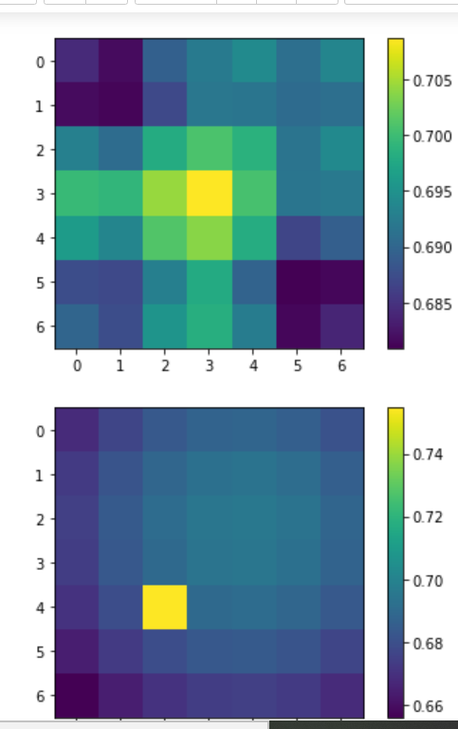
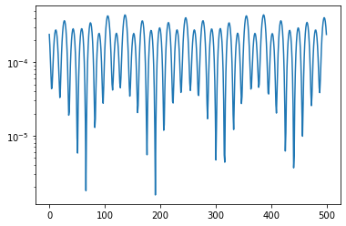
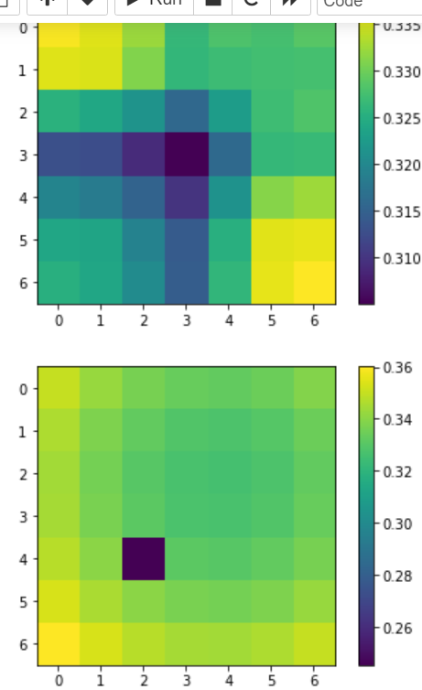
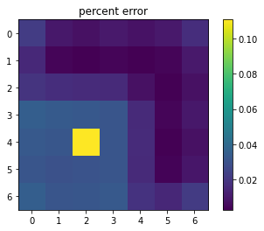
Using MrCAE with the lowest isn’t really that good
Predicted at lowest possible level
Mse between these two
truth

Slide 7
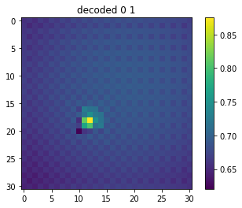
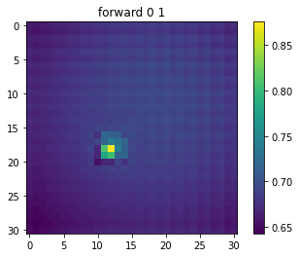
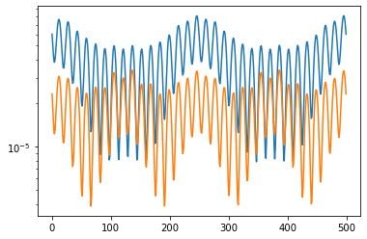
Something is not going right with encoding and then decoding in the widening part
Blue is using decoded
Orange is using forward

Slide 8
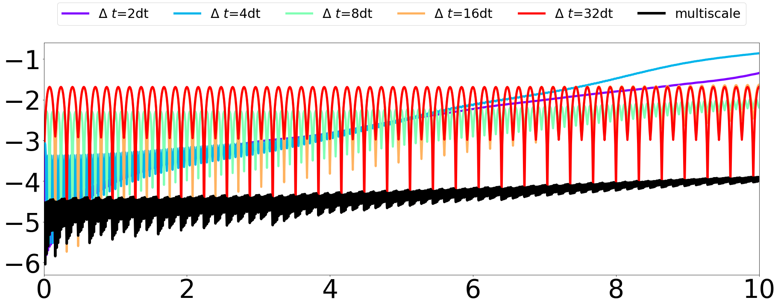
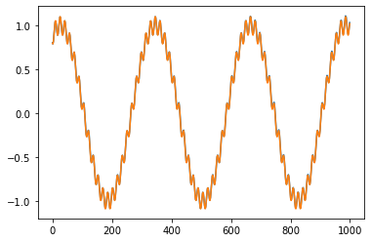
Figured out the time delay embed thing this is the two cosines

Slide 9
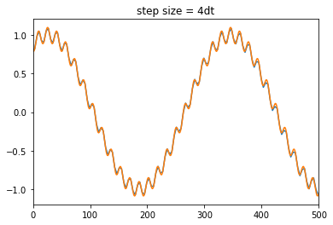





Slide 12
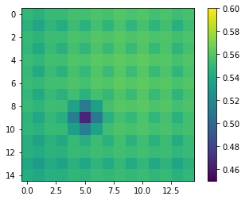
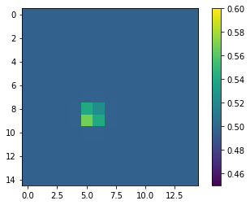
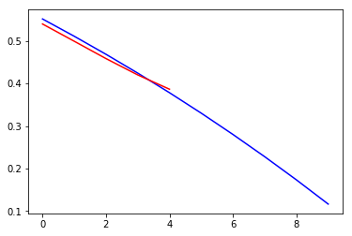
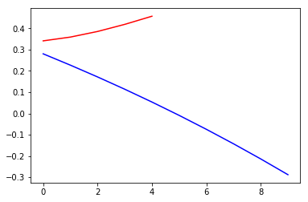
2/19
Working with MrCAE, and just going from x_t->x_t+1, so not actually an autoencoder anymore. It’s not really picking up the behavior at all yet. Here are a few graphs for the first training. So idk yet if it just needs more training, different hyperparameters, or it’s just bad.
Predicted on the first timestep
Truth at t = 1
A couple trajectories on the (0,0) point.
All predictions look very similar, but the truth can vary.

Slide 13
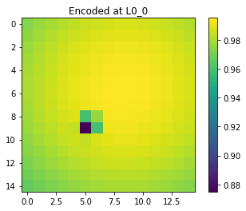
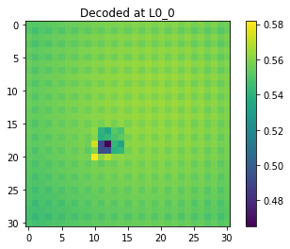
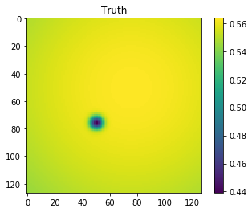
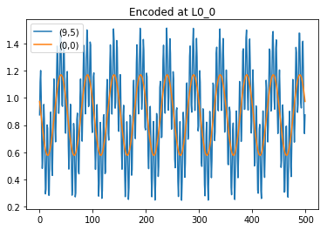
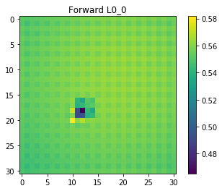
Encoding and decoding on the first step.

Slide 14
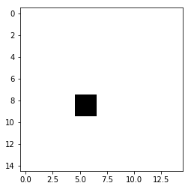

Slide 15
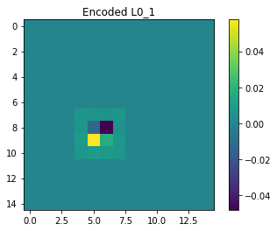
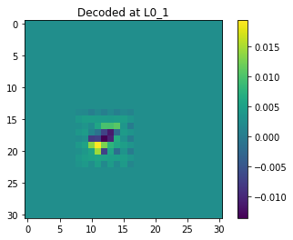
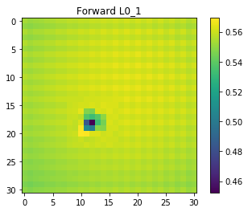
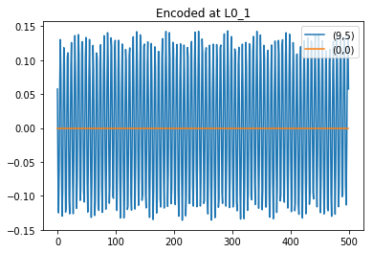
The next widening layer, does the adjustment on the 4x4 squares that need to be more modified.

Slide 16
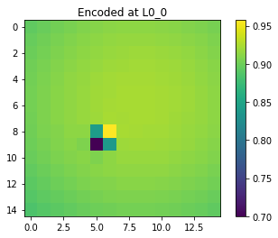
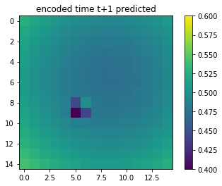
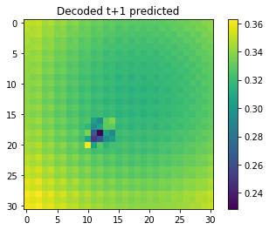
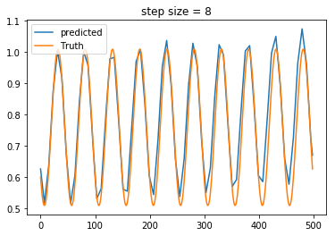
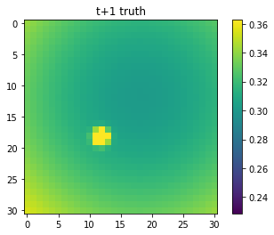
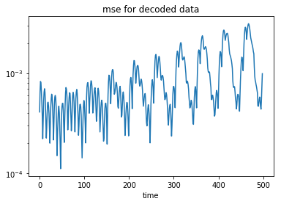
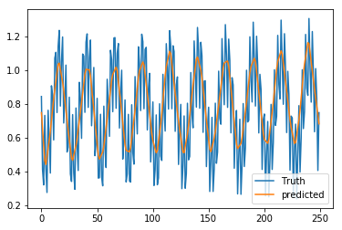
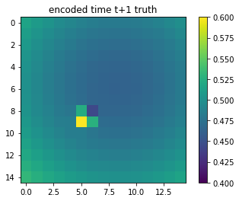
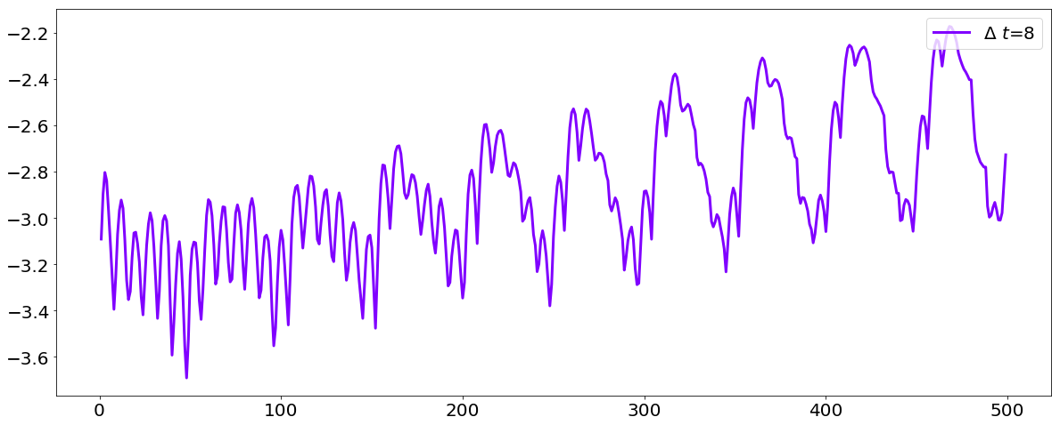
For the first refinement, encode, move in time, and then decode. It does alright for a while, and then comes off. It doesn’t really have the fast scale figured out very well.

Slide 17
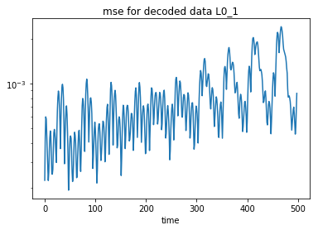

Slide 18
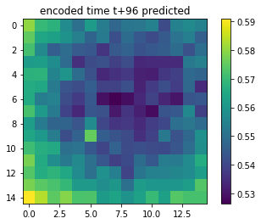
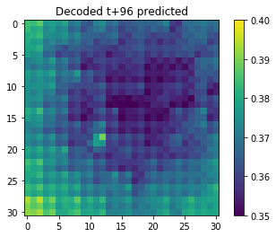
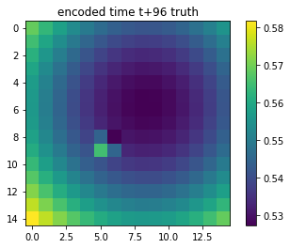
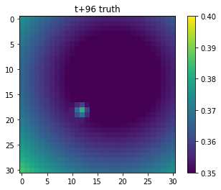
Looking at t=96, (8*12). It seems like its sort of picking up the big period, but not finding the small one at all, which is expected.

Slide 19
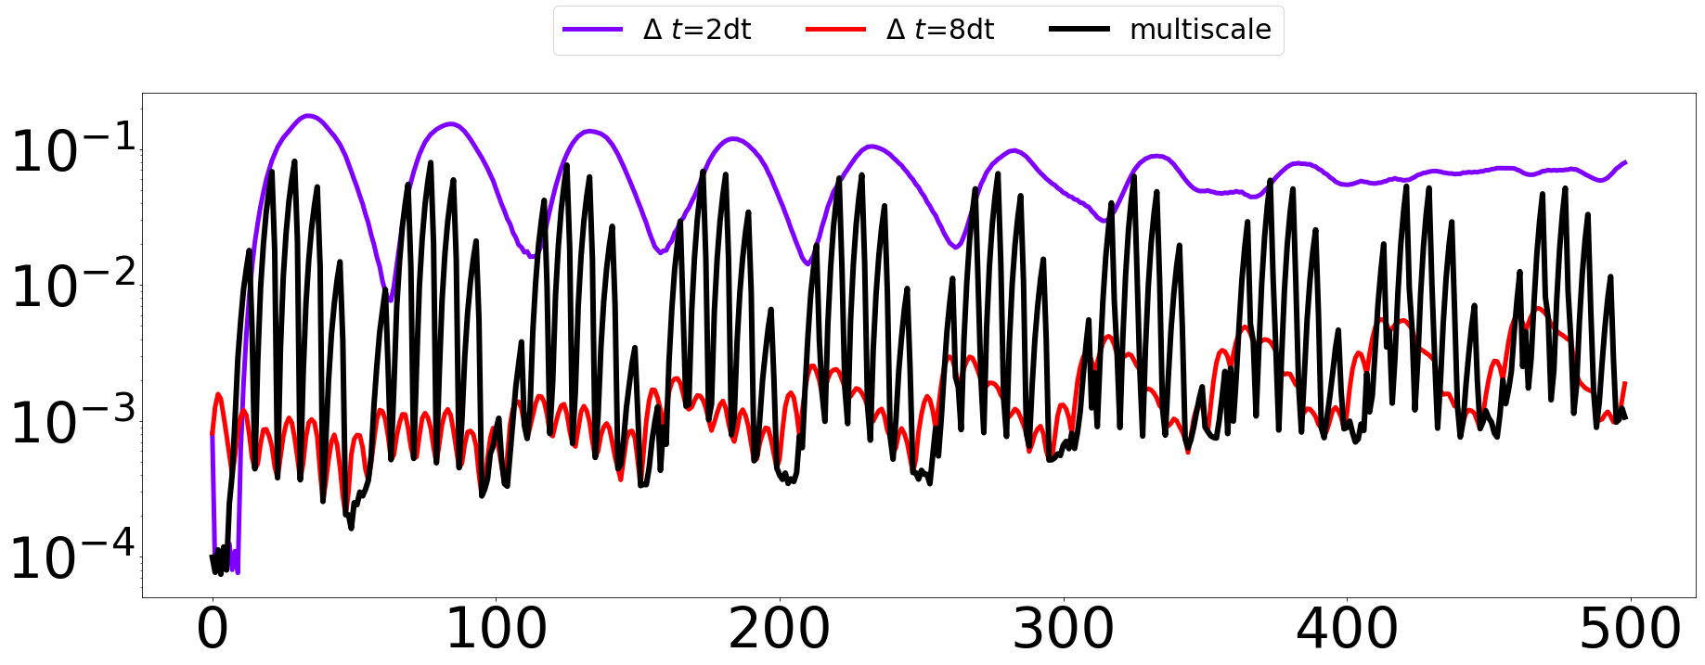
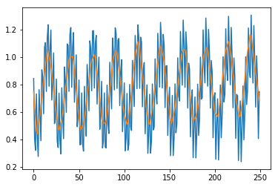
One timestep is doing well on the main behavior, but not the multiscale part. Try using 2 timescales at once. When training the encoded in time, if we consider 2 timescales at once, I am getting something weird. I don’t know if it is just a bug or something going wrong

Slide 20
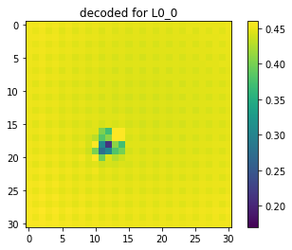
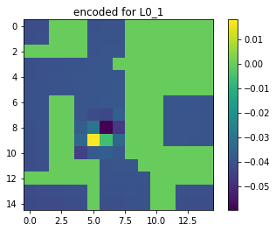



Doing the next step. First train a widening layer so we go from output of first step to truth
For training used t+1 of all 500 samples, and all 100 for validation.
There is a mask at the threshold, and that’s why a lot of the encoded is 0

Slide 21



Next, we move that forward in time. Did a little hyperparameter tuning and it’s better to use stepsize =4, and a few other things changed.

Slide 22



Decoded for t+2

Slide 23



Largest error is at t=86, and it’s really bad there. I am confused why the ossilcations on the error are getting less, and why are they so big here.
Questions to consider:
How should I pick input data for next step? Should I do t+1 or something else?
Is this even a good outline?

Slide 24

Doing the next step, but I’m getting weird results.
For 1, my validation error is going up when I am training a lot, right away

Slide 25





I tried just going from truth to truth_t+1. but wasn’t getting the behavior really at all. I made it so it’s not actually an autoencoder anymore. These are a few of the single cell trategories
Predicted t+1
Truth t+1
Predicted t+2

Slide 26


Slide 27




In meeting, we talked about doing two timesteppers. 1 for big area, and 1 for smaller high error area
1 example of smaller chunk
Error of smaller chunk

