Slide 2
Plan we made last week
Exp 1: - done
\dot x = A cos omega1 t
\doy y = B cos omega 2 t
Exp 2:
A: Make \dot y more complicated – working on it
\dot x = A cos omega1 t
\doy y = van der pol
B: Make \dot x more complicated
\dot x = van der pol
\doy y = B cos omega 2 t
Exp 3:
Both complicated
\dot x = van der pol
\dot y = Lorenz
Exp 4:
Add noise
Exp 5:
SST
Opt DMD -> BOP DMD

Slide 3
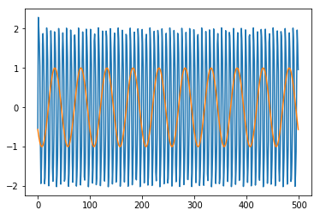
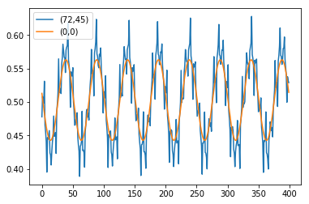
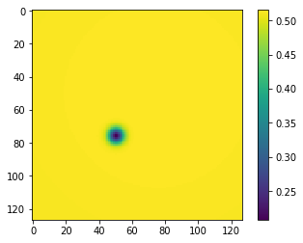
On project 1:
Working on 2a: where big is still \dot x = A\cos (\omega t), but smaller is van der pol.
I’m using a combination of these two functions.
The orange is the corner point. The blue is one of the points with the sum of the two parts.

Slide 4
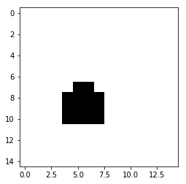
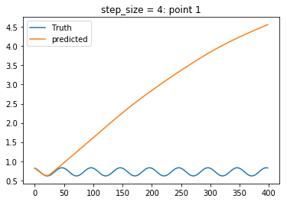
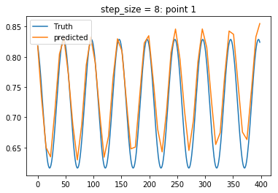
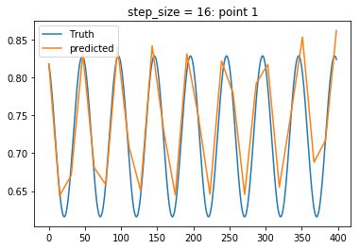
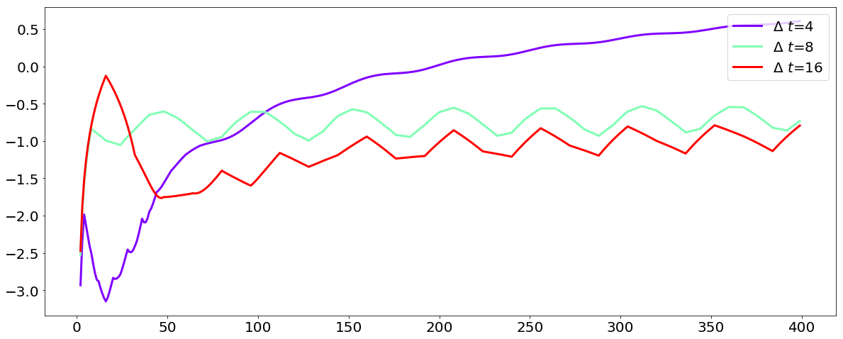
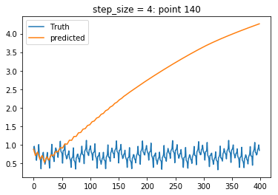
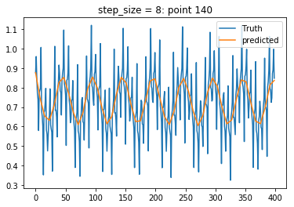
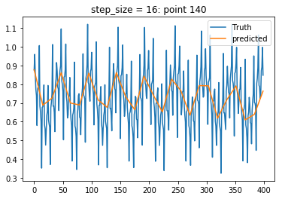
Doing the same thing as with exp 1.
Encode in space with MrCAE. Identifies area that is different.
First, we want to fit slow/big scale. (this new fitting is a lot better than the first one I did. So, getting the fit is a little finiky)

Slide 5
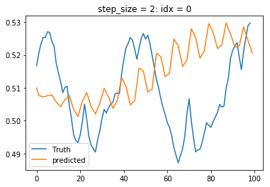
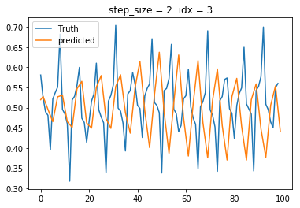
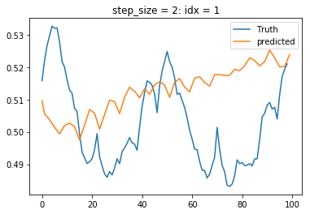
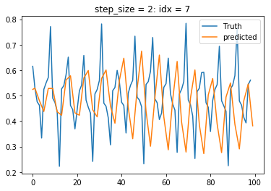
Next step that I was doing before was subtract and fit difference inside box. Not getting a good fit. (14 squares in box)
Some are still the big behavior (but look like they have a little noise) and some are definitely have both behaviors.)
Should I change my threshold value to make box smaller?

Slide 6
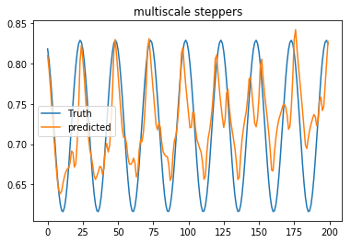
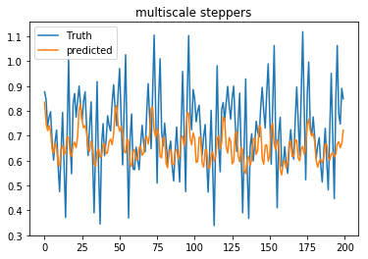
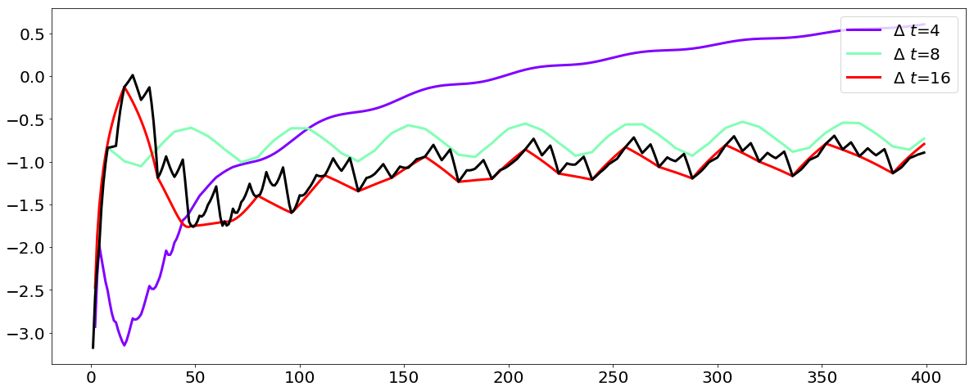
Doing HiST with multiple steps, it’s weird and makes it worse.

Slide 7
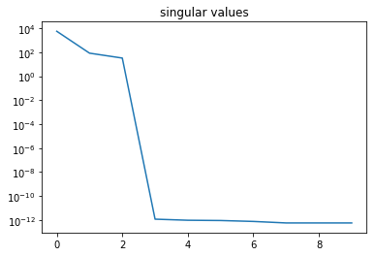
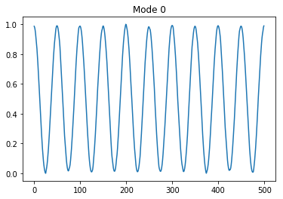
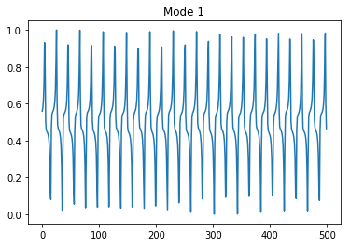
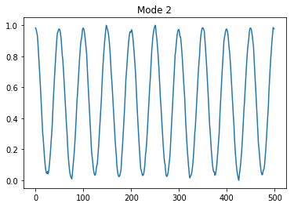
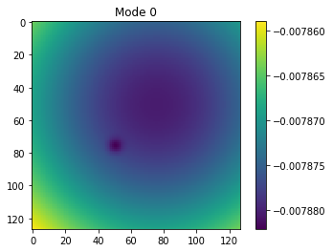
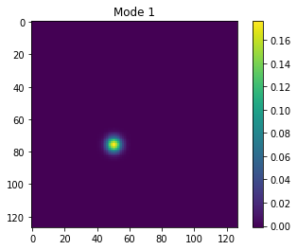
Using DMD on this, we get 2 modes, but these are really hard to fit because their scales are different.
2 major modes

Slide 8
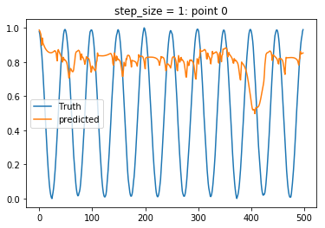
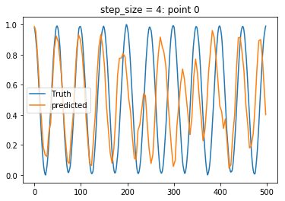
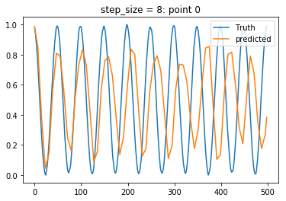
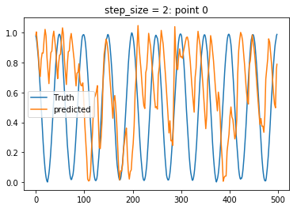
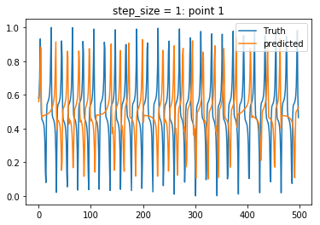
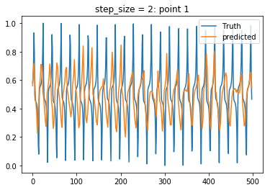
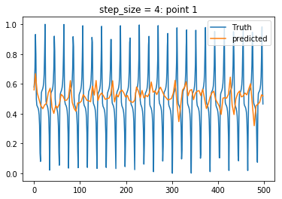
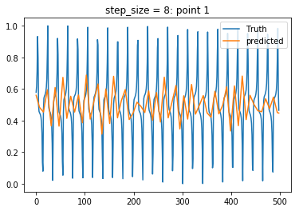
Fitting with a variety of step_sizes is giving gibberish for all

Slide 9
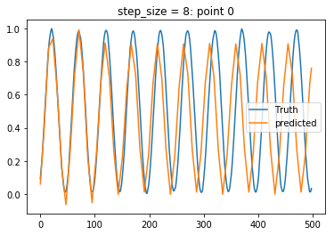
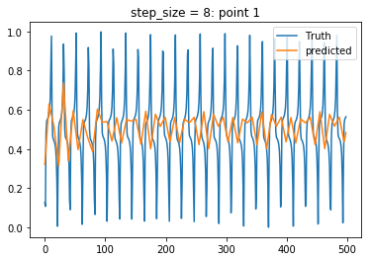
Tuning hyper parameters, I’m getting a little better. At least on the big scale

Slide 10
Where to move forward

Slide 11
Project 2:
Doing some experiments with less data and adding noise.
Project 2 is where we consider any path to get to x_T
Need to code this is a way that doesn’t take forever

Slide 12
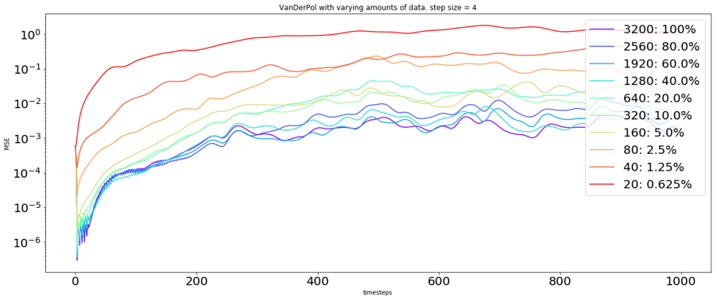
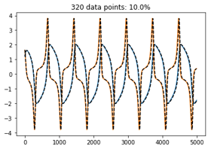
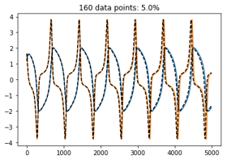
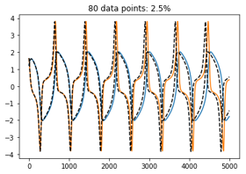
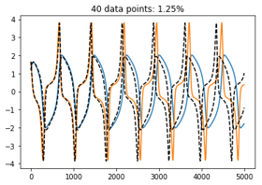
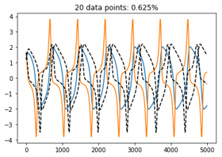
How does current behave with less noise. Actually did better than I was expecting. At some point you start to get a phase slip and then at 20 points, it kind of failed.

Slide 13
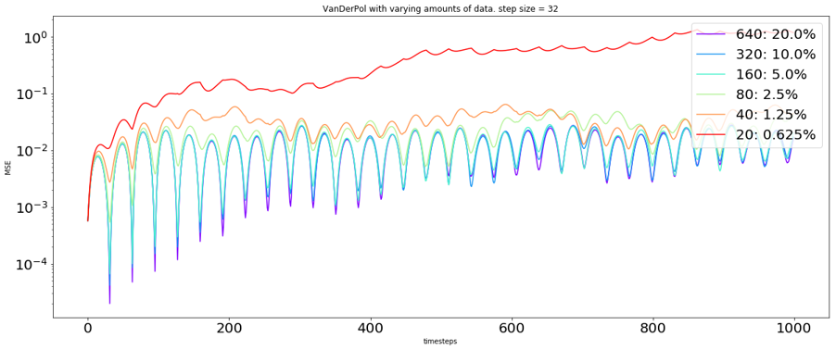
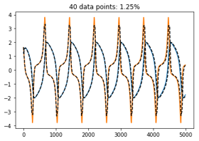
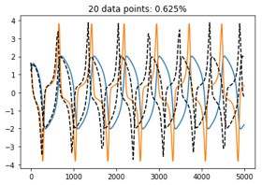
Some with larger step size

Slide 14
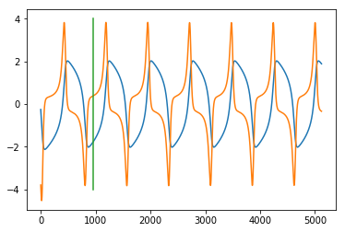
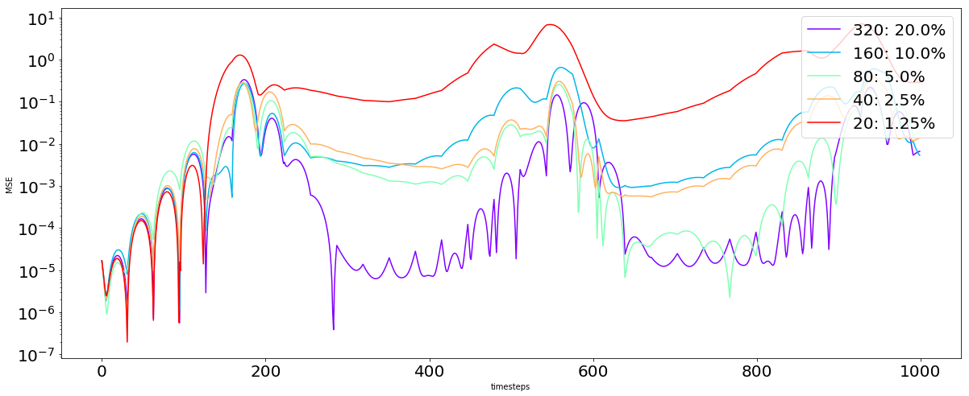
Looking when the data is just coming from 1 stream. This actually seems to work fine. Used the end of the stream for testing.
This is the stream we are using. Training points are evenly divided before green line. Testing after that
This test data is only over 1 stream, so there is only 1 test data point. Probably should make that better

Slide 15
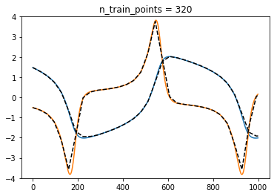
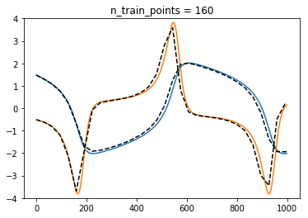
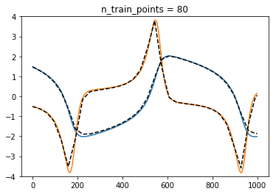
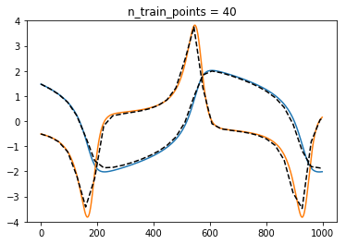
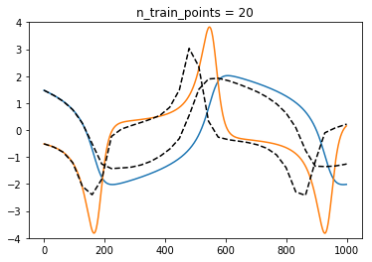

Slide 16

Adding noise. Yuying explored 1 and 2% (there’s more details in overleaf document) Hyperbolic

Slide 17






This is just 1 example of a test set (the one that happends to be index 0)

Slide 18







Slide 19

And putting these two scales together

Slide 20

Adding noise. Yuying explored 1 and 2% (there’s more details in overleaf document)

Slide 21







