Slide 2
Toy 2
Cos(w0 t) for the whole square
And cos(w1 *t + alpha) for the small square (width 8, over 16)

Slide 3
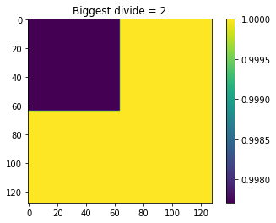
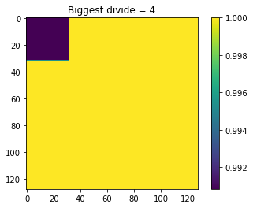
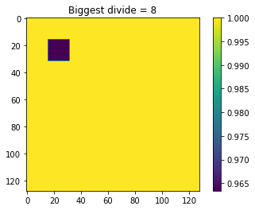
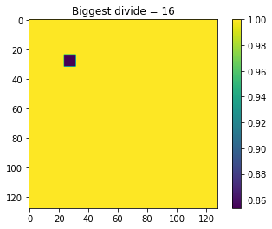
Using averages and keep dividing
Exactly the truth

Slide 4
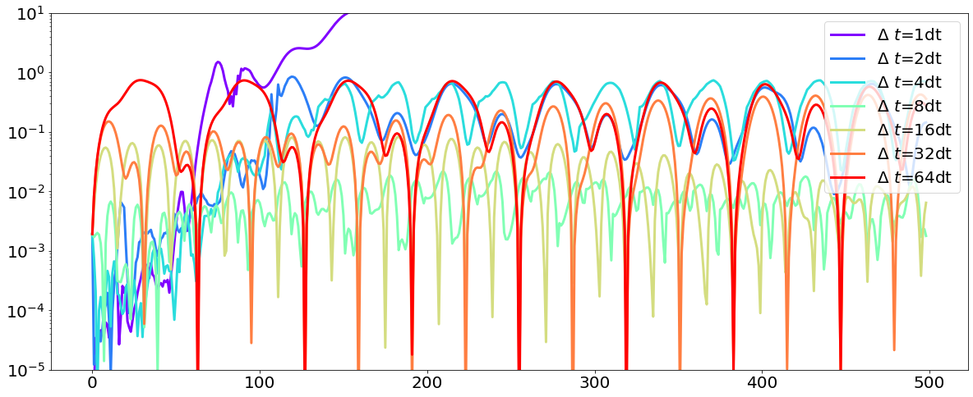
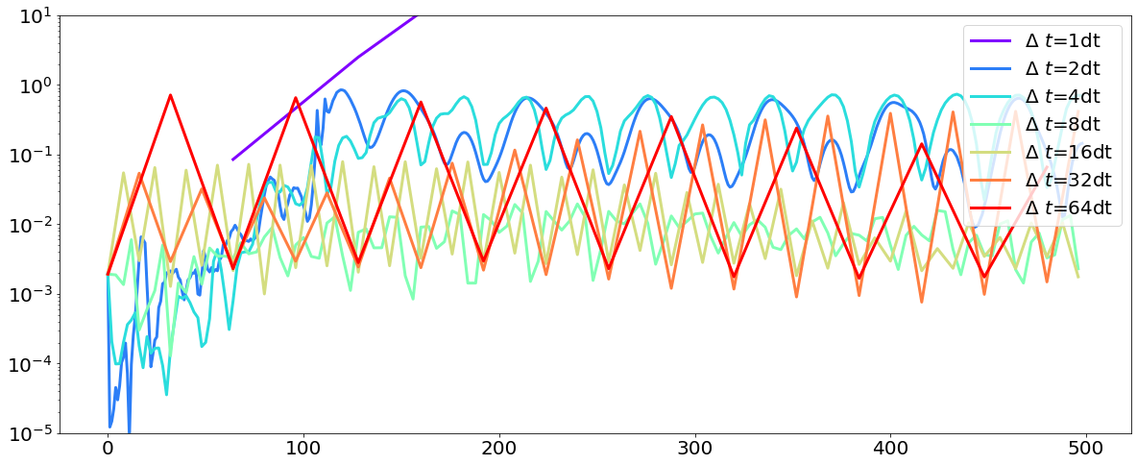
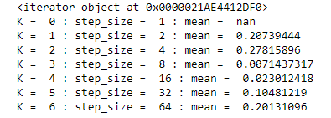
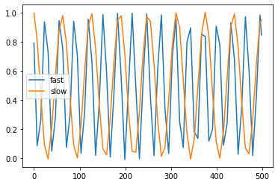
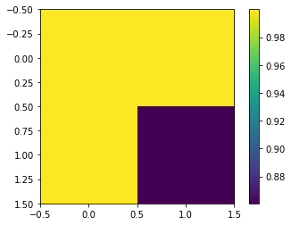
Time stuff on 2x2 square of 16x16
All time scales with interpolating
All time scales predicting on scale of 2^(k-1)
Value on k = 3, step_size = 8
Fast is blue square, slow is one of the yellows
How should I go on from here??
Picking up both timescales. Fast is double frequency of slow
If I train, starting with biggest, on next refinments, I can check if I have low enough error, and if not, refine.
How should I pick for small to large?

Slide 5
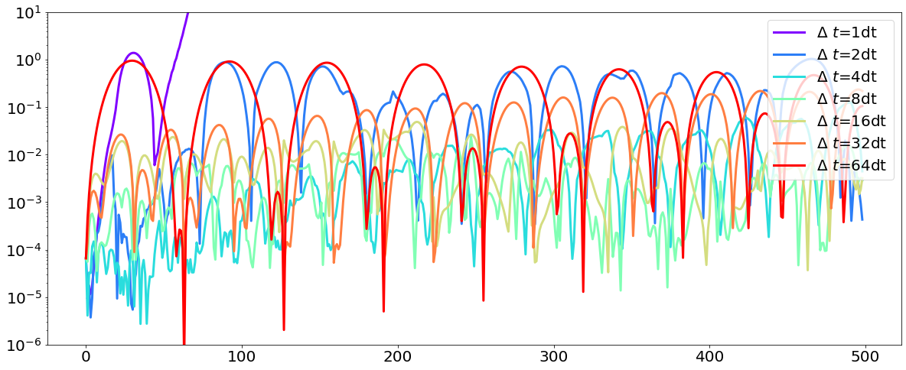
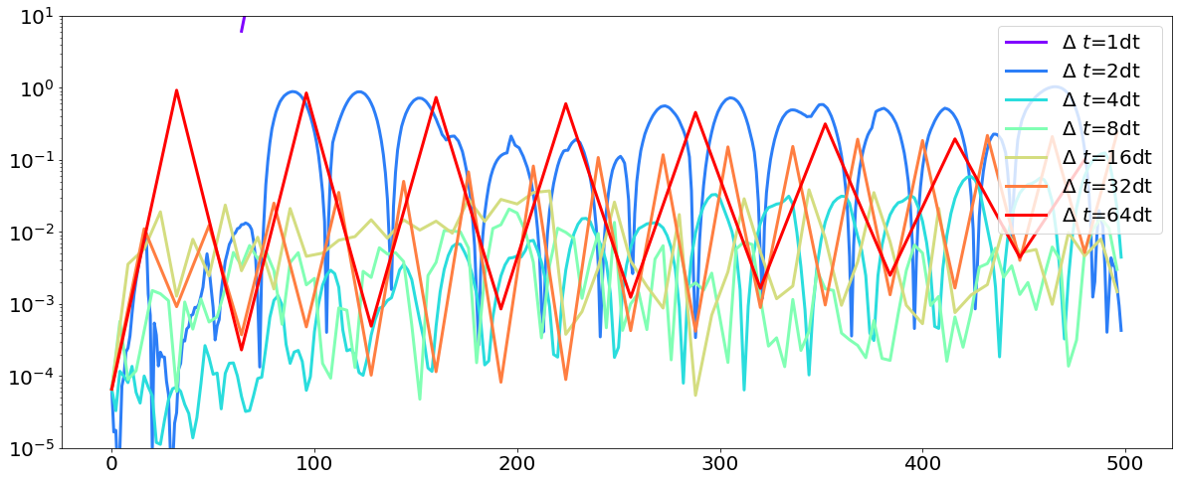
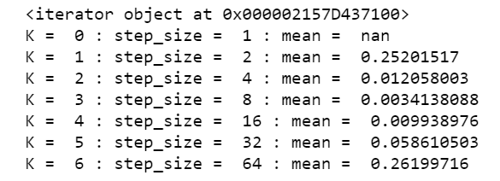
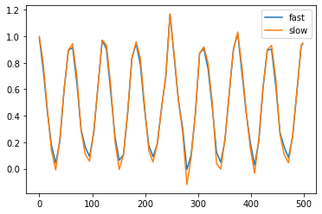
Fitting on the coarsest scale
Picking up the 1 timescale

Slide 6
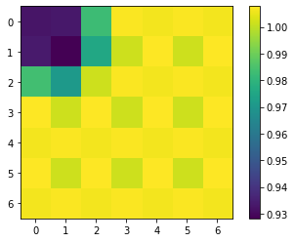
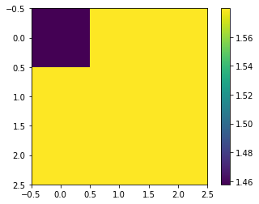
Toy2 through the cnn
Based on our structure of the cnn, we need data 2^n – 1 (original data 127x127, smallest is 3x3)
encoded
Autoencoder (final decoded)

Slide 7
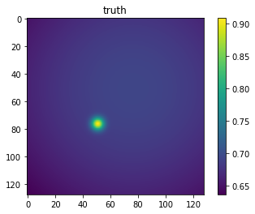
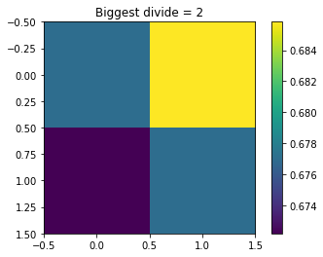
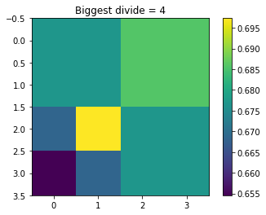
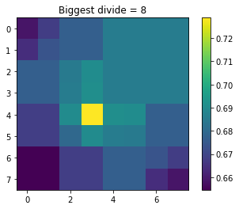
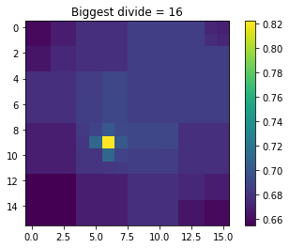

Slide 8
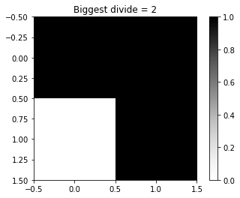
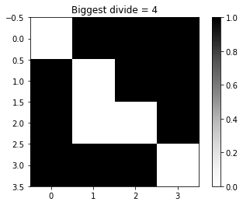
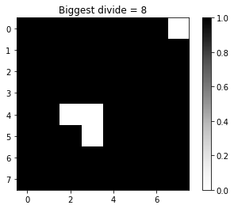
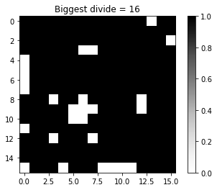
Resolved maps

