Slide 1


리스트
Chapter 8
Python for Informatics: Exploring Information
www.pythonlearn.com
Notes:
Note from Chuck. If you are using these materials, you can remove the UM logo and replace it with your own, but please retain the CC-BY logo on the first page as well as retain the entire last page.

Slide 2


Slide 3
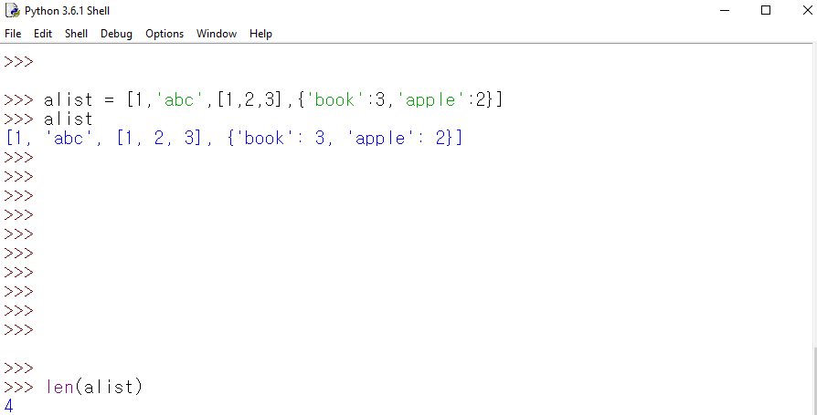
List Constants

Slide 4
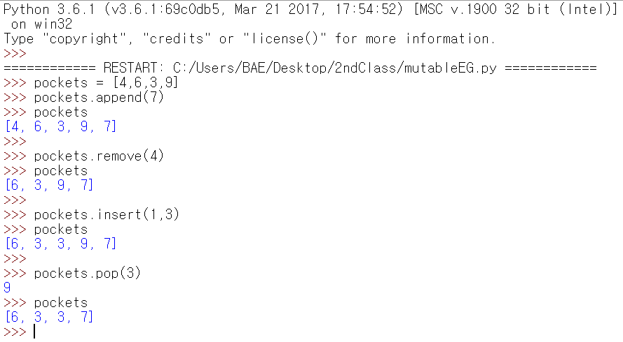
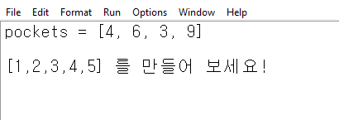
리스트형은 변경가능한(Mutable) 자료형

Slide 5
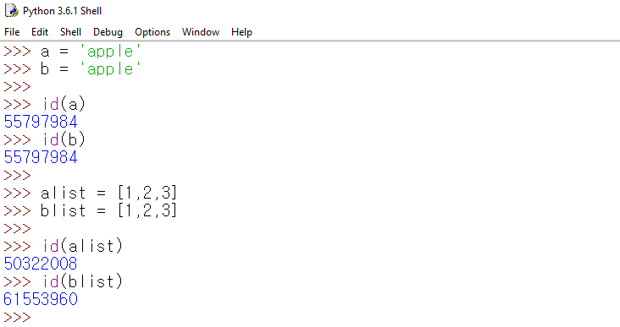
객체와 값

Slide 6
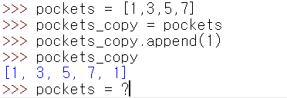
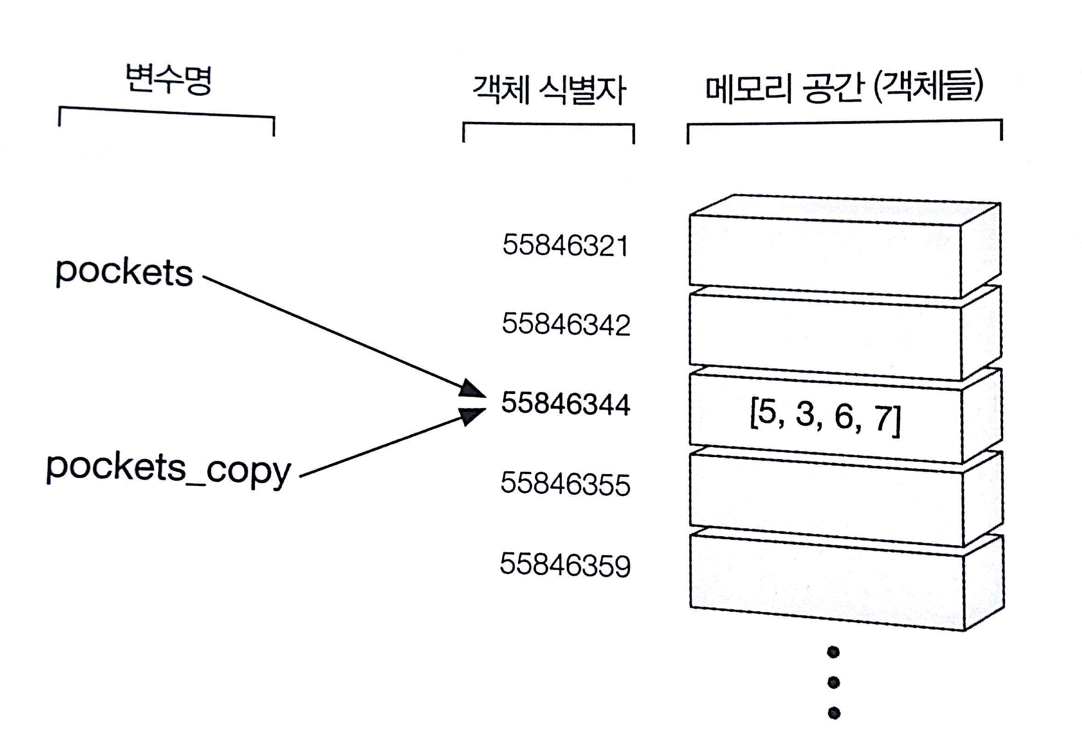

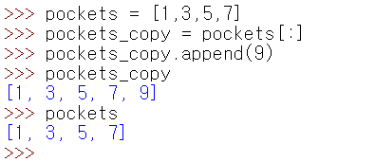
객체와 값

Slide 7
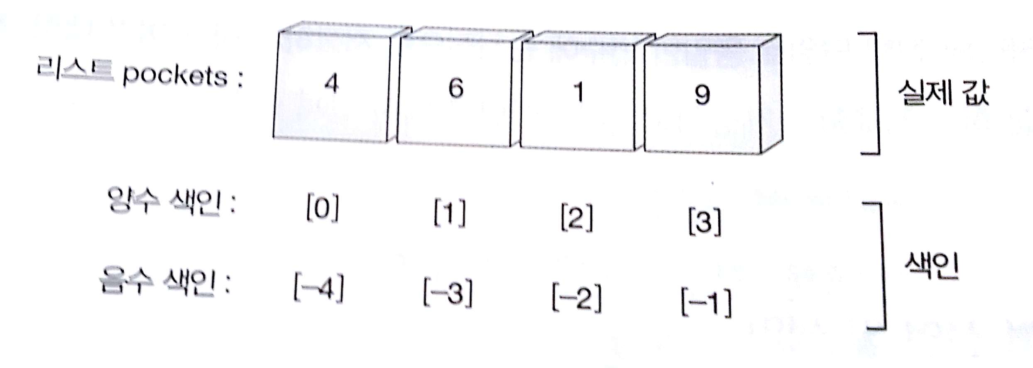
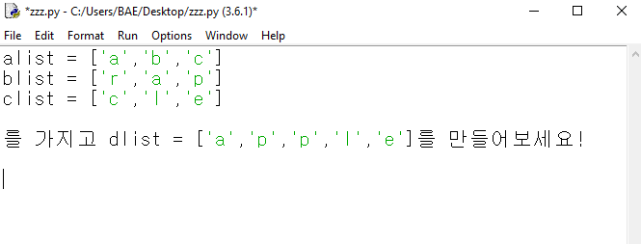
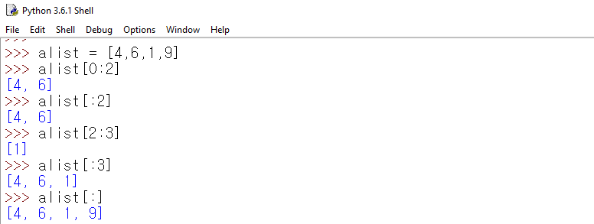
리스트자르기

Slide 8
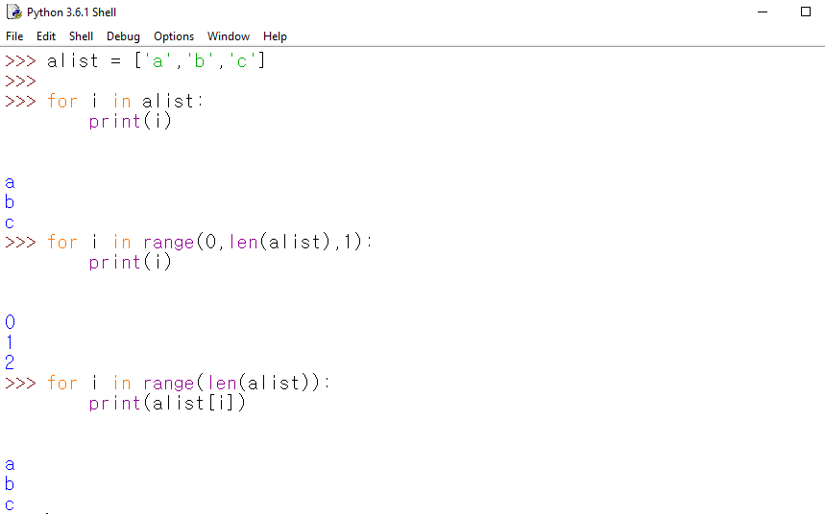
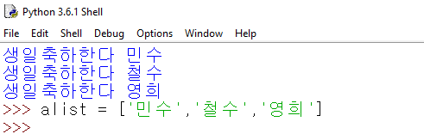
반복문 사용하기
The range function returns a list of numbers that range from zero to one less than the parameter
We can construct an index loop using for and an integer iterator

Slide 9
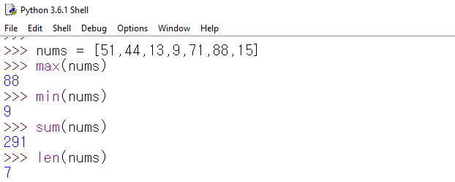
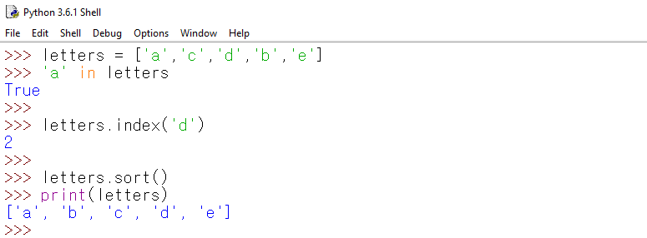
리스트 내장함수

Slide 10
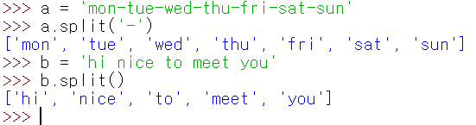
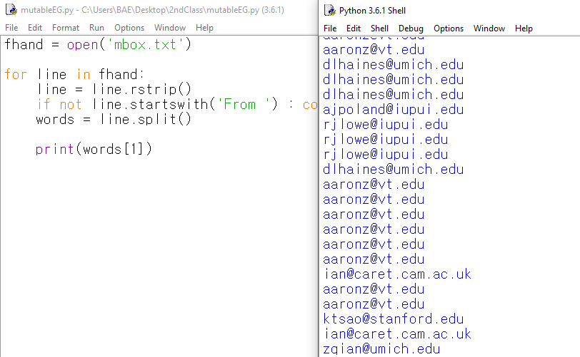

Slide 11
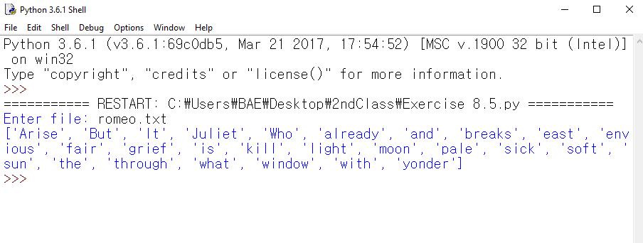
Exercise 8.4

Slide 12
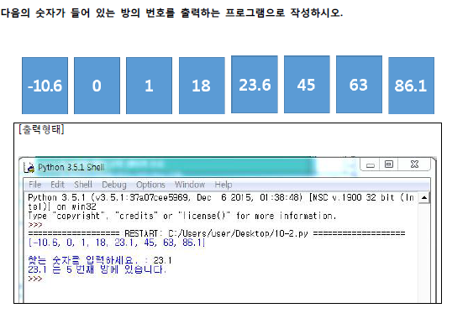
실습

Slide 13
List Summary
Slicing lists
List methods: append, remove
Sorting lists
Splitting strings into lists of words
Using split to parse strings
Concept of a collection
Lists and definite loops
Indexing and lookup
List mutability
Functions: len, min, max, sum

Slide 14
Acknowledgements / Contributions
These slides are Copyright 2010- Charles R. Severance (www.dr-chuck.com) of the University of Michigan School of Information and open.umich.edu and made available under a Creative Commons Attribution 4.0 License. Please maintain this last slide in all copies of the document to comply with the attribution requirements of the license. If you make a change, feel free to add your name and organization to the list of contributors on this page as you republish the materials.
Initial Development: Charles Severance, University of Michigan School of Information
… Insert new Contributors and Translators here
...

