Slide 1
VIP Preliminary Content Analysis and Topic Modeling
Katie Murenbeeld

Slide 2
Content Analysis and Topic Modeling of Wildlife Conservation Articles
Content analysis is a systemic approach to infer the meaning or focus of a text, or collection of texts, based on data derived from the text(s) (Stemler, 2001).
Topic modeling is a technique in which an algorithm analyzes words in a collection of texts or documents and then determines the themes, or topics, within the collection of the texts, which topic best represents each text, and how those topic can change through time (Blei, 2012).

Slide 3
VIP Data Collection
Students collected and coded 50 news articles related to bears or wolves.
15 codes were created ranging in theme from wildlife conflicts with grazing to wildlife issues with people, wildlife, management, and so on.
Each article was classified as one or several of the 15 codes and a valence (or positive or negative sentiment) was decided for each code in the article.

Slide 4
Corpus and Data Formats
A corpus is any collection of texts, where texts can be the written word, spoken word, or music.
There are several useful data formats for content analysis and topic modeling. These include, but are not limited to, a document term matrix (DTM) and a tidy data frame.

Slide 5
DTM
In a DTM each:
row represents one document
each column represents one term
each value in the cell contains the number of times that term occurs in the document.
This leads to a “sparse” data frame where many of the values are zero. Later on we will use this format to complete some more complex types of analysis on the corpus.

Slide 6
Tidy Data Frame
A tidy data frame is the opposite of a sparse matrix. In a tidy data frame:
each variable is a column
each observation is a row.
This results in a one-token-per-row data frame (or one-token-per-document-per-row).
A token is a meaningful unit of text. Here a token refers to to a single word (unigram), but in other analyses a token could be pairs of words (bigrams), sentences or paragraphs.

Slide 7
Data Preprocessing
To build the data frames we will:
remove all punctuation and make all words lower case
remove stop words (words like “to”, “the”, and “and”)
we will also keep all numbers and all words that occur in at least one article
we will not stem the words

Slide 8
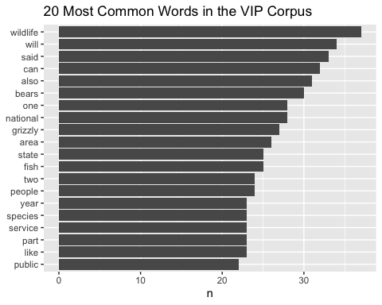
Let’s explore the corpus
What are the 20 most common words in the corpus?
The most common word in the corpus is “wildlife”!
Should we make our own list of stop words? - For example, how helpful are the words will, said, can, also, and like?

Slide 9
Sentiment Analysis
Often one wants to understand the overall sentiment or feeling of a text.
Within the VIP class we referred to this as the “valence”.
One common approach to determining the sentiment of the text is to the combine or sum the sentiment content (or connotation) of each word within the text.
Here we will use the Bing lexicon which classifies a word as either positive or negative.

Slide 10
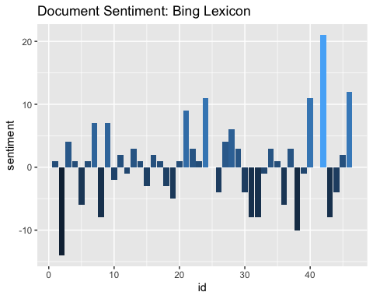
Overall Sentiment of the Articles

Slide 11
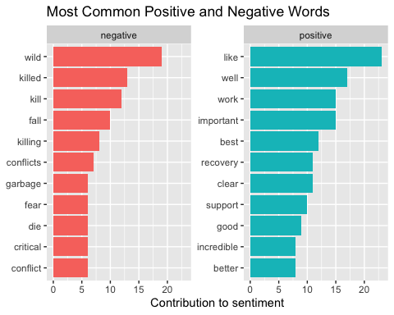
Common Positive and Negative Words
What are the most common positive and negative words?

Slide 12
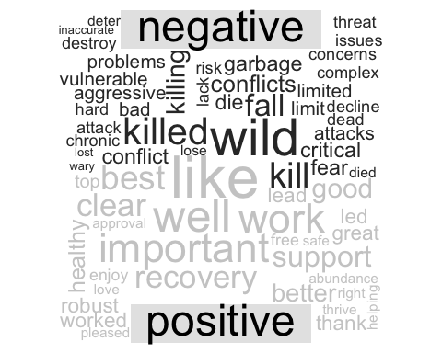
Word Clouds of Positive and Negative Words
Another fun visualization of content analysis is a word cloud.

Slide 13
Considerations
We may want to consider “stemming” as described above.
In the future we may want to consider using a different lexicon, for example is “wild” really a negative word in this project?

Slide 14
Term Frequency
Term frequency can be a useful metric to help one determine the meaning or focus of a text.
However, often times common stop words like “the” and “to” will be the most frequent words within a text.
A term frequency weighted by how often the term occurs in the text is another way to use term frequency instead of just removing stop words from the text or corpus.
A type of weighted term frequency is term frequency - inverse document frequency, or tf-idf.

Slide 15
Term Frequency and Inverse Document Frequency
Term frequency refers to how frequently a word occurs in a document relative to the total number of words in the document.
$tf=\frac{n_{word_{i}}}{totalwordcount}$
Inverse document frequency is the natural log of the number of documents relative to the number of documents containing a term.
$idf=ln\left(\frac{n_{documents}}{n_{documentscontainingtheterm}}\right)$

Slide 16
TF-IDF
Term frequency - inverse document frequency (tf-idf) is term frequency and idf multiplied together.
The idf part of the equation will decrease the weight of a term for common terms and increase the weight of a word for rarely used words. Basically, “the frequency of a term weighted for how rarely it occurs.
Tf-idf answers the question, “How important is this word in a document?”.

Slide 17
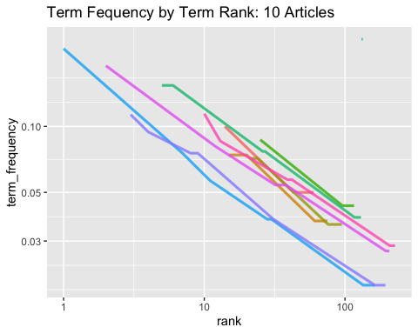
TF-IDF for 10 Articles
Here we determine the count n for each term in a document and the total word count total for each document.
$tf=\frac{n_{word_{i}}}{totalwordcount}$
The rank is determined by the word count, so the most common word is ranked 1.

Slide 18
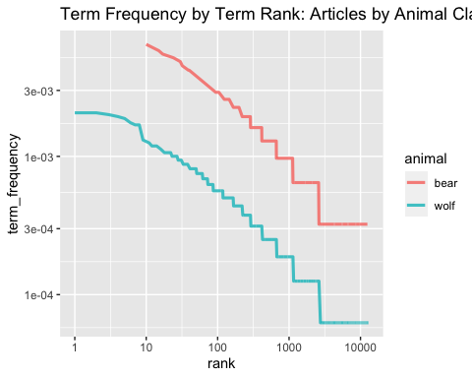
TF-IDF for Articles Grouped by Animal
We could also group the corpus by the animal topic of the article.

Slide 19
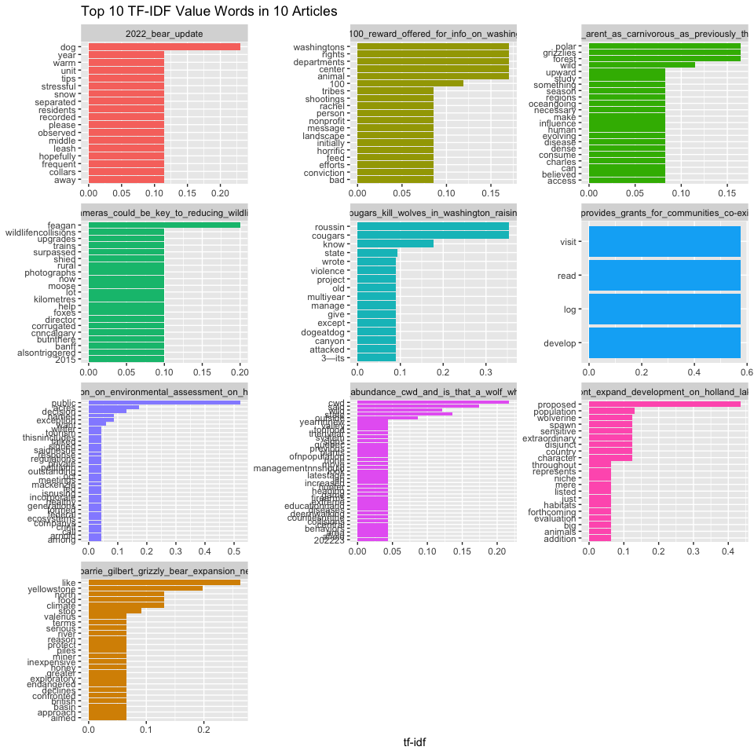
Slide Title
The highest tf-idf values for a document will show the most important words for a document.
For example, in the “Deer abundance_CWD_and_is_it_that_a_wolf” article, the term “cwd” has the highest tf-idf for the document.

Slide 20
Topic Modeling
Topic modeling uses algorithms to examine a collection of texts and discover the topics of the corpus and the topic of each text. Topic models can organize a collection of documents based on these discovered themes. One very common approach is the latent dirichlet allocation.

Slide 21
Latent Dirichlet Allocation (LDA)
Latent dirichlet allocation (LDA) is a probabilistic topic model. The LDA assumes that documents can have multiple topics (i.e. a document is a mixture of topics) and that each topic is made up of a distribution of words. The words within one topic can also occur within another topic’s distribution of words.

Slide 22
How does LDA work?
LDA is a generative model (i.e. it models how a document could be generated) which assumes that:
a set of topics are generated first
the model randomly chooses a distribution over that collection of topics
for each word in the text, the model will randomly choose a topic from the distribution and then randomly choose a word from the distribution of words associated with the chosen topic (Blei, 2003).

Slide 23
LDA Parameters
There are two (hyper)parameters of interest for a LDA.
beta - is the probability that a word belongs to the word distribution of a topic.
gamma - is the probability that a document belongs within a specific topic.

Slide 24
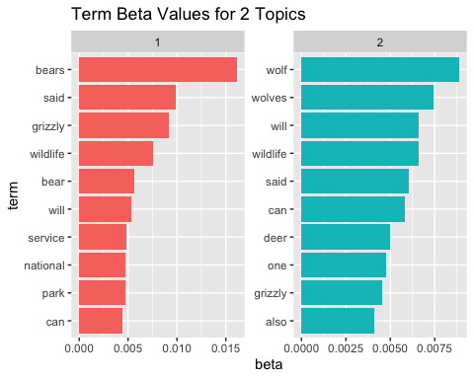
2 Topic LDA
Let’s start with 2 topics, to see if the model can identify articles as relating to bears or wolves.
What is the probability that a word belongs in a topic?

Slide 25
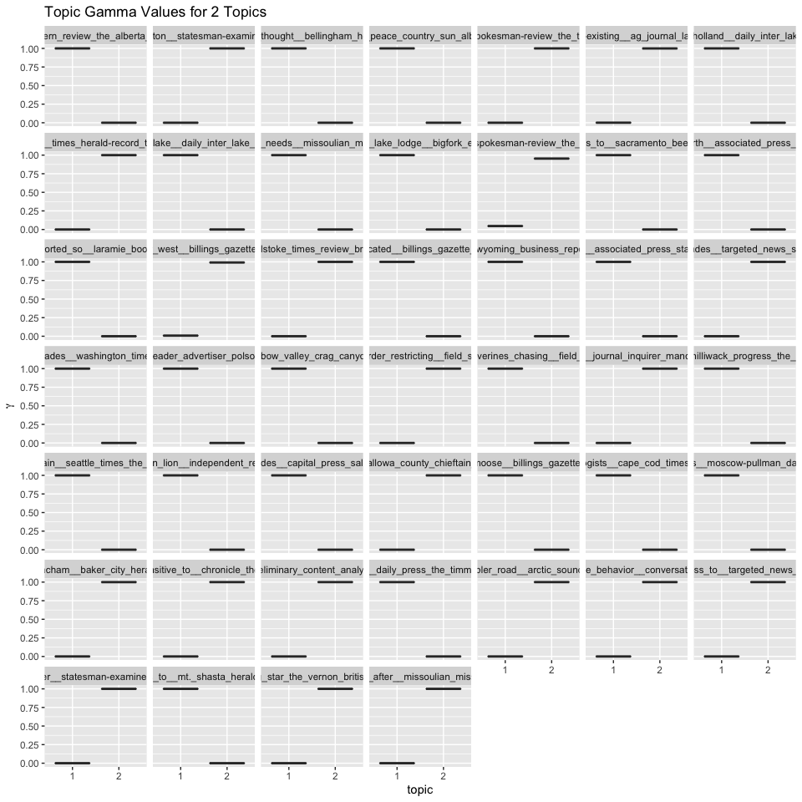
2 Topic LDA Gamma Values
What is the probability that an article belongs to a topic?

Slide 26
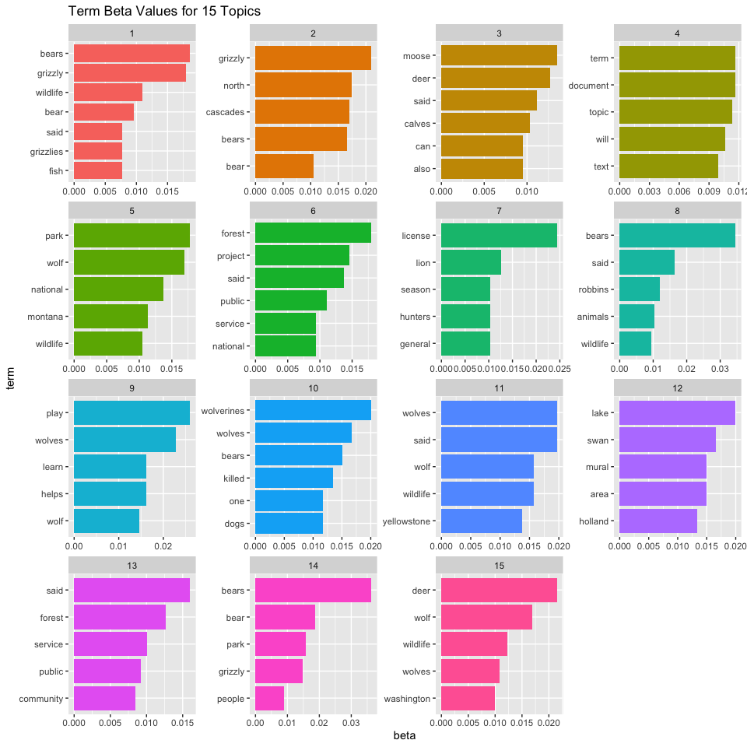
15 Topic LDA
Let’s do 15 topics (the number of codes in the class code book).
What is the probability that a word belongs in a topic?
How would we describe the topics based on these words?

Slide 27
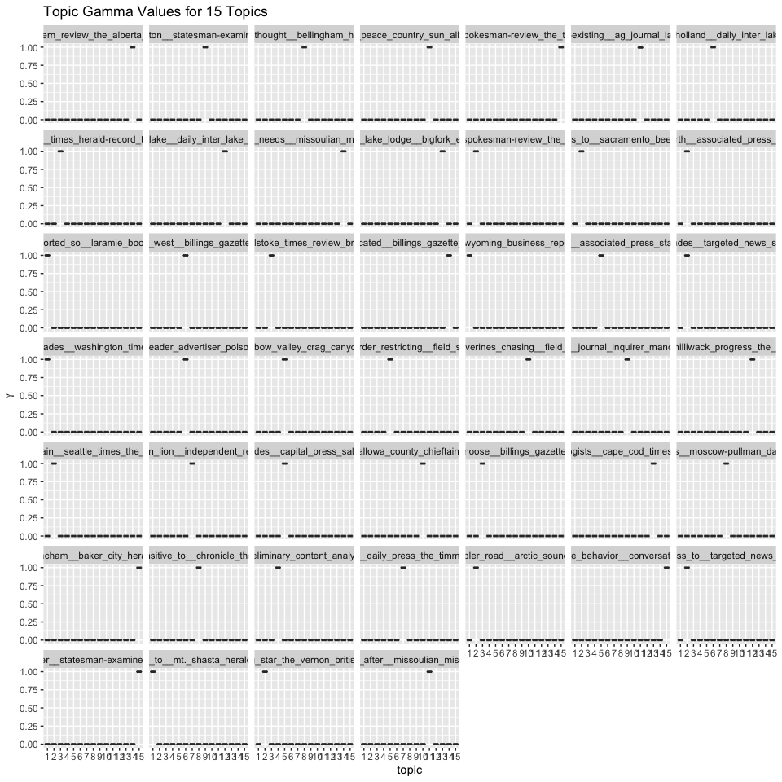
15 Topic LDA Gamma Values
What is the probability that an article is associated with a topic?

Slide 28
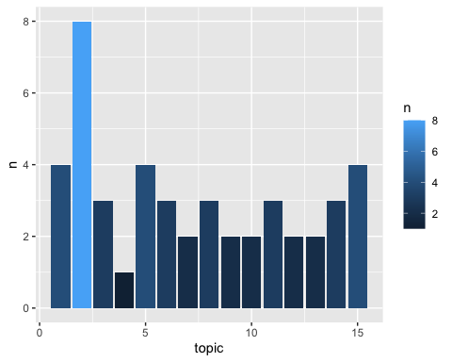
Most Common Topics
What are the most common topics in the corpus?

Slide 29
References
Blei, David M. “Probabilistic topic models.” Communications of the ACM 55.4 (2012): 77-84.
Ford, Clay. Reading PDF Files into R for Text Mining, University of Virginia Library, 14 May 2019, https://data.library.virginia.edu/reading-pdf-files-into-r-for-text-mining/.
Silge, Julia, and David Robinson. Text mining with R: A tidy approach. ” O’Reilly Media, Inc.”, 2017.
Stemler, Steve. “An overview of content analysis.” Practical assessment, research, and evaluation 7.1 (2000): 17.

