Slide 1
Analysis reports for
Shop satisfaction survey dataset

Slide 2
Background of the survey
The survey was conducted by interviewing 102 customers of our shop between 1.1.2022 and 14.1.2022 (These are imaginary!!!)
We took every 100th customer that entered our shop and did the survey in such a way that equal amount of customers were interview between 9 am – 12 am, 12 am – 3 pm, 3 pm - 6 pm and 6 pm – 9 pm
All the participants got movie tickets for their effort
… whatever other information would be needed, needs to be written down here…

Slide 3
Variables of the survey
Background variables 1-7
Variables of main interest 8-9 (Likert scale)
Variables |  | 1 | gender (1 = woman, 2 = man)
 |  | 2 | age (years)
 |  | 3 | family size (persons)
 |  | 4 | house (1 = own apartment, 2 = rental apartment, 3 = employy housing)
 |  | 5 | education (1 = primary school, 2 = vocational school or similar, 3 = secondary school graduate,
 |  |  | 4 = applied science university, 5 = other university)
 |  | 6 | net household income (€/month)
 |  | 7 | purchases of household (€/month, 1 = less than 250,
 |  |  | 2 = 250 - 499, 3 = 500 - 749, 4 = 750 - 999, 5 = 1 000 or more)
 |  | 8 | satisfaction with the store's product range (scale 1 - 5, 1 = very
 |  |  | unsatisfied, 5 = very satisfied)
 |  | 9 | satisfaction with the price level of the store (scale 1 - 5, 1 = very unsatisfied,
 |  |  | 5 = very satisfied)

Slide 4
Background analysis (variable by variable)

Slide 5
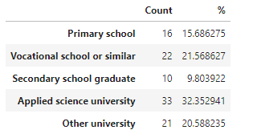
Background analysis (Education variable)
Based on the survey the educational levels of our customers are distributed based on the percentage table shown here.
More analysis/explanation goes here…
Or maybe better to use percentages in this case….

Slide 6
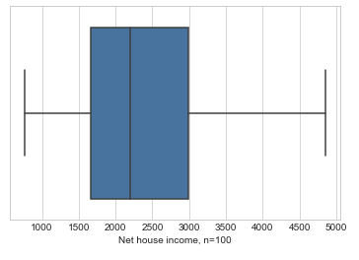
Background analysis (Net house income variable)
Based on the survey the Net house income of our customers is much distributed as shown in the boxplot diagram.
More analysis/explanation goes here…

Slide 7
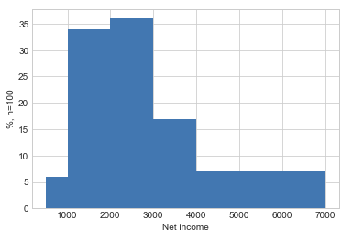
Background analysis (Net house income variable)
Since boxplot does not describe the customer net house income fully the histogram of that variable is provided here. The income classes used where
500 - 1000
1000 – 2000
2000 – 3000
3000 – 4000
4000 – 7000
We can see that about 70% of our curtomers net house income is between 1000 and 300 euros and also 3000 – 4000 e net income is rather common.
Maybe some suggestions based on your findings… (no need now for this course!)

Slide 8
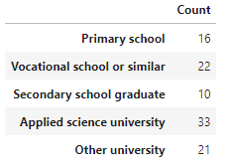
Background analysis (Education variable)
Based on the survey the educational levels of our customers are distributed based on the frequency table shown here.
More analysis/explanation goes here…

Slide 9

Background analysis (more ….)
Report other relevant findings here…

Slide 10
Analyzes two qualitative variables
Maybe there are some variable pair of variables 1-7 that provide meaningful background information for the business already
However, remember that your boss is most interested in findings with variables 1-7 together with variables 8 and 9!
Here I will report analysis between variables gender and education… Which does not have much if any meaning for the business here … but just for the illustration.
… So it is your job to analyze something interesting for your boss!!

Slide 11
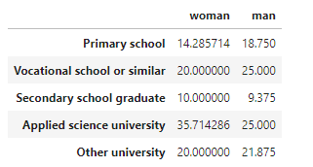

Analyzing dependency between variables gender and education
Note! This may not make much sense for the business we are dealing with here. But this is just for an example. Your job is to find meaningful dependencies from the data and report them to your boss/me

Slide 12
Analyzing dependency between variables gender and education
Note! This slide is just for illustration
Actually we did not find anathing interesting here that should be actually reported!
It is your job to find something meaningful for the business with the dataset used for the Project Work!!
Here we analyze, whether there is dependency between variables gender and education.
Out of all women, 14.3% of them has their highest education level as primary school. This is bit less than for men.
The respective values seem to be rather close in all the educational levels and we suspect there is no dependency between the variables
This was tested with Chi2 test which gave us the p-value of 0,85 which tell us that there is no dependency between the two variables.

Slide 13
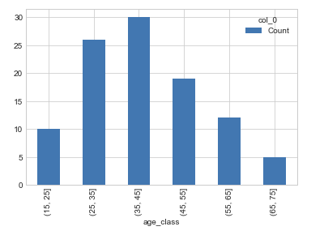
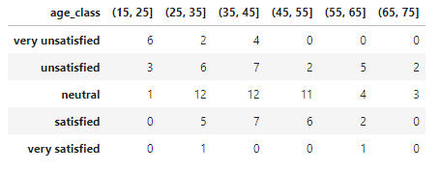
Analyzing dependency between age_groups and sat_price_level
The figure here shows the the age classes that we used in our analysis – the counts are shown also
The crosstabulation is given in the table on the right
Based on the cross tabulation it seems that for example that our youngest customers and mostly unsatisfied or even very unsatified with our price levels.
…
We suggest that we make a campaign for our youngest customers of some kind…

Slide 14
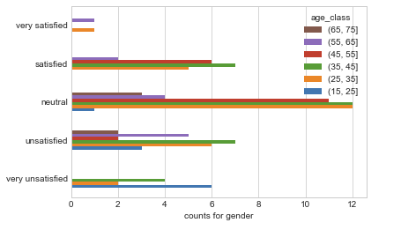
Analyzing dependency between age_groups and sat_price_level
We made a proper test for these variables. The p-value for the test was ~0.0036 so the level of dependency between the two variables is statistically significant.
By examining the data we can see that, for example, our youngest customers are the most unsatisfied age group what comes to the price level.
…
…

Slide 15
Continue with your other findings
When you are done with analysing and you have done this powerpoint accordingly, make the Project work video where you discuss this PowerPoint and especially your findings clearly.
Remember to see the Project Work guidelines fully for other things to be discussed on the video also!!

