Slide 1
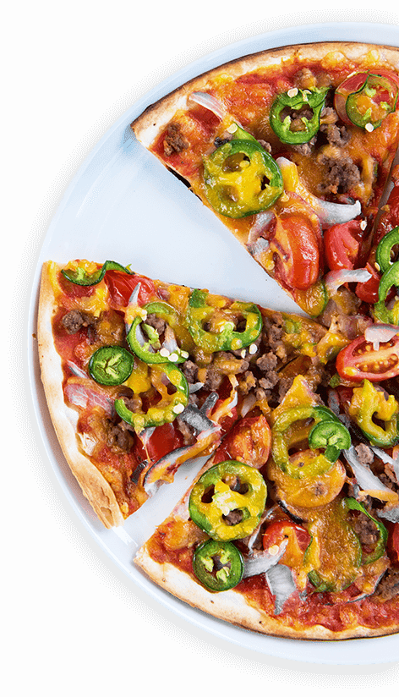
HOT SLICE PIZZERIA
A Taste Of Happiness
Presented by
Confidence Ihediohamma

Slide 2
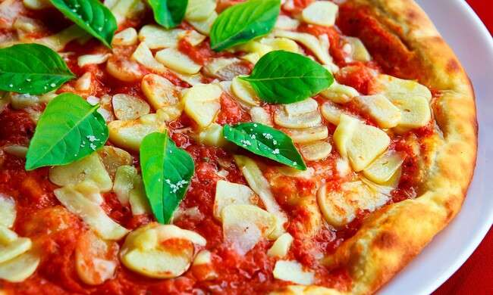
01
Introduction and Summary
02
Problem Statement
TABLE
OF
CONTENTS
03
Aim and Objectives of the Analysis
04
Key Finding and Insights
05
Conclusion and Recommendation

Slide 3
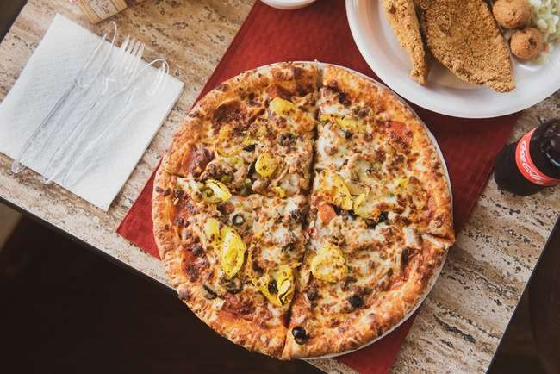
Introduction
Hot Slice Pizzeria is a fictional family-owned pizzeria located in the heart of a bustling city, specializing in gourmet, hand-tossed pizzas. Established in 2013, the pizzeria has gained a loyal customer base due to its commitment to fresh ingredients and a personalized customer experience. In 2015, Hot Slice’s Pizzeria decided to start analyzing its sales data to better understand customer preferences, and drive revenue growth for the single location.

Slide 4
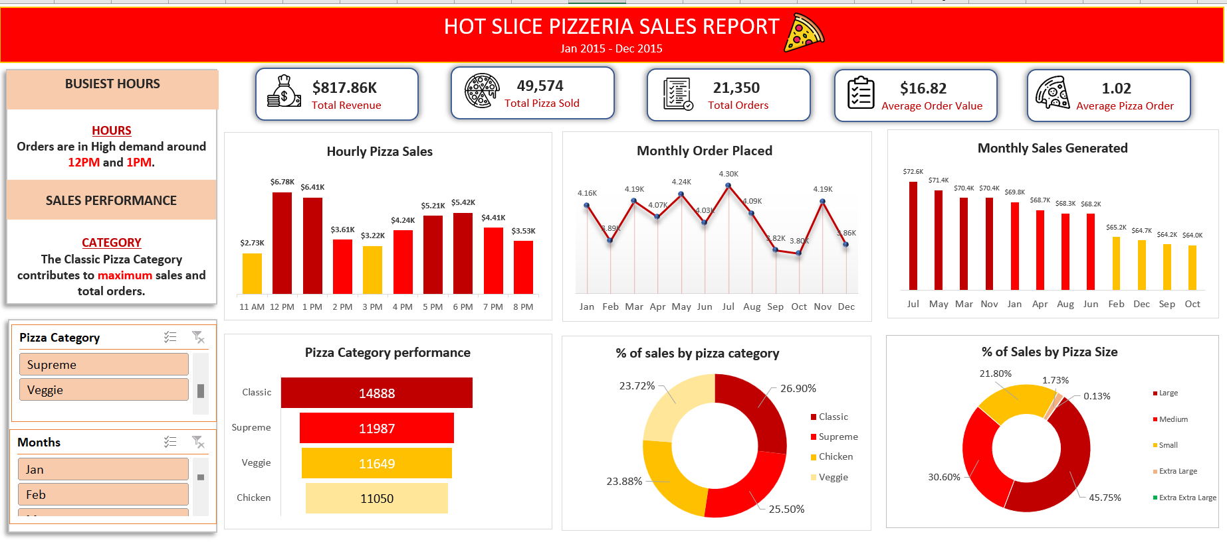

Slide 5
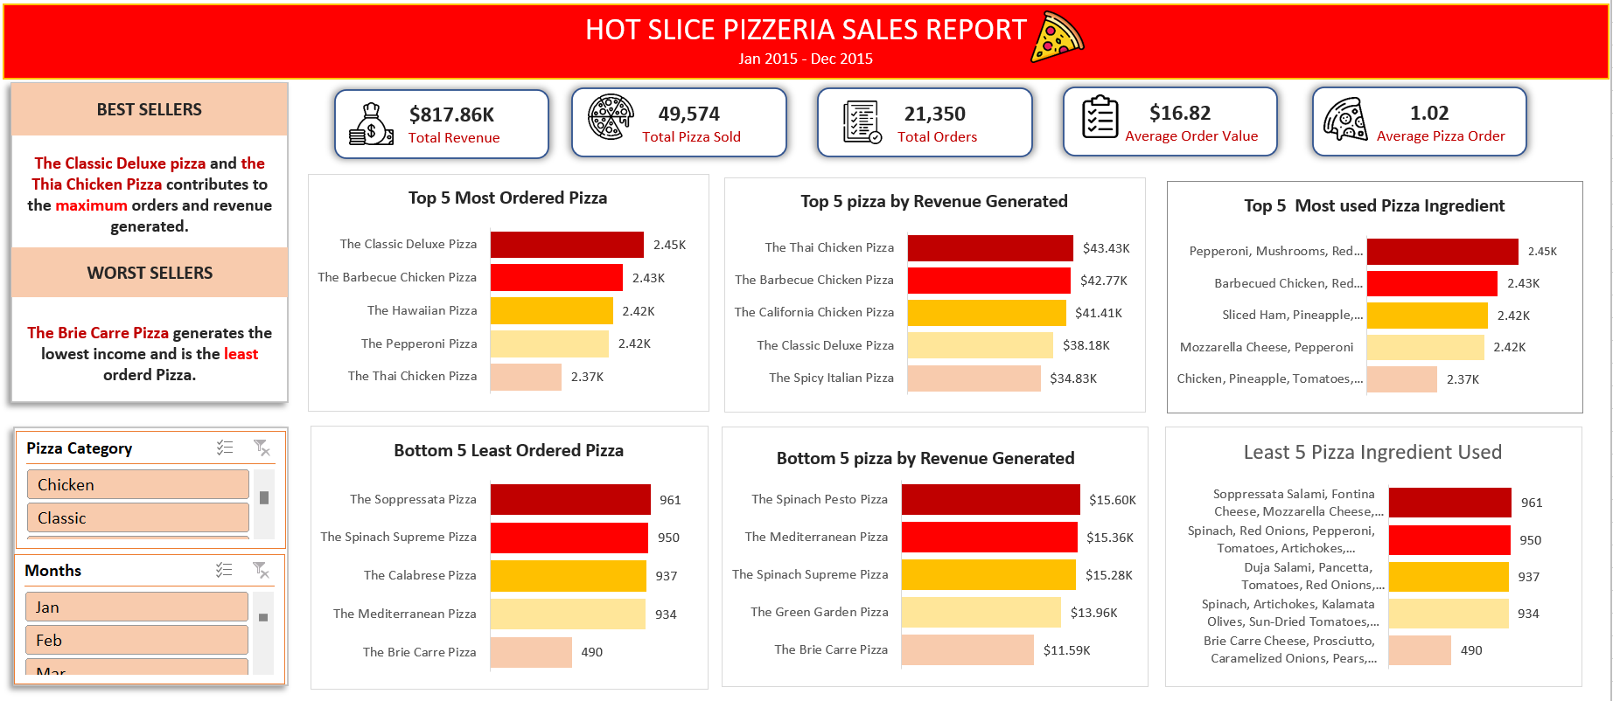

Slide 6
PROBLEM STATEMENT
Hot Slice's Pizzeria, a local pizza shop, aims to improve its sales performance and operational efficiency by analyzing its order data. The company struggles with understanding customer preferences, managing inventory needs, and identifying peak sales periods. By analyzing the sales data, Hot Slice's Pizzeria seeks to uncover trends in popular pizza types, order volume, and customer behavior. The goal is to optimize the menu, reduce waste, and enhance customer satisfaction while maximizing revenue through data-driven insights.

Slide 7

Key Performance indicators (KPIs)
Total Revenue
The sum of the total price of all item ordered
Total Orders and Total Pizza Sold
This is the Total number of orders placed and the Sum of the quantities of Pizza sold.
Average order value
The average amount spent per order, calculated by dividing the total revenue by the total number of orders
Average Pizza Order
The average number of pizzas sold per order, calculated by dividing the total number of pizzas sold by the total number of orders
Notes:
Photo by Cel Lisboa on Unsplash

Slide 8
Objectives
To Analyze Sales Trends, including peak times of the day, week and month.
To Optimize Menu Offerings by assessing customer preference for various pizza type.
To Improve Inventory Management by predicting ingredient demand based on historical sales.
To Analyze customer ordering behavior to streamline the ordering process and improve service.
To Track revenue growth over time.

Slide 9
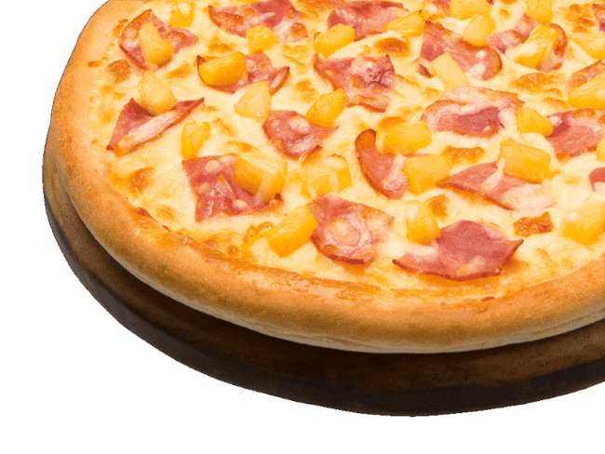
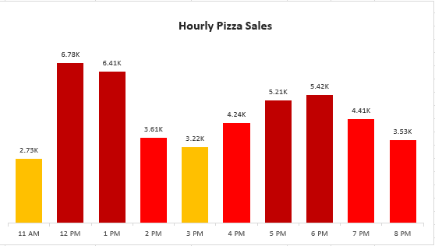
Finding and Insights
The results from the chart reveals the hourly trend of pizza sales. It indicates that 6776 and 6413 sales were generated around 12PM and 1PM respectively. This is mostly during Brunch/Lunchtime Break, and is the fastest and quickest available meal. Also, within the hours of 5PM and 6PM , the evening dinner rush sees another surge in sales, as people begin to prepare for dinner or opt for takeout after a busy day.

Slide 10
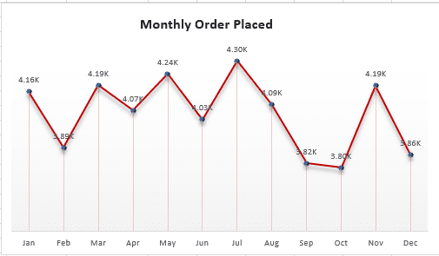
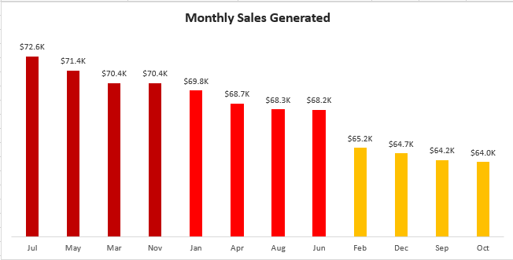
The chart above shows the monthly order placed and monthly sales generated for all pizza types. For the monthly order placed and sales generated, the highest orders and sales were recorded in the month of July and May. Each month having 4,301 pizza orders with 72.6K sales generated, and 4,239 pizza orders with 71.4K sales generated respectively, this is due to the social gathering and outdoor events during holidays (e.g. Independence Day, Memorial Day). However, the decrease in sales in the month of October and September recorded the least pizza orders of 3,797 pizza orders with 64.0K sales generated and 3,819 pizza orders with 64.2K sales generated respectively, this could be affected by the back-to-school season.

Slide 11
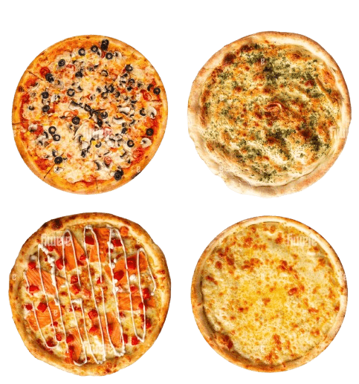
PIZZA SALES BY CATEGORY PERFORMANCE
Classic Pizza recorded about 14888 orders and attributes to 26.90% sales generated.
The Supreme Pizza recorded about 11987 orders and attributes to 25.50% sales generated
The Chicken Pizza recorded about 11649 orders and attributes to 23.88% sales generated.
The Veggies Pizza recorded about 11050 orders and attributes to 23.72% sales generated
Notes:
Image by pngfly.com

Slide 12
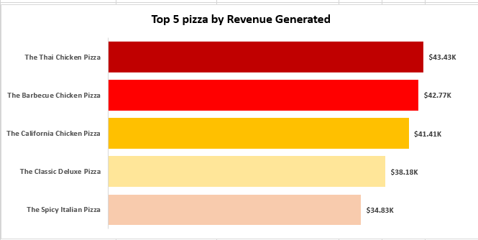
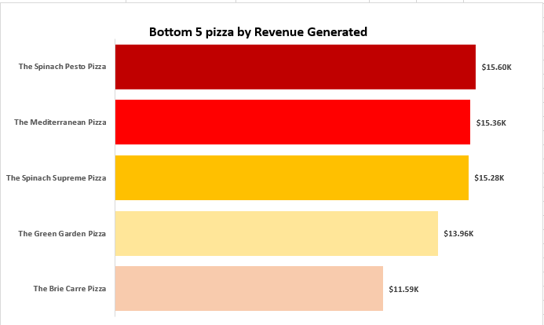
The chart above shows the top 5 pizzas with the highest revenue generated and also the bottom 5 pizzas with the least revenue generated for all pizza types. The pizza type which contributes to the most revenue generated is “The Thai Chicken Pizza” generating over $43,343 maximum revenue. While the pizza type which generates the least revenue is “The Brie Carre Pizza” which generated $11,588 revenue.

Slide 13
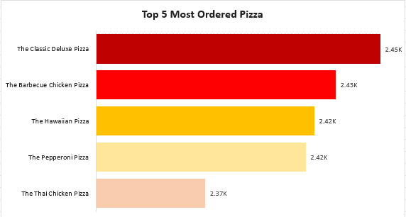
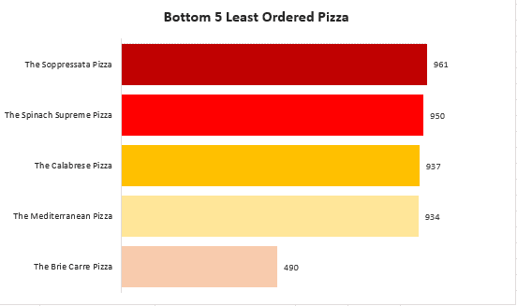
The chart shows the top 5 most ordered pizza and the bottom 5 least ordered pizza for all pizza types. The pizza type which is the most ordered is “The Classic Deluxe Pizza” generating over 2,453 maximum order sales. While the pizza type which is the least ordered pizza is “The Brie Carre Pizza” which generated only 490 pizza sales.

Slide 14
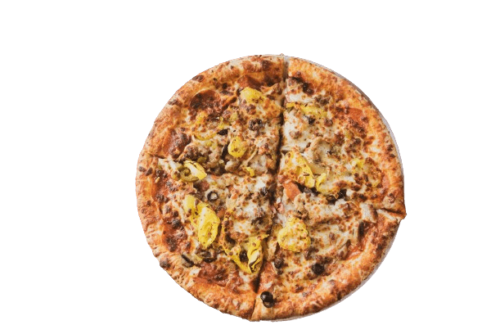
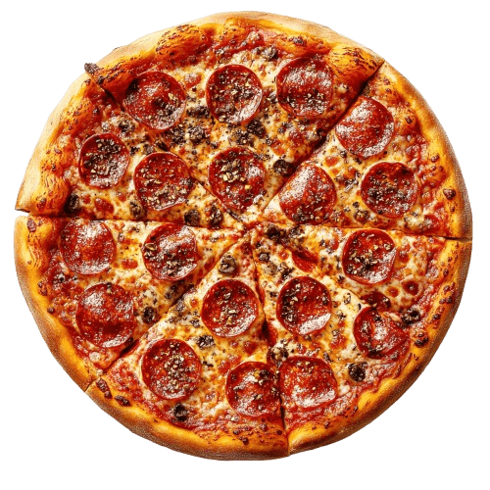
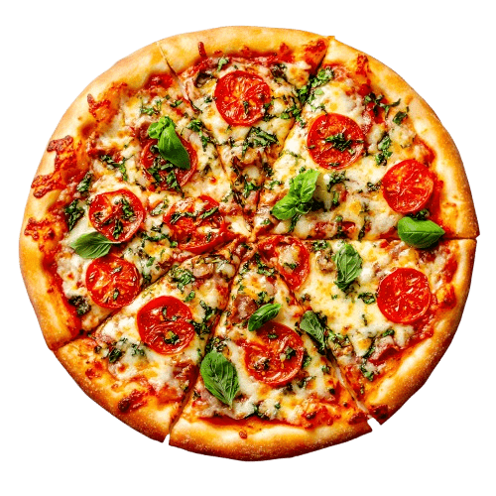
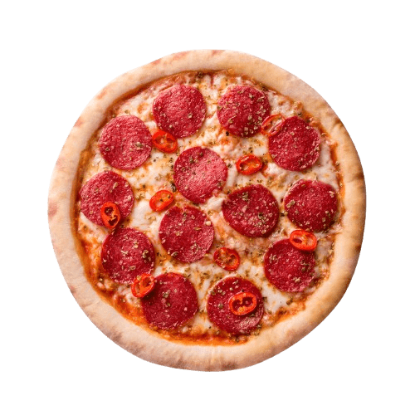
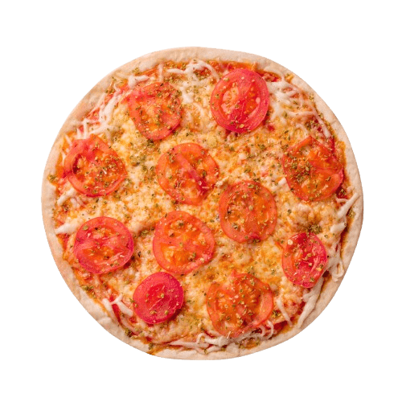
Most used Pizza Ingredients
01
Pepperoni, Mushrooms, Red Onions, Red Peppers, Bacon
02
Barbecued Chicken, Red Peppers, Green Peppers, Tomatoes, Red Onions, Barbecue Sauce
03
Sliced Ham, Pineapple, Mozzarella Cheese
04
Mozzarella Cheese, Pepperoni
05
Chicken, Pineapple, Tomatoes, Red Peppers, Thai Sweet Chili Sauce

Slide 15
Least used Pizza Ingredients
01
Brie Carre Cheese, Prosciutto, Caramelized Onions, Pears, Thyme, Garlic
02
Spinach, Artichokes, Kalamata Olives, Sun-Dried Tomatoes, Feta Cheese, Plum Tomatoes, Red Onions
03
Duja Salami, Pancetta, Tomatoes, Red Onions, Friggitello Peppers, Garlic
04
Spinach, Red Onions, Pepperoni, Tomatoes, Artichokes, Kalamata Olives, Garlic, Asiago Cheese
05
Soppressata Salami, Fontina Cheese, Mozzarella Cheese, Mushrooms, Garlic

Slide 16
Focus on promoting popular pizza varieties like Classic and Supreme while experimenting with new variations of these pizzas to cater to customer preferences.
.
RECOMMENDATION
Create special promotions or discounts for time duration like 3PM and 11AM, to balance demand and increase sales during slower periods.
Use predictive analytics based on order history to better forecast ingredient usage and prevent overstocking or stockouts of popular items like Pepperoni, Onion, Red Pepper.
Offer loyalty rewards for frequent customers to encourage repeat business and foster customer retention.
Notes:
Image by pngfly.com

Slide 17
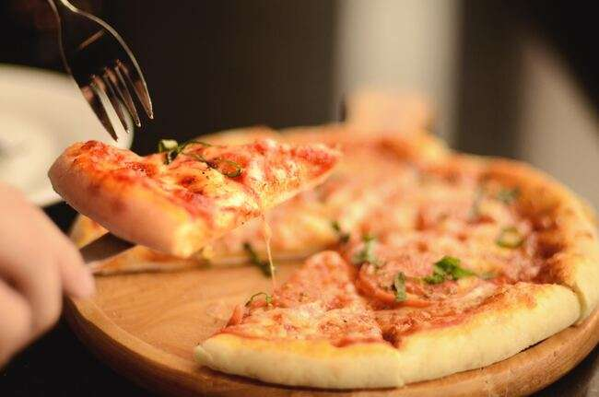
Conclusion
In conclusion, the analysis of Hot Slice Pizzeria sales data highlights clear trends that can inform both operational strategies and marketing efforts. Sales are significantly influenced by time of day, with peak hours observed during lunch (12 PM - 1 PM) and dinner (5 PM - 6 PM).
Also, seasonal fluctuations play a crucial role, with sales surging in May, July, March, and November due to holidays, vacations, and weather-related factors. Conversely, sales tend to dip in September and October as routines settle and consumers turn to homemade meals.
Additionally, ingredient usage alongside pizza sales trend provides valuable insights for inventory management and menu optimization. By leveraging these insights, Hot Slice Pizzeria can better plan promotions, staffing, and product offerings to maximize sales during peak times and seasons, while adjusting strategies during slower periods to maintain consistent growth and customer satisfaction.
Notes:
Photo by Lim Lin on Unsplash

Slide 18
THANK YOU

