Slide 1
OpenStudyBuilder
Steps
(Working Document)
Katja Glaß

Slide 2
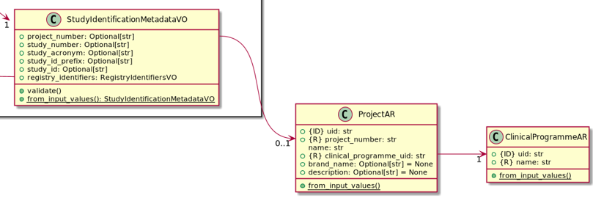
Setup
\clinical-mdr-api\doc\ddd_developers_guide\sample_domain_model.png
ClinicalProgramme
Project
Study
ClinicalProgramme & Project:
Created in \data-import\run_import_mockdata.py
handle_projects
Data located in \data-import\datafiles\mockup\project_exp.csv

Slide 3
Script Data Import
Definition CSV files & import programs available in:
\data-import\run_import_mockdata.py
def run(self):
self.log.info("Migrating mock data")
self.handle_projects(MDR_MIGRATION_PROJECTS)
self.handle_study(MDR_MIGRATION_STUDY)
self.handle_objective_templates(MDR_MOCKUP_OBJECTIVES_OBJECTS)
self.handle_objectives(MDR_MOCKUP_OBJECTIVES_OBJECTS)
self.handle_endpoint_templates(MDR_MOCKUP_ENDPOINTS_OBJECTS)
self.handle_endpoints(MDR_MOCKUP_ENDPOINTS_OBJECTS)
self.handle_timeframe_templates(MDR_MOCKUP_TIMEFRAMES_OBJECTS)
self.handle_timeframes(MDR_MOCKUP_TIMEFRAMES_OBJECTS)
self.handle_study_objectives(MDR_MOCKUP_STUDY_OBJECTIVES)
self.handle_study_endpoints(MDR_MOCKUP_STUDY_ENDPOINTS)
self.log.info("Done migrating mock data")
File definitions available in .env (MDR_...)

Slide 4
Order
Create ClinicalProgram & Project (only script/API)
Create Study (script/API/GUI)

Slide 5
ClinicalProgramme & Project
Cannot be created via GUI
Create via Script or direct API calls
Update project_exp.csv
Available as mockdata import
Within data-import (follow readme.md for setup): pipenv run mockdata
Example Execution / Setup & Steps
OpenStudyBuilder-devops (location OpenStudyBuilder as downloaded & docker installed/running)
OpenStudyBuilderScripts (location from this repository)
Update data-import/.env.import
MDR_MIGRATION_PROJECTS="../../OpenStudyBuilderScripts/data-import/example_projects.csv"
Update script to run only projects
run_import_mockdata.py, comment lines 622-630 (in def run(self), only keep logging and self.handle_projects)
Have your docker environment up and running
Open command line and execute mockdata creation
pipenv run mockdata

Slide 6
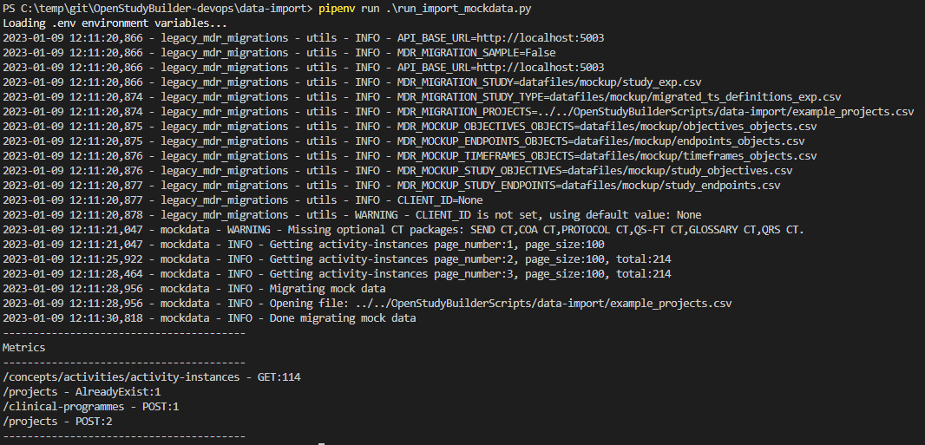
ClinicalProgramme & Project
Running single programs
pipenv run ..\..\OpenStudyBuilderScripts\scripts\test_api_connection.py
pipenv run .\run_import_mockdata.py
Program/Project is created

Slide 7

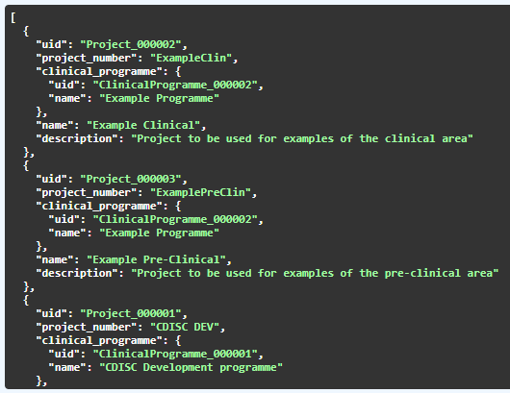
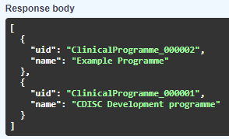

ClinicalProgramme & Project
clinical_programme_code | clinical_programme_name | project_code | project_code2 | project_name | brand_name | VIRTUAL | status | description
CDISC | CDISC Development programme | CDISC DEV | CDISC DEV | CDISC Dev |  | N | A | Project to be used for test of CDISC implementation, e.g. SDTM, ADAM
Example | Example Programme | ExampleClin | ExampleClin | Example Clinical |  | N | A | Project to be used for examples of the clinical area
Example | Example Programme | ExamplePreClin | ExamplePreClin | Example Pre-Clinical |  | N | A | Project to be used for examples of the pre-clinical area

Slide 8
Study
Can be created via GUI (OpenStudyBuilder application)
Can also be greated via Script or API calls
Script: /data-import/run_import_mockdata.py
Content defined in CSVs:
/data-import/datafiles/mockup/study_exp.csv
Mapping of CSV columns to content (see „study_mapper” definition)
Not all columns listed in CSV are used, only the following:
"study_number": IMPACT_NUM,
"study_acronym": "“
"project_number": PROJ
"ct_gov_id": CLINICAL_TRIALS_GOV
"eudract_id": EUDRACT_NUM
/data-import/datafiles/mockup/migrated_ts_definitions_exp.csv
Not all columns listed in CSV are used, only the following:
"study_number": IMPACT_NUM
"study_define_param_name": TSPARAM
"c_value": TSVAL
"c_code": TSVALCD

Slide 9
Study
Trial Summary
Currently only a few parameters from TS are supported:
"Intervention Model": "intervention_model_code",
"Trial is Randomized": "is_trial_randomised",
"Trial Blinding Schema": "trial_blinding_schema_code",
"Control Type Response": "control_type_code",
"Trial Title": "study_title",
"Trial Phase Classification": "trial_phase_code",
"Trial Type Response": "trial_type_codes",
Remark: make sure these labels are used, e.g. CDISC Pilot data contains “Control Type” instead of “Control Type Response” and “Trial Type” instead of “Trial Type Response”

Slide 10

Data Import - Remark
The CSV file imports should not be used,
use JSON format instead!

