Slide 1

Olist Store AnalysIS
Presented by – Priya Katkar

Slide 2
Project Details
The OLIST STORE is an e-commerce business headquartered in Sao Paulo, Brazil. This firm acts as a single point of contact between various small businesses and the customers who wish to buy their products. In this project we were given multiple tables in CSV format and a schema depicting how these tables are connected. After connecting all the 8 tables, we analyzed the entire dataset. It contains multiple categorical and numerical columns and information about 100k orders made at multiple marketplaces between 2016 to 2018.
In this project we were provided the KPI’s on which we have to work & provide answers & solutions by analyzing the dataset. During this project we worked in different phases & tools. Steps involved in this process were data cleaning using power query, data modeling for fact & dimensions table based on the basis of primary & foreign key relationship. By using MYSQL Workbench we found the answers for particular KPI by joining the tables using joins concept.

Slide 3
Project Phases
Data Cleaning: Streamlined the dataset using Excel and Power Query.
Data Modeling: Crafted fact and dimension tables based on primary and foreign key relationships.
MySQL: Leveraged MySQL Workbench for in-depth analysis
Power BI: report is a visual feast, showcasing a variety of charts and graphs to effectively communicate insights.

Slide 4
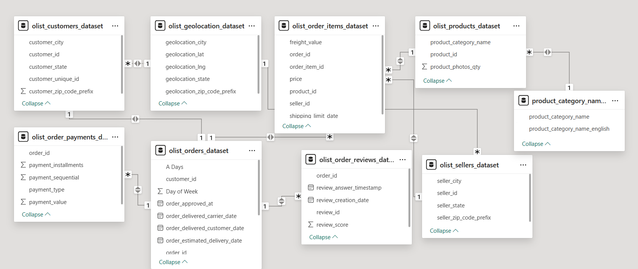
Model View

Slide 5
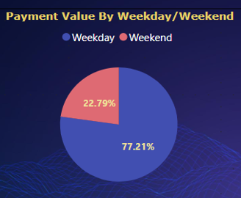
KPI 1 Weekday Vs Weekend (order_purchase_timestamp) Payment Statistics
Orders and Payment Value is more on weekdays as compared to weekends
Maximum sales, orders & customers are from Sao Paulo city during weekdays & weekends.
The analysis of payment statistics based on weekday vs. weekend provides an understanding of the buying behavior of customers. and can also help Olist to improve their weekend sales and plan promotions accordingly.

Slide 6
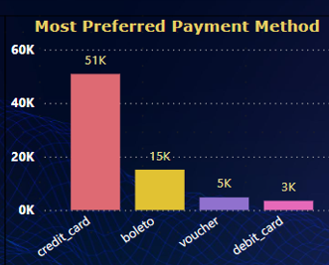
KPI 2 Number of Orders with Review score 5 and Payment_Type as Credit_card
Currently credit cards are the most preferred payment type by customers which contributes a major role in overall sales(76K).
To promote other payment types, Olist Store can provide discounts and offers on other payment types.
Most of the orders received review score more than 4
Main reason customers preferred credit card is installment option
Most recommended products by customers have avg. review score more than 4

Slide 7
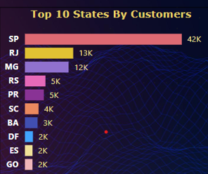
KPI 3 Avg. Price and Payment_Values from customers states
Avg price and Avg. payment_value in Sao Paulo city is 42K respectively
Sao Paulo city has a large customer base
Contribution of Sao Paulo is more as compared to other cities in overall sales and payment value
Maximum customer crowd is from Sao Paulo & Eastern side of the country as compared to other regions. To improve the sales in other regions stores need to focus on campaign & promotion in these regions.

Slide 8
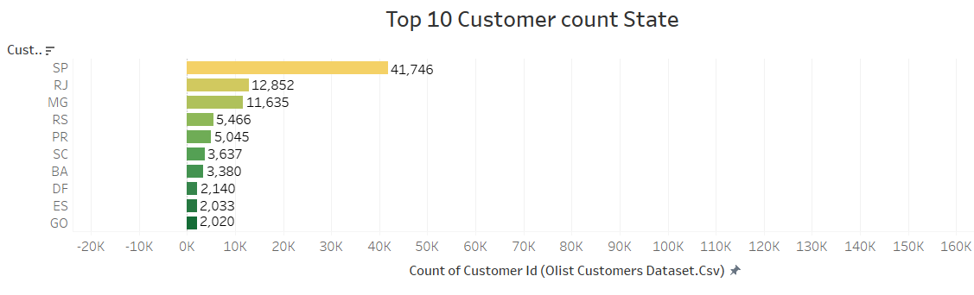
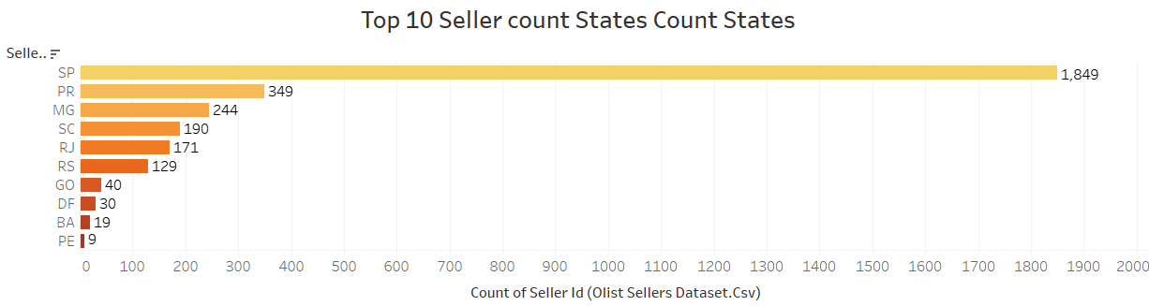
KPI 4 Top customer count and seller count state
Top Customer count State and Seller count State are from Sao Paul

Slide 9
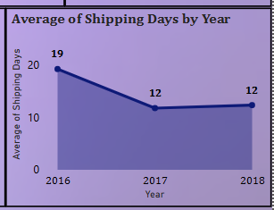
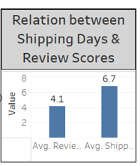
KPI 5 Relationship between shipping days Vs review scores
Avg. Shipping days is 12 for year 2017 and 2018 and Avg. Review Score is 4.1
Longer delivery days significantly decrease the average review score
Review score improves when delivery days are less
Delivery costs generally increase with increase in delivery days

Slide 10
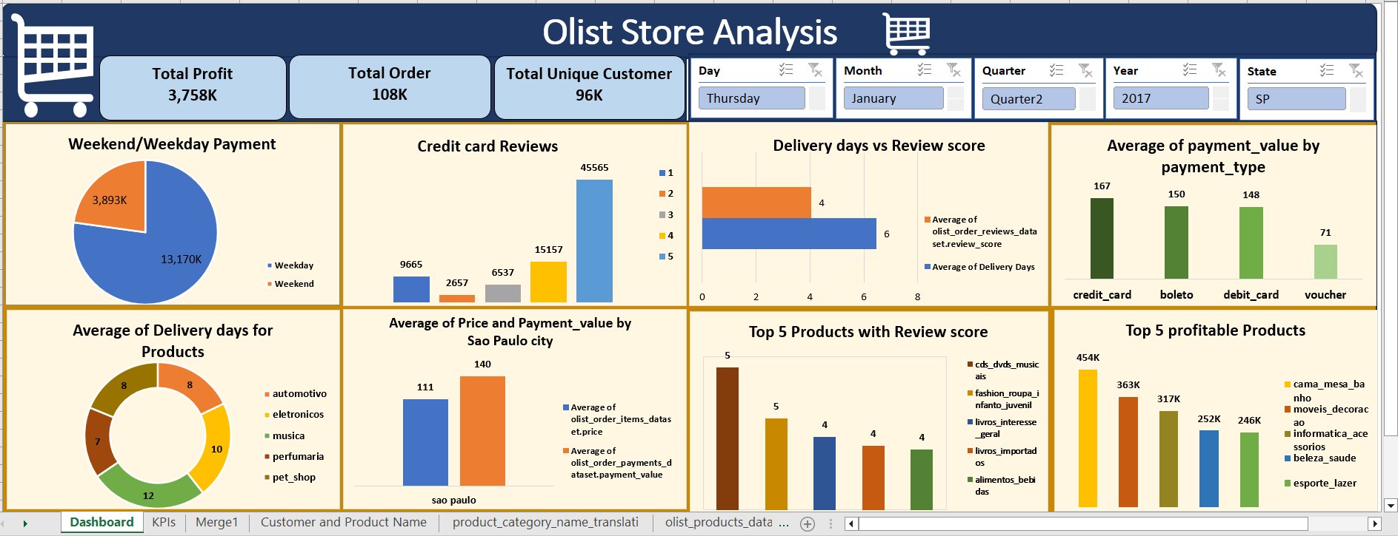
Excel Dashboard

Slide 11
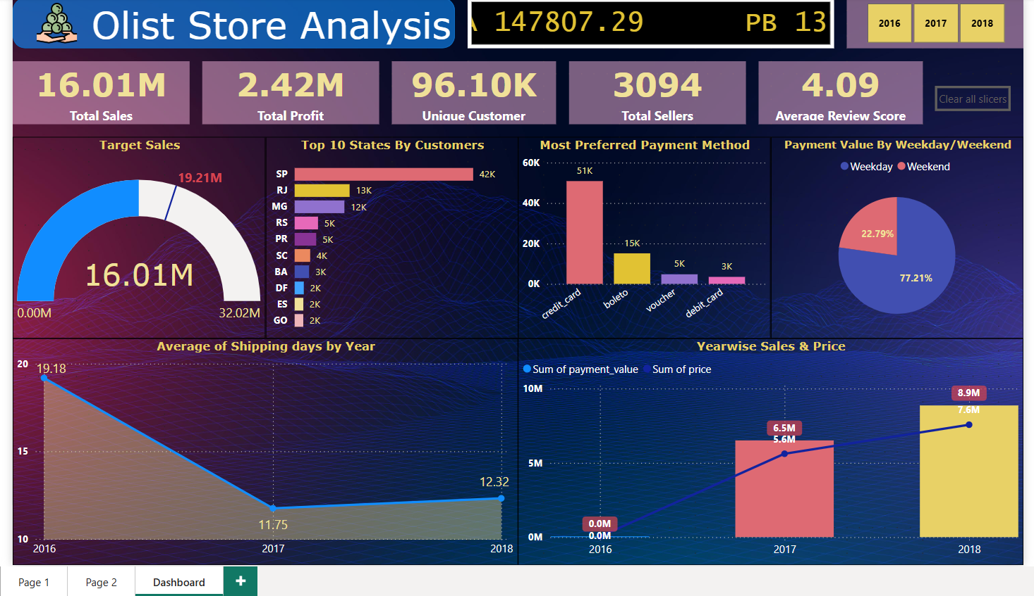
Power BI Dashboard

Slide 12
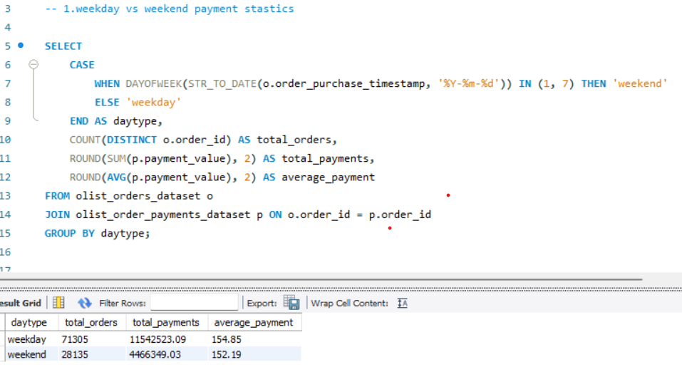
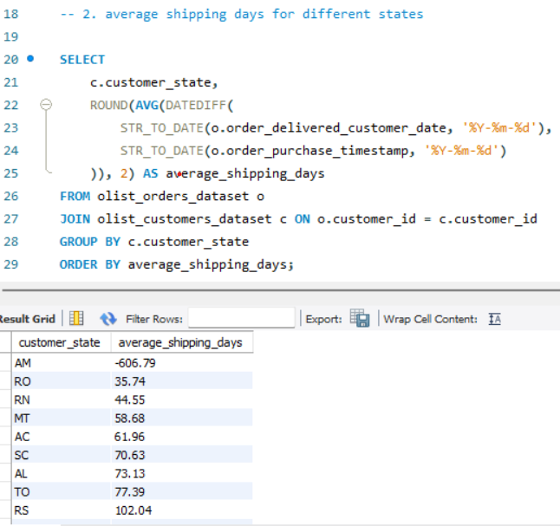
SQL Queries and OUTCOMES

Slide 13
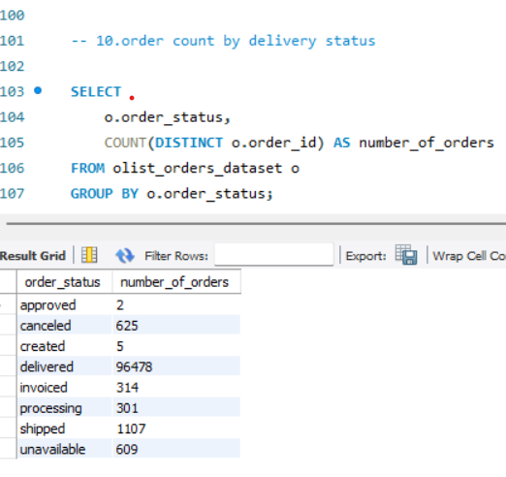
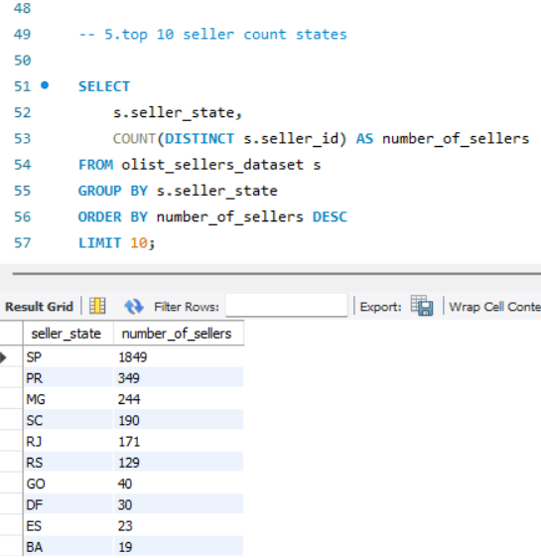
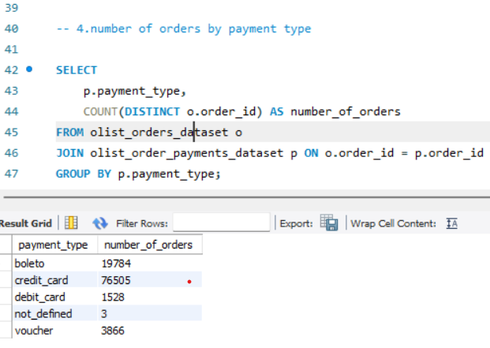
SQL Queries and OUTCOMES

Slide 14
Values Added by Dashboards:
1. Customer Behaviour: >> Insights: Most customers prefer to do shopping on Weekdays than Weekends. Per day %_Contribution-> Weekdays=(77/5)=15.4% Weekends=(23/2)=11.5% >> Actions: The company can run advertisements on its website and introduce new offers as per demand, particularly on weekdays, to grab the attention of customers. 2. Most Preferable Payment Mode: >> Insights: Credit card is the most preferable payment mode, followed by boleto. >> Actions: Perform customer segmentation as per their product choice, the gap between repeat orders, and who used a credit card. Then send personalized messages or mail containing new product information with discounts as per their interests.

Slide 15
3. Customer Satisfaction: Considering an e-commerce business, customer satisfaction is the top priority for survival and growth. With multiple shopping options available in the market, it's not an easy game to retain customers without providing them with an exceptional experience. This parameter is directly connected with the customer experience. These days, no one wants delays. >> Insights: The review score given by customers is inversely proportional to delivery time (Shipping Days). >> Actions: To improve customer satisfaction, company must identify those products that take longer time to deliver. And compare it with the fast-delivery product categories. This comparison gives a clue about where these bottom categories are lacking so that they can improve them. In the charts, I show the worst five product categories where delivery time needs to be reduced. 4.Top performing cities: >> Insights: Sao Paulo is the top-performing city, contributing 14% of total sales, followed by Rio de Janeiro. >> Actions: These top-performing cities help the company prioritize its marketing efforts and manage its resources. With its help, the company can understand where its potential customer base is concentrated. This help the company to identify new opportunities in similar places.

Slide 16
Insights
According to the data, Olist E-commerce has about 99,440 orders. With about 89,940 orders being delivered, the company has a 90% delivery success rate. Their average product rating is 4.09 stars, with product categories going as high as 4.67 stars and as low as 2.5 stars. 1 Star reviews are on third place in the review score distribution ranking which likely indicates that there could be problems with product quality in some product categories. Delivery performance could also influence review scores and success rate could certainly be improved.
Insights from this analysis can help in making business decisions, such as focusing on products that customers are interested in, improving product and service quality, and optimizing marketing in provinces with high total sales. In addition, this analysis also provides an overview of customer consumption trends and patterns that can be used to direct further business strategies.

Slide 17
Recommendations
Regularly monitor and analyze customer reviews to gain insights in product quality and identify areas for improvement. Dashboards can be used to identify patterns in customer reviews. This will provide a data-driven approach to enhance customer experience.
Investigate delivery delays and undelivered orders. Analyzing geographic locations could bring insights about certain challenges with demographics, accessibility, and possible route optimization. Tracking fleet performance with the use of telematics can help identify issues before they become a problem.
Providing a proper shipment tracking system aids in having clear and concise communication between customers, sellers and couriers. Regular updates can set proper expectations among customers and specific delivery instructions of customers can be properly accommodated. By establishing trust and communication, both parties can work together to resolve any issues that may arise.

Slide 18
Conclusion
The Olist Store Analysis project provides valuable insights into customer behavior and payment statistics. The analysis of these KPIs helps Olist in identifying areas of improvement and creating targeted marketing campaigns. As a data analyst, I have used Excel and Power BI to clean and manipulate the dataset and create meaningful visualizations. This project serves as a great example of how data analysis can help businesses make informed decisions.

Slide 19


