Slide 1
Credit Card Transactions Insights Report
Prepared by: Katlego Kgakgamatso

Slide 2
Project Overview
Power BI dashboard analyzing credit card transaction behavior
  Includes trends, card type performance, customer segmentation, category spending
  Supports strategic decision-making for banking operations

Slide 3
Data Preparation Steps
Data Cleaning: removed duplicates, standardized dates, normalized card categories
  Data Transformation: aggregated by city, gender, card type, and category
  Feature Engineering: created KPIs (total spend, avg transaction, count)
  Data Modeling: dataset was a single table; in production, this would typically be modeled into a star schema separating facts (transactions) from dimensions (customers, cards, dates, cities, categories)

Slide 4
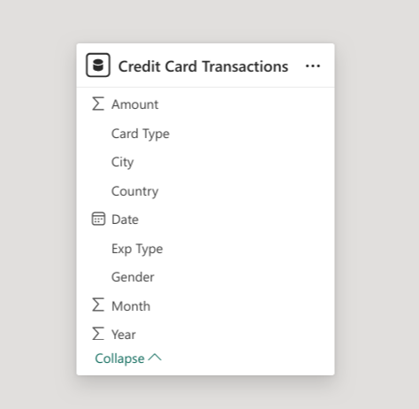
Data Model
The dataset was a single table; in production, this would typically be modeled into a star schema separating facts (transactions) from dimensions (customers, cards, dates, cities, categories)

Slide 5
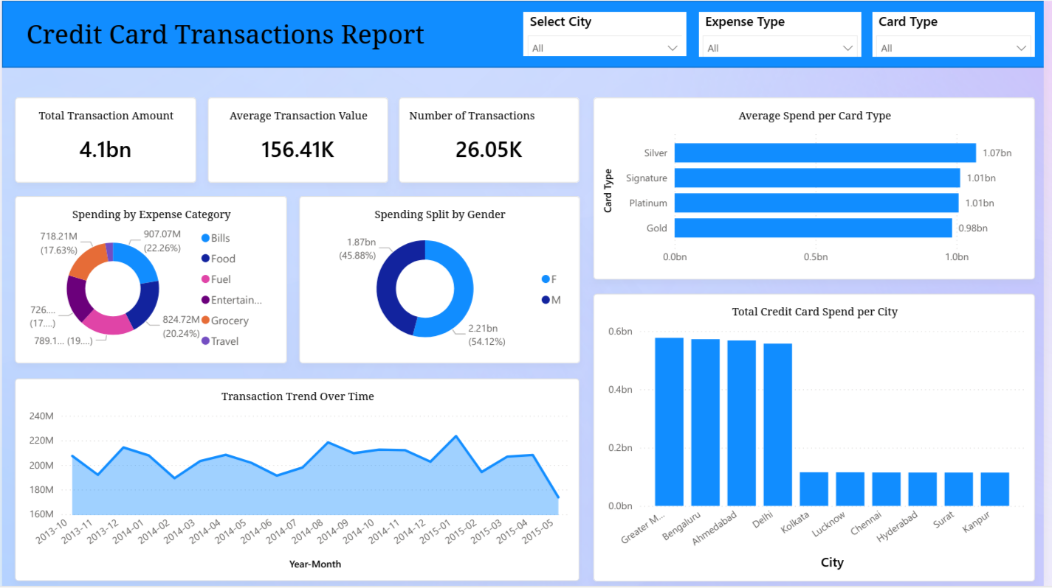
Dashboard Overview

Slide 6
Spending by Category – Insights
Food (22%) and Grocery (20%) are the highest spending categories
  Shows customers use credit cards mainly for daily lifestyle expenses
  Insight Use: Strong opportunity for category-based merchant partnerships
  Business Action: Develop grocery & food cashback campaigns

Slide 7
Category Visualization

Slide 8
Gender Spending Insights
Male: 54%, Female: 46% — balanced usage across genders
  Shows both genders find credit cards equally valuable
  Insight Use: Bank can design gender-focused promotional bundles
  Business Action: Female-oriented lifestyle perks, male-oriented travel/fuel rewards

Slide 9
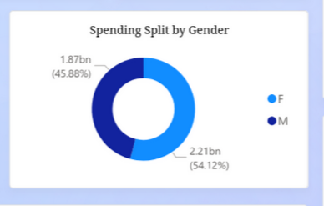
Gender Split Visualization

Slide 10
Card Type Performance Insights
Silver card has the highest total spend (1.07bn)
  Premium cards underperform despite higher earning potential
  Insight Use: Upgrade strategy for premium customers
  Business Action: Improve premium benefits ( lounges, travel points, EMI offers )

Slide 11
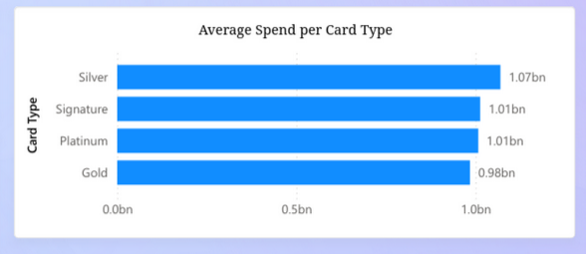
Card Type Visualization

Slide 12
City-Level Spending Insights
Highest spending: Mumbai, Bengaluru, Ahmedabad, Delhi
  Metro cities dominate credit card usage
  Insight Use: Focus premium card offerings in metro areas
  Business Action: Awareness campaigns for smaller cities to boost usage

Slide 13
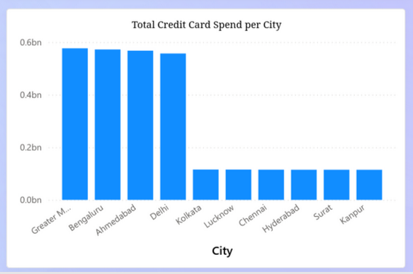
City Spend Visualization

Slide 14
Transaction Trend Insights
Stable monthly spending with noticeable seasonal peaks
  Peaks align with holidays and year-end festive periods
  Insight Use: Helps forecast demand & plan seasonal promotions
  Business Action: Launch promotions during low-activity months

Slide 15
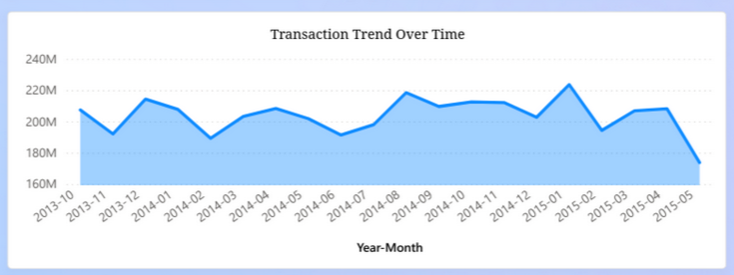
Trend Visualization

Slide 16
Strategic Recommendations
Enhance premium cards to improve performance
  Boost everyday rewards (food/grocery)
  Expand merchant partnerships in high-spend categories
  Improve penetration in low-spend cities
  Use trends to align promotional calendars

Slide 17
Limitations & Future Improvements
Dataset limited to 2013–2015
  No demographic variables like income or age
  Future: predictive modeling, customer segmentation, risk score integration
  Addition of real-time transaction monitoring

