Slide 1



e-learning solutions
we're on a mission to revolutionize the way education and training is delivered.
enrol.edulink@gmail.com www.edulinklearning.netlify.app

Slide 2



transforming education in south africa
1
introduction
Our mission is clear - we aim to revolutionize the way education and training are delivered across rural and peri-urban areas in South Africa. We firmly believe that every student, teacher, and employee deserves access to high-quality, engaging, and accessible learning materials.
e-learning solutions

Slide 3
addressing the educational challenges in south africa
2
Total Schools Reported
23,258 Schools
Including Independent Schools: 2,154
Internet Connectivity Status
Connected for Teaching & Learning:
4,695 schools
Percentage: 20%
Not Connected for Teaching & Learning:
18,563 schools
Percentage: 80%
the proBL em
In South Africa, limited access to quality education in rural and peri-urban areas poses a significant challenge.
Traditional teaching methods often fall shor t in engaging students, and a lack of resources hinders educational progress.
Note: The majority of schools (80%) lack internet connectivity for teaching and learning, posing challenges for digital education and skill development.
e-learning solutions

Slide 4
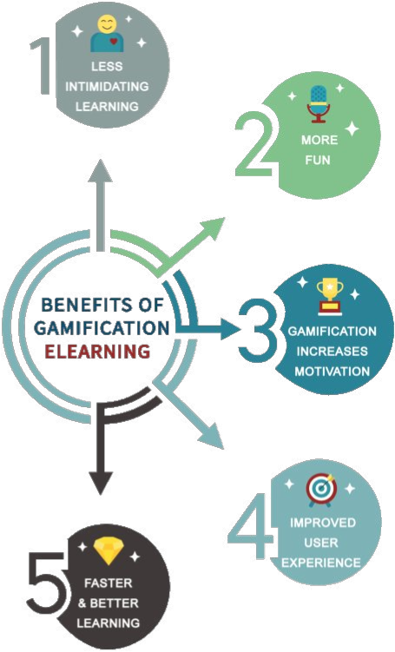
digitizing and gamifying Learning for all
3
the soLution
Edulink E-Learning introduces a transformative approach to education. We digitize and gamify learning content, making it accessible and engaging for students, teachers, and employees alike. Our commitment lies in creating an immersive and effective learning experience that goes beyond traditional boundaries, fostering a love for learning in every individual.
e-learning solutions

Slide 5

unlocking a world of possibilities
4
impact on education
Our solutions have a tangible impact on education outcomes. Improved learning results, increased student engagement, and higher teacher satisfaction are just a few of the benefits.
e-learning solutions

Slide 6
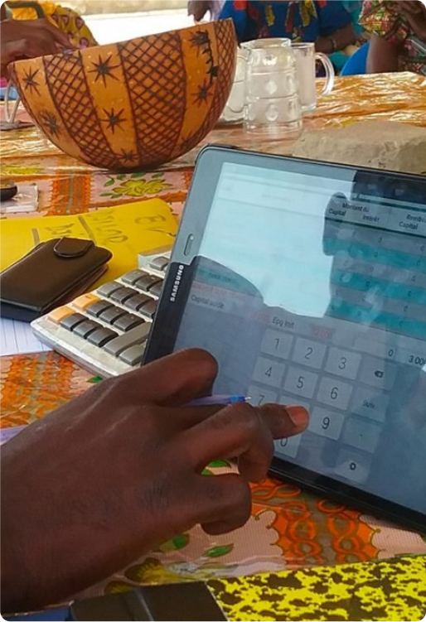
Leading the charge for change
5
digitaL tr ansFormation
We stand as a passionate advocate for digital transformation in the South African education system.
Through collaborations with educational institutions and businesses, as well as active par ticipation in legislative and policy initiatives, we can drive positive change in the landscape of education.
1
e-learning solutions

Slide 7

reaching the unreachable
6
our tar g et audience
Our focus extends to schools, teachers, and businesses in rural and peri-urban areas. We’re committed to breaking barriers, addressing the unique challenges faced by these communities, and providing a transformative learning experience. Grounded in the realities of the country’s educational landscape.
e-learning solutions

Slide 8

standing out in the market
7
competitive Landscape
In a competitive landscape, Edulink E-Learning distinguishes itself by offering unique features and advantages. Hear from satisfied users through testimonials and reviews, and understand why our platform is the preferred choice for those seeking innovative and effective e-learning solutions.
e-learning solutions

Slide 9


sustainable growth for a sustainable Future
8
suBscription modeL:
Tiered subscription plans based on the number of students, teachers, or employees accessing the platform.
r evenue modeL
corp or ate tr aining partnerships:
We charge corporations based on the number of employees using the platform or offer customized enterprise plans.
Edulink E-Learning not only focuses on impact but also ensures sustainable growth. Explore our diversified revenue streams and transparent pricing models, demonstrating scalability and the potential for expansion.
deveLopment & integr ation services:
We offer customization and integration services for schools or businesses requiring tailored solutions.
consuLtation services:
Offer consultation services to educational institutions seeking guidance on digital transformation.
e-learning solutions

Slide 10


strengthening our impact through collaboration
9
partnerships
Partnerships play a crucial role in amplifying our impact. Explore existing collaborations and discover how future par tnerships can contribute to our mission. Learn how joining forces with Edulink E-Learning can create synergies that elevate the quality of education for all.
e-learning solutions

Slide 11

Building a Brighter Future together
10
roadmap For the F uture
Edulink E-Learning is not just about the present; it's about building a brighter future together. Explore our roadmap, outlining future plans and milestones. From expansion into new regions to the introduction of cutting-edge features, join us in anticipating the exciting developments that lie ahead.
e-learning solutions

Slide 12
Join the revolution
L et’s w ork t og ether!
Contact us for fur ther discussions on how you can be a part of Edulink E-Learning's mission to revolutionize education in South Africa.
Together, let's pave the way for a future where quality education knows no boundaries..
enrol.edulink@gmail.com www.edulinklearning.netlify.app
e-learning solutions

