Slide 1
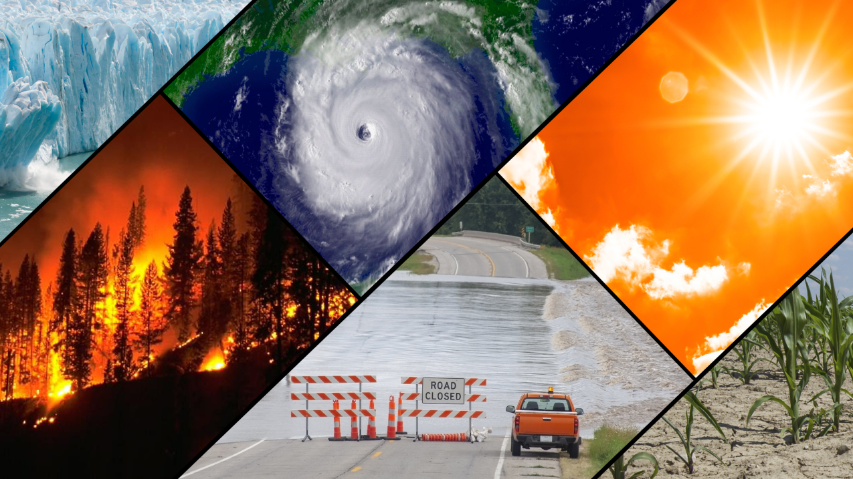
Tech Sales Analysis Report
Insert a picture - Climate related
KATLEGO KJ PHIRI

Slide 2
Overview on Drones and Climate Change
Drones can be used to as a tool in addressing challenges of climate change:
Assessing Climate-Related Disasters- Drones can quickly observe areas affected by circumstances like storms, floods, or wildfires, giving emergency responders real-time data. They help produce 3D maps in order to improve urban planning against potential climatic hazards. Moreover, thermal imaging assists in identifying hotspots in wildfires.
Renewable Energy Infrastructure Inspection- Drones increase efficiency and decrease disruption by checking solar panels and wind turbines for damages.
Air Quality & Pollution Tracking- Drones can assess air pollutants in cities and industrial cities, offering real time data to improve public health programs and policies
Reforestation & Afforestation Support- Drones that drop seeds can plant thousands of trees per day in areas hard to reach, increasing reforestation. They can monitor seedling survival rates to ensure a long-term growth.

Slide 3
Drone Sales Data
The drone market share varies across models. The graph below illustrates the market share.
See below spreadsheet for drone sales revenue across various regions:

Slide 4
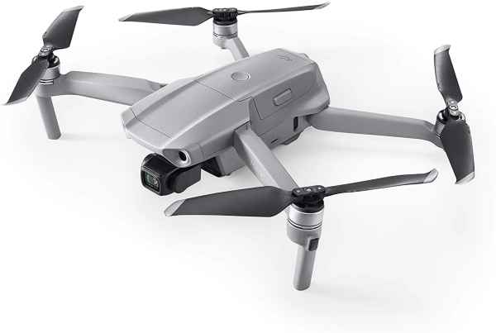
DJI Mavin Air 2
The market sales of the drone shows a promising conversion rate resulting to a high marketable product of the drone.
4 specifications
Internal storage- 8GB
Video resolution- 4K ultra HD, 2.7K, FHD, and HD
Operating temperatures- 0 to 40 degrees Celsius
Hovering time- 20 minutes

Slide 5
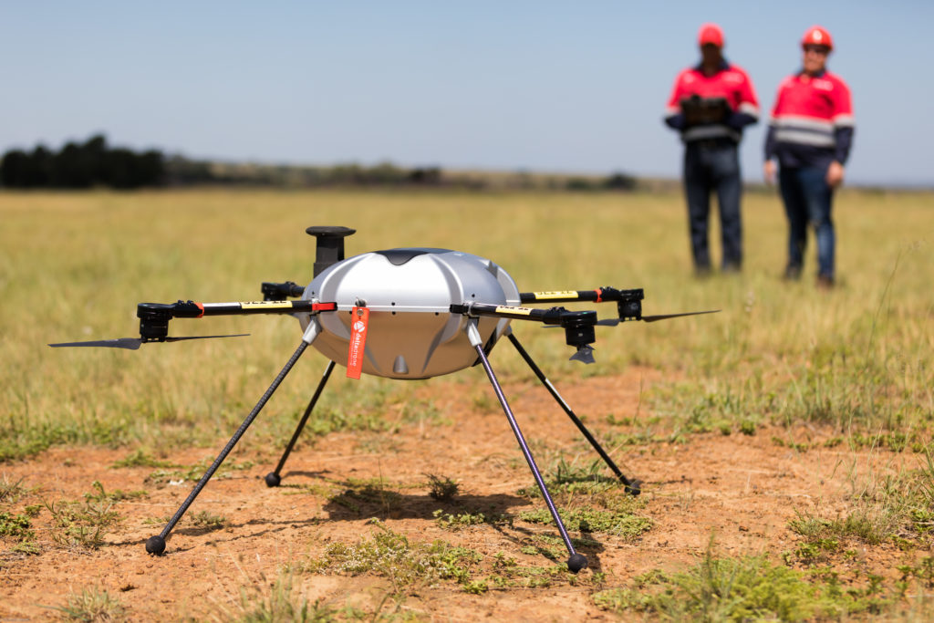
Conclusion
Drones can be utilized in revolutionary ways such as monetarizing climate change, surveying, agriculture, search & rescue, and delivery.

