Slide 1
ITC327W · UNIT 3 · CTRL+ALT+DEFEAT
Phase 2: System Architecture
& Design
Phehello Secondary School — Online Enrolment System
Building on the confirmed requirements and refined scope from Phase 1, this phase presents the architecture, database and interface design for the prototype.
Makhoali · Lebusa · Mahlatsi · Lepitla · Motaung · Adegbola
Notes:
[0:20] Good day. We are Ctrl+Alt+Defeat: Makhoali, Lebusa, Mahlatsi, Lepitla, Motaung and Adegbola. This is our Phase 2 presentation for ITC327W: the system architecture and design for the Phehello Secondary School online enrolment system. Phase 1 gave us the confirmed requirements; Phase 2 turns them into a design. First, a quick reminder of the problem we are solving.

Slide 2
PROJECT INTRODUCTION
The problem, the stakeholder and our solution
Phehello Secondary School — Online Enrolment System
01
02
03
The problem
The stakeholder
Our solution
Enrolment is fully manual and paper-based.
Parents make repeated trips when documents are wrong or incomplete. This is costly for young and working parents, some of whom travel on foot.
Parents cannot track their application status, and staff lose time to one-on-one handling.
Phehello Secondary School, a public secondary school in Odendaalsrus.
Sponsor: Principal Maleshoane Gweneth Adegbola.
Representative: Zukiswa Khondlo, Secretary to the Principal, who confirmed the requirements at the 24 August 2026 interview.
One integrated system on a shared Supabase backend.
Flutter mobile app: parents apply, upload documents and proof of payment, and track status.
ASP.NET web app: the Financial Clerk verifies payment; the Administrator reviews and decides.
Notes:
[1:00] PROBLEM → STAKEHOLDER → SOLUTION (lecturer requirement: brief intro straight after the cover)
PROBLEM: Enrolling a learner at Phehello is fully paper-based. A parent collects a form, fills it in by hand, gathers four documents (immunisation record, birth certificate, previous school progress report, transfer letter), travels to the school, and pays the enrolment fee to the financial clerk. If any document is wrong or missing, the parent has to travel back. The school told us this is hardest on young and working parents, and some travel on foot. Parents also cannot see the status of their application. On the school side, the clerk and administrator spend their time on one-on-one handling instead of their other duties.
STAKEHOLDER: Phehello Secondary is a public secondary school in Odendaalsrus. The Principal, Ms Maleshoane Gweneth Adegbola, agreed to be our official stakeholder on 20 August. Because of her workload she delegated her secretary, Zukiswa Khondlo, who took part in our formal interview on 24 August and confirmed our findings.
SOLUTION: A prototype with two applications on one shared backend: a Flutter mobile app where parents apply, upload documents and proof of payment, and track status; and an ASP.NET web app where the Financial Clerk verifies payment and the Administrator reviews and decides. The shared backend is Supabase. Today we cover four things: the architecture, use cases and sequence diagrams, the database design and the interface design, followed by our project-management evidence.

Slide 3
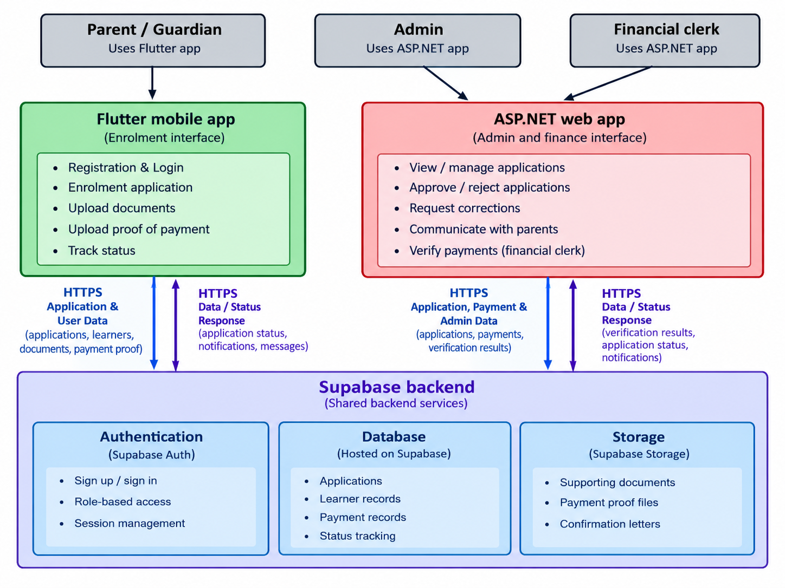
SYSTEM ARCHITECTURE
System Architecture Design
Why this shape
Both apps talk to the same Supabase backend, never to each other. A submission on Flutter is visible to staff on ASP.NET, and a staff decision is reflected back to the parent (IR1–IR3).
What HTTPS means in our system
HTTPS is HTTP sent over an encrypted (TLS) connection. Every blue arrow is an encrypted request and response.
Flutter ⇄ Supabase: parent sign-in, application data, documents and proof of payment go up; status, notifications and messages come back.
ASP.NET ⇄ Supabase: staff sign-in, payment checks, decisions, notes and letters go up; applications and documents come down for review.
HTTPS protects data in transit; Supabase Auth and role-based access decide who can read it.
Authentication
Database
Storage
Notes:
[2:00] Walk the diagram top to bottom.
Top: three user types. The parent uses the Flutter app. The Administrator and Financial Clerk use the ASP.NET app.
Middle: the two applications. They never talk to each other directly.
Bottom: one shared Supabase backend with three services: Authentication (sign-in, roles, sessions), Database (applications, learners, payments, status) and Storage (documents, proofs of payment, confirmation letters).
Why this shape: both apps read and write the same backend, so an application submitted on Flutter is visible to staff on ASP.NET, and a status change by staff shows up for the parent (IR1-IR3). The apps stay loosely coupled.
WHAT HTTPS MEANS IN OUR SYSTEM (lecturer requirement). Point to the blue arrows:
HTTPS is ordinary HTTP, the way apps request and send data, but sent through an encrypted TLS connection. So every blue arrow is an encrypted request and response between an app and Supabase.
- Flutter to Supabase (left pair of arrows): the parent's sign-in, application data, learner details, supporting documents and proof of payment go UP to Supabase. Back DOWN to Flutter come the application status, payment-verification status, notifications and messages.
- ASP.NET to Supabase (right pair of arrows): staff sign-in, payment-verification results, approve/reject decisions, notes, messages, reminders and confirmation-letter data go UP. Submitted applications, documents, proofs of payment and the running count come DOWN for review.
- There is no arrow between Flutter and ASP.NET. The two apps only ever exchange data through Supabase.
Why it matters: parents upload birth certificates and payment proofs, often on mobile data or shared Wi-Fi. HTTPS means nobody on the network can read or alter that data in transit, and the certificate proves the app is talking to the real Supabase (NFR2).
If asked for the technical definition: the server presents a certificate, the app checks it, both sides agree a secret key, and everything after is encrypted with it.
Honest limit: HTTPS only protects data while it travels. Who may read it once it arrives is controlled by Supabase Authentication, Row Level Security and role-based access (NFR1, NFR6).

Slide 4
USER ROLES
Three roles, two applications, clearly separated access
Parent / Guardian
Financial Clerk
Administrator
FLUTTER MOBILE APP
ASP.NET WEB APP
ASP.NET WEB APP
Register & sign in
Submit enrolment application
Upload documents & proof of payment
Track application & payment status
Sign in with staff role
View submitted proof of payment
Verify payment against school records
Cannot approve/reject applications
View & review applications
Approve, reject or request corrections
Message parents, send reminders
Generate confirmation letters
Notes:
[0:45] Three roles, two applications. Parent: Flutter. Financial Clerk and Administrator: ASP.NET, each with their own dashboard. The clerk only sees payment information and cannot approve or reject applications. The Administrator is the only role that can approve, reject or request corrections (NFR6). This mirrors the two staff roles the school described in the interview. Keep it brisk.

Slide 5
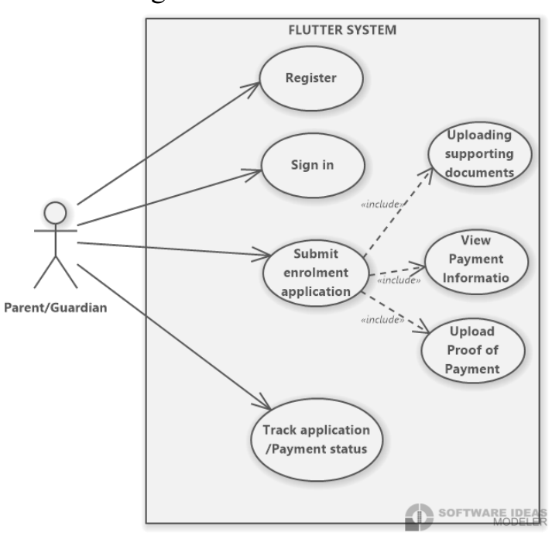
USE CASES — PARENT / GUARDIAN
Use Case diagram – Flutter for Parents/Guardians
<<include>> Submitting an application includes viewing payment information, uploading documents and uploading proof of payment (FR15) — all required before submission is complete.
Notes:
[1:00] Parent/Guardian use cases: register, sign in, submit an application, and track application and payment status. Submitting an application <<include>>s three things: viewing the payment information (the R200 fee and bank details, FR15), uploading the supporting documents, and uploading proof of payment. <<include>> means they are always part of submitting, not optional.

Slide 6
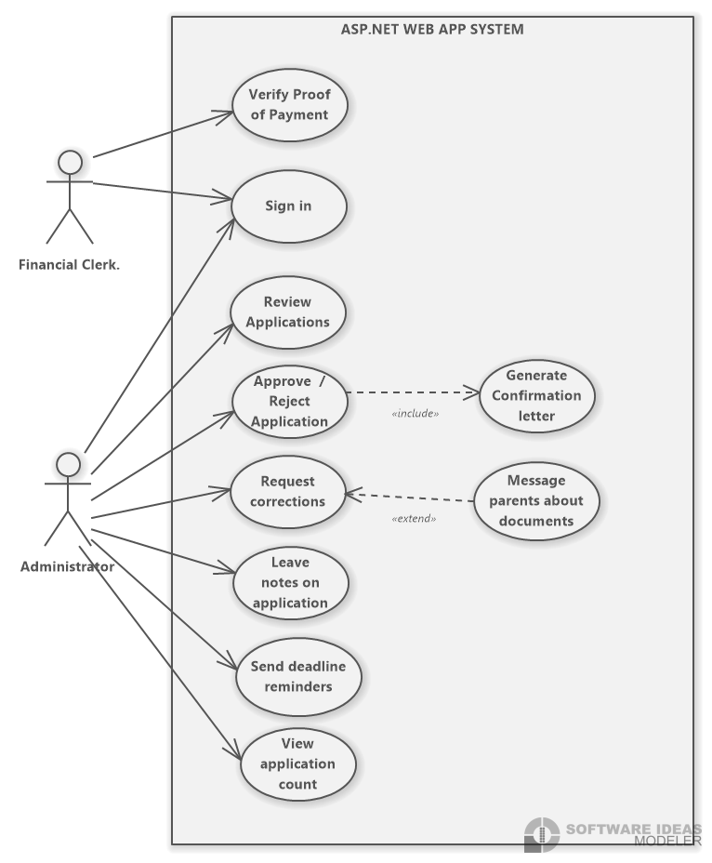
USE CASES — STAFF
Use Case Diagram - Financial Clerk and Administrator, on one ASP.NET web app
<<extend>> Message Parent extends Request Corrections — only triggered when a correction is actually needed. <<include>> Approve/Reject Application always includes Generate Confirmation Letter, whichever way the application is decided.
Notes:
[1:00] Staff use cases on one ASP.NET app. The Financial Clerk signs in and verifies proof of payment. The Administrator views applications, approves or rejects, requests corrections, leaves notes, sends reminders and views the application count. Two relationships: Approve/Reject <<include>>s Generate Confirmation Letter, because the parent always receives a formal record of the outcome. Message Parent <<extend>>s Request Corrections, because we only message the parent when a correction is actually needed.

Slide 7
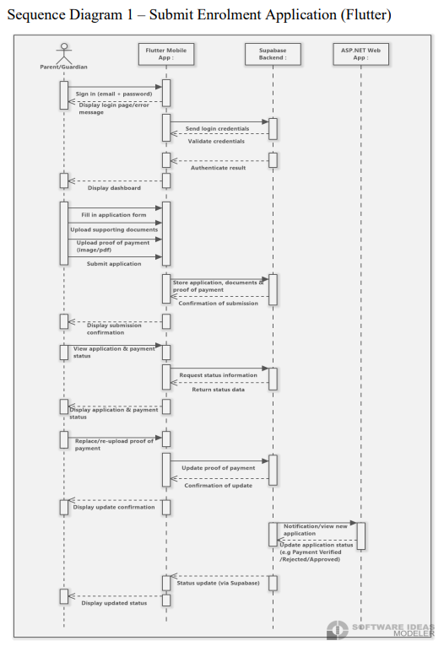
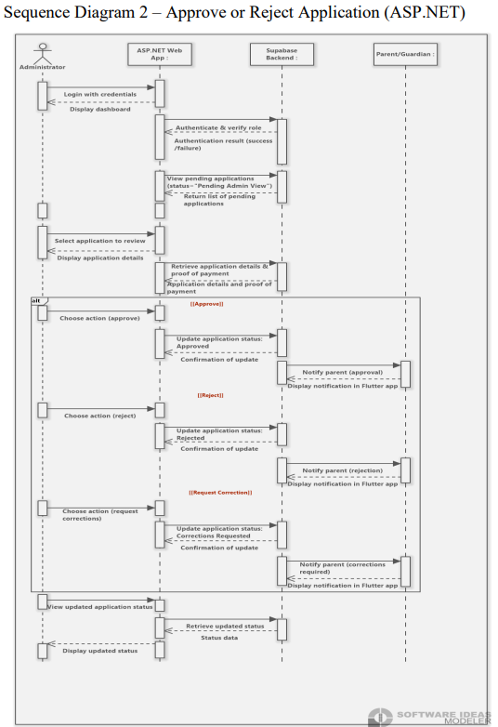
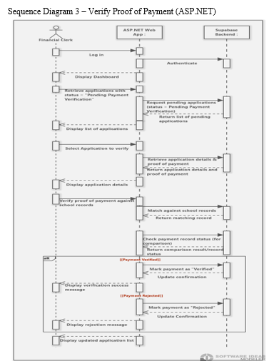
KEY INTERACTION FLOWS
Three sequence diagrams across Flutter and ASP.NET
Notes:
[1:30] Three sequence diagrams: left, the parent submits an application; middle, the Administrator approves, rejects or requests corrections; right, the Financial Clerk verifies proof of payment.
Key message on every diagram: the apps never call each other. The parent app writes to Supabase; staff apps read from Supabase and write the decision back; the parent sees the update through Supabase. Every call between an app and Supabase is over HTTPS.
In the third diagram the clerk compares the parent's proof of payment with the school's own payment records using the payment reference the parent entered. Payment is never processed online; the system only verifies proof.

Slide 8
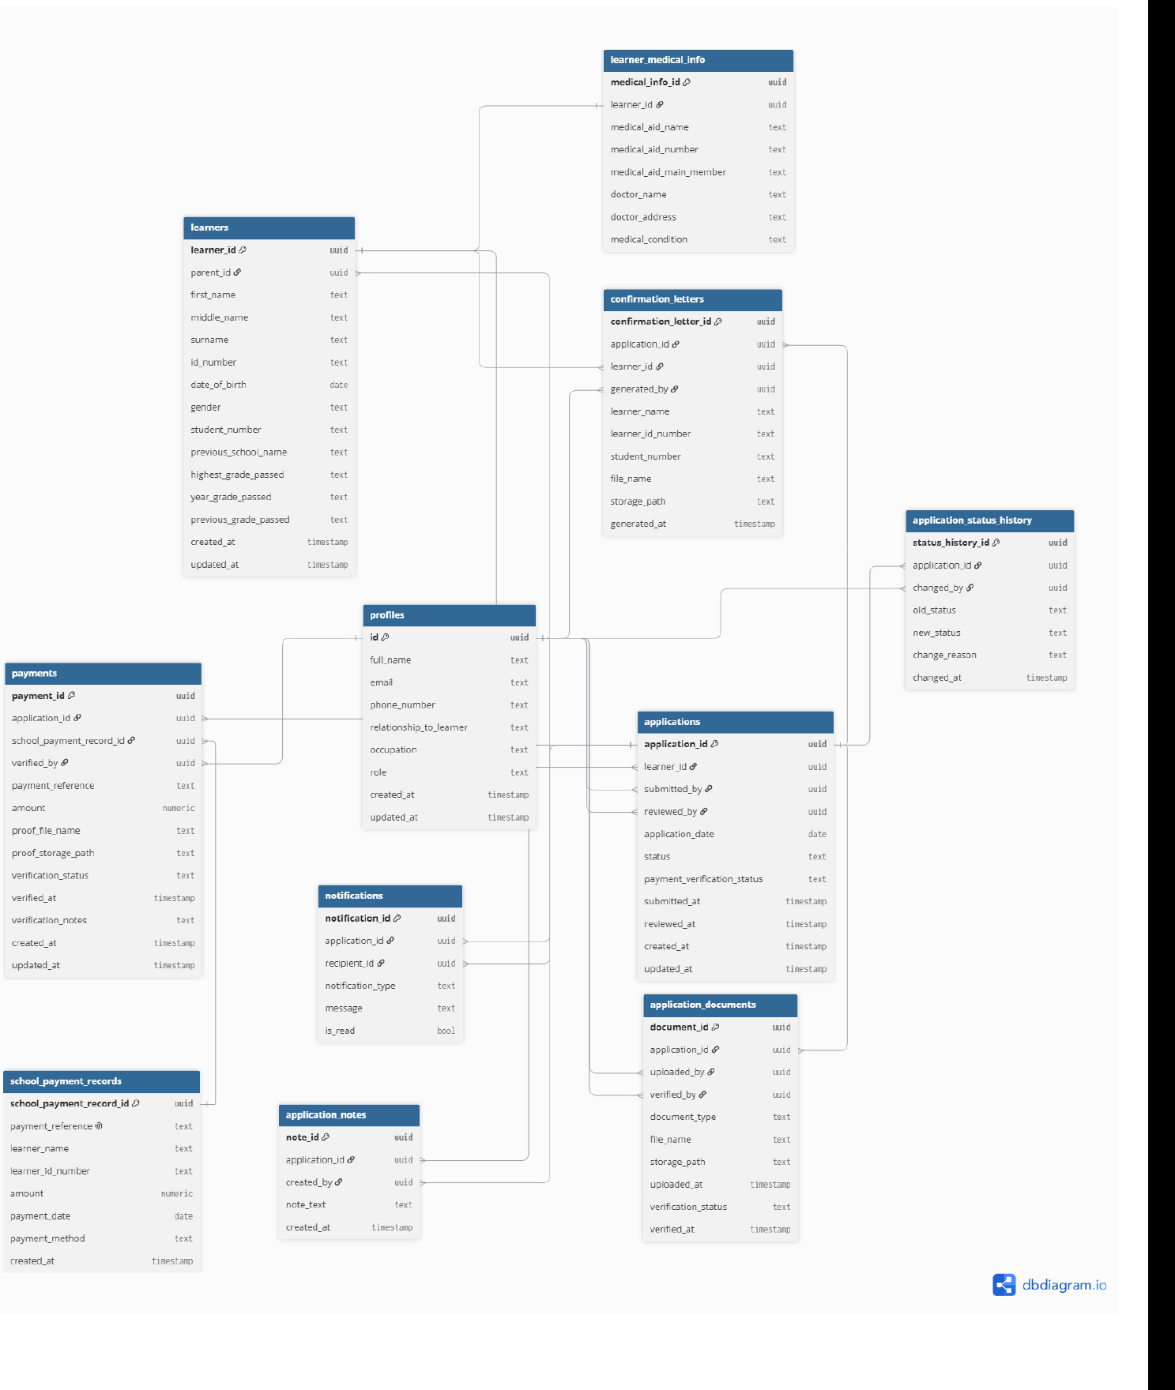
DATABASE DESIGN
ERD and Database Design - Eleven entities behind the enrolment workflow
Core relationship logic
Every application must have at least one supporting document and one payment record.
A learner may have several applications over time; a new payment row is added for each re-upload, so full payment history is kept.
profiles.id matches Supabase auth.users.id and stores the Parent / Financial Clerk / Administrator role.
confirmation_letters and school_payment_records store the learner’s name/ID as text, independent of later profile edits.
Key attributes tracked
APPLICATIONS — status, payment_verification_status, submitted_at, reviewed_by
PAYMENTS — payment_reference, amount, verification_status, verified_by
APPLICATION_DOCUMENTS — document_type, storage_path, verification_status
LEARNERS — id_number, student_number, date_of_birth, previous_school_name
CONFIRMATION_LETTERS — learner_name, learner_id_number, student_number
Notes:
[1:30] Eleven tables. Core logic: an application must have at least one document and one payment record. A learner can have several applications over time. A new payment row is inserted for each re-upload, so the full history of payment attempts is kept after a rejection. profiles.id matches the Supabase auth user id and stores the role.
Deliberate design choices to mention: confirmation letters and school payment records store the learner's name and ID as text, so a letter stays as issued even if the profile is edited later. No cascading deletes on payments, letters or status history, so financial and audit history cannot disappear silently. The per-document verification columns exist but are not used yet, because this phase only verifies proof of payment.

Slide 9
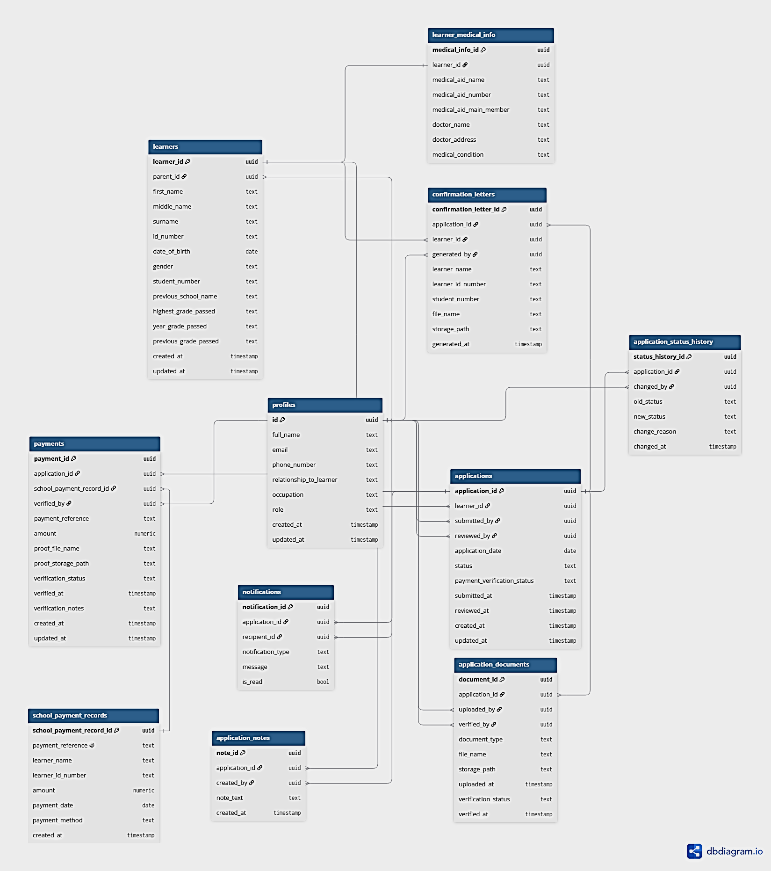
DATABASE DESIGN
ERD and Database Design - Eleven entities behind the enrolment workflow
Notes:
[0:20] Full ERD for reference. Point out the central APPLICATIONS table with learners, documents, payments, notes, status history and notifications around it. If a panel member asks about a specific table, come back to the previous slide.

Slide 10
INTERFACE DESIGN
Interface Design - Required screens and how users move through them
FLUTTER (PARENT)
Register → Login → Home → Learner Details → Enrolment Form → Documents → Payment Information → Proof of Payment → Submit → Status → Notifications → Help & Support
Every screen maps to a requirement
Enrolment Form
FR2
Supporting Documents
FR3
ASP.NET (ADMINISTRATOR)
Proof of Payment
FR4
Login → Dashboard → Application List → Application Details → Review → Approve / Reject / Request Corrections → Notes / Message Parent → Confirmation Letter; Send Reminder from the menu
Application Status
FR5
Review Application
FR8
ASP.NET (FINANCIAL CLERK)
Payment Verification
FR6
Login → Dashboard → Payments Verification→ View (opens Proof of Payment)→ Payment Details/Verified Payment
Confirmation Letter
FR12
Payment Information
FR15
Notes:
[1:15] Left: the parent journey from Register to Notifications and Help. Right: the Administrator and Financial Clerk flows. Every screen maps back to a requirement; the chips on the right show the mapping (for example Payment Information is FR15, Proof of Payment is FR4). The staff login uses one page with a role selector, and each role lands on its own dashboard.

Slide 11
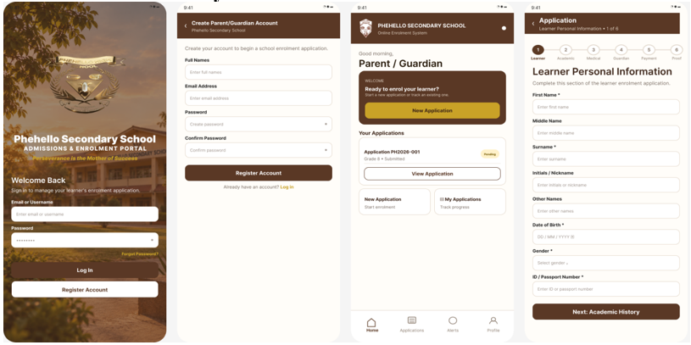
PROTOTYPE STATUS
Flutter mobile app — key screens for parents
https://www.figma.com/design/afkx2OMta474iXNnlscqO5/Flutter-and-ASP.NET-interfaces?t=oVbnTCBoJvalux20-1
Notes:
[0:45] Low-fidelity Flutter wireframes in the school's colours: the secretary chose brown and white on 14 September. Note the six-step form (learner, academic, medical, guardian, payment, proof), and the Payment Information screen that shows the R200 fee and the school's banking details and captures the payment reference. The full interactive version is in Figma via the link on the slide.

Slide 12
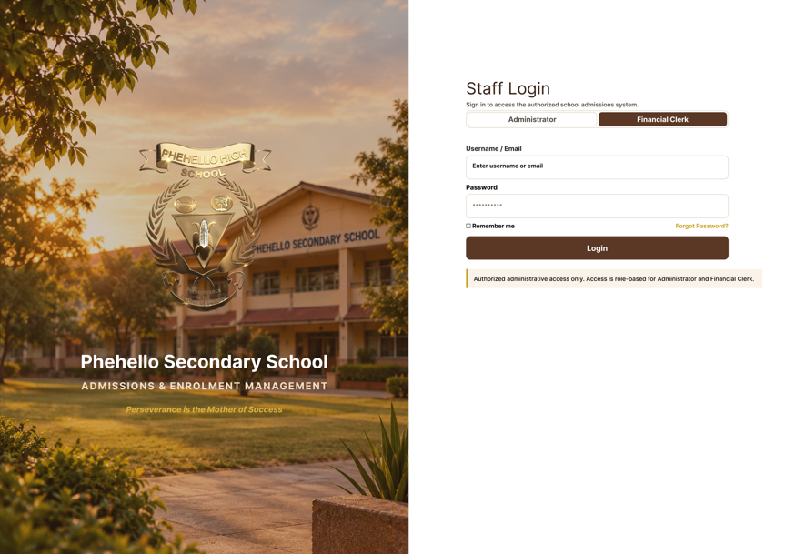
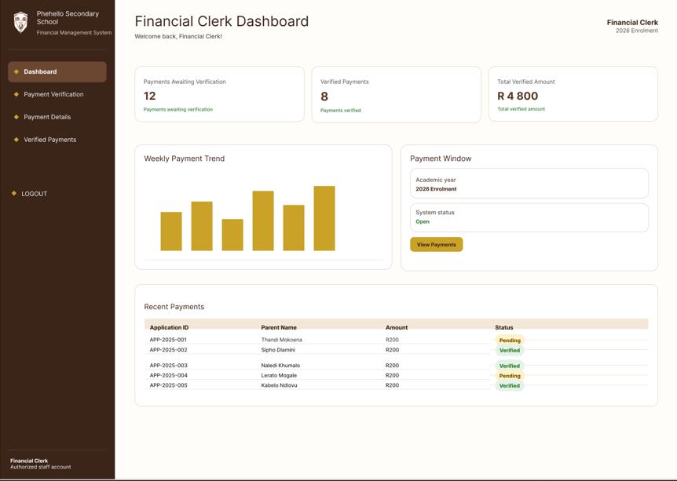
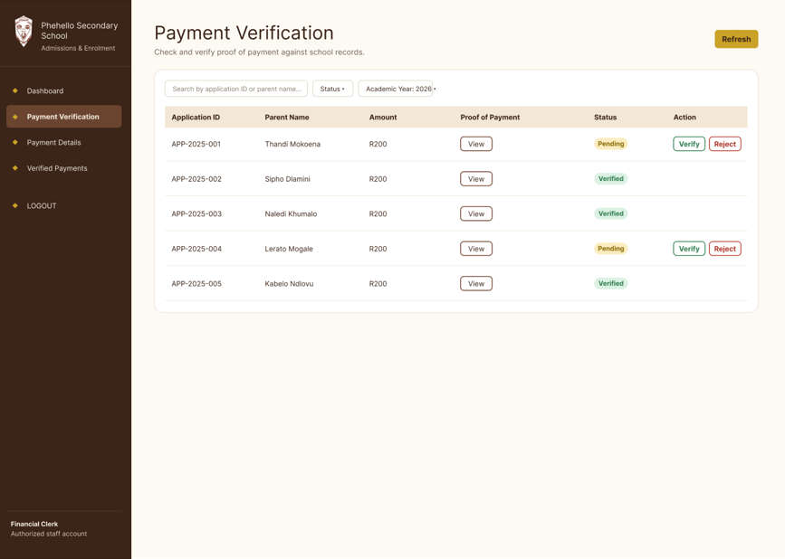
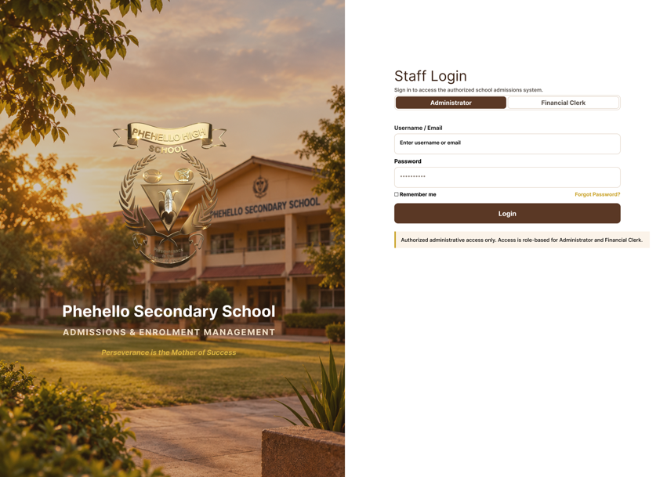
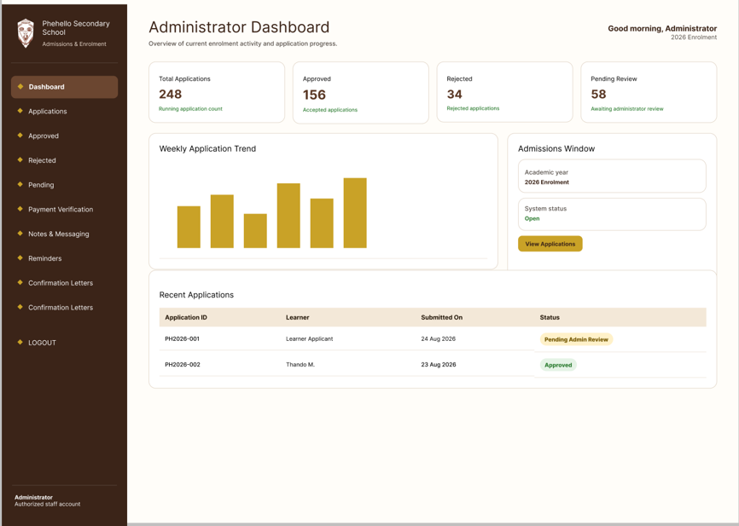
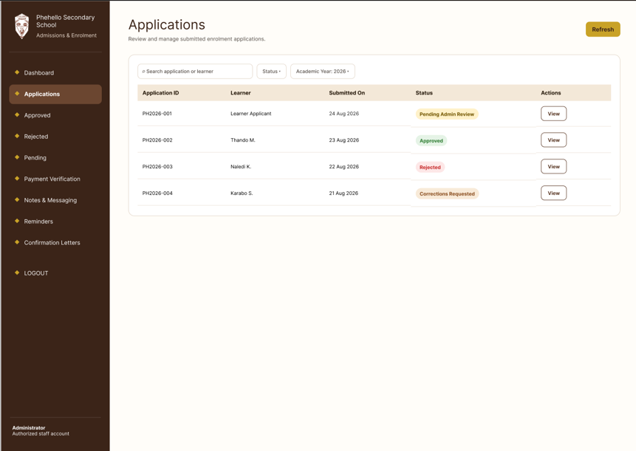
PROTOTYPE STATUS
ASP.NET web app — key screens across both roles
Notes:
[1:15] ASP.NET screens for both staff roles. Administrator: dashboard with the running application count, filtered lists, application review with approve / request corrections / reject, notes, messages, reminders and confirmation letter preview. Financial Clerk: dashboard, payment verification next to the proof of payment, and verified payments. These are wireframes, not the finished build.

Slide 13
DESIGN ALIGNMENT & DOCUMENTATION
Every diagram traces to an approved requirement and an editable source
Design | Tool used | Source link / editable file
System architecture diagram | Software Ideas Modeler | System Architecture.simp (in SRS)
Use Case Diagrams (Parent/Guardian; Staff) | Software Ideas Modeler | Ctrl-Alt-Defeat.simp (in SRS)
Sequence Diagrams 1–3 | Software Ideas Modeler | Ctrl-Alt-Defeat.simp (in SRS)
ERD | dbdiagram.io | https://dbdiagram.io/d/ERD-6ab5c1300f25a52d0100e2b7
Flutter wireframes (design + interactive) | Figma | https://www.figma.com/design/afkx2OMta474iXNnlscqO5/Flutter-and-ASP.NET-interfaces?t=oVbnTCBoJvalux20-1
ASP.NET wireframes (design + interactive) | Figma | https://www.figma.com/design/afkx2OMta474iXNnlscqO5/Flutter-and-ASP.NET-interfaces?t=oVbnTCBoJvalux20-1
GitHub repository | GitHub | https://github.com/Katleho-19/WIL-Project-2026
A design-alignment table in the SRS links every requirement, use case, sequence diagram, ERD element and interface to the others; only the architecture colour scheme was adjusted for print clarity — the source .simp file keeps the original palette.
Notes:
[0:30] Every design has an editable source: Software Ideas Modeler files in the ZIP, dbdiagram.io for the ERD, Figma for wireframes, GitHub for the repository. The SRS contains an alignment table linking each requirement to its use case, sequence diagram, ERD tables and screens. One disclosure: the architecture diagram colours were adjusted for print clarity; the source file keeps the original colours.

Slide 14
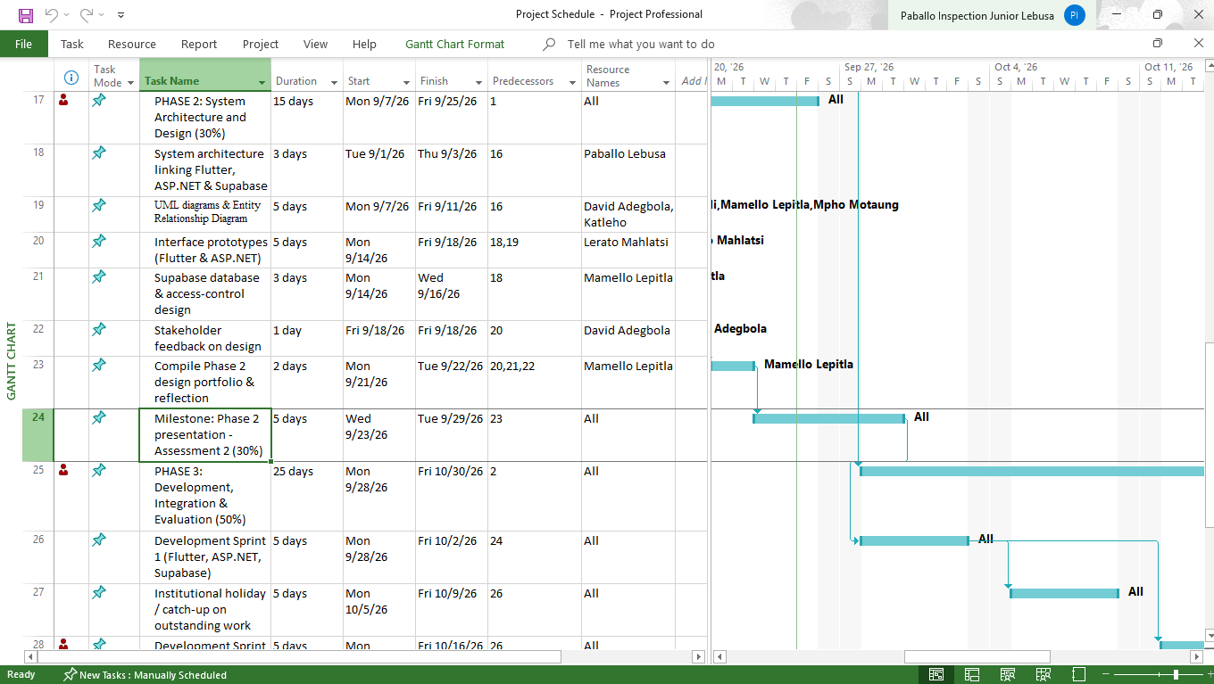
PROJECT MANAGEMENT EVIDENCE
Microsoft Project Schedule
Gantt chart — Project Schedule.mpp (Phase 2 tasks, dependencies, milestone)
Microsoft Project plan
Original editable file (Project Schedule.mpp) submitted with the SRS; schedule reflects actual progress, dependencies, responsibilities and the Phase 2 milestone.
Notes:
[0:20] The Microsoft Project file shows Phase 2 tasks, dependencies, responsibilities and the Phase 2 milestone. The editable .mpp file is submitted with the SRS.

Slide 15
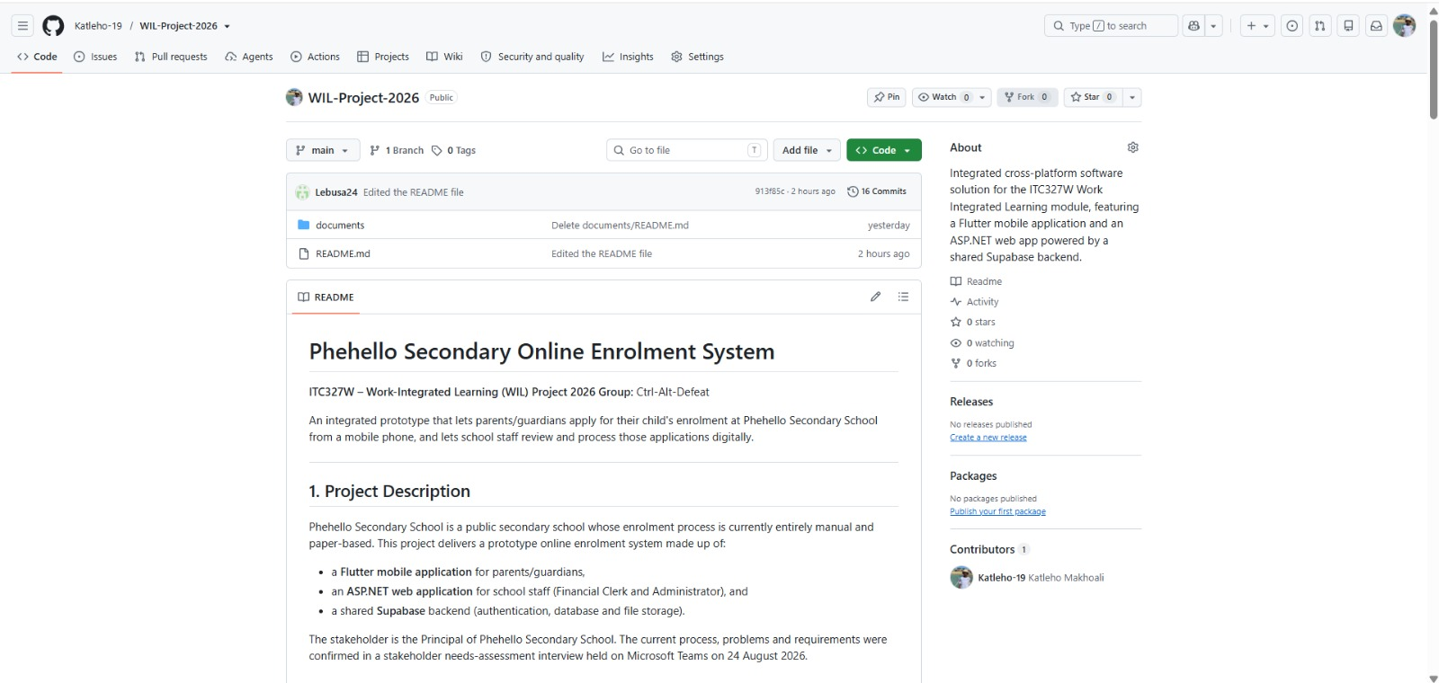
PROJECT MANAGEMENT EVIDENCE
GitHub repository
Private repository, all six members added, no credentials committed
GitHub repository
github.com/Katleho-19/WIL-Project-2026 — Private, all 6 group members added as collaborators.
README names the project and team; docs/ folder holds current architecture, UML, ERD and interface documentation plus design source links.
No passwords, API keys or confidential stakeholder information are committed.
Notes:
[0:20] The repository is private and all six members have access (it was public at first; we identified that as a risk in the feasibility study and corrected it). No passwords, API keys or confidential stakeholder details are committed.

Slide 16
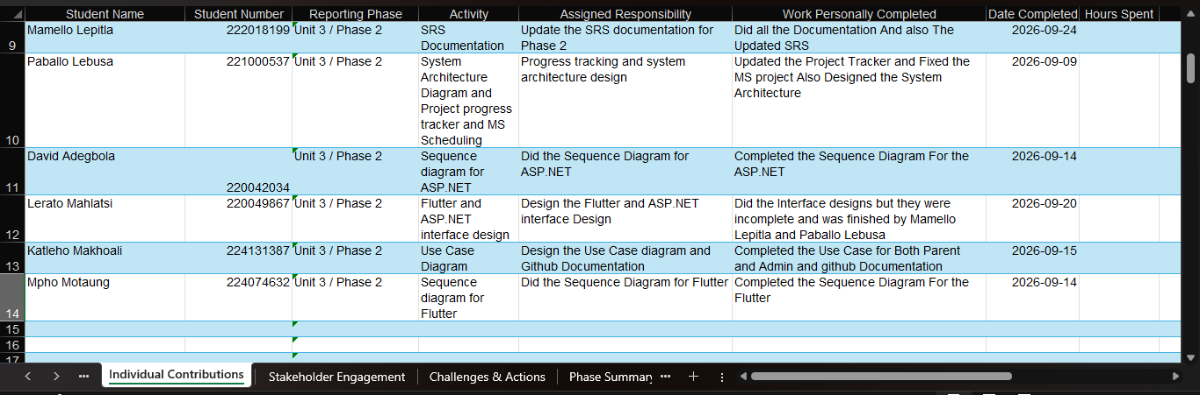
PROJECT MANAGEMENT EVIDENCE
Progress Tracker
Task progress, individual contributions and the Phase 2 reflection
ITC327W Project Progress Tracker
Submitted as a separate Excel workbook: task progress, individual contributions, challenges/actions and the Phase 2 group reflection.
Notes:
[0:15] The Progress Tracker is a separate Excel workbook with task progress, individual contributions, challenges and the group reflection.

Slide 17
PHASE 2 SUMMARY
Architecture, database and interface
design are complete and aligned.
Every requirement traces through the use cases, sequence diagrams, ERD and interfaces consistently (15 FRs)
Database schema implemented in Supabase; GitHub, Microsoft Project and the Progress Tracker are current and linked in the SRS
Next step: finalise and refine the high-fidelity interactive prototype ahead of the Phase 2 presentation and defence
Notes:
[0:45] To close: architecture, database and interface design are complete and aligned across all 15 functional requirements. The schema is implemented in Supabase. Next step is the high-fidelity interactive prototype and then the build. Return to the problem: our design means a parent can apply, upload documents and track status without repeated trips, and staff can process applications without paper. Thank you. We are happy to take questions.

