Slide 1
Final year project by Katleho Mofokeng

Slide 2
Acknowledgements
I would like to acknowledge the contribution of my two supervisors, Ernesto Ismail and Daniel Slater.
They provided me with support and guidance which enabled me to complete my research project.

Slide 3

Machine-learning clustering approaches for automated processing of stress-strain data in Python

Slide 4
Background
Designing and manufacturing are important parts of engineering.
To ensure the safety of a final product mechanical testing must be done.
Mechanical testing is used to mitigate against unexpected failures and as part of a failure investigation

Slide 5
Background
Uniaxial compression test was done
Test measurements collected contain spurious data, like leading and trailing measurements and various forms of noise.
This research project was born because it’s difficult to clean this data in a robust, automated fashion, which is necessary for a large set of experiments.

Slide 6
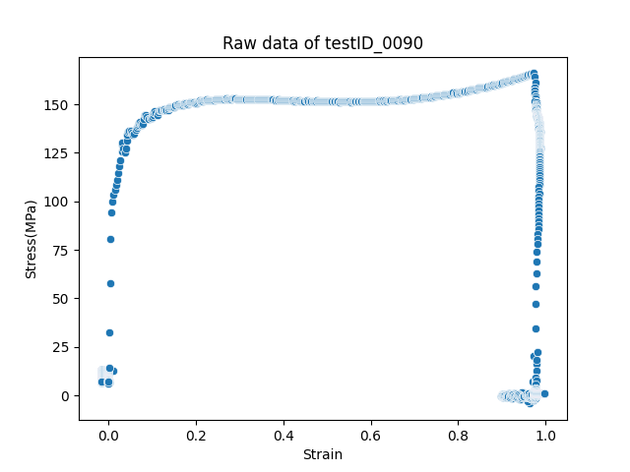

Slide 7
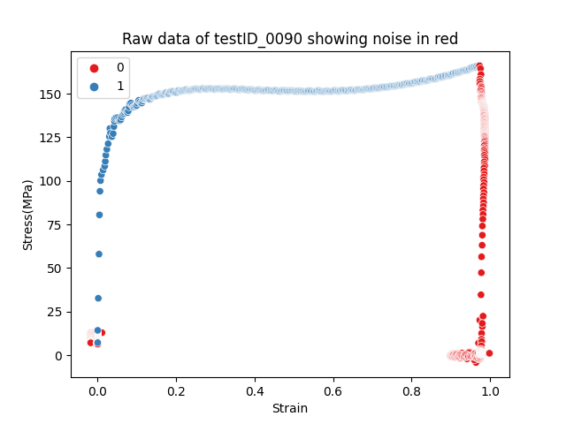

Slide 8
Aims
The purpose for this research project is to use the automated post-processing clustering methods to remove the noise from the collected data and output ‘clean’ data.
Successfully completing this project will save researchers working in mechanical testing a lot of time and manual labour. It will also allow researchers to find parameters such as:
Yield strength
Elastic modulus
Strength at failure
The aim is to use machine learning clustering algorithms that will be selected and trained to perform automated processing on the given stress-strain dataset.

Slide 9
Objectives
The objective of the project will be achieved by following these steps:
Performing exploratory data analysis
Identify regions of interests
Comparing how different clustering algorithms
Pick the algorithm
Train and test the clustering algorithm
Optimize the clustering algorithm
Evaluate the performance of the algorithm

Slide 10
Limitations
The data used to build an algorithm is only collected from uniaxial compression test
Only machine learning algorithms will be used

Slide 11
Literature review
Mechanical testing
Machine learning

Slide 12
Literature review
Mechanical testing
The primary objective of mechanical testing is to ensure product safety, whether through characterising material properties or validating final products[1].
Mechanical testing covers a wide range of tests, which can be divided broadly into two types:
Those that aim to determine a material's mechanical properties, independent of geometry.
Those that determine the response of a structure to a given action, e.g. testing of composite beams, aircraft structures to destruction, etc.

Slide 13
Literature review
Mechanical testing
The most common tests can be split into the following types:
Hardness
Tensile / Compression
Impact
Fracture toughness,
Creep
Fatigue
Non-destructive testing

Slide 14
Literature review
Machine Learning
Machine learning is a subset of artificial intelligence, which enables the machine to automatically learn from data, improve performance from past experiences, and make predictions[1].
Machine learning contains a set of algorithms that work on a huge amount of data.
Data is fed to these algorithms to train them, and on the basis of training, they build the model & perform a specific task

Slide 15
Literature review
Machine Learning
Based on the methods and way of learning, machine learning is divided into mainly four types, which are:
Supervised Machine Learning
Unsupervised Machine Learning
Semi-Supervised Machine Learning
Reinforcement Learning

Slide 16
Literature review
Machine Learning
Due to limited time given to complete the project I will only explore two main types which are:
Supervised learning.
Unsupervised learning.

Slide 17
Literature review
Supervised Learning
In supervised learning, the machine is taught by example.
The operator provides the machine learning algorithm with a known dataset that includes desired inputs and outputs, and the algorithm must find a method to determine how to arrive at those inputs and outputs.

Slide 18
Literature review
Supervised Learning
Συπερϖισεδ μαχηινε λεαρνινγ χαν βε χλασσιφιεδ ιντο τωο τψπεσ οφ προβλεμσ, ωηιχη αρε γιϖεν βελοω:
Χλασσιφιχατιον
Ρεγρεσσιον

Slide 19
Literature Review
Supervised Learning
Classification
Some popular classification algorithms are given below[2]:
o Random Forest Algorithm o Decision Tree Algorithm o Logistic Regression Algorithm o Support Vector Machine Algorithm

Slide 20
Literature Review
Supervised Learning
b) Regression
Some popular Regression algorithms are given below[3]:
o Simple Linear Regression Algorithm
o Multivariate Regression Algorithm
o Decision Tree Algorithm o Lasso Regression

Slide 21
Literature review
Unsupervised Learning
Τηε μαχηινε λεαρνινγ αλγοριτημ ισ λεφτ το ιντερπρετ λαργε δατα σετσ ανδ αδδρεσσ τηατ δατα αχχορδινγλψ.
Τηε αλγοριτημ τριεσ το οργανιζε τηε δατα ιν σομε ωαψ το δεσχριβε ιτσ στρυχτυρε.

Slide 22
Literature review
Unsupervised Learning
Υνσυπερϖισεδ λεαρνινγ χαν βε φυρτηερ χλασσιφιεδ ιντο τωο τψπεσ, ωηιχη αρε:
Χλυστερινγ
Ασσοχιατιον

Slide 23
Literature review
Unsupervised Learning
a) Clustering
Some of the popular clustering algorithms are given below:
K-Means Clustering algorithm
Mean-shift algorithm
DBSCAN Algorithm
Principal Component Analysis
Independent Component Analysis

Slide 24
Literature review
Unsupervised Learning
b) Association
The main aim of this learning algorithm is to find the dependency of one data item on another data item and map those variables accordingly so that it can generate maximum profit.
This algorithm is mainly applied in Market Basket analysis, Web usage mining, continuous production, etc [3].

Slide 25
Literature review
Unsupervised Learning
b) Association
Some popular algorithms of Association rule learning are:
Apriori Algorithm
Eclat
FP-growth algorithm

Slide 26
More aims
As discussed in the literature review, there are four types of machine learning methods name:
Supervised
unsupervised
semi-supervised
Reinforced.
For this project I will only focus on supervised learning and unsupervised learning.
The goal is to compare the two different machine learning methods to see which one works best for the project.

Slide 27
Unsupervised learning
The steps that will be followed for unsupervised learning are:
Choose a clustering algorithm
Test the algorithm
Optimize and test the algorithm

Slide 28
Unsupervised learning
The list of clustering algorithms that I will pick from are:
KMeans
MiniBatchKMeans
DBSCAN
Agglomerative
MeanShift
Birch
Optics
GaussianMixture

Slide 29
Unsupervised learning
The method for selecting the best clustering algorithm is:
1. Perform exploratory data analysis. By analysing the pair plot of the clustering algorithms.

Slide 30
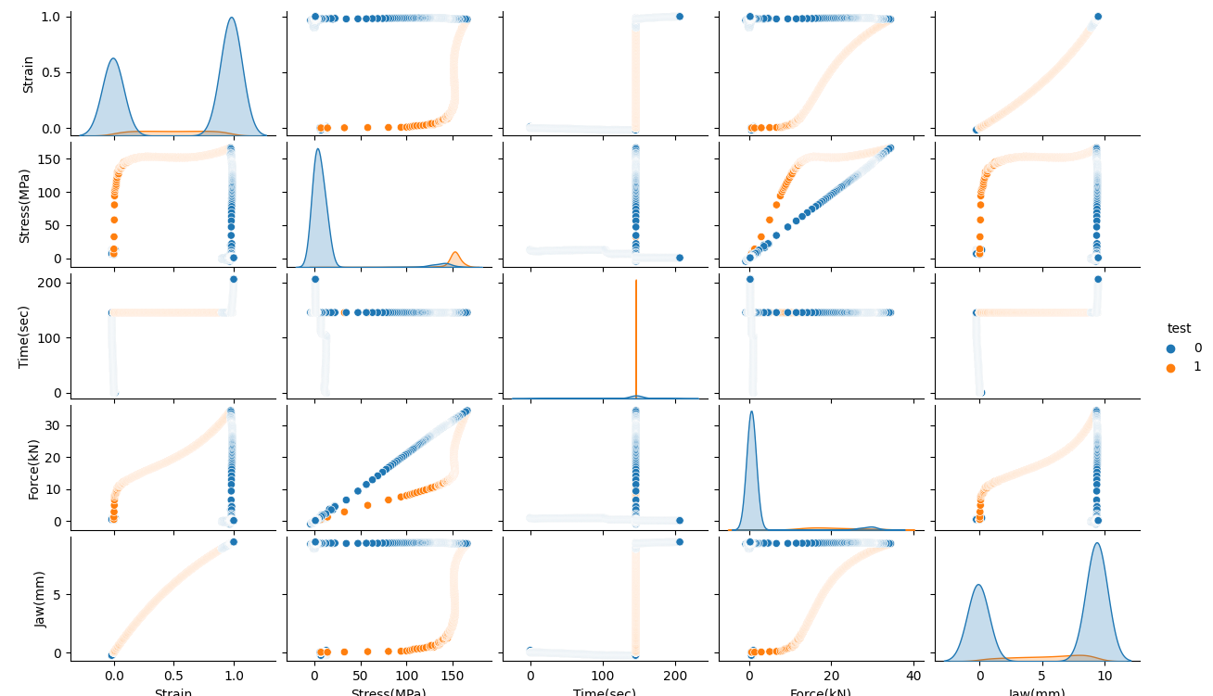

Slide 31
Unsupervised learning
The method for selecting the best clustering algorithm is:
Perform exploratory data analysis. By analysing the pair plot of the clustering algorithms.
2. Develop a rating systems out of 10. To see which clustering algorithms are able to cluster the spurious data points together.
3. Pass multiple tests through the clustering algorithms.
4. Develop a rating system out of 10. To see which clustering algorithm, perform best under different tests. Choose the best clustering algorithm that will be tested and optimized.

Slide 32
Unsupervised learning
The rating systems will be used to eliminate the clustering algorithms that do not fit the criteria.
There are two criteria:
Able to cluster spurious data in beginning
Able to cluster spurious data at the end

Slide 33
Clustering algorithm | cluster spurious data in beginning | cluster spurious data at the end | Total rating
KMeans | 7 | 5 | 12
MiniBatchKMeans | 8 | 6 | 14
DBSCAN | 10 | 8 | 18
Agglomerative | 9 | 3 | 12
MeanShift | 9 | 7 | 16
Birch | 8 | 7 | 15
Optics | 1 | 0 | 1
GaussianMixture | 9 | 8 | 17

Slide 34
Unsupervised learning
Thus, the eliminated clustering algorithms are the following:
KMeans (Total rating of 12)
Agglomerative (Total rating of 12)
Optics (Total rating of 1)
The next step is to pass multiple test through the algorithms and see which one gets the highest total rating score.

Slide 35
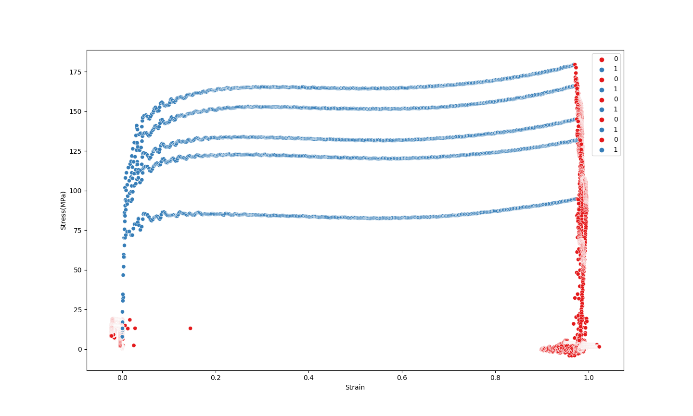

Slide 36
Unsupervised learning
The criteria is the following:
Able to cluster noise at the beginning for all tests
Able to cluster noise at the end for all tests
Maintains the same cluster label number for noise at the beginning
Maintains the same cluster label number for noise at the end

Slide 37
Clustering algorithm | Cluster noise at the beginning | Cluster noise at the end | Maintain the same cluster number at the beginning | Maintain the same cluster number at the end | Total rating | Comments
MiniBatchKMeans | 7 | 6 | 2 | 2 | 17 | Unable to maintain the same cluster label number for spurious data.
DBSCAN | 9 | 7 | 9 | 9 | 34 | Able to cluster noise and maintain the same cluster label number for noise.
MeanShift | 8 | 4 | 8 | 6 | 26 | It struggles to cluster all spurious data at the end together.
Birch | 8 | 4 | 5 | 5 | 22 | It maintains the same cluster label number for noise half of the time.
GaussianMixture | 8 | 9 | 3 | 4 | 24 | Unable to maintain the same cluster label number for spurious data.

Slide 38
Unsupervised learning
DBSCAN algorithm
Test
Optimized

Slide 39
Supervised learning
The steps that will be followed for supervised learning are:
Choose an algorithm
Train the algorithm
Evaluate the performance of the algorithm
Optimize the algorithm

Slide 40
Supervised learning
The algorithms that will be used are the following:
Polynomial Features
Linear Regression
Polynomial Features algorithm is chosen because the stress strain curve has a non-linear relationship. The algorithm is able to raise existing features to an exponent, so that the points predicted can follow a specific polynomial curve.
Linear Regression allows one to build a relationship between multiple features to estimate a target output.

Slide 41
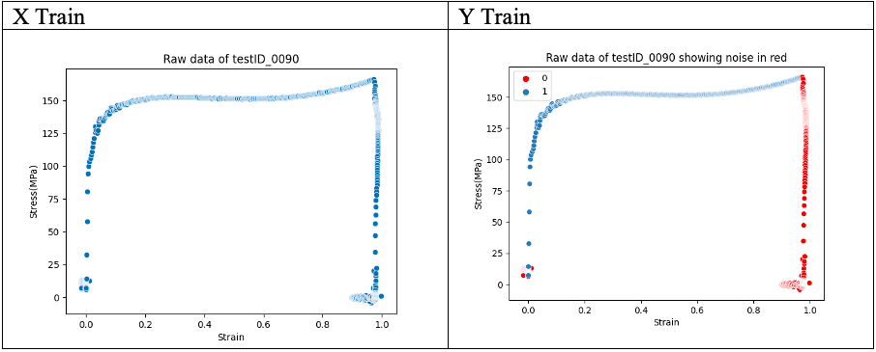

Slide 42
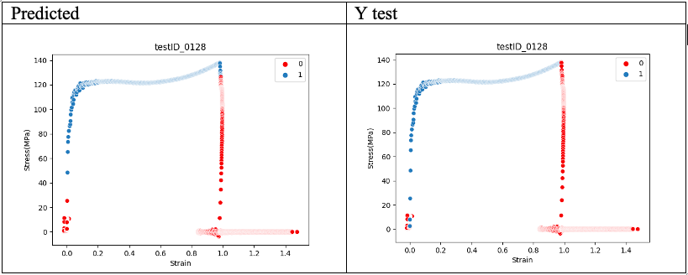

Slide 43
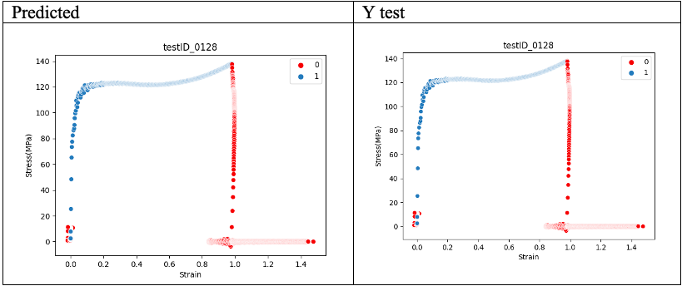

Slide 44
Compare
The performance of the two algorithms will be evaluated under the following conditions:
Raw data with few spurious data points.
Raw data with moderate number of spurious data points.
Raw data with a lot of spurious data points.

Slide 45
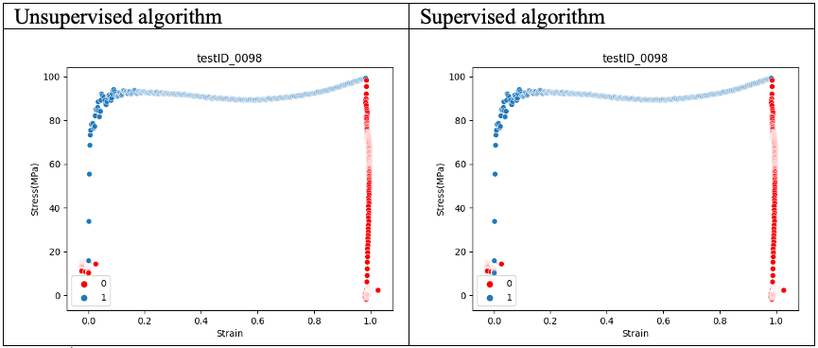
Few spurious data points

Slide 46
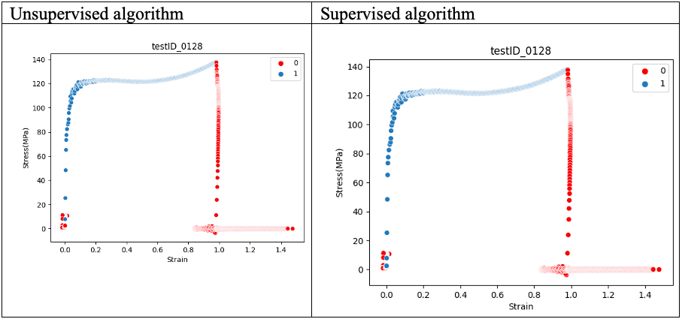
Moderate spurious data points

Slide 47
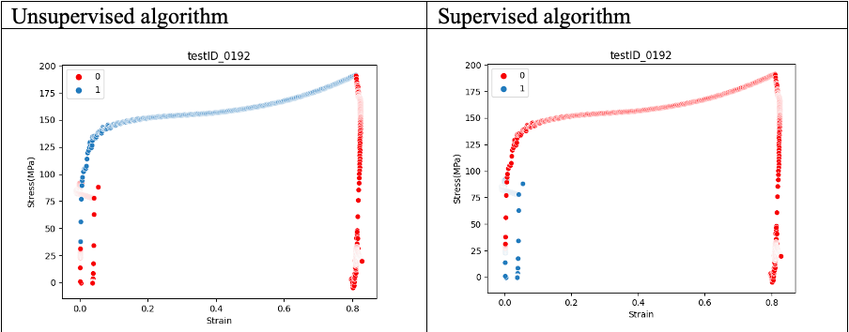
A lot spurious data points

Slide 48
Project overview
The aim of the project is achieved.
Which is to use automated post-processing clustering methods to remove the noise from the collected data and output ‘clean’ data.

Slide 49
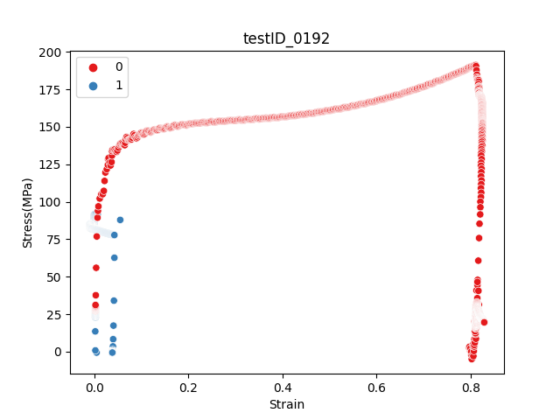
Recommendations
Cross validation
Vector based machine

Slide 50
Further Research
A stress-strain graph gives us many mechanical properties such as:
Yield point
Elastic modulus
Strength Failure

Slide 51
Conclusion
The aim of the project was to use machine learning clustering algorithms that will be selected and trained to perform automated processing on the given stress-strain dataset.
The following flow diagram shows how the project aims and objectives were achieved.

Slide 52
Unsupervised learning
Test
Optimize
DSCAN
Elastic modulus
Yield strength
Strength at failure
Read literature about machine learning
Compare
Unsupervised
algorithm
Supervised learning
Polynomial Features
Linear Regression
Train
Test
Optimize

Slide 53
References
[1] Qifang Bi, Katherine E Goodman, Joshua Kaminsky, Justin Lessler, What is Machine Learning? A Primer for the Epidemiologist, American Journal of Epidemiology, Volume 188, Issue 12, December 2019, Pages 2222–2239
[2] Yang, Xin-She, and Xing-Shi He. Classification and Clustering Algorithms of Machine Learning with Their Applications. Vol. 855. Cham: Springer International Publishing :, 2020. Web.
[3] Kanungo, T., Mount, D.M., Netanyahu, N.S., Piatko, C.D., S, R., Angela, Y.W.: An efficient kmeans clustering algorithm: analysis.
[4] F. R. Brotzen (1994) Mechanical testing of thin films, international materials reviews, 39:1, 24-45.
[5] Y. Hiramatsu, International Journal of Rock Mechanics and miming Sciences & Geomechanics abtracts. Volume 3, issue 2, May 1966, Pages 89-90.

