Slide 1
Use data effectively.

Slide 2
Final Project

Slide 3
Introduction — Aims of the Project
Trend analysis
Differences between groups
Open-ended analysis of one’s own choosing

Slide 4
Methods — Data Selection
Used Blackmore dataset from car package in R
Data from York University on exercise histories of 138 teenaged girls hospitalized for eating disorders and 93 control subjects
Four variables in the dataset:
subject : subject identifier
age : age in years at time of measurement
exercise : estimated hours of weekly exercise
group : either patient or control

Slide 5
Methods — Data Cleaning
Data contained repeated measurements from subjects every two years until final measurement
Data were filtered to only examine the final data contributed from each subject

Slide 6
Methods — Models to Build
Trend analysis : examined correlation between age and hours of exercise per week (exercise ~ age)
Differences between groups : examined if patients or control subjects were likely to exercise more (exercise ~ group)
Open-ended analysis of one’s own choosing : built quasibinomial regression model to predict if an individual were a patient or control subject based on age and hours of weekly exercise (group ~ age + exercise + age * exercise)

Slide 7
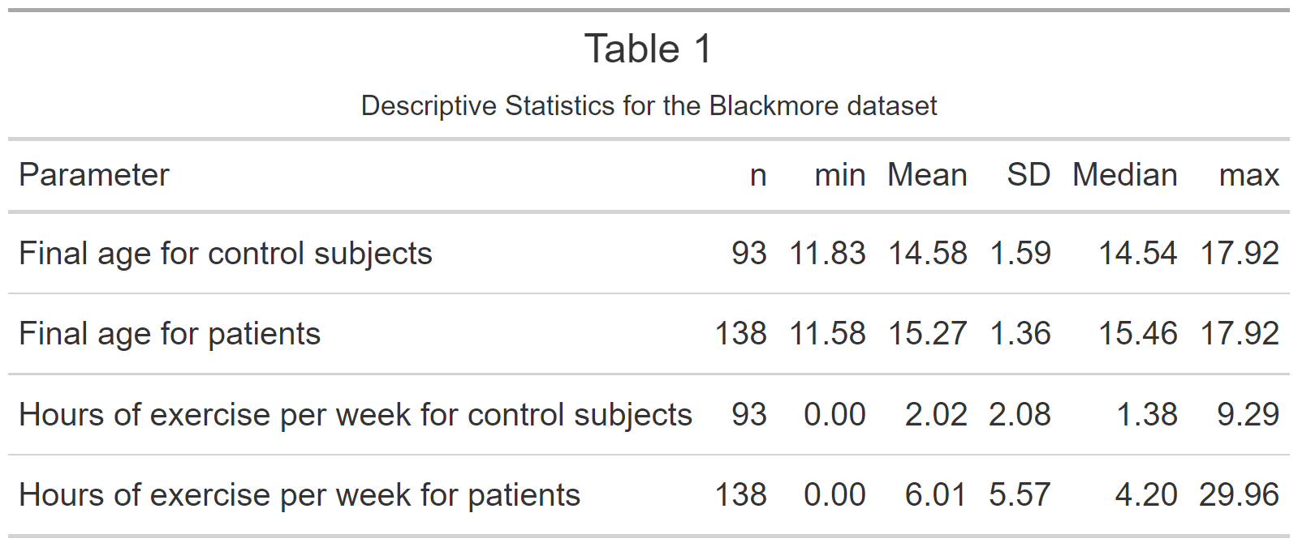
Results — Descriptive Statistics

Slide 8
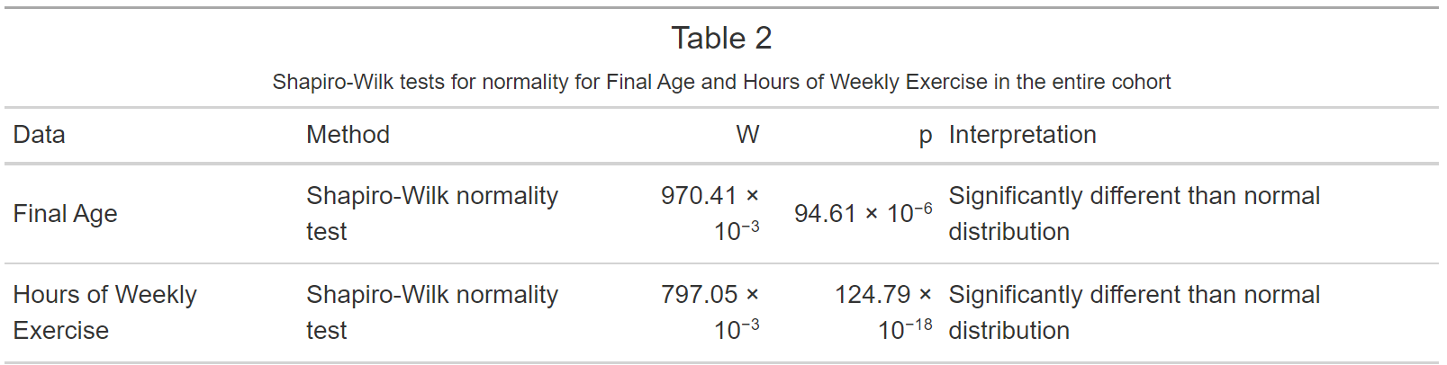
Results — Normality Testing

Slide 9
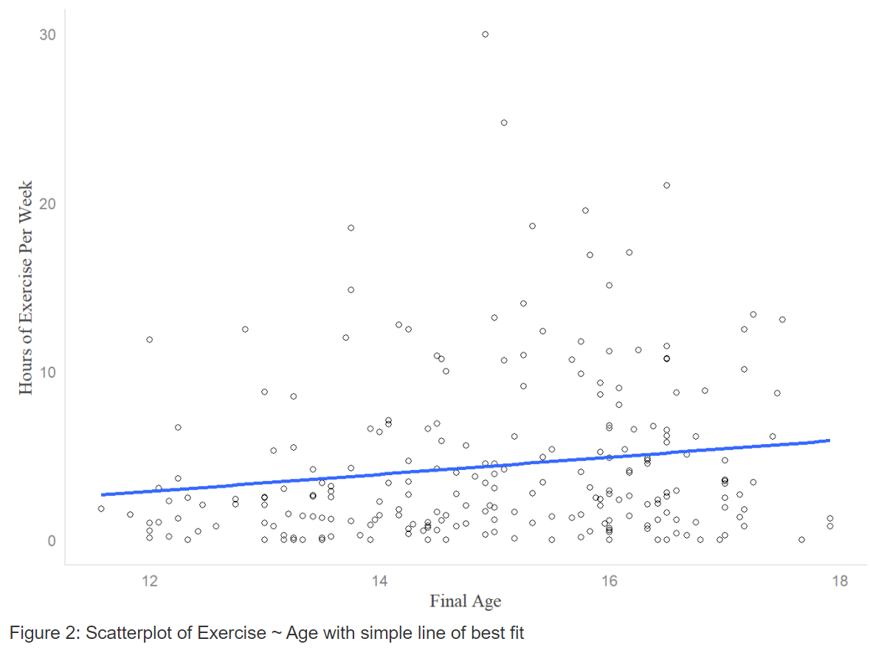
Results — Trend Analysis

Slide 10
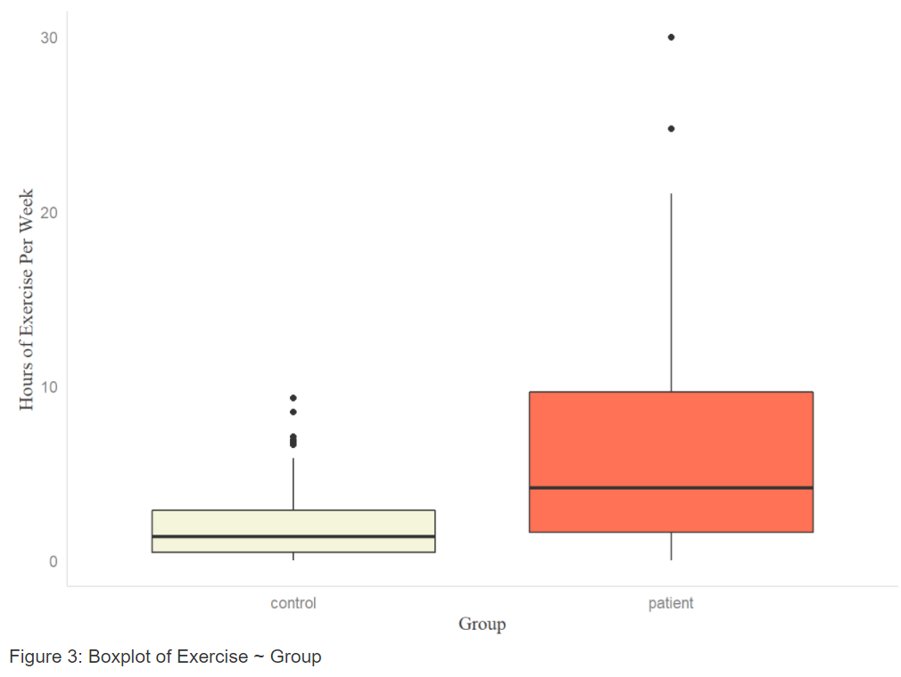
Results — Group Differences

Slide 11
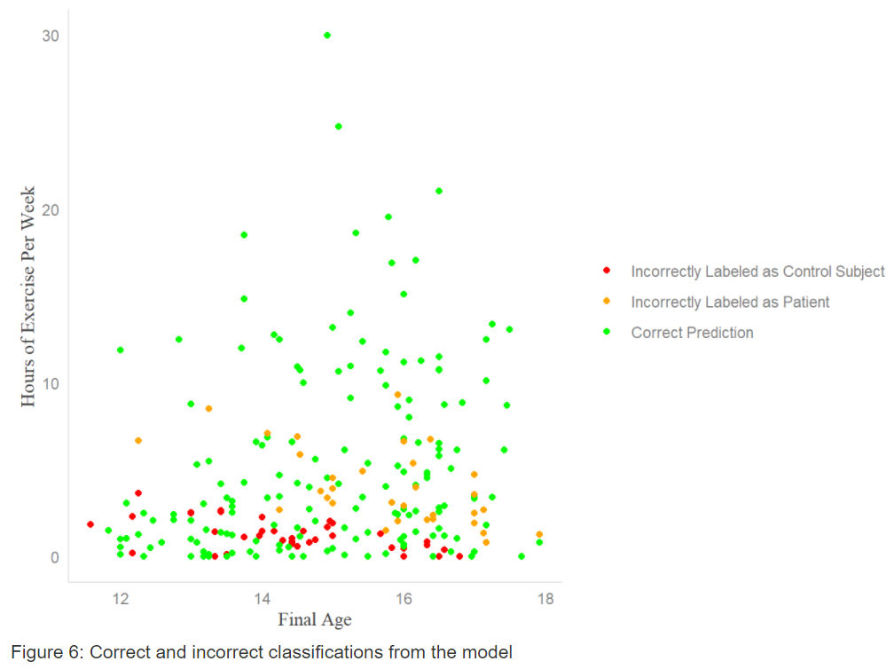
Results — Quasibinomial Regression Model

Slide 12
Discussion
Significant correlation between final age and hours spent exercising
Spearman’s rho; ρ = 0.17, p = 0.009
Significant difference in hours spent exercising between groups
Wilcoxon Rank-Sum; test, W = 0.003, p < 0.001
Time spent exercising and final age each independently predict group classification, and no interaction observed
Quasibinomial regression model; t = 5.35, p < 0.001 and t = 2.526, p = 0.012 for time spent exercising and age, respectively

Slide 13
Final Word
“All models are wrong but some are useful” – George Box
Quasibinomial regression model performs poorly for girls under 17 years old who exercise for fewer than 5 hours per week
Model may be improved by incorporating:
Family history of eating disorders
Other comorbidities
Time spent ingesting social media

