Slide 1
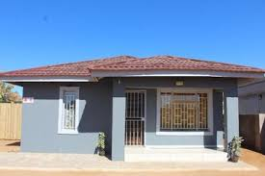
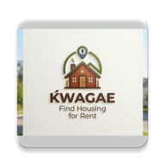
KwaGae
Gaborone Student Housing Platform
Connecting students across Gaborone
with verified, affordable accommodation
from trusted property hosts.
208
17
5
Available Listings
Areas Covered
Property Hosts

Slide 2
Project Overview
The Problem
🎓 Student Homeseeker
• Browse & filter 208+ listings
Students at UB, Botho, Limkokwing and other Gaborone universities struggle to find safe, affordable off-campus housing. Traditional methods — word of mouth, Facebook groups, paper notices — are fragmented, unverified and unsafe.
• Chat directly with landlords
• Pay deposit & reserve online
• Student ID verification
The Solution
🏠 Property Host
KwaGae is a mobile-first marketplace that verifies student identities via student numbers and connects them with property hosts offering houses, apartments, studios, bachelor flats, bedsitters and shared rooms.
• Create & manage listings
• Toggle availability in real-time
• Receive & respond to enquiries
• Track reservations
Tech Stack:
Android (Kotlin)
Firebase Auth
MySQL (Room)
PesaPal Payments
Material 3 UI

Slide 3
App Design & User Interface
Kwagae · STUDENT HOUSING FINDER
Create Account · Join Kwagae
Welcome back, Petra 🎓
MY LISTINGS · KwaGae Housing
SIGN IN
FULL NAME
🏠 208 Available 📍 17 Areas 🏢 5 Landlords
🏠 50 Total ✅ 50 Available ❌ 0 Unavailable
EMAIL ADDRESS
EMAIL ADDRESS
EXPLORE CATEGORIES
MY LISTINGS
student@example.com
PASSWORD
ALL APARTMENTS HOUSES ROOMS
HOUSE Budget 2-Bed – Ledumang BWP 3,800/mo ✅ Available
PASSWORD
CONFIRM PASSWORD
RECENT LISTINGS
HOUSE 2-Bed House – Tlokweng BWP 4,500/mo ✅ Available
••••••••
I AM A:
🏠 Spacious 3-Bed House · Block 8 · BWP 7,500/mo ✅ Available
─────────────────
LOGIN
STUDENT
🏠 Modern 2-Bed House · Phase 2 · BWP 6,000/mo ✅ Available
+ ADD LISTING
No account? Register here
PROVIDER
RECOMMENDED FOR YOU
─── OR ───
REGISTER
Google
Login
Registration
Student Home Feed
Host Dashboard

Slide 4
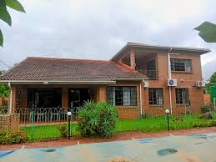
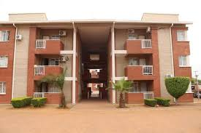
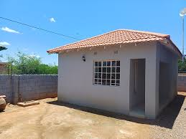
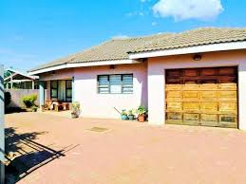
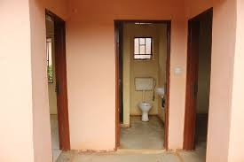
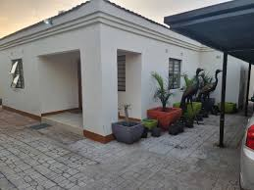
Core Features
SEARCH
Smart Search & Filter
LIST
Listing Management
Students filter by price range (BWP 0-15,000/mo), property type (House, Apt, Studio, Room, Bachelor Flat, Duplex, Bedsitter), Gaborone area (17 zones), and move-in date.
Hosts create detailed listings with multiple photos, rent & deposit, availability dates, utilities (Wi-Fi, Water, Electricity), property features (parking, security, furnished) and room details.
CHAT
In-App Messaging
PAY
Secure Reservation
Students and landlords communicate in real-time through listing-linked chats. Each chat thread is tied to a specific property, keeping conversations organised and in context.
Students pay a deposit via integrated PesaPal gateway. On success a unique reference (e.g. KWG-HEXEAV) is generated. The landlord uses this code to confirm the booking.
VERIFY
Student Verification
MAP
Area Coverage
New student accounts require a verified student number from UB, Botho, Limkokwing, BOU, ABM, BAISAGO or Botswana Accountancy College before gaining access.
Listings span 17 Gaborone zones: Block 6-9, Phase 2 & 4, Broadhurst, CBD, Old Naledi, Bontleng, Phakalane, Riverwalk, Ext 10 & 12, G-West, Ledumang, Mogoditshane, Tlokweng.

Slide 5
Database Schema
kwagae_database · MySQL (via Room ORM)
🗃 users
🗃 listings
Column
Type
Description
Column
Type
Notes
userId 🔑
INT (PK)
Auto-increment primary key
listingId 🔑
INT
Primary key (PK)
firebaseUid
VARCHAR
Firebase Auth UID
firestoreId
VARCHAR
Firebase doc ref
fullName
VARCHAR
User's full name
title
VARCHAR
Display title
email
VARCHAR
Login email address
1 : N
description
TEXT
Property info
studentId
VARCHAR
KW-prefixed internal ID
location
VARCHAR
Area & address
role
ENUM
student | provider
type
VARCHAR
House/Apt/Room…
ubStudentNo
VARCHAR
University student number
price
DECIMAL
Rent (BWP/mo)
university
VARCHAR
Enrolled institution
deposit
DECIMAL
Deposit (BWP)
isVerified
BOOLEAN
Student verification status
availability
DATE
Move-in date
passwordHash
VARCHAR
Hashed password
isAvailable
BOOLEAN
Visible toggle
amenities
TEXT
Feature list
ownerId 🔗
VARCHAR
FK → providers
providerName
VARCHAR
Host name

Slide 6
Reservation & Payment Flow
1
2
3
4
5
▶
▶
▶
▶
Browse Listings
Message Landlord
Pay Deposit
Reservation Confirmed
Landlord Confirms
Student filters listings by area, price, type and move-in date. 208 verified listings available.
Student sends enquiry via in-app chat. Chat is linked to the specific listing for context.
Student initiates a secure deposit payment (e.g. BWP 15,000) via the integrated PesaPal gateway.
System generates a unique reference code (e.g. KWG-HEXEAV). Property status updates to Reserved.
Landlord receives the reference number, verifies payment, and marks the listing as unavailable.
CONFIRMED | Ref: KWG-HEXEAV | Property: Spacious 3-Bed House, Block 8 | Deposit: BWP 15,000 | Date: 22 May 2026, 23:09 | Status: Reserved

