Slide 1
A Bottom-Up Approach to Job Recommendation System
Manoj Reddy & Sonu K. Mishra
University of California, Los Angeles

Slide 2
Impressions Data
Contains information about jobs that were already displayed to users
Sort the job items based on how frequently and recently they were displayed to the user
Using the existing recommender system knowledge
Looks naïve but a good start
Many users in the test dataset do not appear in the impressions data
Performs decently well on the scoreboard

Slide 3
Interactions Data
Purely focus on interactions
1 – user clicked on the item
2 – user bookmarked the item on XING
3 - user clicked the reply button or application form button
4 - user deleted the recommendation
Idea is that if a user interacted positively with a particular job item, then they are more likely to interact positively again
Issues:
Data is sparse and doesn’t include all users
Not every user has at least 30 positive interactions

Slide 4
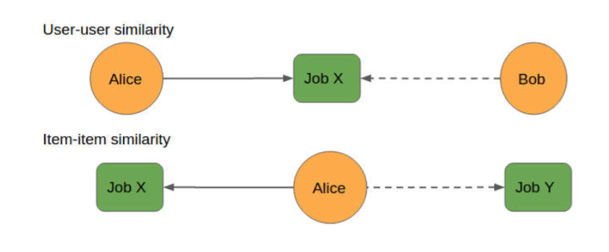
Collaborative Filtering
Leverages the notion of homophily
User-user similarity
Item-item similarity
Challenges:
Sparsity
Definition of Similarity
Gray/Black Sheep Behavior
For similarity, we use K-Means clustering with cosine similarity
Impute the interaction of user u with item i as average of interactions of other users v, in the same cluster, weighted by cosine similarity

Slide 5
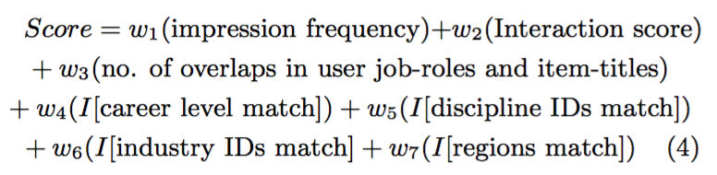
Scoring
Given a user, score each job and finally rank based on score
Weights
Heuristic: w1 = 1, w2 = 100, w3 = 10, w4 = 12, w5 = 10, w6 = 5 & w7 = 2
Linear Regression: Learn the weights
Gradient Boosting
5-fold cross-validation; 80 : 20 random split
Train on different subsets of data with 300K data points

Slide 6
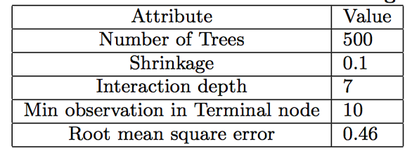
Gradient Boosting

Slide 7
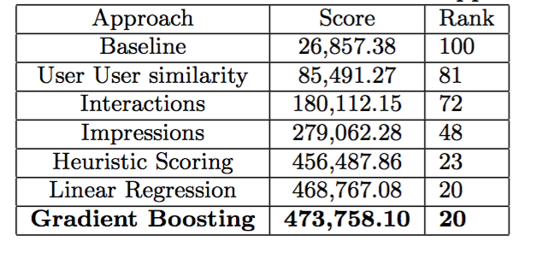
Evaluations

Slide 8
Conclusion
Took a bottom-up approach and analyzed individual datasets
Combined multiple datasets (impressions, interactions, users, jobs etc.)
Applied linear regression and gradient boosting methods to learn weights for scoring jobs.
Our team, “Falcon”, was ranked 20th on the official leader-board of the competition.

