Slide 1
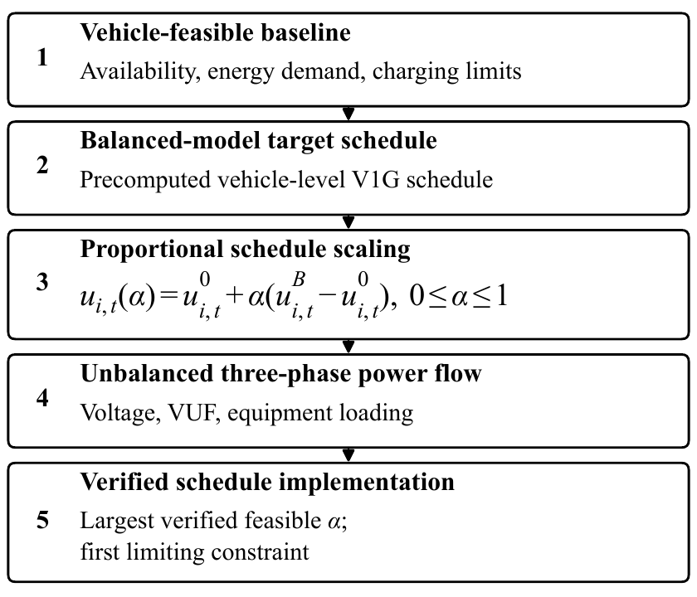
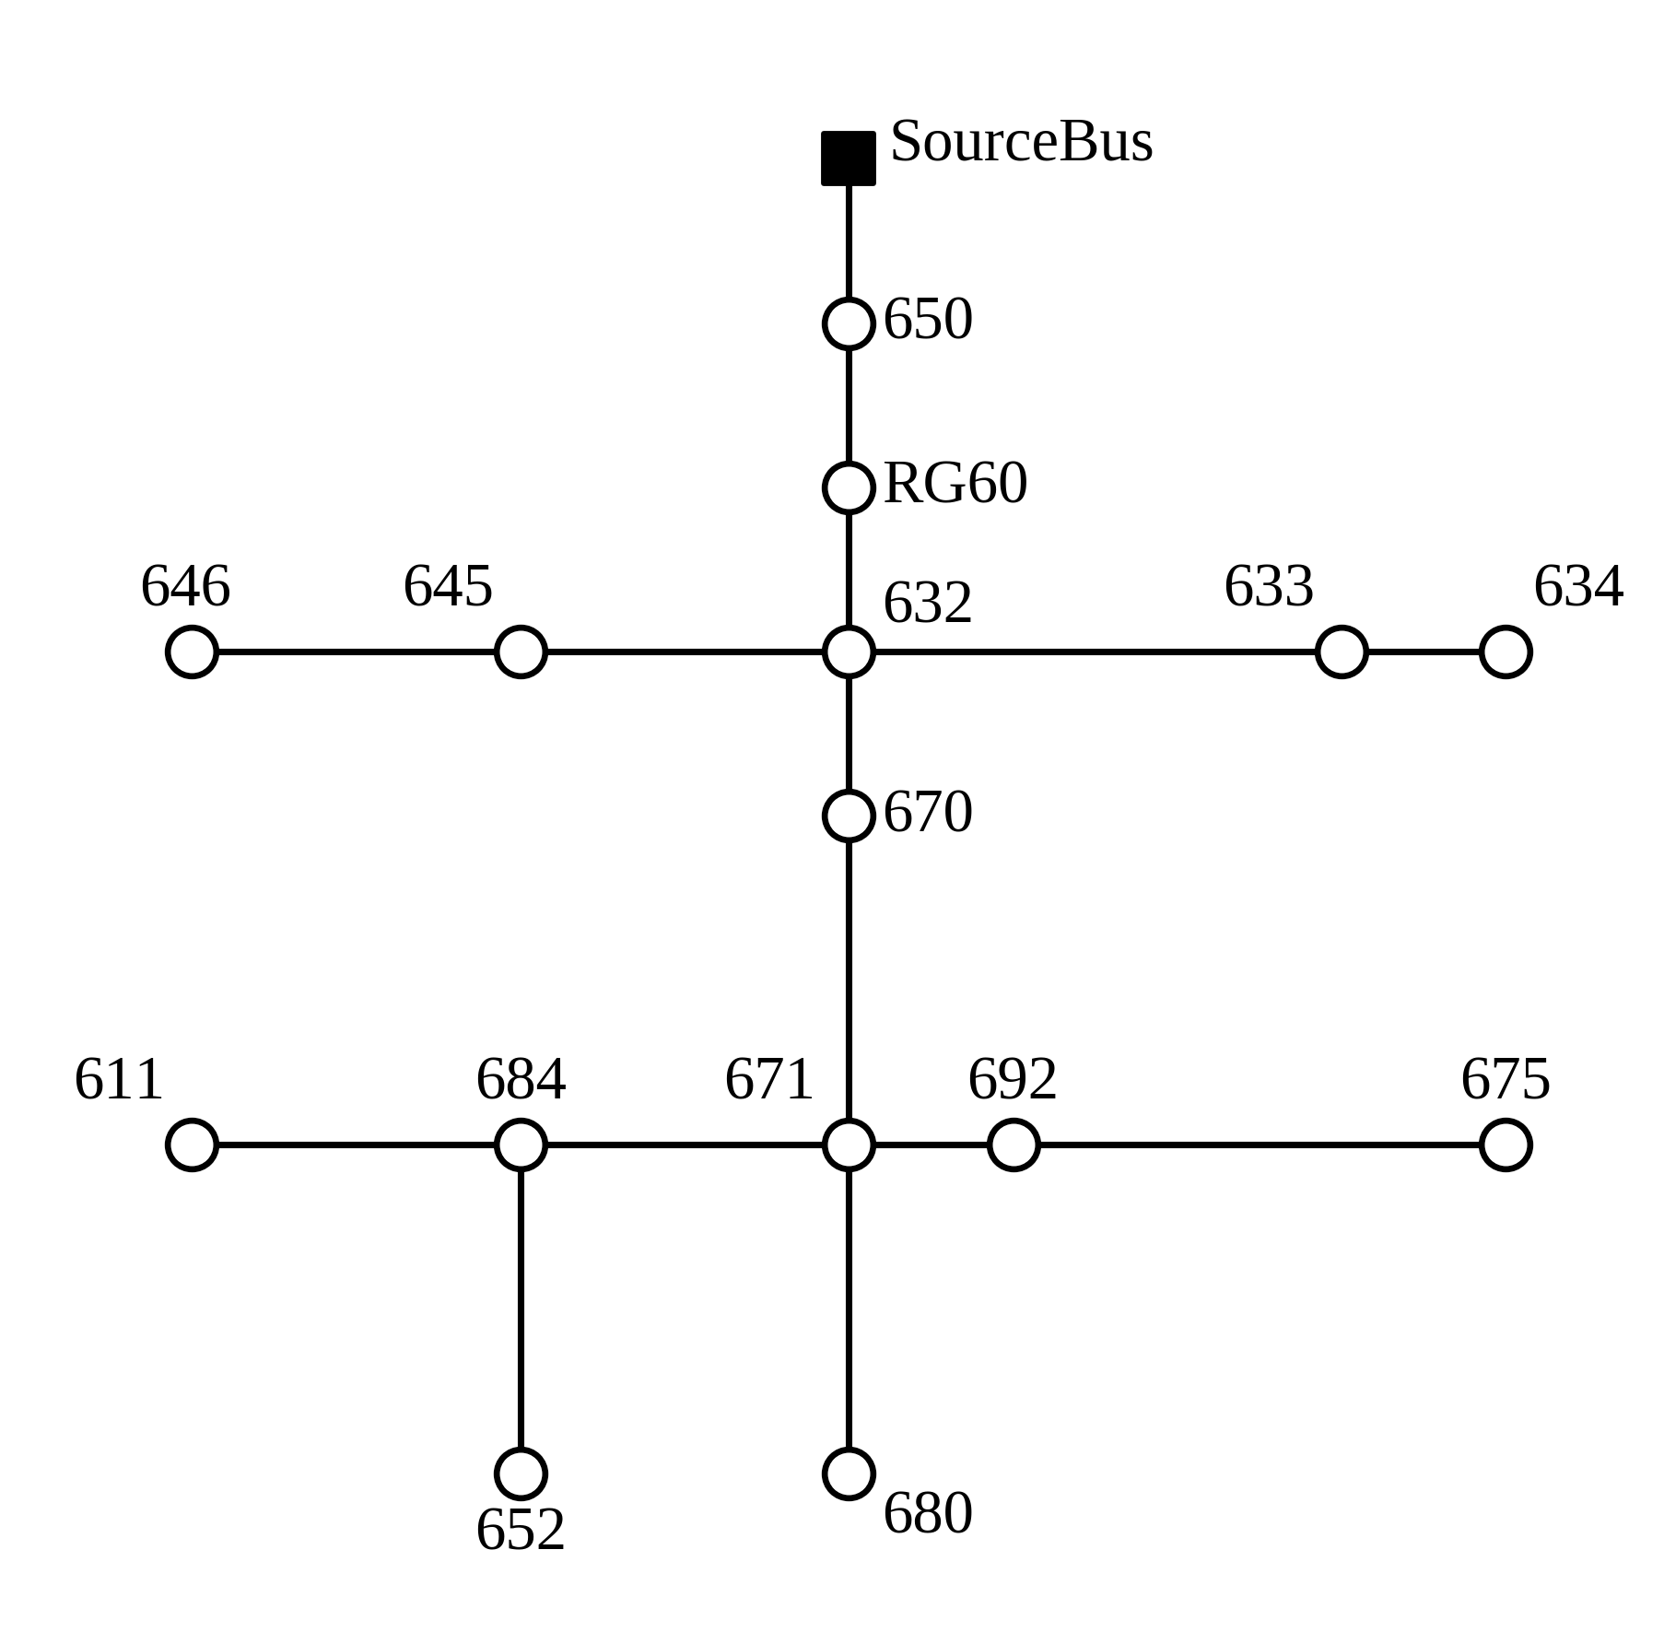
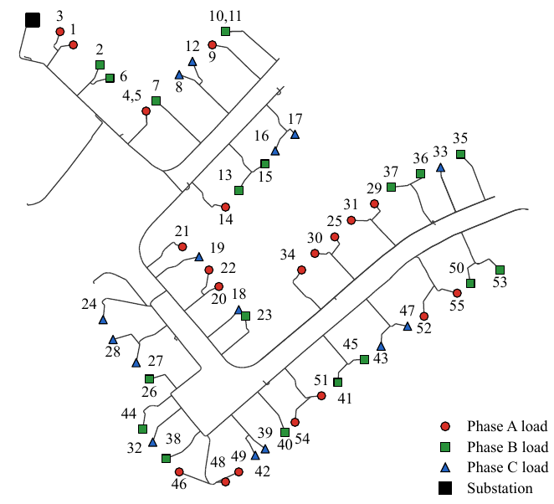
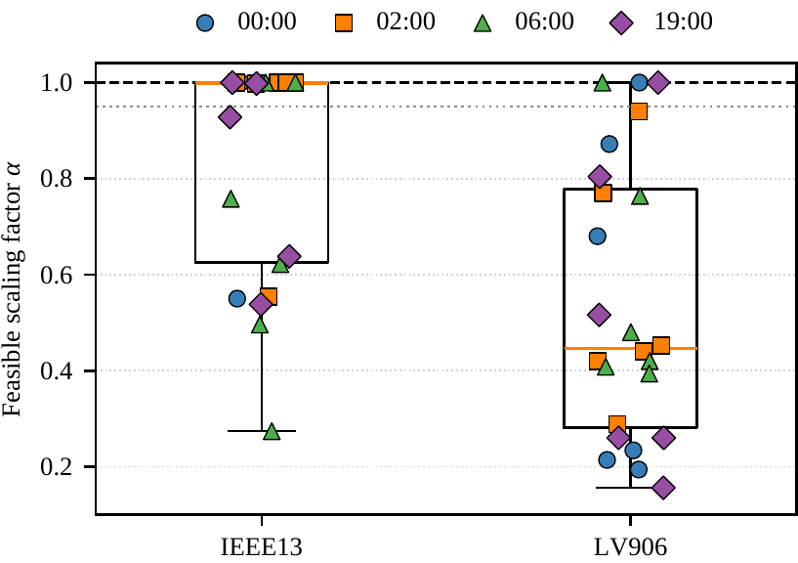
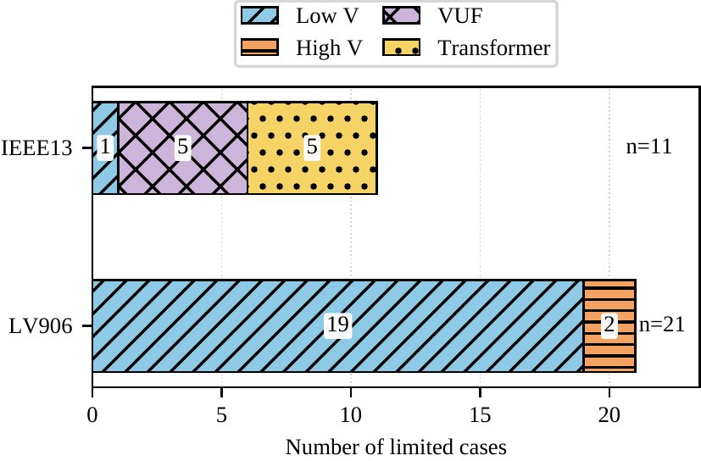
Feasibility of Balanced-Model EV Charging-Flexibility Schedules
in Unbalanced Three-Phase Distribution Networks
Paper ID 9499
IEEE PES ISGT Asia 2026
Junxing Tan, Jun Wu, Shiting Cui, Chaofan Yang, Jiangcheng Wang
School of Electrical and Automation Engineering, Wuhan University, Wuhan, China
Motivation
Architecture
WHY VALIDATION IS NEEDED
FIVE-STEP ASSESSMENT WORKFLOW
Balanced distribution-network models can produce attractive EV flexibility schedules that are infeasible when implemented on phase-specific, unbalanced feeders.
Question: how much of a precomputed V1G schedule can the detailed feeder actually deliver?
CORE IDEA
Scale the original vehicle–time adjustment by one common factor α. This preserves the vehicle allocation and energy equalities while exposing network limits before dispatch.
The same schedule is carried from vehicle feasibility to a nonlinear, unbalanced three-phase power-flow check. The transition search refines the feasible–infeasible boundary to a spacing of at most 0.002.
uᵢ,ₜ(α) = u⁰ᵢ,ₜ + α (uᴮᵢ,ₜ − u⁰ᵢ,ₜ), 0 ≤ α ≤ 1
TEST FEEDERS
NETWORK CHECKS
• Voltage magnitude: 0.95–1.06 p.u.
• Voltage-unbalance factor (VUF): ≤ 2%
• Transformer and feeder-head loading: ≤ 1.0 p.u.
• All 96 fifteen-minute slots are checked
IEEE13
positive-sequence planning
LV906
balanced planning → unbalanced validation
The deliverable output is the largest verified feasible α and the first limiting constraint.
EV phase assignments and native feeder imbalance are restored for validation.
Study design
Results
CASE CONSTRUCTION
46
validated cases
32
targets needing derating
27/32
first limited by V or VUF
• 3,568 NHTS vehicle-day records; overnight availability windows
• Calls at 00:00, 02:00, 06:00, and 19:00; six EV realizations per feeder–call pair
• V1G charging only: 7.2 or 11 kW, η = 0.95; 15-minute slots over a noon-to-noon horizon
Mean verified scaling factor α
First limiting constraint (32 limited cases)
VALIDATED CASE MATRIX
Feeder | Cases | EVs / caseᵃ | Scheduled offer (kW)ᵃ
IEEE13 | 22 | 173 [65–337] | 940 [237–1942]
LV906 | 24 | 29.5 [11–54] | 174 [11–261]
ᵃ Median [minimum–maximum] across study cases.
IEEE13: mean α = 0.834; 11/22 targets are fully implementable.
LV906: mean α = 0.540; only 3/24 targets reach α = 1.
All 21 limited LV906 cases are voltage-limited.
The validated offer is α × scheduled offer, with the vehicle–time allocation retained.
SEARCH AND VALIDATION
• Coarse α grid: 0, 0.02, …, 1; nine interior points refine each transition
• Largest verified feasible factor: max { α ∈ {0, 0.002, …, 1} : all constraints pass }
• OpenDSS restores each EV at its assigned bus and phase for the final check
Operational use
Before dispatch, recompute α from current network conditions and EV states; recheck every revised dispatch.
Resolution: Δα ≤ 0.002
Project: github.com/Kato814/EV-FLEX-BIAS | Funding: Smart Grid-National Science and Technology Major Project (2025ZD0806600)
Notes:
Sources: paper9499终稿.pdf (camera-ready v1.22), source_package/figures/fig1–fig5, and project repository https://github.com/Kato814/EV-FLEX-BIAS.
All quantitative claims on this poster are limited to the 46 evaluated cases reported in the paper. Figures are reused from the supplied source package.

