Slide 1
Telecom Customer Churn Prediction Analysis
Data Preprocessing, Exploratory Analysis, and Machine Learning Evaluation
Presented By:kato michael
Context: Analysis of East African Telecom Subscriber Data

Slide 2
Part A - Data Loading & Integrity
Objective: Load data and ensure quality for analysis.
Dataset Overview:
  7,043 Rows, 21 Columns.
  Target Variable: Churn.
Data Quality Issues Identified:
  TotalCharges contained whitespace strings; converted to numeric.
  Missing values in TotalCharges filled with Median.

Slide 3
Part A - Preprocessing Pipeline
Objective: Prepare raw data for Machine Learning algorithms.
1. Encoding Categorical Data:
  Used Label Encoding to convert text features (e.g., Gender, Partner, Contract) into numeric format.
2. Feature Scaling:
  Applied StandardScaler to tenure, MonthlyCharges, and TotalCharges to normalize ranges.
3. Target Labeling:
  Converted Churn (Yes/No) to Binary (1/0).
Notes:
Speaker Note: Normalization is crucial for models like Logistic Regression to prevent features with large values (like TotalCharges) from dominating the model.

Slide 4
Part B - Exploratory Analysis (Numerical)
Objective: Understand the distribution of customer behavior.
Observations:
  Tenure: Distribution is bimodal. Many customers are brand new (< 5 months), and many are long-term loyalists (> 60 months).
  Monthly Charges: Skewed slightly towards higher-cost plans.

Slide 5
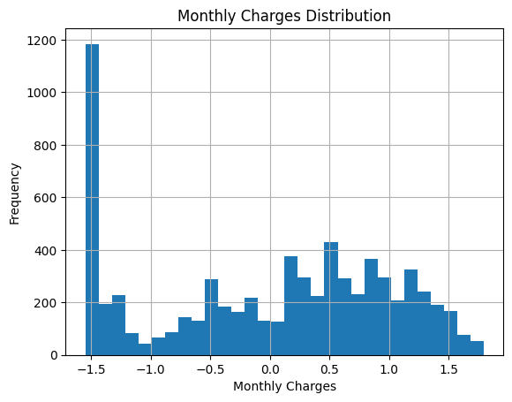
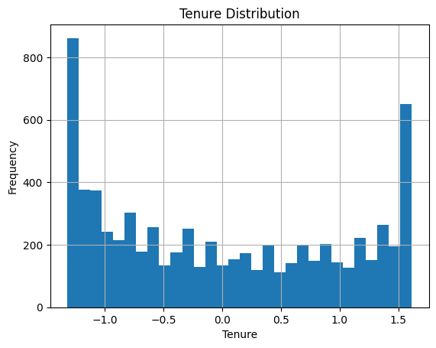

Slide 6
Part B - Churn by Contract Type
Objective: Analyze the impact of contract commitments on retention.
Key Insight:
  Month-to-Month contracts have the highest churn rate (significantly higher than 1 or 2-year contracts).
  Customers with long-term commitments rarely churn.

Slide 7
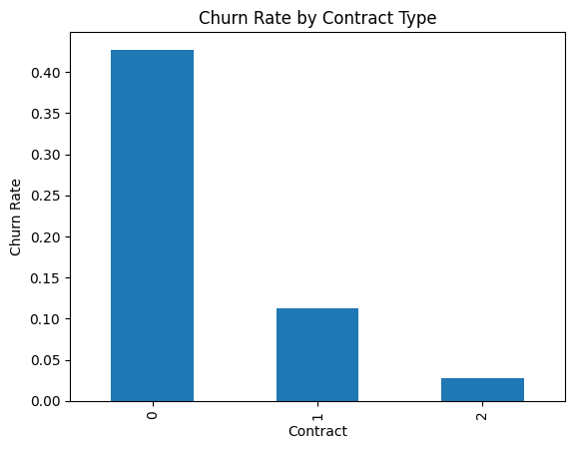

Slide 8
Part B - Correlation Analysis
Objective: Identify relationships between numerical features.
Key Correlations:
  Strong positive correlation between Tenure and TotalCharges (logical, as longer stay = more money paid).
  MonthlyCharges has a moderate correlation with Churn.
  Tenure has a negative correlation with Churn (Newer customers leave more often).

Slide 9
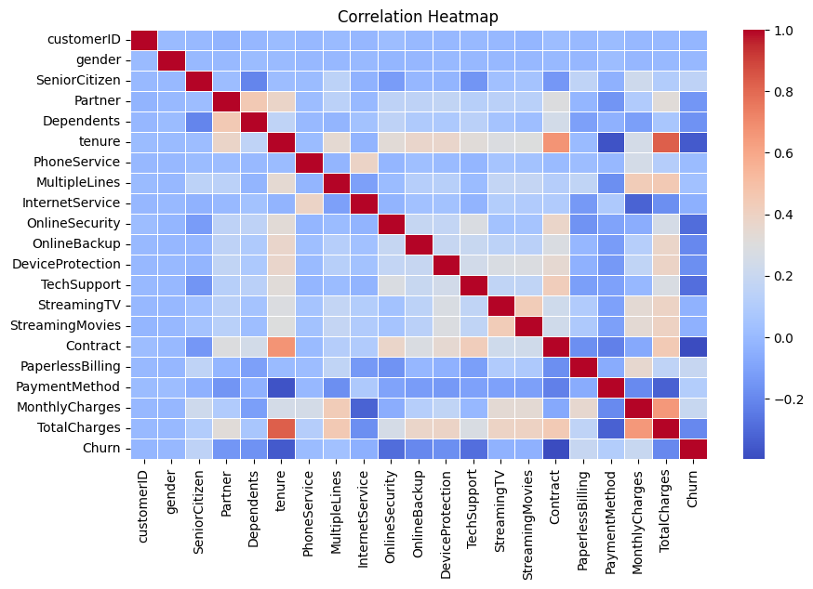

Slide 10
Part B - EDA Conclusion
Major Factors Contributing to Churn:
1. Contract Flexibility:
  Customers not bound by 1-2 year contracts leave frequently.
2. Tenure:
  The first few months are the 'danger zone' for customer attrition.
3. Pricing:
  Higher monthly charges tend to drive higher churn rates.

Slide 11
Part D - Machine Learning Models
Methodology:
Data Split:
  80% Training Data, 20% Testing Data.
Models Selected:
1. Logistic Regression:
  Selected for its interpretability and efficiency with binary classification.
2. Random Forest Classifier:
  Selected for its ability to handle complex, non-linear relationships and determine feature importance.

Slide 12
Part D - Model Evaluation Metrics
Metric | Logistic Regression | Random Forest
Accuracy | 81.6% | 79.6%
Precision | 68.0% | 65.2%
Recall | 57.6% | 48.8%
F1-Score | 0.62 | 0.56

Slide 13
Part D - Feature Importance
What drives the model predictions?
Top 4 Features (Random Forest):
  1. Total Charges: The cumulative value of the customer.
  2. Monthly Charges: The recurring cost burden on the customer.
  3. Tenure: The length of the relationship.
  4. Contract Type: The legal binding of the customer.

Slide 14
Conclusion & Recommendations
Summary:
  Logistic Regression outperformed Random Forest in this iteration, specifically in Recall (catching more actual churners).
Strategic Actions:
1. Migrate Customers:
  Incentivize Month-to-Month users to move to 1-Year contracts.
2. Onboarding:
  Create a specific retention program for the first 6 months (high tenure risk).
3. Pricing Review:
  Investigate why high monthly charge users are leaving—do they need more value adds?

