Slide 1


In association with
Modelling Drug Substance Production Processes
-Shivaani Katragadda
R00183214

Slide 2

Acknowledgements
I would like to thank my supervisor, Dr. David Hawe for his valuable inputs and contribution in this project.
Patrick T. O’Sullivan, Janssen Pharmaceutical Sciences UC for giving me an opportunity to work on this project with them.

Slide 3
What does the Janssen Pharmaceutical Sciences UC do?
Since 1981 Janssen Pharmaceutical Sciences UC has been operating in Cork, Little Island.
The company manufactures pharmaceutical ingredients to all other Janssen branches and third party companies.
These ingredients are processed further into tablets and injectable dosage forms.

Slide 4
AIM OF THE PROJECT
To create a predictive model for a Y variable IgG(immunoglobulin G) concerning the independent variables using different machine learning algorithms.
IgG: Immunoglobulin G (IgG) is an antibody type. It is the most common antibody detected in blood circulation, containing around 75 percent of serum antibodies in humans. IgG molecules are formed and produced by plasma B cells.

Slide 5
Biopharmaceutical manufacturing
The steps involved in the biopharmaceutical production process is as follows:
1. Fermentation: It includes the cultivation of bacteria, fungi, or biological cells to produce protein drugs.
2. Chromatography: In this step antibodies products are polished and filtered.
3. Purification: In this step, all the antibodies are purified completely.
4. Final product: The final antibodies product is tested in this step.

Slide 6
Biopharmaceutical manufacturing
One can express fermentation in two streams. They are bioprocessing upstream and bioprocessing downstream
Upstream Processing : In this process cells are generated
Preculture Phase: The cell/seed will be grown in a flask for 4 to 5 days
Profusion phase: Then the seed will be moved to a bioreactor and processed for 60 days
Harvest :It will then be shifted to a tank to harvest
Downstream Processing: Purification and polishing(Chromatography) comes under this process
Initial recovery: In this phase the separation of the cells of the bioreactor takes place. Generally, in this phase the small molecules, water, and growth supplements are removed.
Purification: In this phase, contaminants (polluting or poisonous substances),host cell proteins(impurities produced by the cells to produce proteins), harmful viruses are removed.
Polishing: During this process, unwanted biomolecules created during insolation and purification, removal of virus or pyrogens(the substance produced by bacteria) and the pollutants are removed in this phase
The final antibodies product is captured.

Slide 7
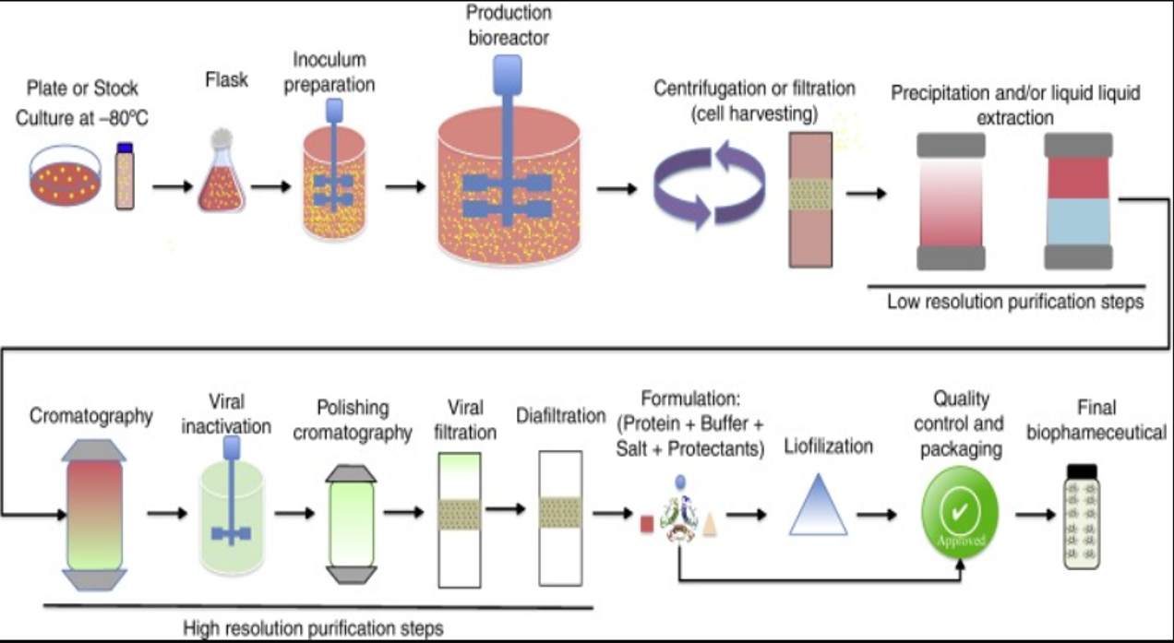
Biopharmaceutical manufacturing
Figure : The upstream and the downstream bioprocess

Slide 8
Dataset
The data is provided in .xlsx file with four sheets of data.
Three sheets contain continuous data for three batches
one sheet contains discrete data.
What is the discrete data and continuous data?
Discrete Data : Janssen uses discrete data to represent the performance of the previous day's bioreactor
Continuous Data : Data is read continuously through hard sensors; and collected across the 60 days in every 10 minutes.

Slide 9
Dataset
Sheet Number | Number of observations | Number of features | Information
1 | 2122 | 26 | Discrete Data
2 | 81674 | 90 | Continuous data of the first batch
3 | 18500 | 60 | Continuous data of the second batch.
4 | 79362 | 90 | continuous data of the third batch
Table : Description of the datasheets

Slide 10
Methodology – Algorithms used
Multiple Linear Regression
Decision Tree
Random Forest
Support Vector Machines
Among all the four algorithms, random forest performance is very promising when compared to others. Hyperparameter tuning is applied to random forest by using GridSearchcv.

Slide 11
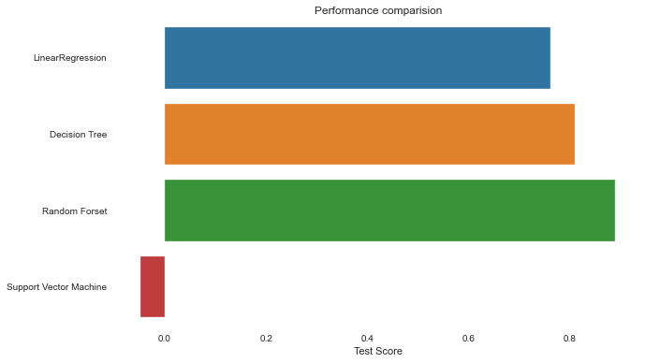
RESULTS
Figure : Performance comparison of all the algorithms

Slide 12
RESULTS
Algorithm | RMSE Value | Model Score
Multiple Linear Regression | 3353.17 | 0.7626
Decision Tree | 3002.86 | 0.8096
Random Forest | 2278.79 | 0.8903
Support Vector Machines | 7046.99 | -0.048
Random Forest after hyperparameter tuning | 2248.15 | 0.8933

Slide 13
Future work
Some possible areas of future work could be from either the data preparation phase or hyperparameter tuning of the various models.
Different techniques for handling missing values, such as imputation, may be used to test the models' performance.
The random search CV technique can be applied instead of the grid search CV method.
It can also implement the various combinations of hyper-parameters to improve the performance of machine learning models for predicting the IgG.

Slide 14
THANK YOU

