Slide 1
THREE INTERESTING THINGS I LEARNED ABOUT R DURING THIS ASSIGNMENT
Student Name: Shivaani Katragadda
Student Number: R00183214

Slide 2

UNITE()
Merging two variables in to one or to paste together multiple columns into one.
The syntax unite(data, col, …, sep=“-”)
This function is available in dplyr package.
It is used to tidy up the data

Slide 3
Relevel()
Relevel stands for Reorder levels
The syntax is relevel(x, ref, …) where x is unordered factor, ref is the reference level
If we want to change the order and to make a particular level first in the list we use relevel

Slide 4
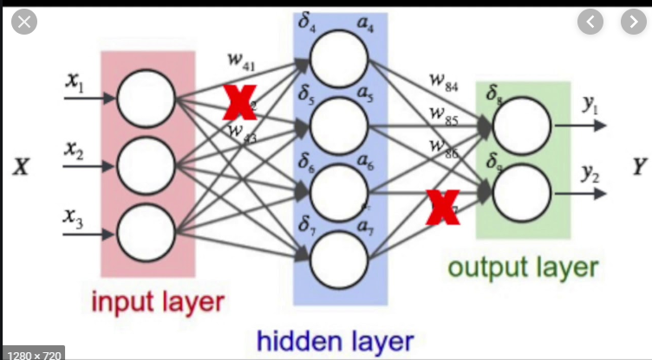
NNET PACKAGE
NNET stands for Neural Network
It acts as an hidden layer or it provides a single hidden layer
To convert the input in to the output
It also provides the multinom() function which helps in finding the regression value by combining two or more columns

Slide 5

THANK YOU

