Slide 1
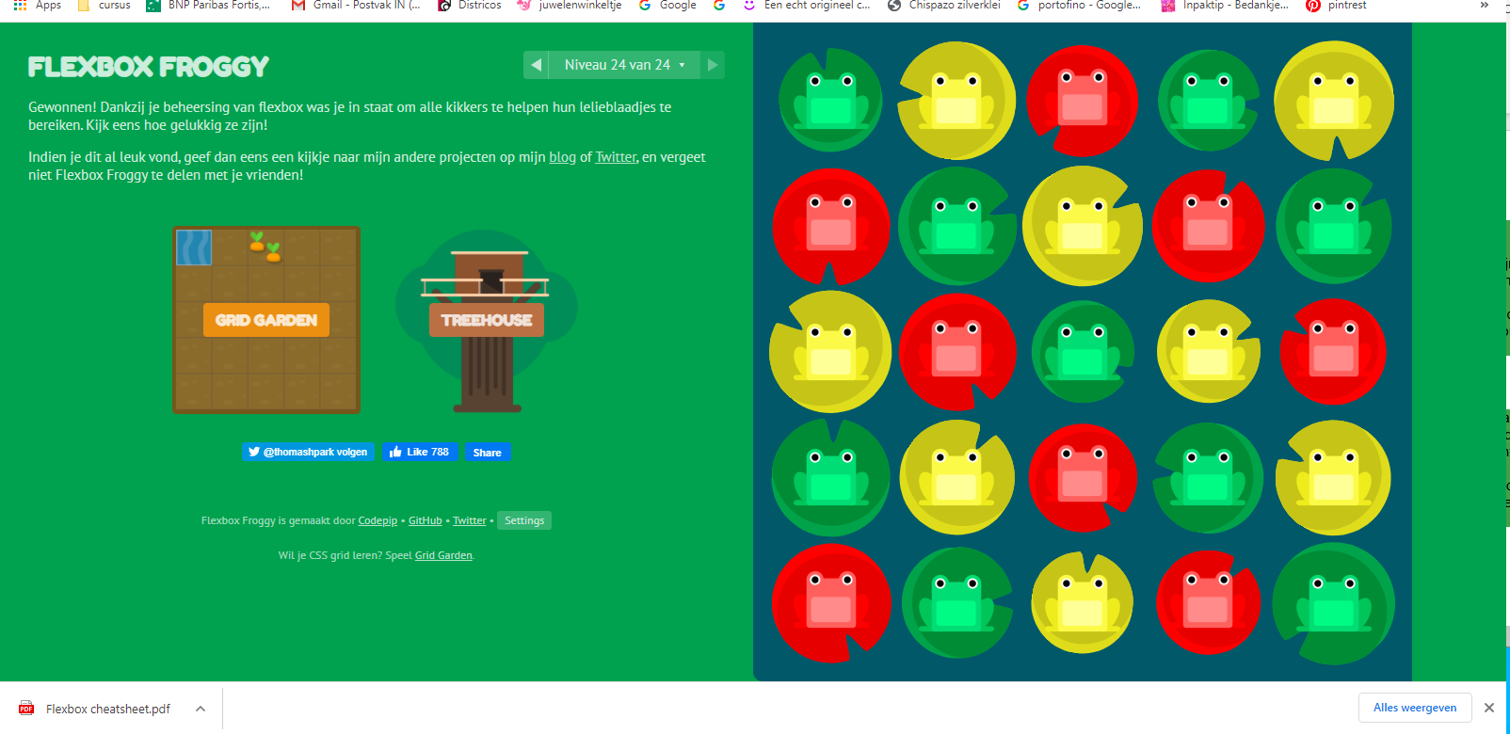
Froggy Flexbox

