Slide 1
Design & Development of Registration
ASL
Last updated on 23 Dec 2021

Slide 2
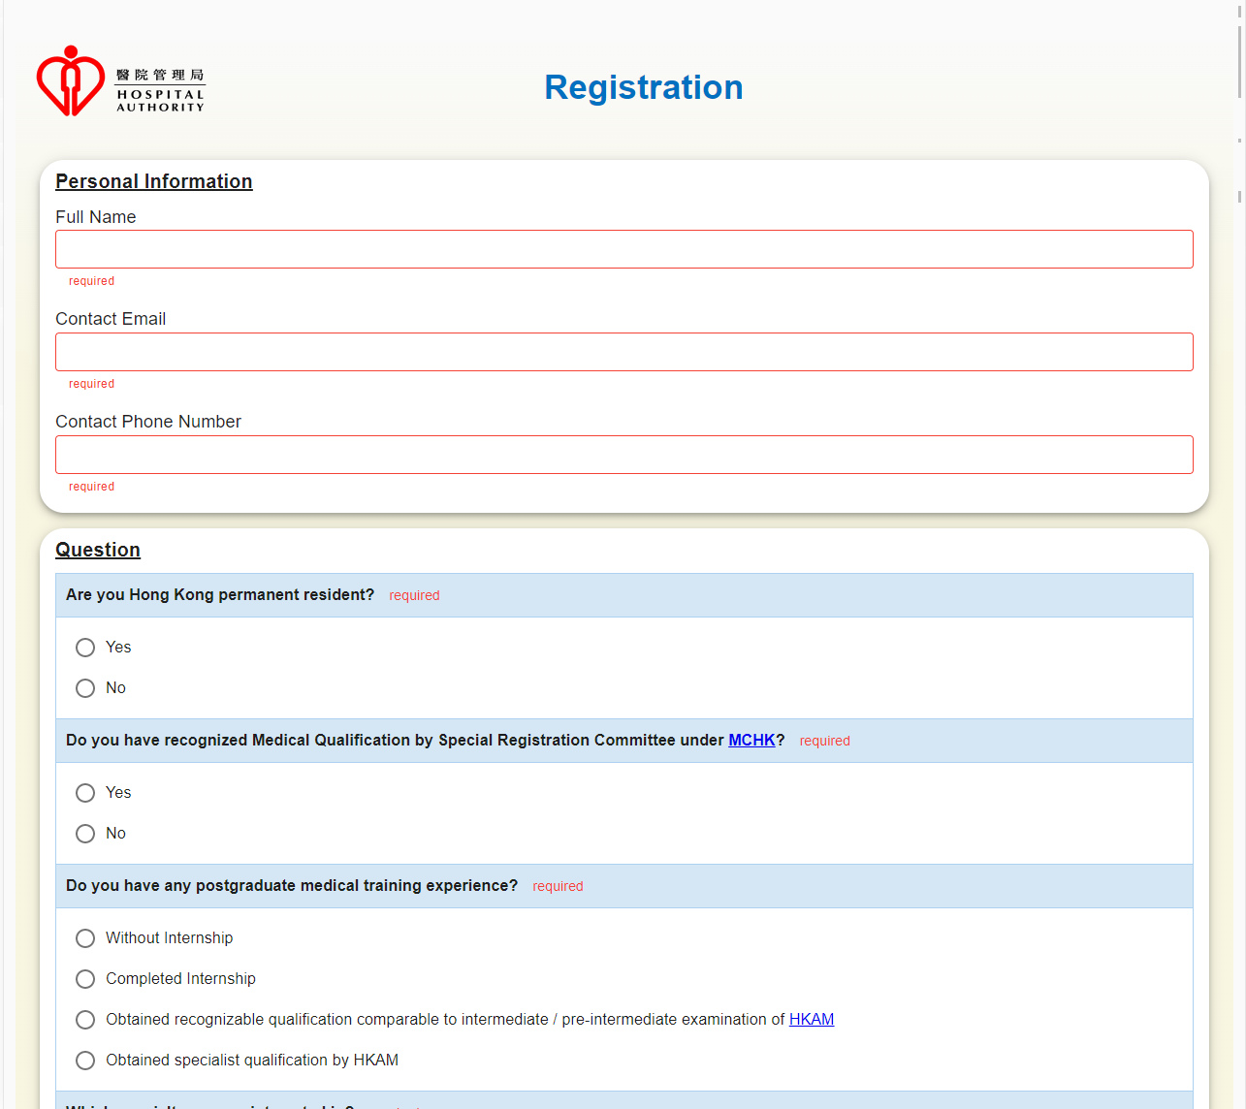
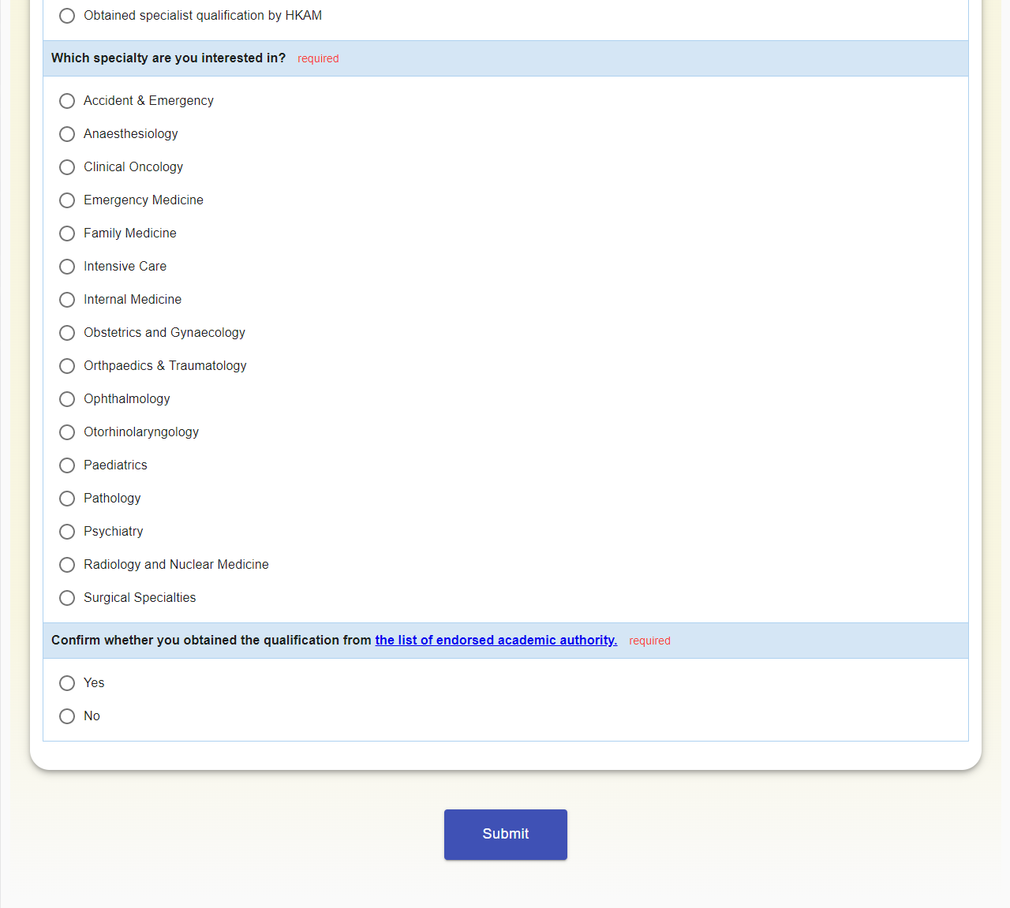
Proposed Screen
Form validation
when the input field is not filled in

Slide 3
Proposed Screen
Form validation
Entering invalid email
Entering invalid phone number

Slide 4
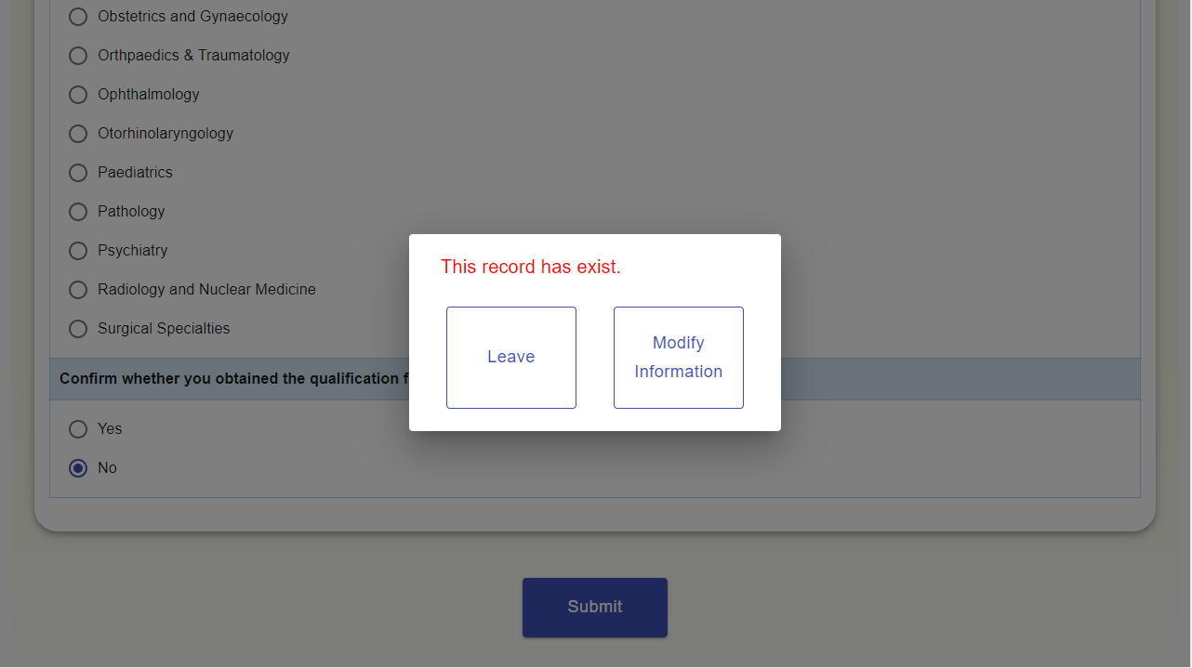
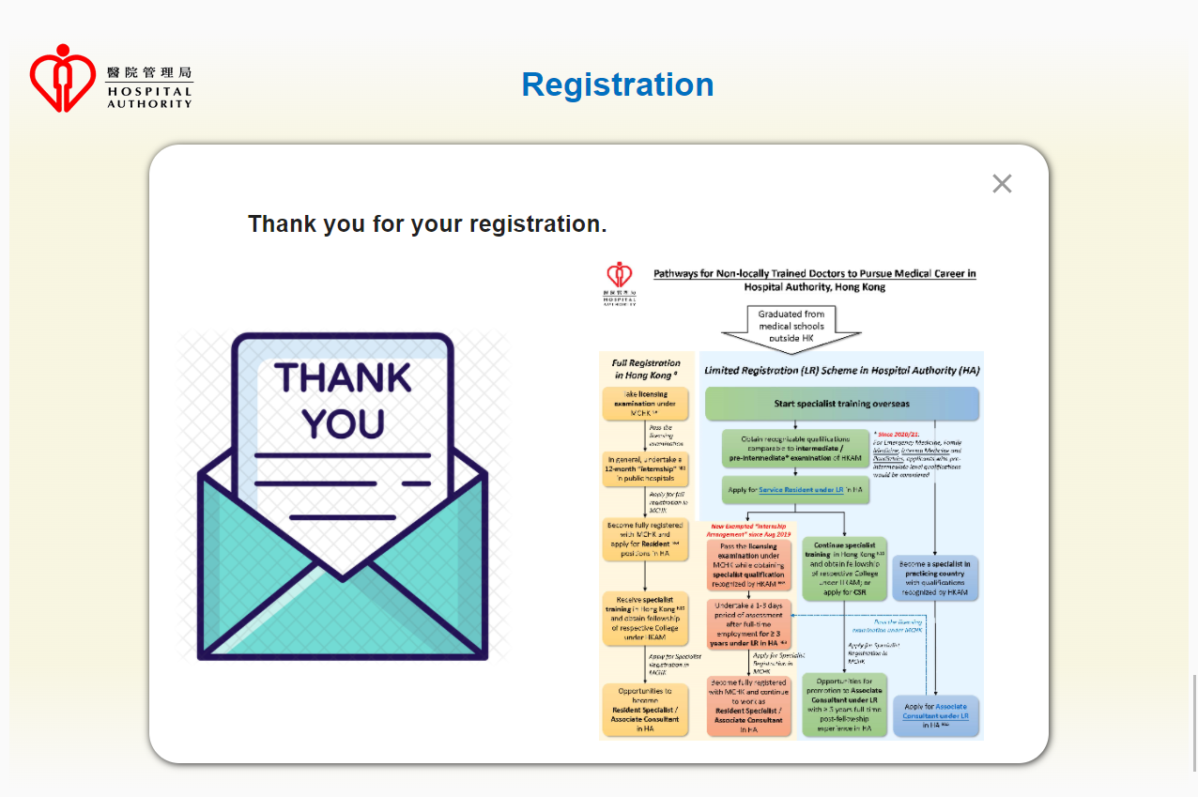
Click the button to submit the form and request api
1.Fail to submit ——Duplicate information was submitted
(dialog follow vis style)
2.Jump to the result page when the commit is successful

Slide 5
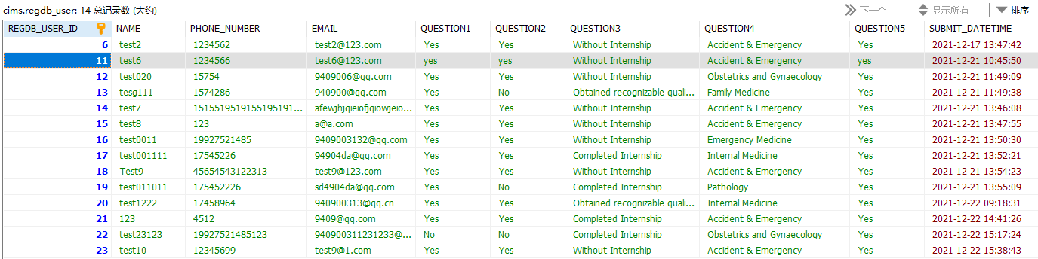
DB Details

