Slide 1
Design & Development of Registration
ASL
Last updated on 29 Dec 2021

Slide 2
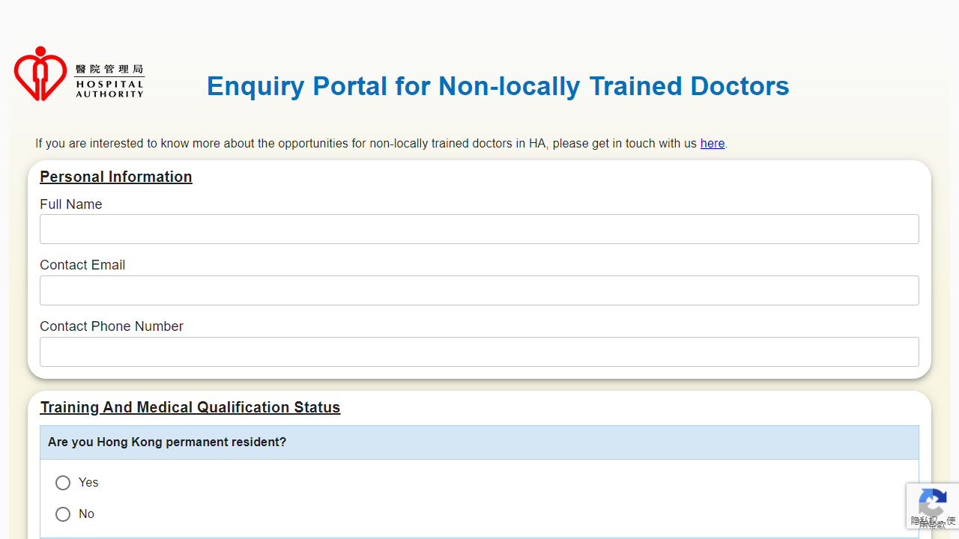
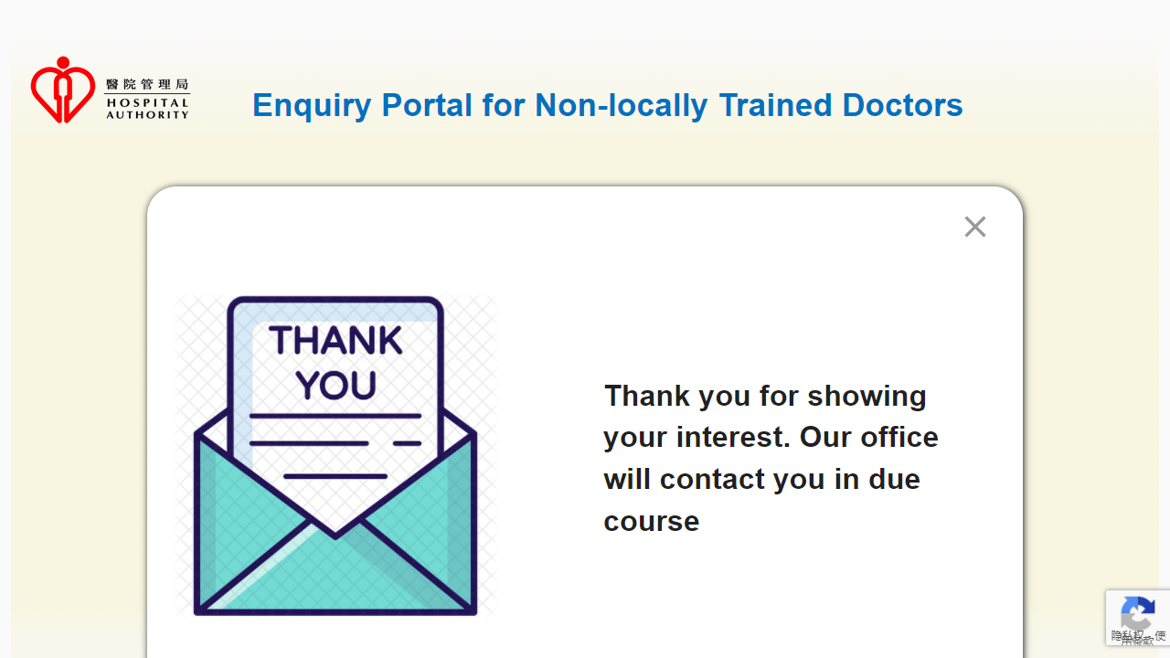
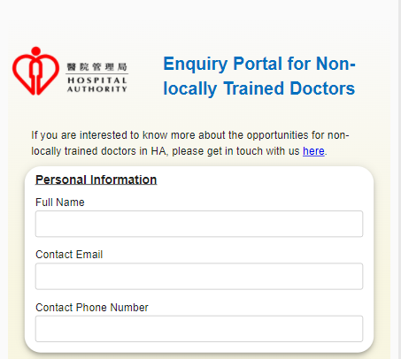
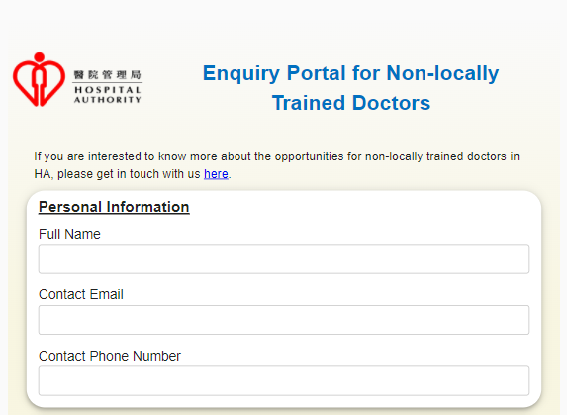
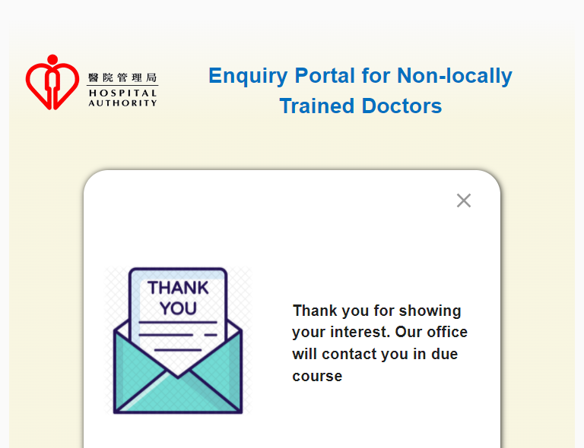

Proposed Screen
1. Screen Width >= 992px
3. Screen Width < 768px
2. 992px > Screen Width >= 768px

