Slide 1
Design & Development of Registration
ASL
Last updated on 4 Jan 2021

Slide 2
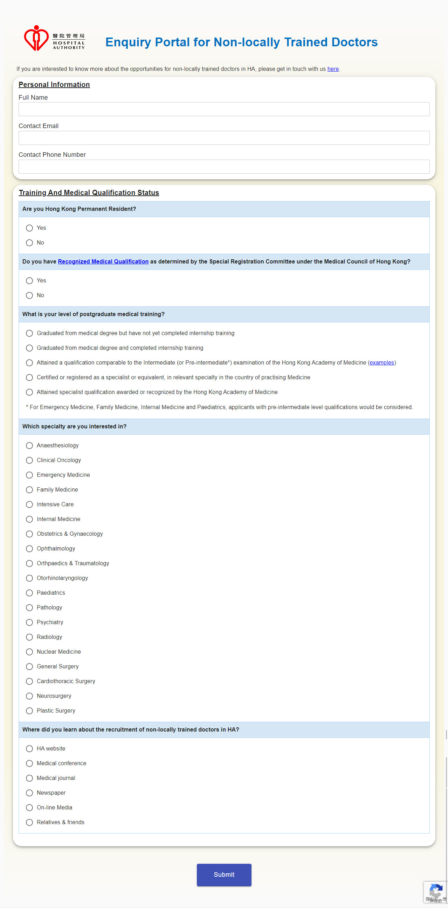
Proposed Screen
Registration Form (Part 1)

Slide 3
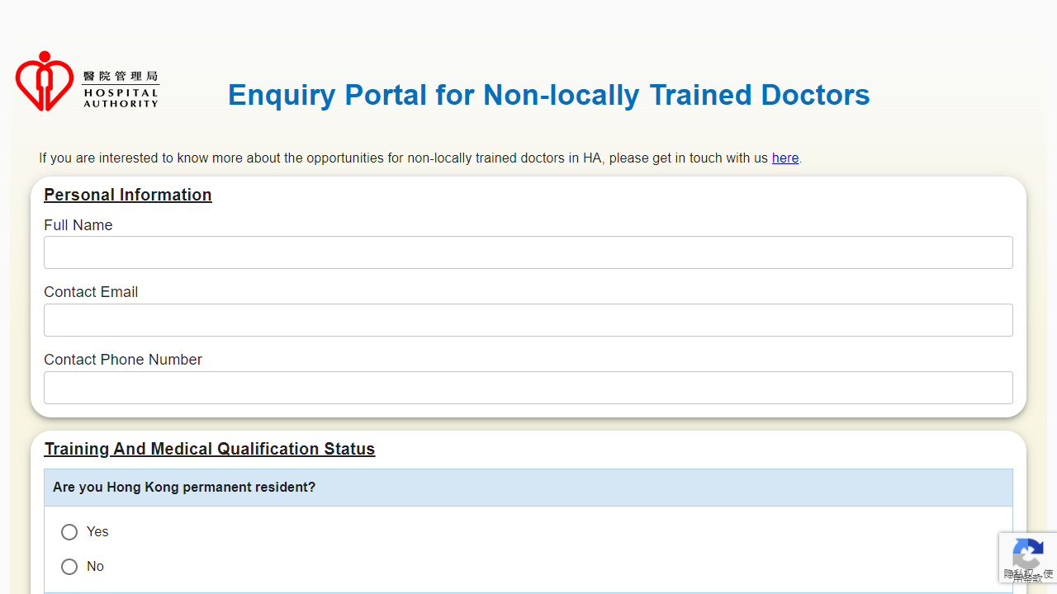
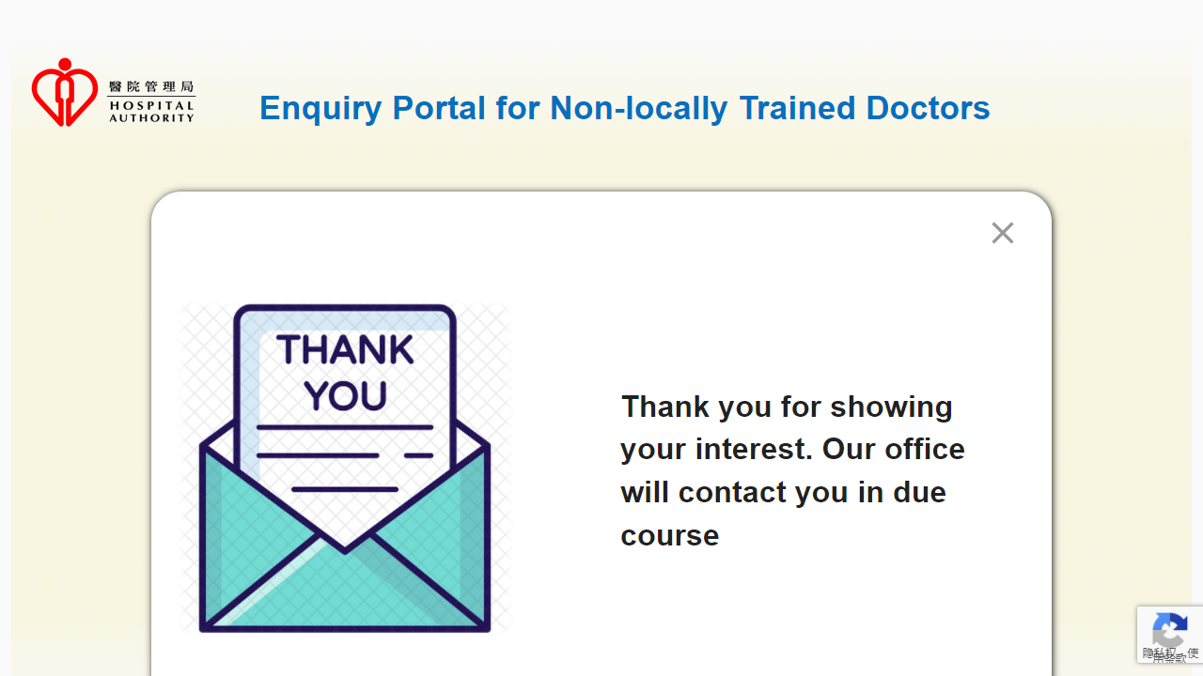
Proposed Screen
The format of the title display
1. If the screen is wide enough, the title is displayed in one line
（Screen Width >= 992px）

Slide 4
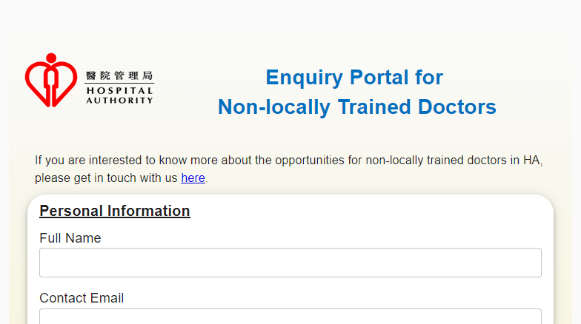
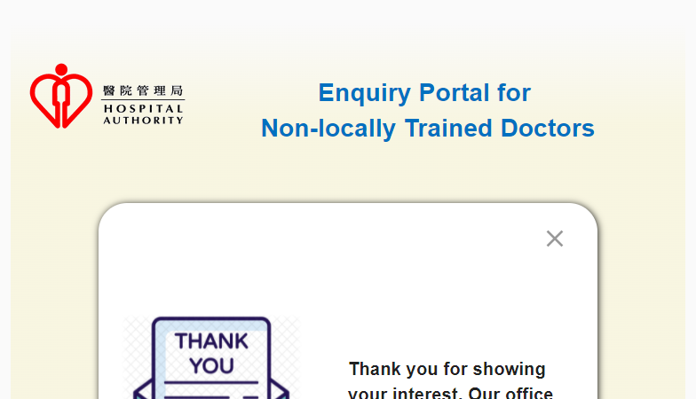
Proposed Screen
The format of the title display
2. If the screen is not wide enough to display the title in one line, it will be displayed in two lines, with a line break after the for word.
(Screen Width < 992px)

