Slide 1
Design & Development of Registration
ASL
Last updated on 21 Dec 2021

Slide 2
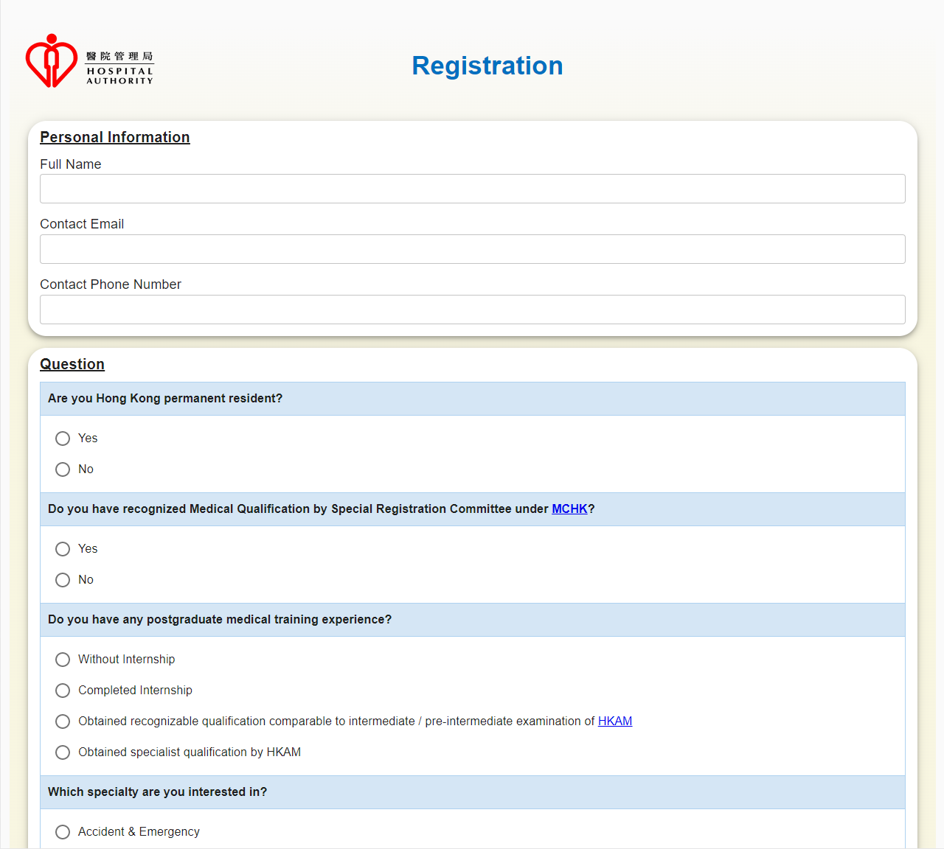
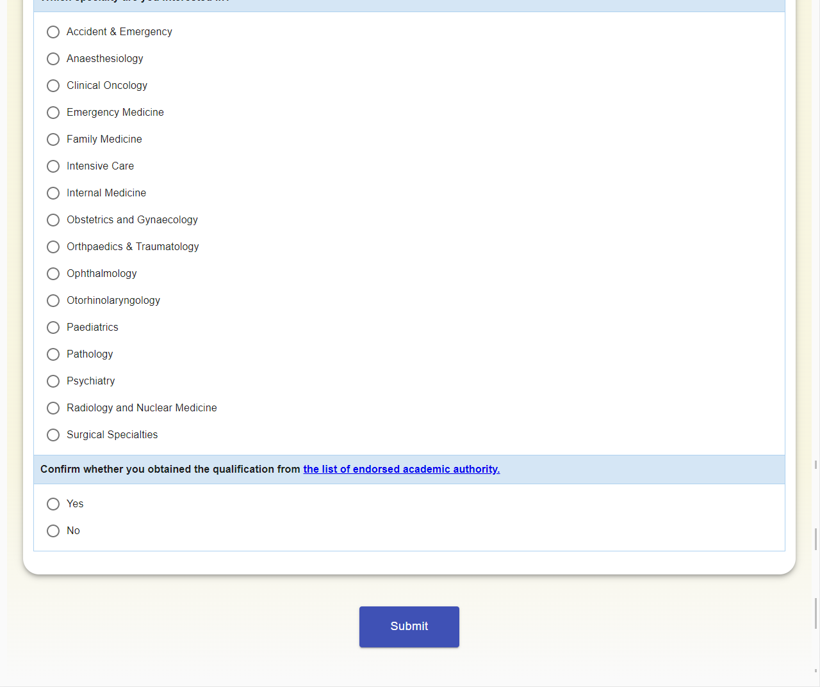
Proposed Screen
Registration Form (Part 1)

Slide 3
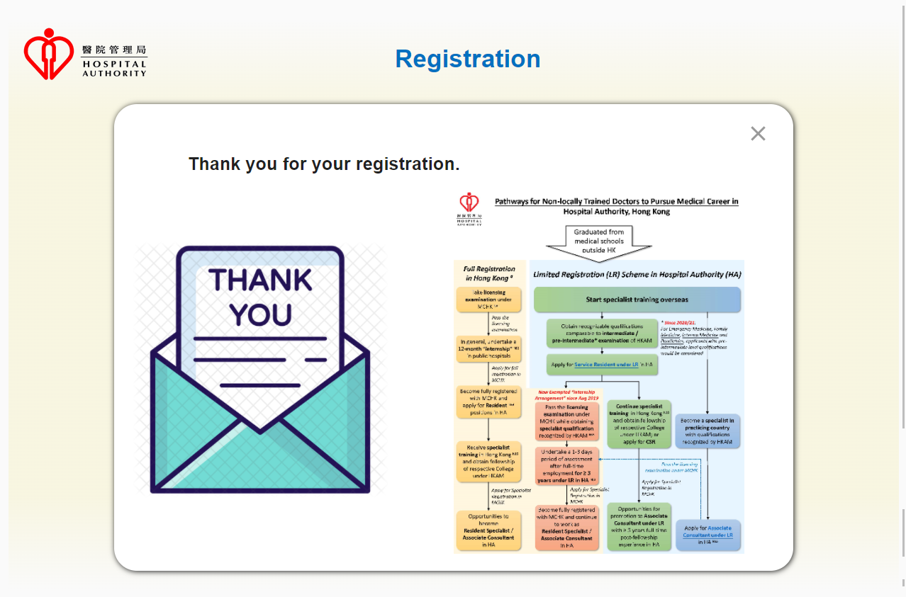
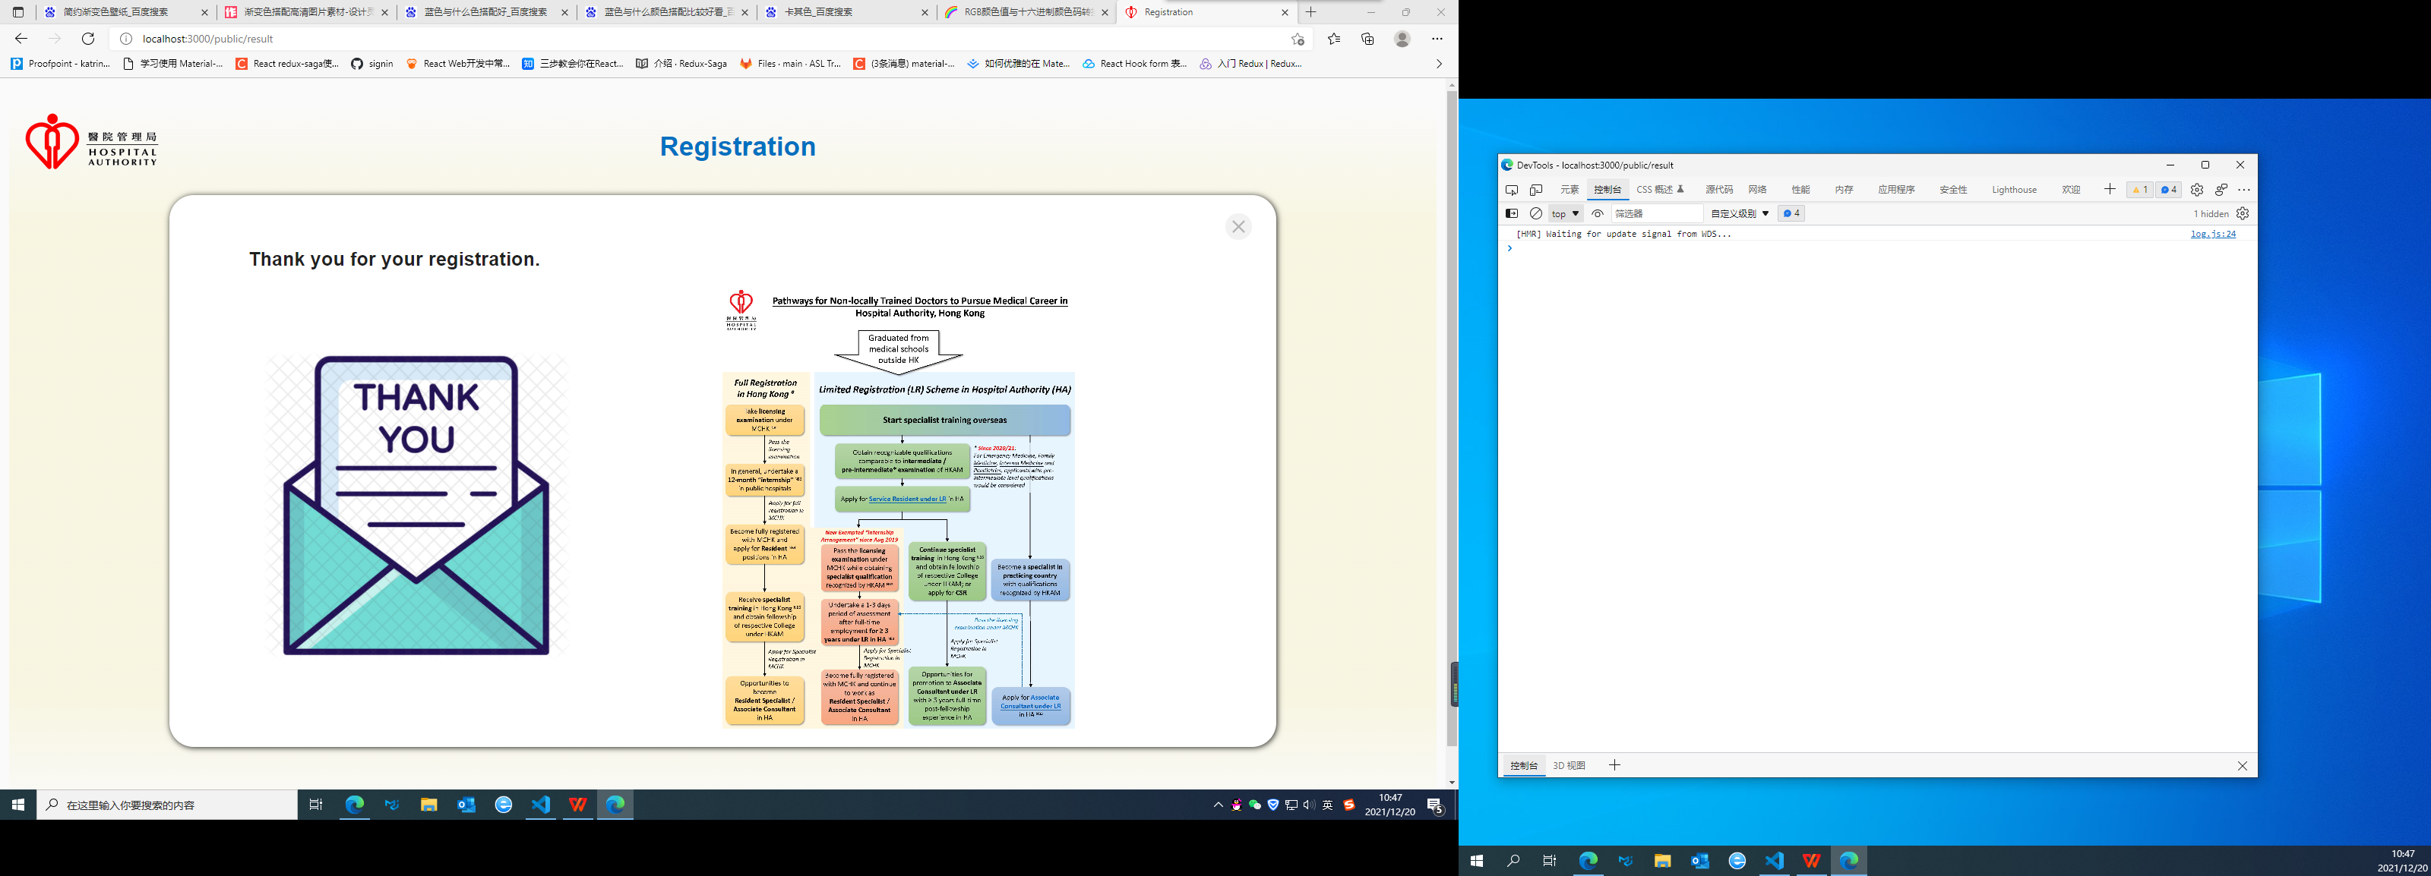
Proposed Screen
Result Page (Part 2)
hover

Slide 4
Proposed Screen
Input Parameter of the Registration form
 | Description | Mandatory | Input | Max Length | Validation
Personal Information
userName | Full Name | Yes | Inputbox | 255
email | Contact Email | Yes | Inputbox | 255
phoneNumber | Contact Phone Number | Yes | Inputbox | 50
Question
question1 | Are you Hong Kong permanent resident? | Yes | Radio | 1
question2 | Do you have recognized Medical Qualification by Special Registration Committee under MCHK? | Yes | Radio | 1
question3 | Do you have any postgraduate medical training experience? | Yes | Radio | 1
question4 | Which specialty are you interested in? | Yes | Radio | 1
question5 | Confirm whether you obtained the qualification from the list of endorsed academic authority. | Yes | Radio | 1

Slide 5
Technology Involved
Backend | Frontend | Supported Client Resolution | Supported Client Browser | Supported Client OS
Spring Boot v2.6.1 | ReactJS v17.0.2 | 1920 x 1080 | Chrome v91 | Windows
Maven | Material-ui v4.12.3 | 1280 x 720 | IE New Edge | Mac OS
IDEA 2021.2 |  |  | IE 11
Java 8
Packaging (WAR)
MySQL8.0

