Slide 1


06.07.2026
Enterprise Architecture Management
ArchiHotel — Reservation Handling

Slide 2
Introduction to ArchiHotel

Slide 3

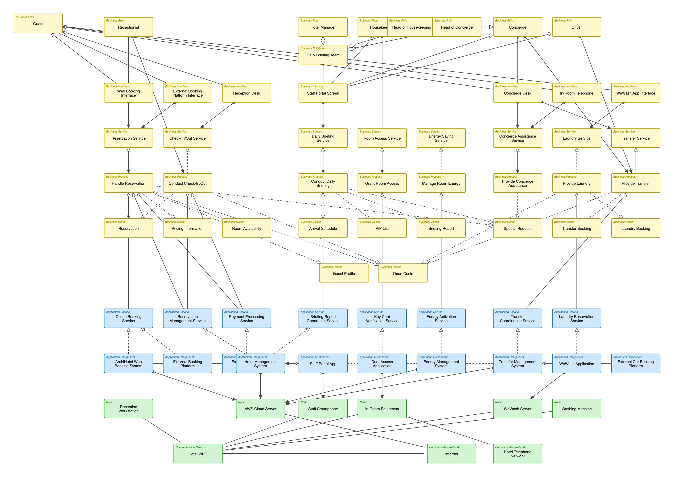
The Abstract EA Model

Slide 4
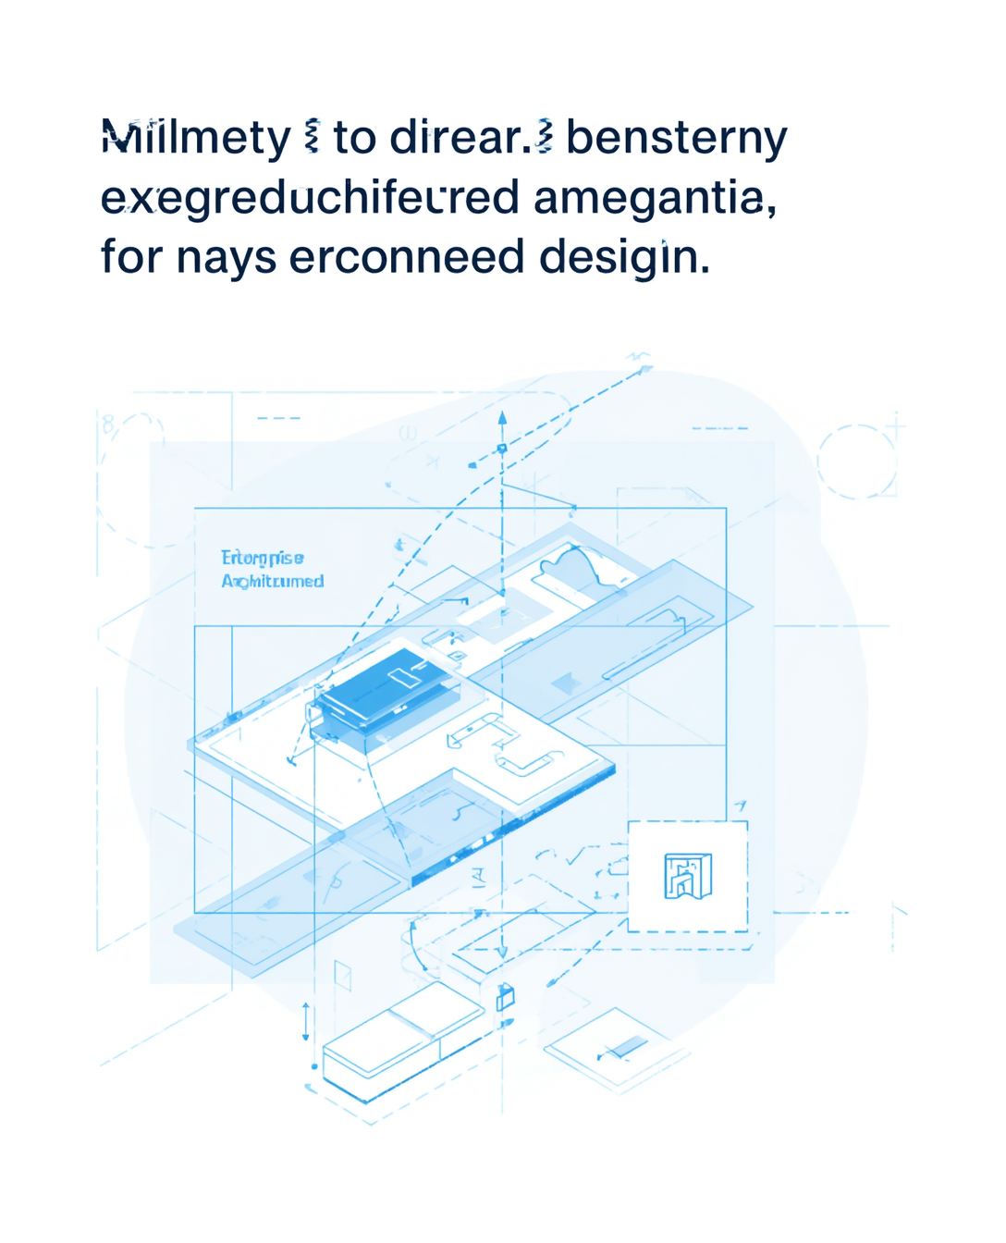
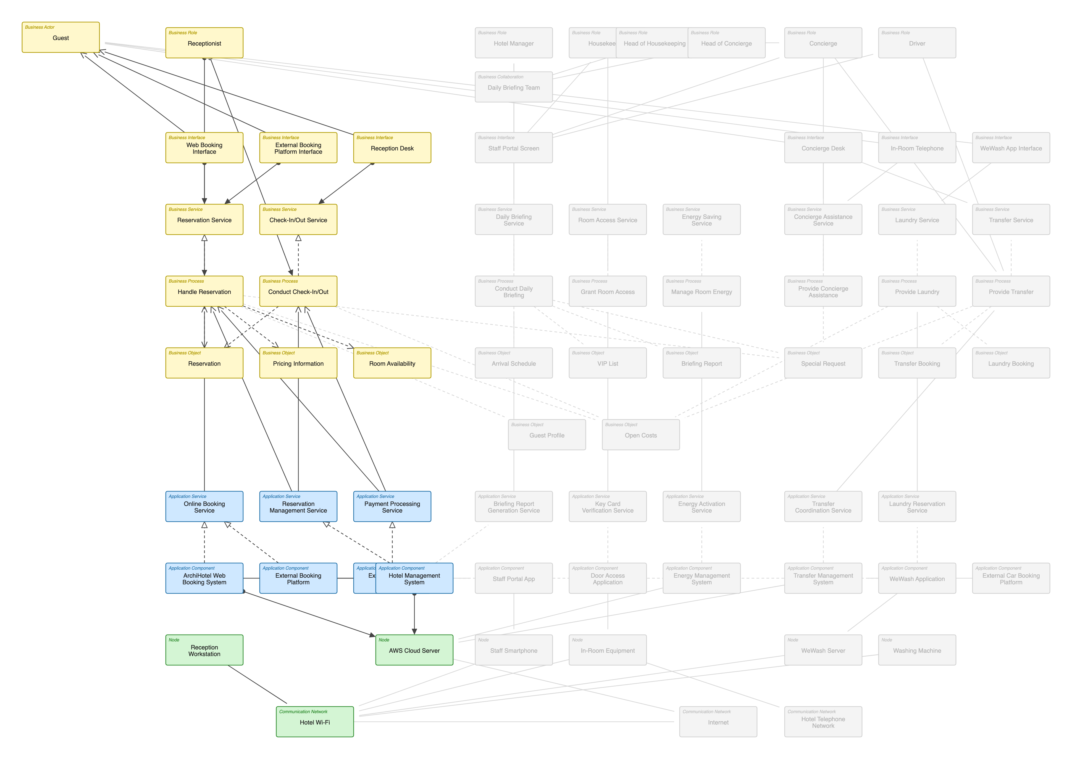
Focus Area F1 Overview

Slide 5

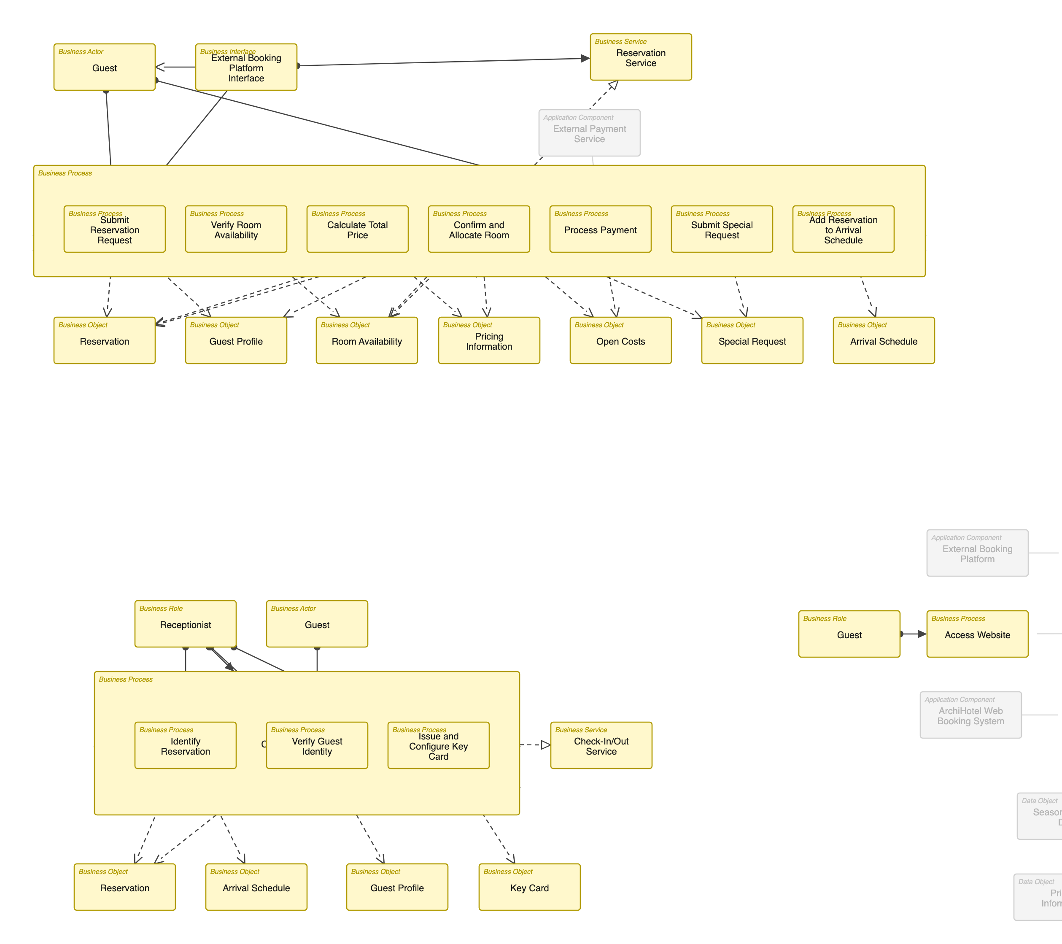
Business Layer Overview

Slide 6
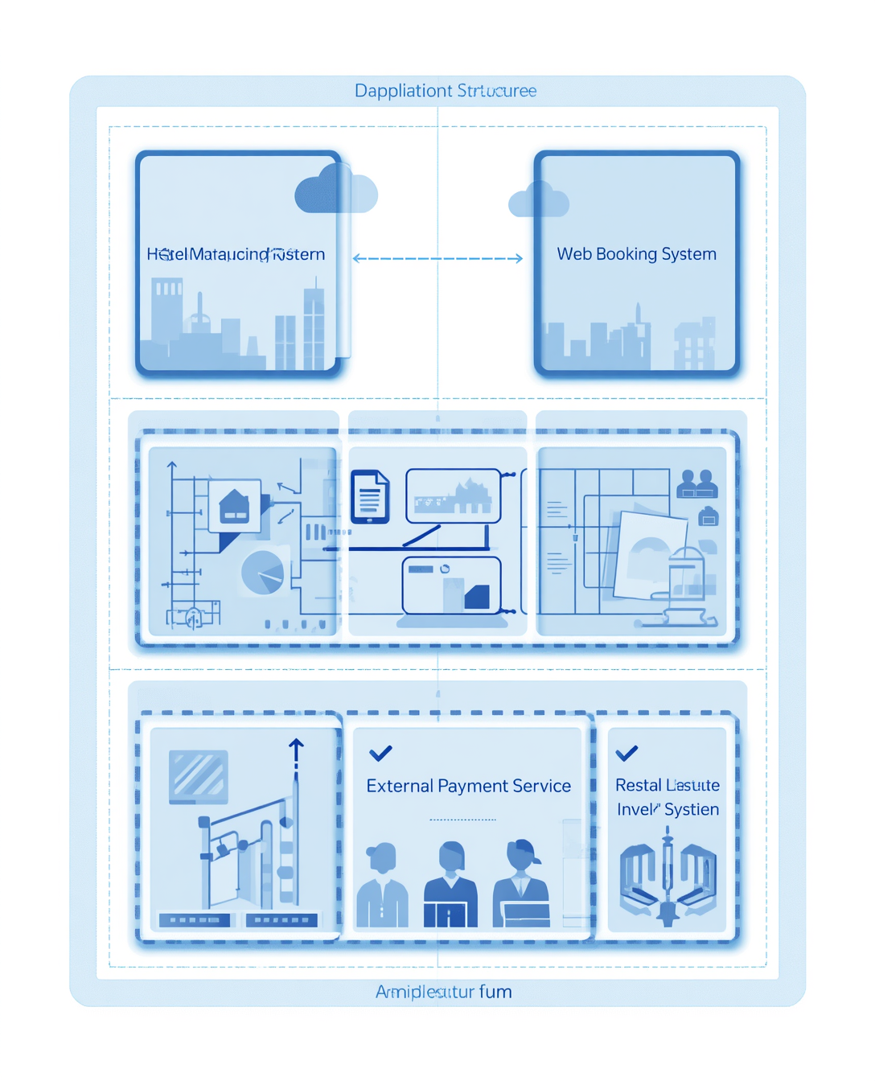
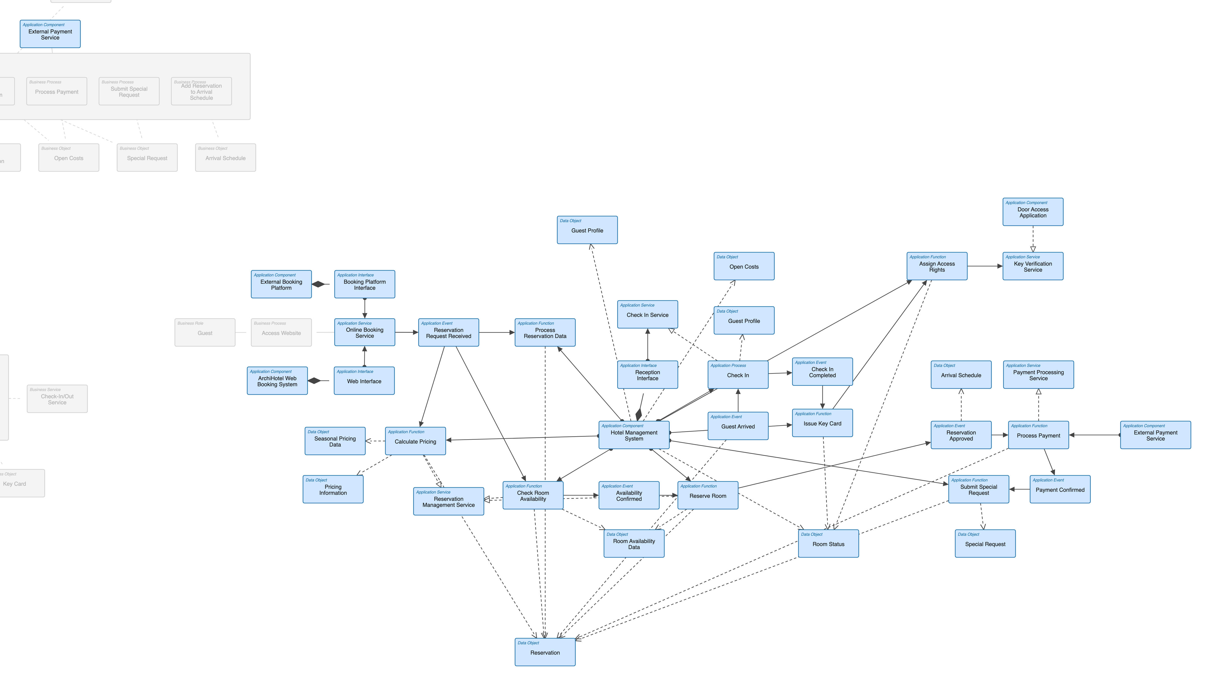
Application Layer Overview

Slide 7

Detailed Model — Technology Layer
⚠ Technology layer not yet modelled in Archi. Add Nodes (AWS Cloud Server, Reception Workstation, Staff Smartphones, Key-Card Encoder) + Networks (Hotel Wi-Fi, Internet) with explicit communication, then re-export.

Slide 8
Reflection
Insights on Value, Limitations, and Challenges
The HMS provides clarity and shared terminology, yet it lacks governance and motivation layers, highlighting the complexities and trade-offs in Enterprise Architecture Management.

Slide 9


Summary

Slide 10
Thank You
Phone
123-456-7890
Email
hello@reallygreatsite.com
Social
@reallygreatsite

