Slide 1
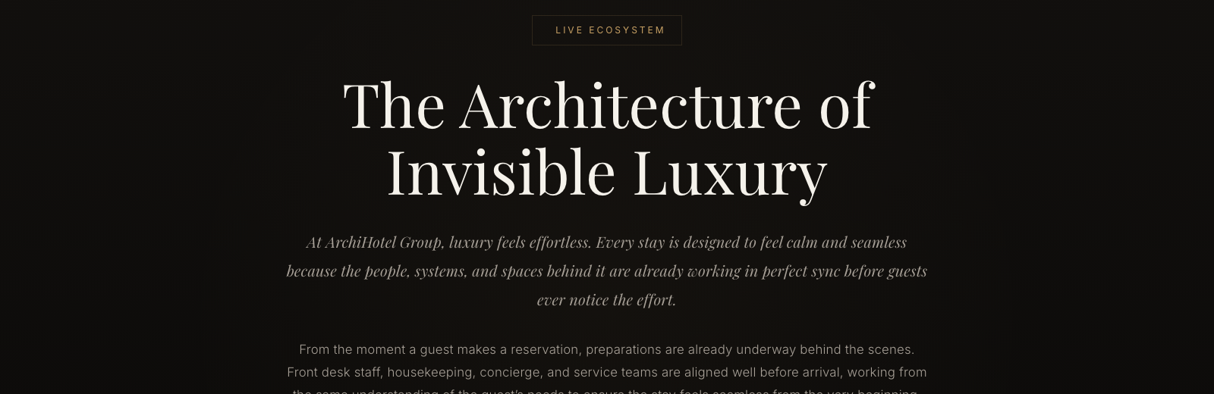
ArchiHotel: Reservation Handling & Check-In
Team C2F1G4: Katrin Schwab · Soyeong Jeong · Fiona Aurelia Tunggalmuljo
Mingwai Kelly Bin · Angel Choi · Demir Eroglu
Technical University of Munich, School of Computation, Information and Technology
EAM and Reference Models, Case Study Final Presentation · Heilbronn · Room C.0.44 · 06.07.2026
Notes:
SPEAKER Katrin (P1), about 15 seconds.
Hook: "At ArchiHotel, luxury feels effortless. But behind the desk, five systems have to cooperate for every single check-in." Say the team name, then move straight on. VERIFY the name spellings before submission, most of the roster comes from repo commits.

Slide 2
Our EAM Team
One layer per person, merged into one model
KS
SJ
FA
KB
AC
DE
Katrin Schwab
Abstract view & QA
Soyeong Jeong
Business layer
Fiona Aurelia Tunggalmuljo
Application layer
Mingwai Kelly Bin
Application layer
Angel Choi
Layer alignment
Demir Eroglu
Technology layer
EAM Case Study ArchiHotel · Group C2F1G4
2
Notes:
SPEAKER Katrin (P1), about 20 seconds.
One sentence: we split the model one layer per person. Angel kept the layers consistent with each other, and Katrin owned the abstract view and the final quality pass. This sets up the reflection answer on how we worked. Fiona and Kelly shared the application layer. Photos can replace the initials if the team prefers.

Slide 3
The Case: ArchiHotel's Services
A luxury hotel that runs on one Hotel Management System
Reservation Handling
Payment
Website and external booking platforms
External payment service provider
Check-In / Check-Out
Daily Briefing & Staff
Identity check, key card, open costs
One shared picture of the day on staff phones
Our Focus Area: F1
EAM Case Study ArchiHotel · Group C2F1G4
3
Notes:
SPEAKER Katrin (P1), about 30 seconds.
Walk the four services: a guest books, arrives and checks in, pays, and every morning the staff aligns on one shared picture. All of it runs on the Hotel Management System. Point at the red box: our focus area F1 covers reservation handling and check-in, the guest journey from booking to arrival. Payment touches it too.

Slide 4
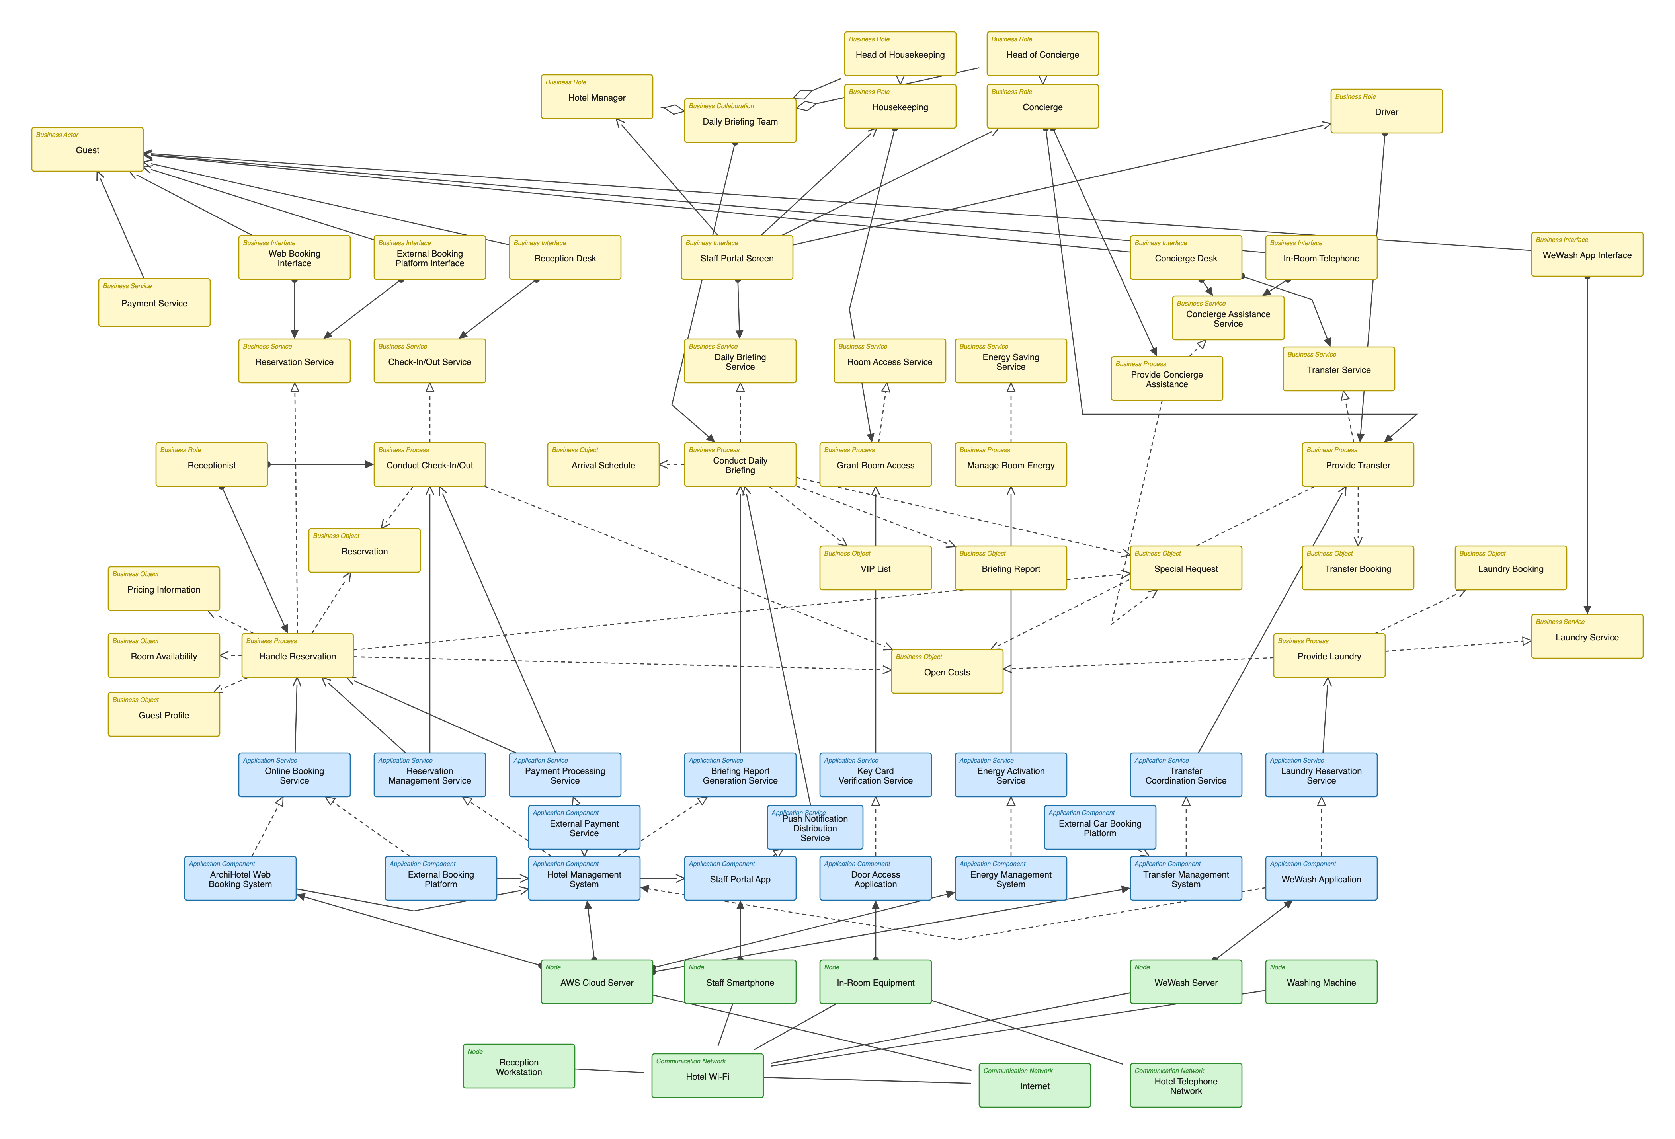
The Abstract EA Model
72 elements, 98 relationships, three layers. Please don't read the boxes.
Guest
Business
Three ArchiMate layers
Business, application, technology
Receptionist
Key stakeholders
Guest and Receptionist drive F1
The convergence point
HMS on the AWS Cloud Server
Application
HMS
AWS
Technology
EAM Case Study ArchiHotel · Group C2F1G4
4
Notes:
SPEAKER Katrin (P1), about 70 seconds. The abstract view is her part of the model.
Say it explicitly: "Don't try to read this. It's the map." CLICK 1: the three layer bands, business in yellow, application in blue, technology in green. CLICK 2: the key stakeholders, the Guest at the top left and the Receptionist who runs check-in. CLICK 3: everything converges on the Hotel Management System, hosted on the AWS Cloud Server. That server is the technology backbone. Name the main services along the top: reservation, check-in and check-out, daily briefing, room access. Hand over to Soyeong.

Slide 5
Focus Area F1: Where We Zoom In
From booking to arrival: Handle Reservation, then Conduct Check-In/Out
1
Business layer
Who does what
F1: Reservation & Check-In
2
Application layer
Which systems support it
3
Technology layer
What it runs on
EAM Case Study ArchiHotel · Group C2F1G4
5
Notes:
SPEAKER Soyeong (P2), about 30 seconds.
Same map, now with the F1 slice boxed in red: the chain from Handle Reservation to Conduct Check-In/Out, the services above them, and the application and technology support below. "We'll zoom into this in three steps: business, application, technology."

Slide 6
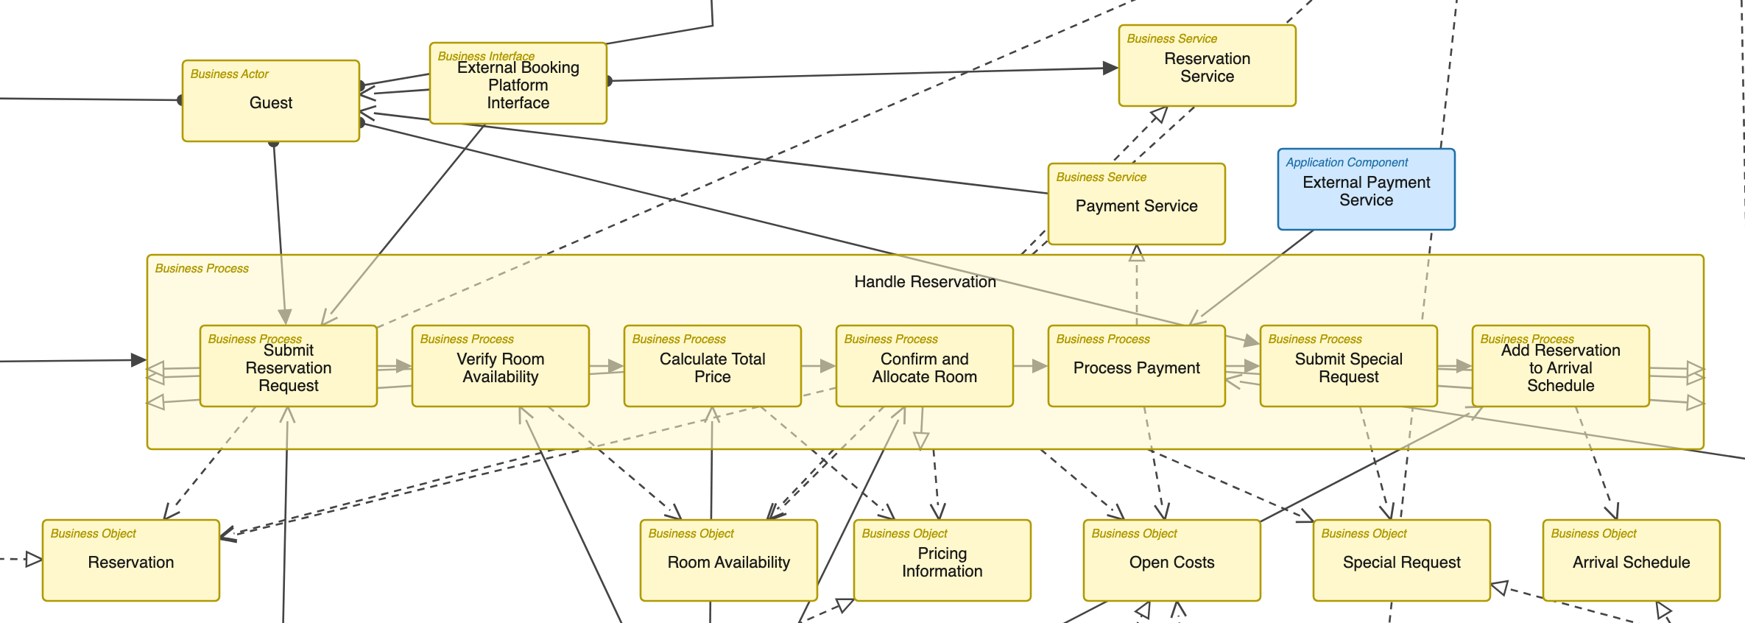
F1 Business Layer: Reservation
One abstract process becomes seven concrete steps
Guest
Payment
Handle Reservation: 7 steps
Business objects
EAM Case Study ArchiHotel · Group C2F1G4
6
Notes:
SPEAKER Soyeong (P2), about 55 seconds. The business layer is her part of the model.
CLICK 1: the Guest triggers everything, through the website or an external booking platform. CLICK 2: walk the chain: Submit Reservation Request, Verify Room Availability, Calculate Total Price, Confirm and Allocate Room, Process Payment, Submit Special Request, Add Reservation to Arrival Schedule. CLICK 3: payment is its own business service, delivered by the External Payment Service. CLICK 4: every step reads or writes a business object, from Reservation to Arrival Schedule.

Slide 7
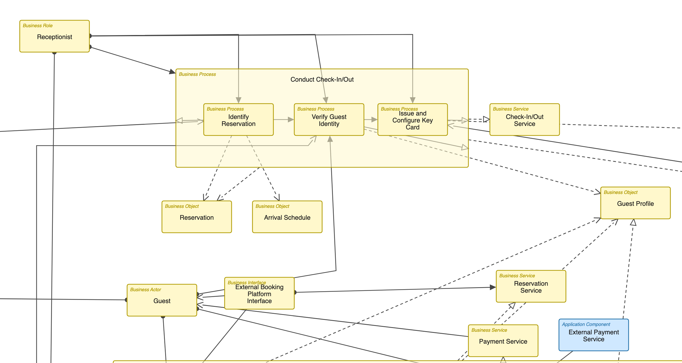
F1 Business Layer: Check-In
The Receptionist turns a reservation into an open door
3 steps
Receptionist
Service
Payment settles open costs
EAM Case Study ArchiHotel · Group C2F1G4
7
Notes:
SPEAKER Soyeong (P2), about 55 seconds.
CLICK 1: the Receptionist is assigned to the whole Conduct Check-In/Out process. CLICK 2: three steps: Identify Reservation, Verify Guest Identity, Issue and Configure Key Card. CLICK 3: together they realize the Check-In/Out Service the guest experiences. CLICK 4: open costs settle through the Payment service, backed by the external provider. Handover line: "So much for the people. Now the systems underneath." Hand over to Fiona.

Slide 8
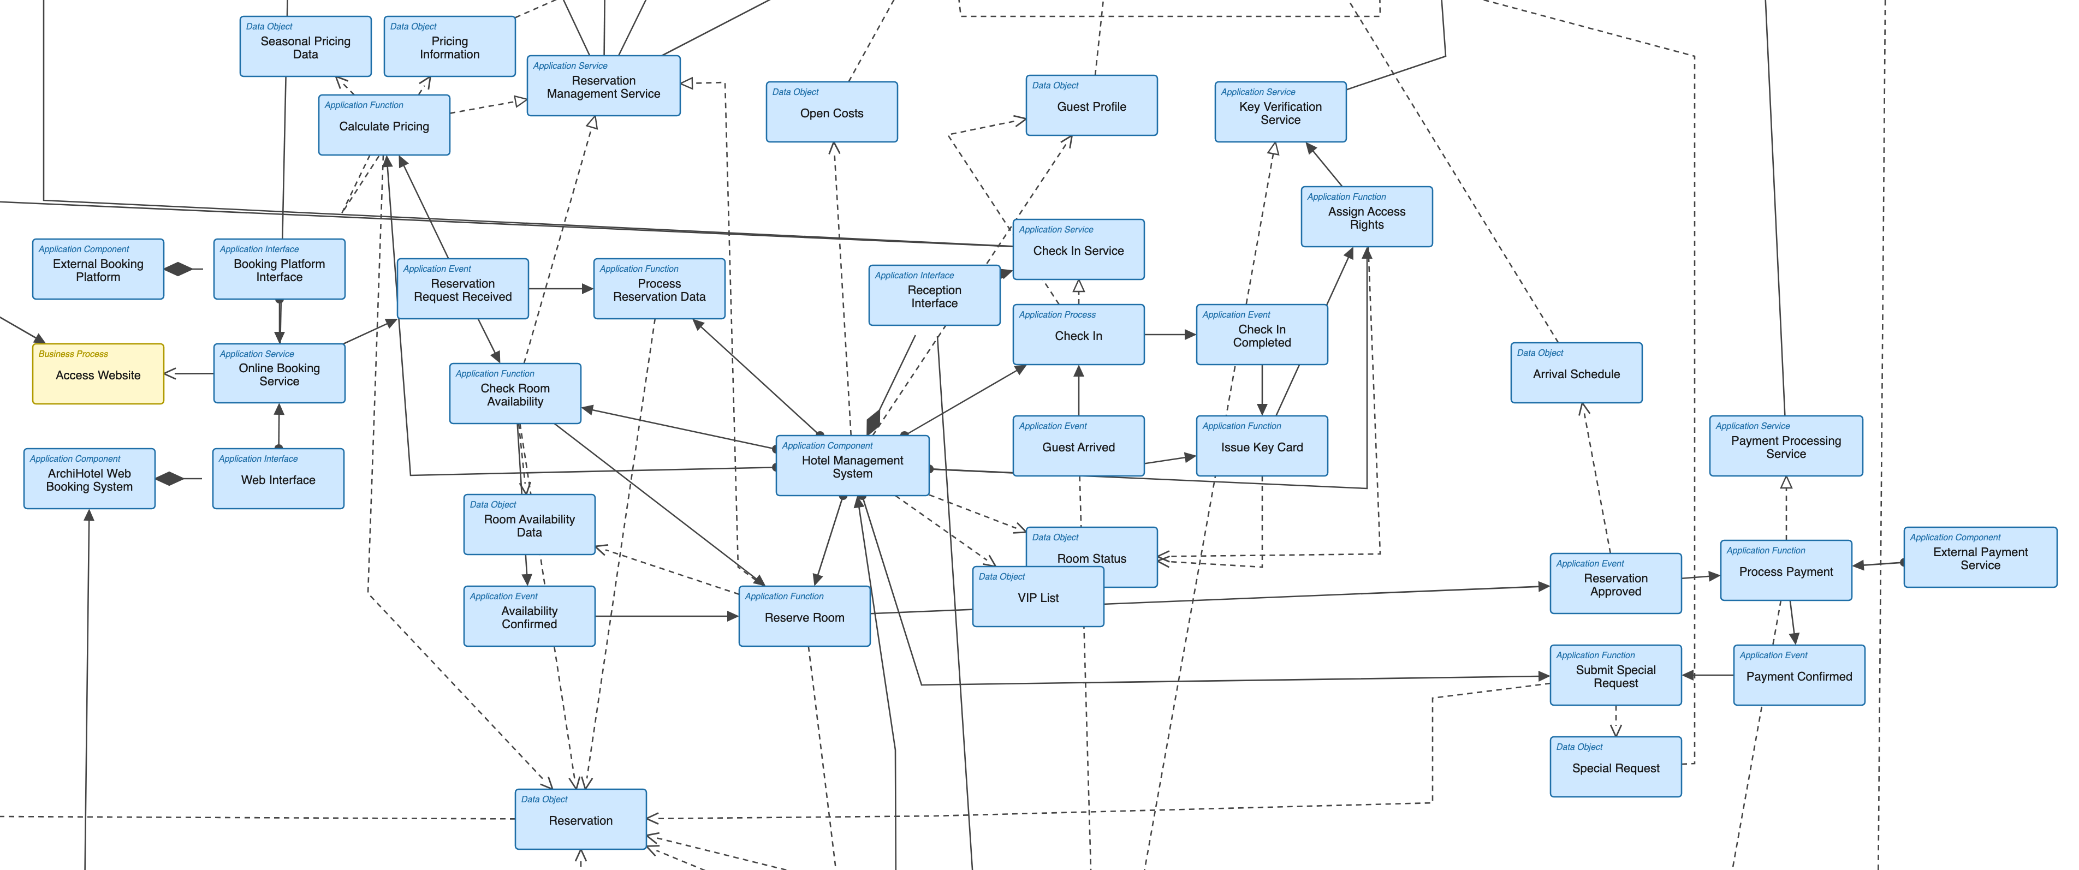
F1 Application Layer: Inside the HMS
The functions and services behind the business processes
Services exposed upward
Internal functions
Hotel Management System
EAM Case Study ArchiHotel · Group C2F1G4
8
Notes:
SPEAKER Fiona (P3), about 100 seconds. She built this part of the model with Kelly.
CLICK 1: the HMS is the central component, everything on this slide lives inside or around it. CLICK 2: its functions are modeled explicitly: Check Room Availability, Calculate Pricing, Reserve Room, Issue Key Card. CLICK 3: those functions are exposed upward as application services like Reservation Management, Check-In and Key Verification. Each one serves a business process from the previous slides. Hand over to Kelly for the dynamic side.

Slide 9
F1 Application Layer: Events & Data
How one reservation flows through the system
Event chain
Approval & payment events
Data object realizes Reservation
EAM Case Study ArchiHotel · Group C2F1G4
9
Notes:
SPEAKER Kelly (P4), about 100 seconds. She built this part of the model with Fiona.
CLICK 1: application events chain the flow: a reservation request arrives and gets processed. CLICK 2: follow it to the right: Reservation Approved, Process Payment, Payment Confirmed, and the special request follows after payment. CLICK 3: pick one realization example and explain the pattern: the Reservation data object is the digital record behind the Reservation business object. Guest profile, pricing and room status follow the same pattern. Hand over to Demir for the technology underneath.

Slide 10
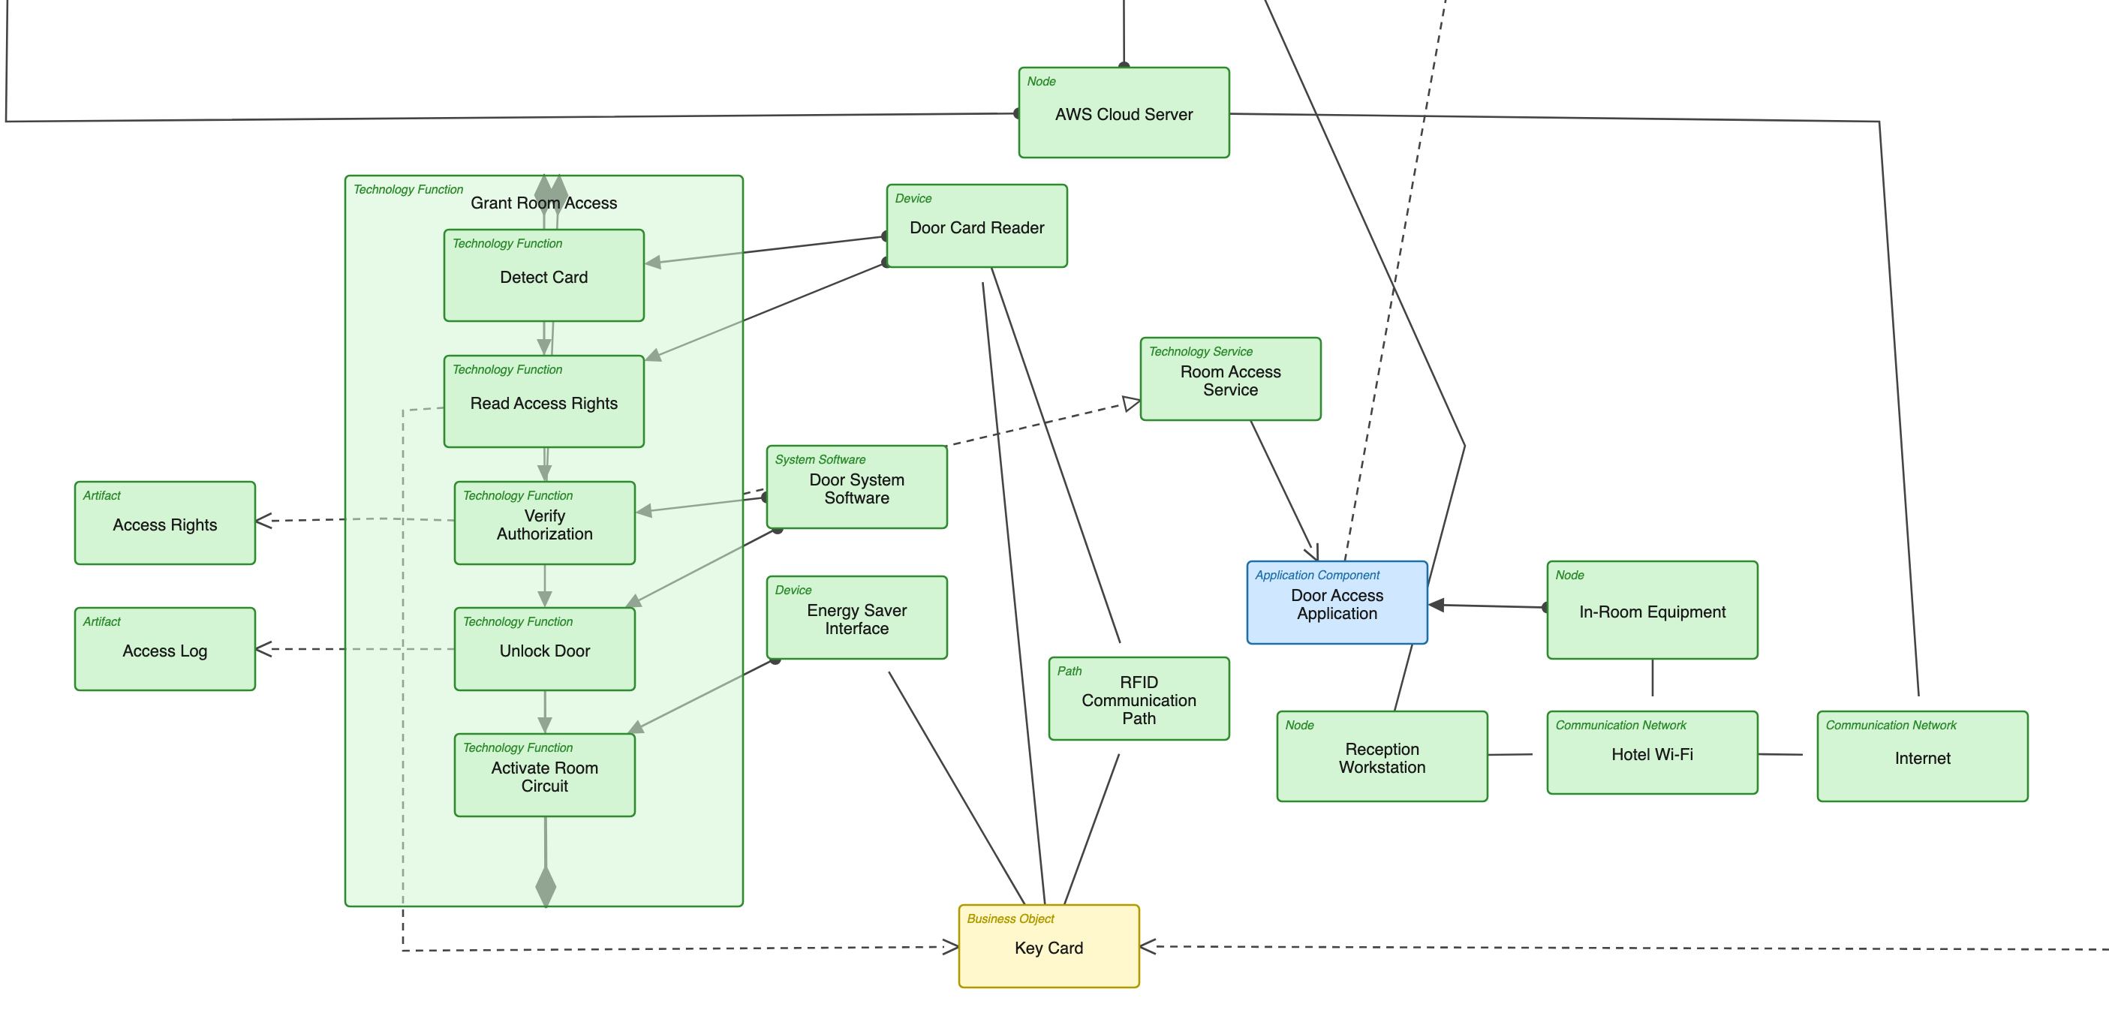
F1 Technology Layer: Down to the Door
How an online reservation becomes a door that opens
Grant Room Access
Door Card Reader
Artifacts
RFID · Wi-Fi
Key Card
EAM Case Study ArchiHotel · Group C2F1G4
10
Notes:
SPEAKER Demir (P5), about 2 minutes. The technology layer is his part of the model.
CLICK 1: the guest taps the key card and the Door Card Reader detects it. CLICK 2: the Grant Room Access chain runs: Detect Card, Read Access Rights, Verify Authorization, Unlock Door, Activate Room Circuit. CLICK 3: the Door System Software reads the Access Rights artifact and writes the Access Log. CLICK 4: communication is modeled explicitly: the RFID path to the card, hotel Wi-Fi and Internet up to the AWS-hosted HMS. CLICK 5: close the loop: "This is how a reservation made online becomes a door that opens."

Slide 11
Reflection: Value & Limitations
Value
Limitations
One shared picture of five cooperating systems
Impact analysis: what breaks if the HMS is down?
Faster onboarding for new staff and developers
A snapshot, with no process to keep it current
No quantities, no SLAs, no capacity answers
Abstraction hides detail by design
EAM Case Study ArchiHotel · Group C2F1G4
11
Notes:
SPEAKER Angel (P6), about 55 seconds. He aligned the layers, so the reflection is his block.
Value: the model gives one shared picture across more than five systems, supports impact analysis (walk one example: HMS down, which services stop?), and speeds up onboarding. Limitations: it's an as-is snapshot with no governance process, it has no quantities or SLAs, and every abstraction choice hides detail on purpose.

Slide 12
Reflection: Missing Information & Challenges
Missing in the case material
Our real challenges
No infrastructure specs for the reservation side
Interfaces to external booking platforms unclear
No failure or volume data
Finding the right abstraction level
Keeping the abstract and detailed views consistent
Merge conflicts and duplicates from modeling in parallel
EAM Case Study ArchiHotel · Group C2F1G4
12
Notes:
SPEAKER Angel (P6), about 55 seconds. The merge conflicts are literally his war story.
Missing: infrastructure specs for the reservation side, the interfaces to external booking platforms, and any failure or volume data. Challenges, use the real ones: choosing the abstraction level, keeping the two views consistent while both evolved, and coArchi merge conflicts from modeling in parallel. We hit that one for real and merged eleven duplicate elements late. The kickoff literally warns about it.

Slide 13
Summary
Thank you! Questions?
F1 modeled across all three layers
Everything converges on the HMS
The map first, then one story per layer
Value: transparency and impact analysis
Limits: a snapshot, no quantities
EAM Case Study ArchiHotel · Group C2F1G4
13
Notes:
SPEAKER Angel (P6), about 30 seconds.
Recap in three sentences: we modeled reservation handling and check-in across all three ArchiMate layers, everything converges on the HMS, and the model's value is transparency and impact analysis, with the limits of a snapshot. Thank the audience. KEEP THIS SLIDE UP during the discussion. Everyone stays up front, they will ask each member something.

Slide 14
Backup
Notes:
Q&A backup, 5 minutes of discussion. Following slides: full detailed view, full abstract view, model facts.

Slide 15
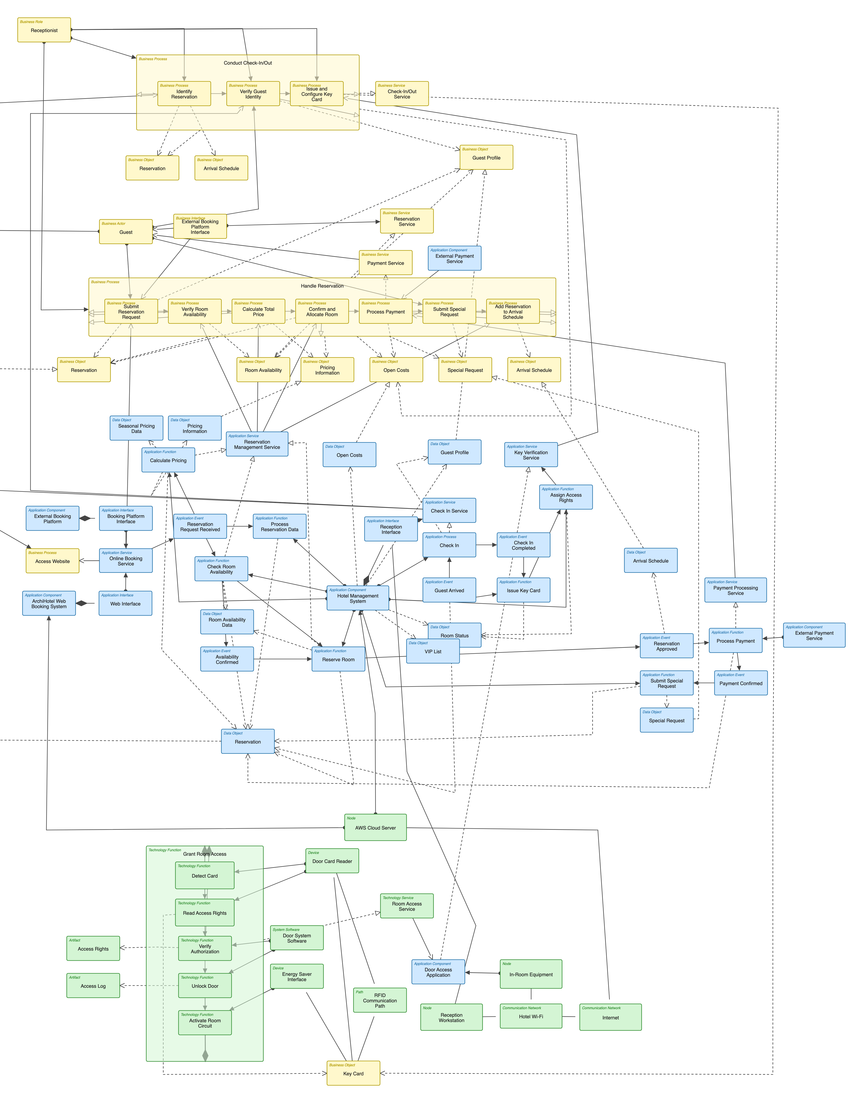
Backup: Detailed View, Complete
Detailed · F1 Reservation & Check-In · 86 objects · 160 connections
EAM Case Study ArchiHotel · Group C2F1G4
15
Notes:
Backup: complete detailed view for zoom-in questions.

Slide 16
Backup: Abstract View, Complete
Abstract · ArchiHotel EA · 72 objects · 98 connections
EAM Case Study ArchiHotel · Group C2F1G4
16
Notes:
Backup: complete abstract view. Useful for questions about the other focus areas, like briefing, laundry or transfer.

Slide 17
Backup: Model Facts
The model
Tooling & workflow
One .archimate file with two views
Abstract: 72 objects, 98 connections
Detailed F1: 86 objects, 160 connections
Nouns for structure, verbs for behavior
Archi with coArchi, shared GitHub repository
One layer per team pair or person, regular alignment
Independent model audit before submission
EAM Case Study ArchiHotel · Group C2F1G4
17
Notes:
Backup: numbers and workflow facts for the discussion.

