Slide 1
F
B
M
S
ile
ackup
and
anagement
ystem

Slide 2
Why use FBMS?
Ensure your files are safely backed up with revisions
No tangling with complex programs like SVN
Functions akin to a local-network version of Dropbox
Works on any locally accessible drive, including external drives and network drives
Set it and forget it
Targeted as the semi-casual audience, who know enough to understand the need for backups, but don't want to use a version control system (or perhaps don't like using such systems)
Notes:
Da: Backup systems are virtually mandatory. Nobody wants to lose years of work because of a shoddy hard drive. FBMS, or the File Backup and Management System, ensures that your programs are safely backed up. But more than that, FBMS keeps revisions of files, akin to programs like subversion. Where FBMS differs is its complexity. There’s no need to tangle with adds and commits. Just tell the program what folder to monitor and where to place the backups and the system does the rest, keeping your files safe until you need them.
FBMS is suitable where programs like Dropbox fail: it functions locally, which makes it considerably faster to backup and restore files, as well as allowing you to manage your own storage instead of depending on a third party.
We targeted this system towards users who know the basics to computers, but don’t need the power of a full version control program.

Slide 3
Just what is FBMS?
Under the hood, FBMS is powered by a diverse set of utilities
File watcher is an interrupt-polling hybrid
Revisions use the speedy SQLite database manager
Patches stored in the unified diff format using Myer’s diff algorithm
Careful logging kept
Full details visible online: https://code.google.com/p/fbms/wiki/TechnicalDetails
Notes:
Mike: Under the hood, FBMS is powered by a large code set that utilizes several libraries.
The file watcher component, for example, uses the Jnotify library to find changes in files efficiently. Jnotify effectively works like an interrupt based system: it doesn’t have to keep requesting the changes to a file system, as it integrates directly with the operating system. Our program, however, uses the library to keep a list of various file changes, then polls this list at regular intervals. This helps prevent too many revisions from being created rapidly and reduces file operations.
We also ditched the default database driver in favour of the SQLite JDBC driver to keep the program’s footprint clean and minimal.
For creating and applying diff patches, we use the Java-diff-utils library, which uses an efficient unified diff format implemented with a more efficient, but slower than the algorithm used by the standard Linux diff utility. We feel this is a strong trade-off due to how rapidly revisions can increase the backup size.
Finally, we also implemented a strong logging system utilizing the Apache log4j library. The logging is critical due to the fact file operations can fail due to factors such as file permissions and corrupted media.
The full details of our implementation, however, can be viewed in great depth in our planning documents.

Slide 4
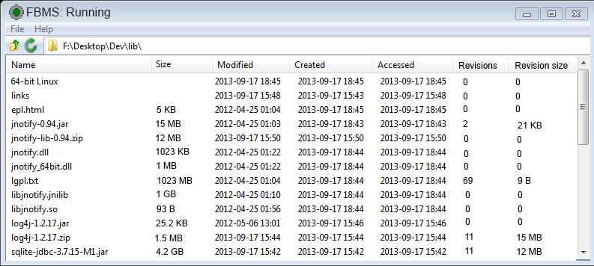
Notes:
Syed: This image is a mockup of the graphical interface that FBMS will use. It’s a straight-up listing of files located in the backup directory. Files can be chosen from this list for restoration.

Slide 5
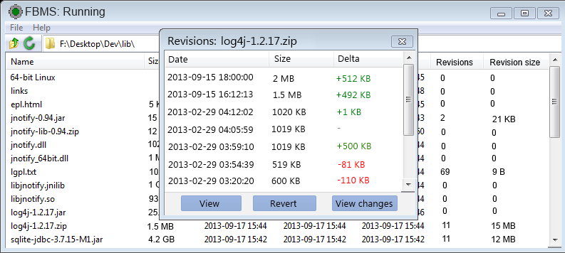
Notes:
Hattan: With a file selected, the user is presented a list of revisions and options to view the revision, revert their live copy to that revision, or to simply view the changes made in that revision.

Slide 6
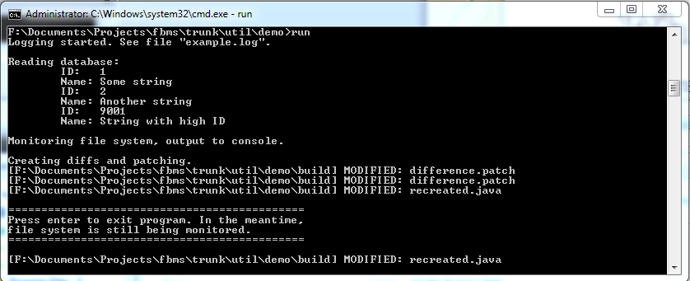
What we got so far
Utility program that detects file changes
Writes and reads database file
Commits constant logging
Template for development
Notes:
Michael: So far, we have created a toy utility program that demonstrates the major functionality of our program by utilizing the core features and libraries, including the database, file watcher, logging system, and concurrency.
This toy utility is a template for the development of our first prototype, which has also been started with an outline of the classes and methods.

Slide 7
Work breakdown
Everyone has their work cut out for them
Group planning and use cases created
Individual component development
Development both test driven and prototype based
Attempt to balance assigned components by estimated time to develop
Primary plan is to develop all the important features first and add onto that iteratively
Notes:
Da: We attempted to breakdown the project into manageable portions that can be developed individually, and spread these components evenly amongst the group members. We tried to make the distribution of work both fair and logical in our assignments.
Together as a group, we developed and constantly tweaked the planning and use cases that the project revolves around.
Our development is mostly based on an iterative design, attempting to get the core features done first, followed by prototypes of more advanced features as time allows.

Slide 8
Work breakdown
DA T:
FileHistory.getRevision()
FileHistory.obtainRevision()
FileHistory.storeRevision()
FileOp.delete()
FileOp.filesize()
FileOp.rename()
FileOp.copy()
FileOp.fileValid()
HATTAN A:
Control.restoreBackup()
FileOp.createDiff()
FileOp.applyDiff()
FileOp.fileToList()
FileOp.isFolder()
Data.getRevisionInfo()
DbManager.insertRevision()
SYED R:
FrontEnd.*
FileHistory.renameRevision()
MIKE H:
Class prototypes, PoD classes
Watcher.*
Control.displayRevision()
Control.displayRevisionChanges()
Control.revertRevision()
DbManager.init()
DbManager.getRevisionData()
Data.getFolderContents()
MICHAEL B:
Control.handleCreatedFiles()
Control.handleModifiedFiles()
Control.handleRenamedFiles()
Control.HandleDeletedFiles()
DbManager.renameFile()
DbManager.getConfig()
DbManager.setConfig()
Notes:
Mike: This breakdown demonstrates how we assigned components based on time estimates, not by the number of components. This splits up our estimated 150 man-hours of work roughly evenly.
We tried to balance diversity with familiarity in our assignments. For example, the diff-related functions have very similar implementation, so it logically follows that one person should do them, as he will likely be the most familiar with them.

Slide 9
There’s always a plan
Planning largely completed already as a group
Individual components will be created and integrated as per the design documentation
Final integration done by an individual with assistance and verification of the group
Test driven development ensures components work as we develop them
Distribution handled by another individual based on the setup used in our toy example
Difficulties include unfamiliar ground and cross platform issues
Notes:
Syed: The planning has largely been completed as part of our design phase. The previously mentioned components will be developed by their assigned individuals and finally put together as a collaborative effort, with one person doing most of the final integration and the rest of the group assisting.
We plan to put a heavy emphasis on test driven development to ensure that the individually developed components work as expected, reducing surprises that may occur when we get to integration.
Similarly, the distribution will be done by an individual. The toy example serves as a basis for both the integration and distribution setup.
Most of the difficulties stem from the fact group members are working with unfamiliar areas, namely file operations. Cross platform issues are also present, although the use of Java helps avoid most of them. Our libraries were specifically chosen for strong cross-platform compatibility.

Slide 10
I enjoy dynamite,
gunpowder, and gasoline
Development largely in Java, with small amounts of other languages, such as SQL
Eclipse used as the primary development tool, customarily configured for agreed conventions
Using modified “Conventions for the Java Language” as outlined by Sun
SQLite database driver used for minimalism and cleanness
Notes:
Hattan: For development tools, we are using the Eclipse IDE for our development, as it is the most fully featured, free, cross-platform IDE. Eclipse also allows us to specify project specific conventions for things such as indentation and brace style. Regarding these, we decided to follow a modified version of Sun’s “Conventions for the Java Language”. This ensures we have consistent formatting in all our development. For example, variable names are always in camel case starting with a lowercase letter, while class names start with an uppercase letter. Some of our modifications include the use of tabs instead of spaces and the use of Allman-style braces.
While development is 99 percent Java, we also have small amounts of SQL used by the database component, as well as Java properties for the logging configuration.
We chose a different database driver due to the fact that SQLite would be cleaner and more minimalistic.

Slide 11
Conclusion
FBMS protects the user’s files from the horror of the disk write head
Ease of use and speed key focuses
Practical uses for all computer users
Prototype-based development allows us to add other features once we get the core features down
Rigorous planning with an open mind to future versions
Notes:
Michael: In conclusion, FBMS is a practical program that helps users keep their files and revisions safe from disk failures, viruses, and themselves. Its ease of use makes it a practical choice for projects that don’t qualify for the effort of setting up a more powerful version control system.
We hope that our prototype based development will allow us to easily add optional features as time allows. These features may include things like trimming the size of revisions stored, restoring a snapshot of a specific time, and SFTP support to allow internet backups. We designed our planning with future possibilities in mind, and believe our design to be reasonably modular.
All in all, FBMS keeps your files from being eaten by a grue.
Any questions?

