Slide 1


Group 06:
Hoffert, Tao, Butler, Rizvi, Alsharif

Slide 2

A backup solution that automatically revisions your programs
A balance between the powerful version control systems like Subversion and the easy to use online backup systems like Dropbox
Not only can files be restored from the backup, but you can restore them from a given point of time
Notes:
Stress simplicity and power balance

Slide 3

It is easy to use FBMS : set it and forget it
When you need to access a file, the interface offers options to restore the file from any given revision
Multi-drive systems will be able to be used by FBMS, including external and network drives
Backups are important: FBMS goes beyond that with the storage of revisions
Notes:
Give quick detail of importance of backups, and detail how revisioning will be useful (eg, when you made an errant change to a file)

Slide 4
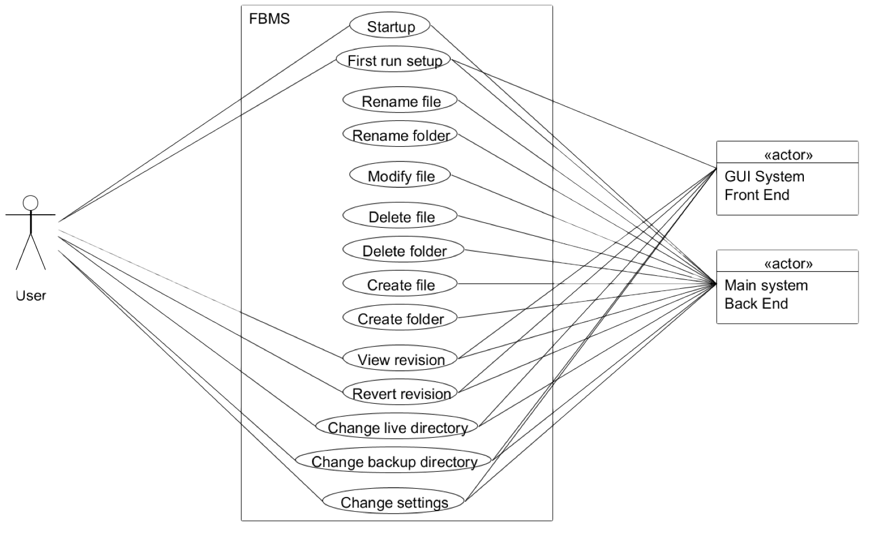
Notes:
Mention that the rename/modify/delete stuff is all in the backend
Some parts are front end, meaning user acts via GUI

Slide 5

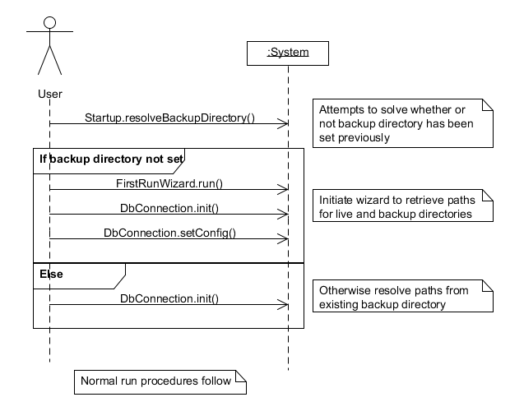
Notes:
Mention that this is the sequence diagram of startup, what it’s meant to accomplish (init everything, live/backup directory, decide if first run wizard needs to be run).

Slide 6
Class_diagram
Notes:
The class diagram is waaay too big to fit in the slide, so we’ll link it. In presentation view, clicking that link will open the file in default editor for PNG files. We can then zoom around the file, pointing out the classes and their relationships.
Just roughly point out the major classes and their purposes

Slide 7

The first version revisioned plain text files, making patches of the changes in each revision
The second version of the project is now finished
Version 2.0 of the program added support for binary files, which are stored as raw binary data

Slide 8
The program is largely a service: it runs in the background without any user guidance
The front end of the program is used to view and restore backed up files
The user can view all revisions for a given file and can choose to view or revert that revision
Notes:
Mention how the bulk of the code is in the backend; lots of handling for errors and unusual circumstances
Also mention copy-to, restore all

Slide 9
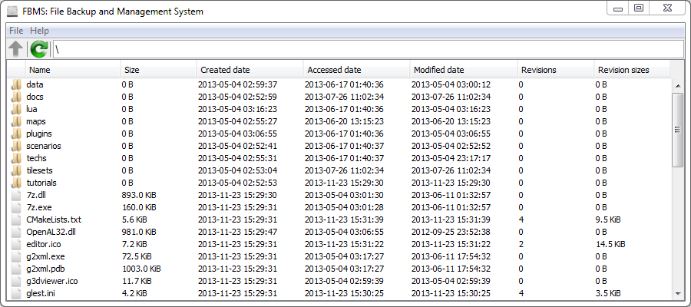
The main interface, showing all available files
Notes:
Point out parts of this window; eg, refresh button, up button, etc

Slide 10

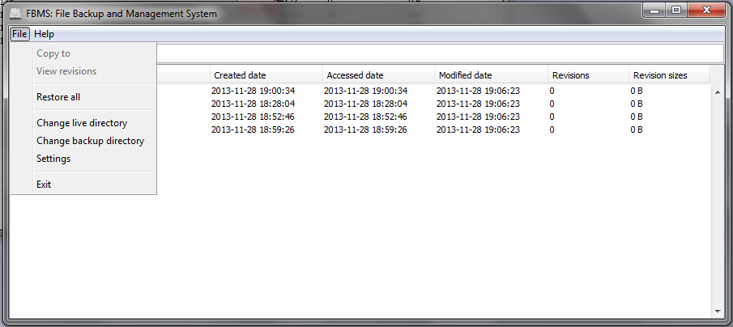
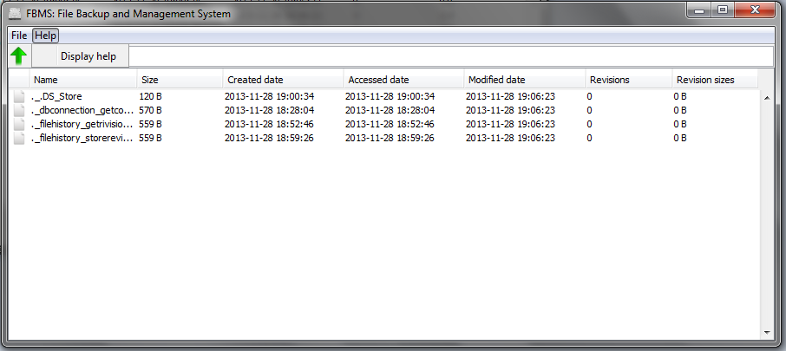
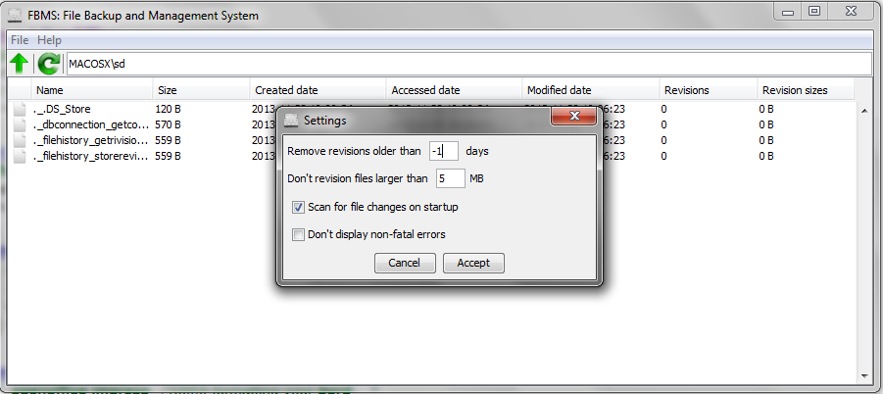
Dialog, menu options, and settings

Slide 11

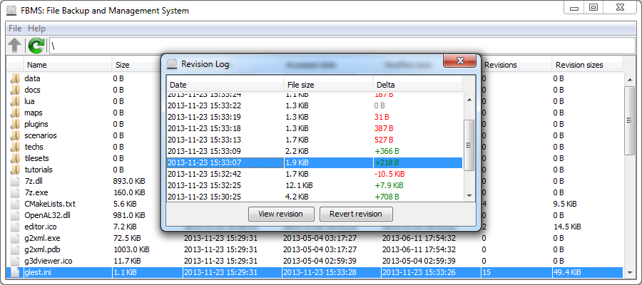
The revision dialog, showing all the available revisions for a file
Notes:
Point out parts of this dialog

Slide 12

Features such as startup scan detects changes
when program not running.
The trim feature regularly removes files older than a user specified date
More than 525 revisions of content, bug fixes, and features
Notes:
Mention how startup scan compares file contents to detect differences between the files; still revisions changes
Trim feature disabled by default; removes files older than a user specified number of days

Slide 13

Maintaining a consistent interface across operating systems
Creating patches for plain text files
Ensuring that the GUI is user friendly and intuitive
Handling binary files, implemented in version 2.0
Notes:
Mention how the interfaces use local L&F, sizing constraints; mention we support WINDOWS and LINUX (no support for macs)
First library failed, used a different one instead
User friendly GUI needs mention of changes to default table behavior, keyboard navigation, etc. Mimicking a file browser
Mention how binary files are stored differently in the revision database and required changes around the board

Slide 14
Numerous ways to create an edit files
Some text editors create swap files and move those over the original file
Other editors directly change the file
You could create a file over another file
Most bugs occurred due to the many ways of modifying files
Notes:
Mention how swap files are recognized in the system as a create and a rename, which requires special handling
Other editors will be recognized as merely an edit
Files could be created in a way that overwrites an existing file
All of these cases are considered to be “modifying” a file, despite how their internal representation is

Slide 15

Using SQLite RDBMS to allow easy serialized access to the database
The GUI, file watcher, and file change handlers all run in different threads
Plain text patches use the google-diff-match-patch library, creating highly efficient patches. Internally, the Myer's diff algorithm is used
Notes:
Mention how swap files are recognized in the system as a create and a rename, which requires special handling
Other editors will be recognized as merely an edit
Files could be created in a way that overwrites an existing file
All of these cases are considered to be “modifying” a file, despite how their internal representation is

Slide 16
Sample file:
Hello world
I like pie.
After changes:
Hello world
Goodbye world
I like pie.
Stored patch:
@@ -9,22 +9,8 @@
rld%0A
-Goodbye world%0A
I li
Notes:
Mention that the patch is BACKWARDS!!! ← ←’



Slide 17

If you are looking for fast, and easy to use backup solution, FBMS is your best choice.
Focus is on ease of use without sacrificing power
Middle-man between software such as Dropbox and Subversion
Supported on Windows and Linux
Licensed under GPLv3, with portions under the Apache license and LGPLv2
Notes:
Mostly the same as the second slide
Also mention the licensing: GPL (GNU General Public License) is a FOSS copy-left license; Apache license is similar, but doesn’t require source code to be distributed; LGPL is the lesser general public license, meant for libraries and allows use in non-GPL software provided the library is not a derivative work

