Slide 1
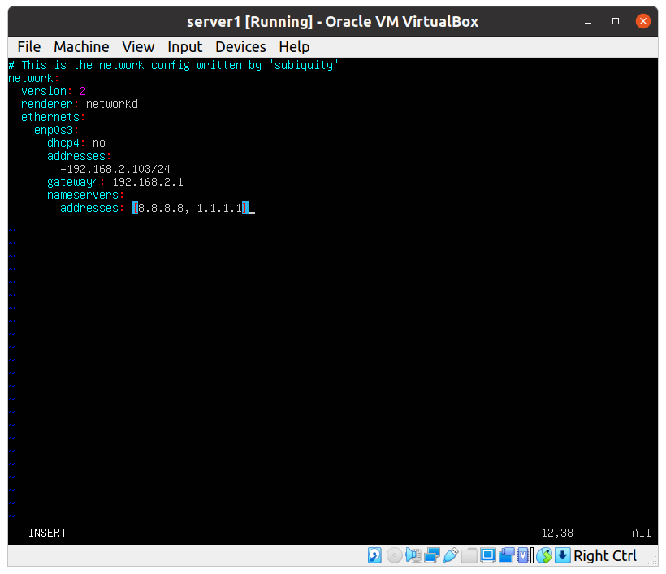
server1
Bridged adapter, static ip address: 192.168.2.103/24
Configured in /etc/netplan/*.yaml

Slide 2
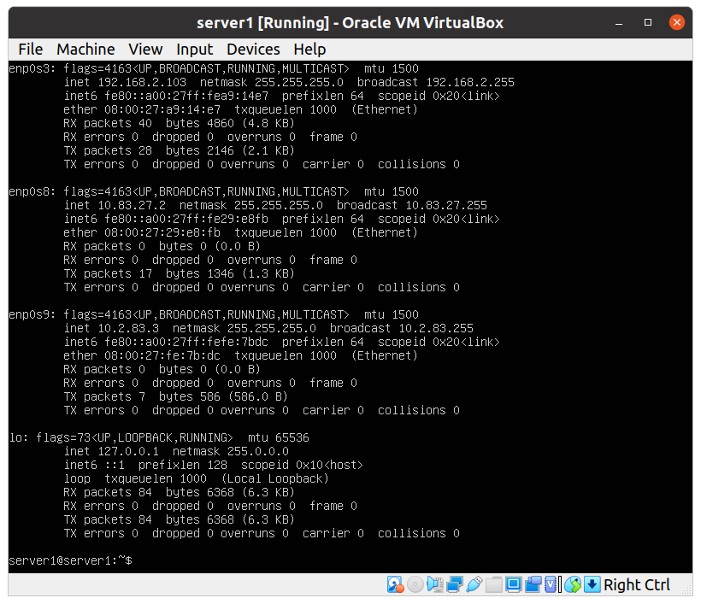
Server1, interfaces configuration:
Int1 – connected to Net1 (home network): interface enp0s3, static ip address 192.168.2.103/24
Int2 – connected to Net2 (internal network): interface enp0s8, static ip address 10.83.27.2/24
Int3 – connected to Net3 (internal network): interface enp0s9, static ip address 10.2.83.3

Slide 3
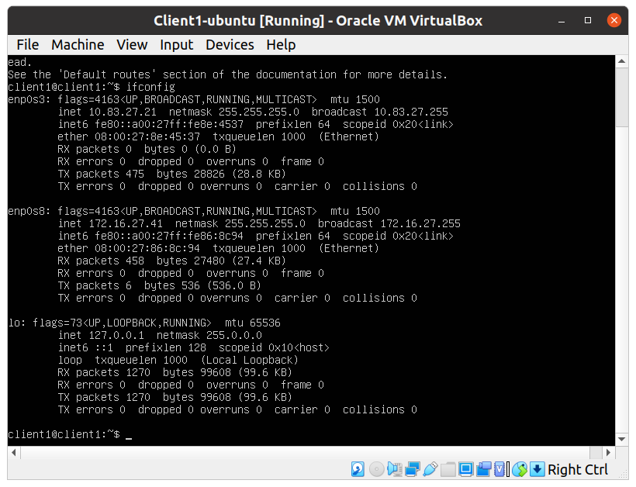
Client1, interfaces configuration:
- Int1 – connected to Net2 (internal network): interface enp0s3, static ip address 10.83.27.21/24
- Int2 – connected to Net4 (internal network): interface enp0s8, static ip address 172.16.27.41/24

Slide 4
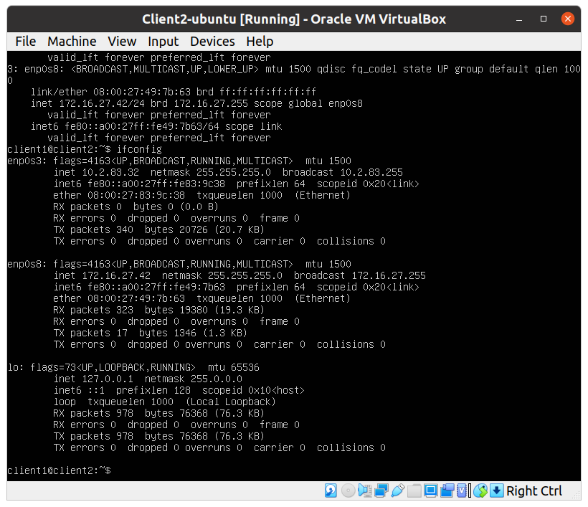
Client2, interfaces configuration:
- Int1 – connected to Net3 (internal network): interface enp0s3, static ip address 10.2.83.32/24
- Int2 – connected to Net4 (internal network): interface enp0s8, static ip address 172.16.27.42/24

Slide 5
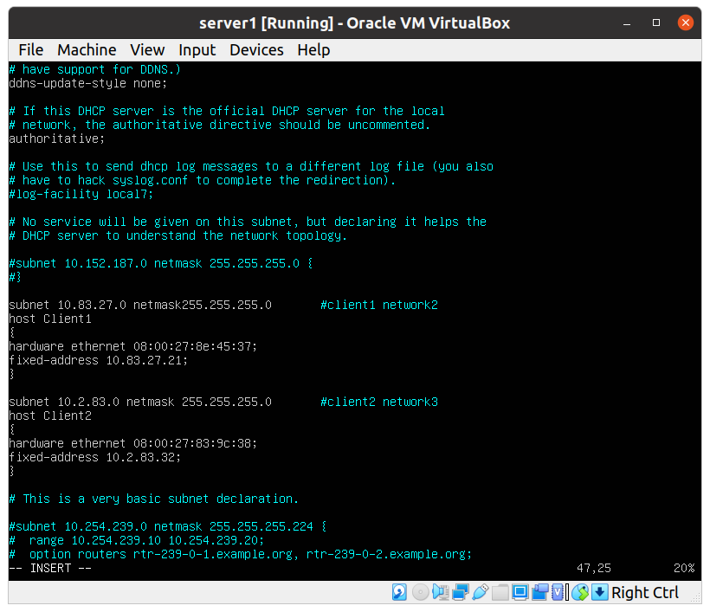
DHCP service configuration
(on Server1):
- for Client1, Int1 in Net2
- for Client2, Int1 in Net3

