Slide 1
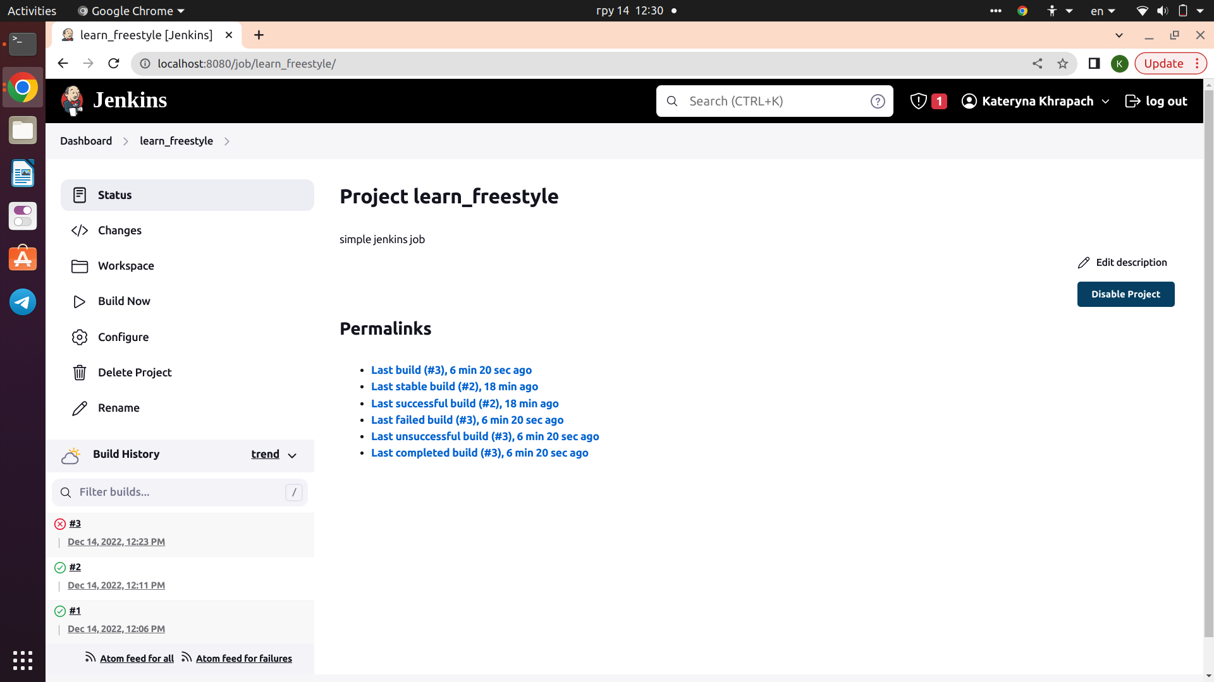

Slide 2
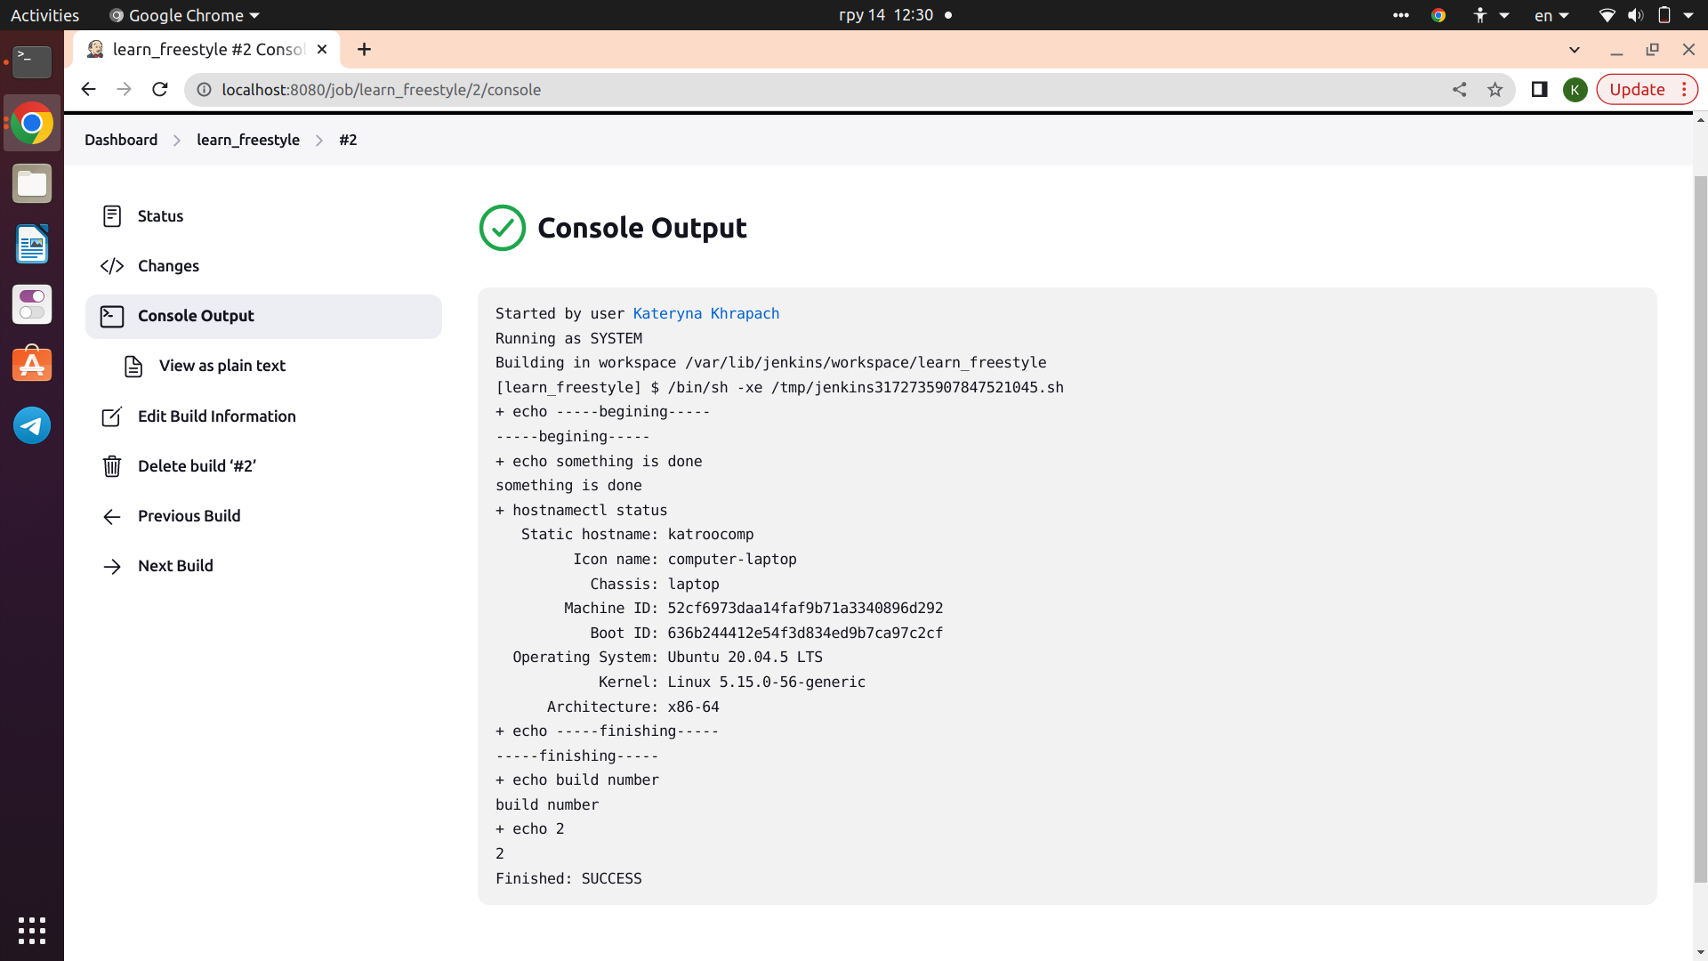

Slide 3
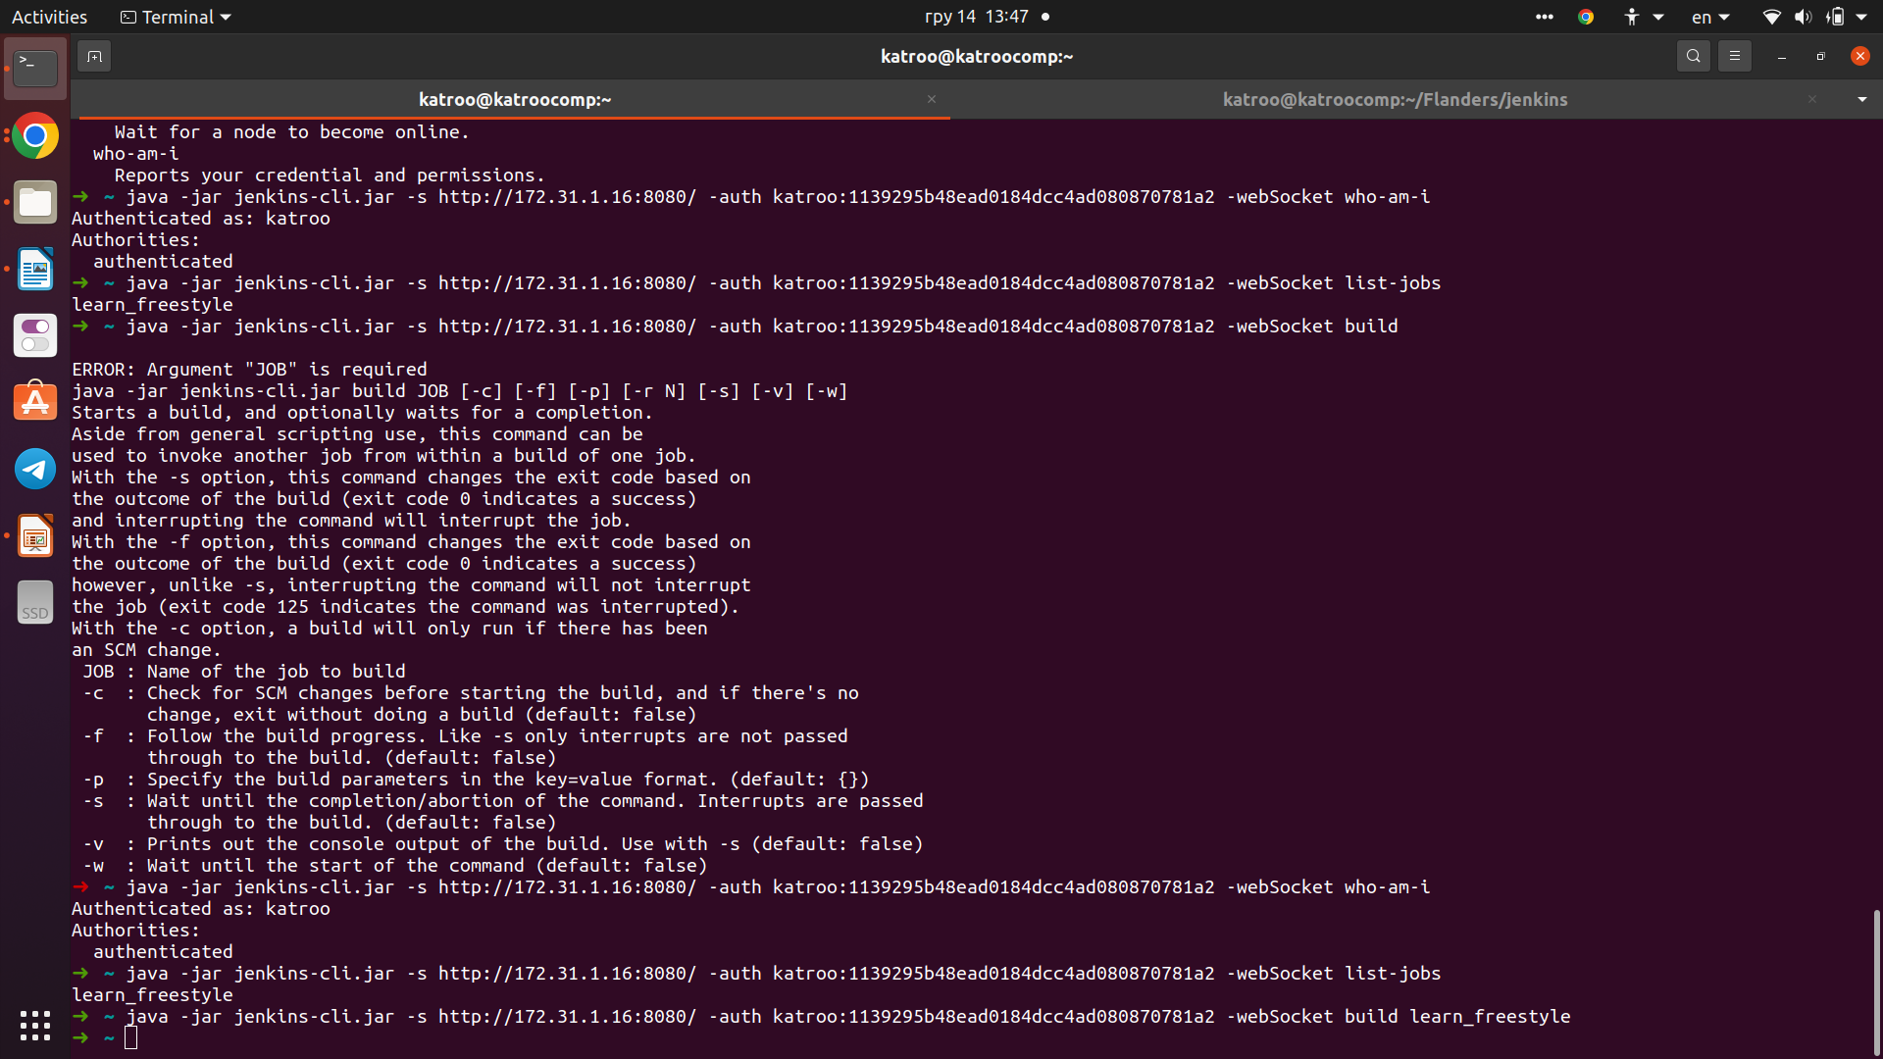
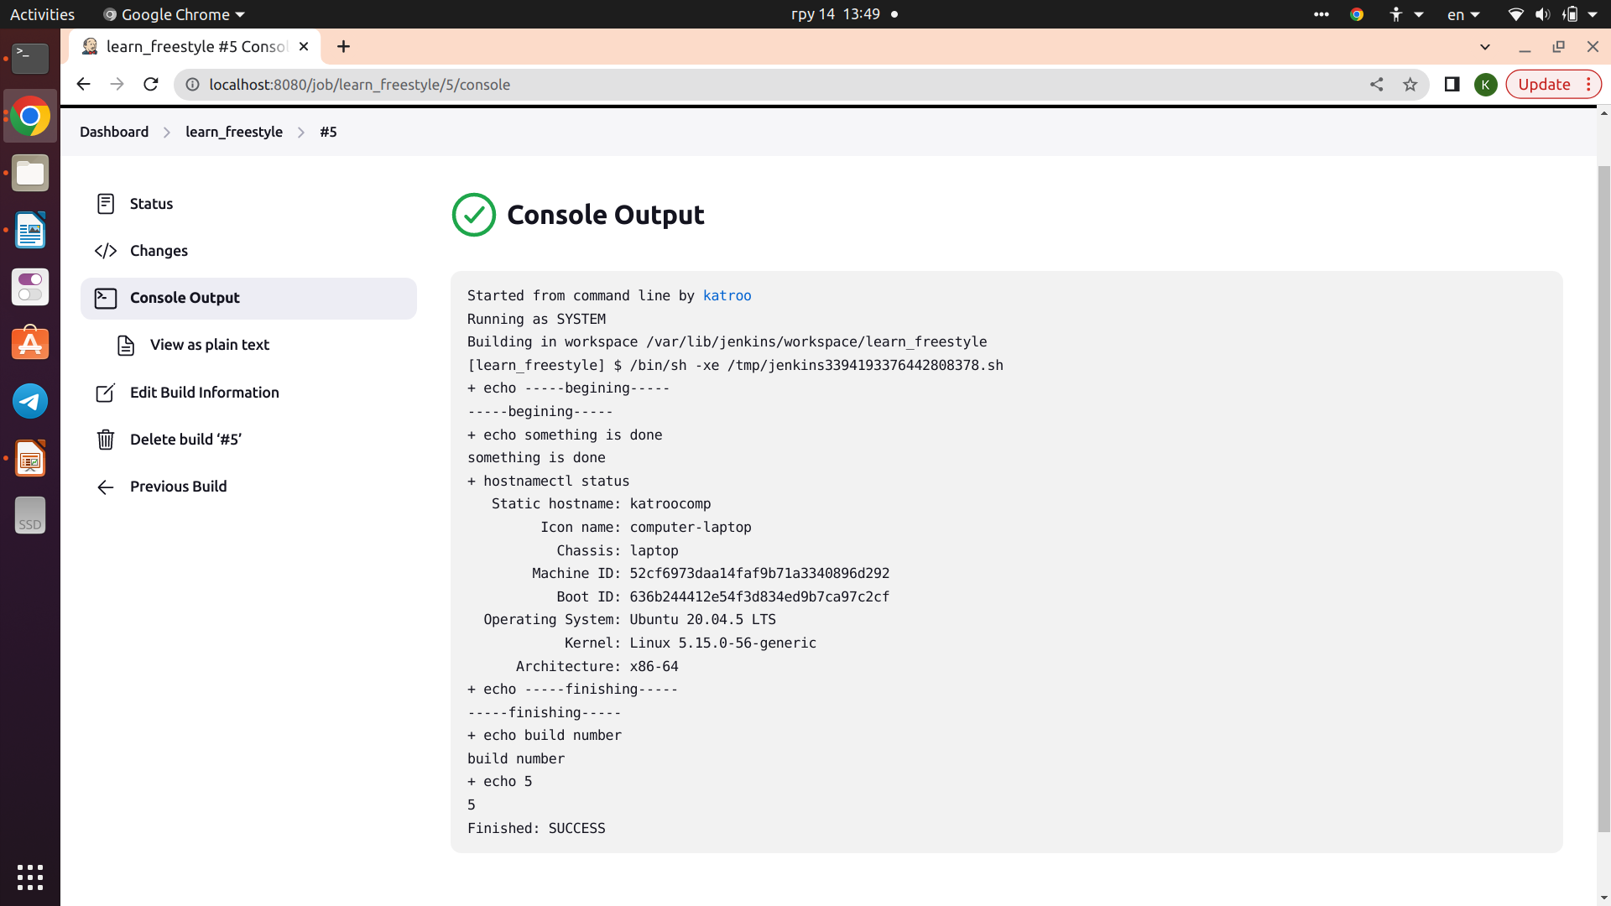
Jenkins CLI configuration
Used site: https://cloudaffaire.com/how-to-use-jenkins-cli-with-examples/
Result:

Slide 4
SSH connection via Jenkins

Slide 5
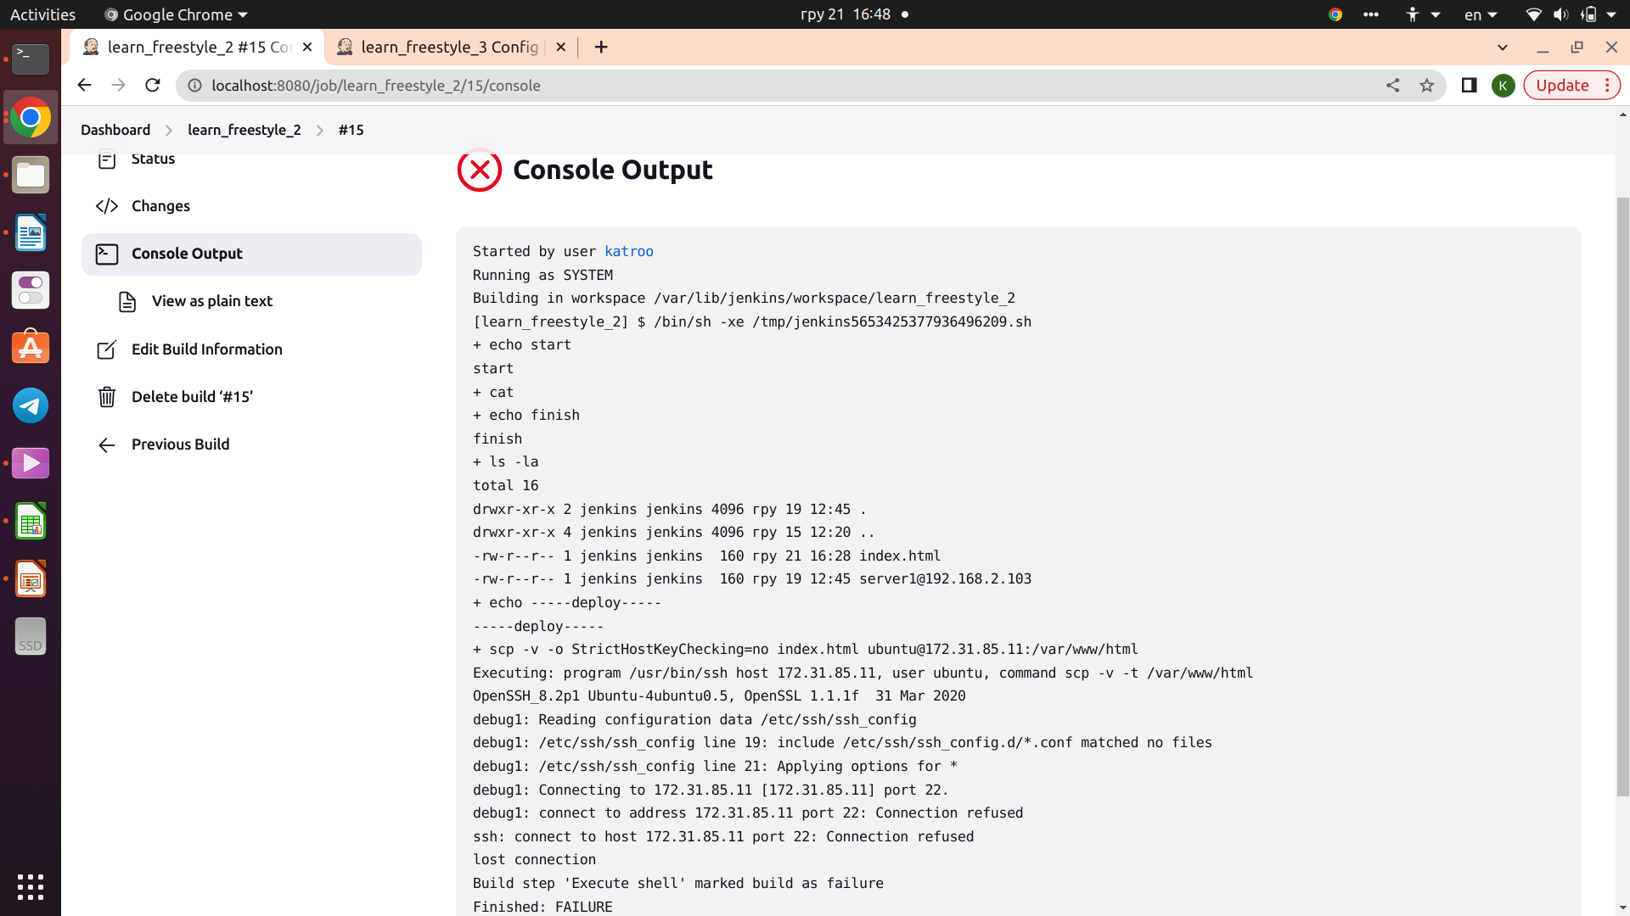

Slide 6
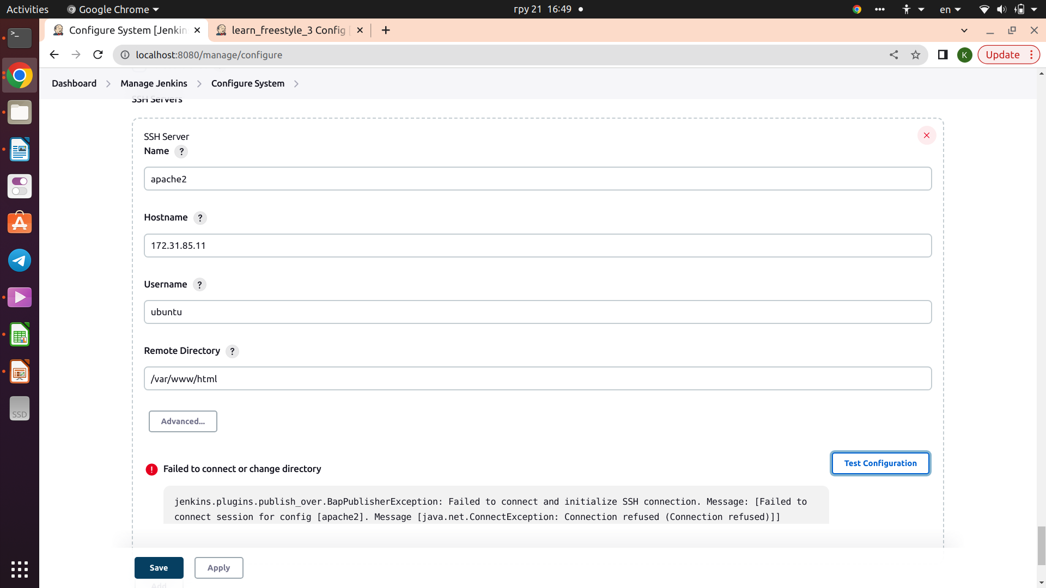

Slide 7
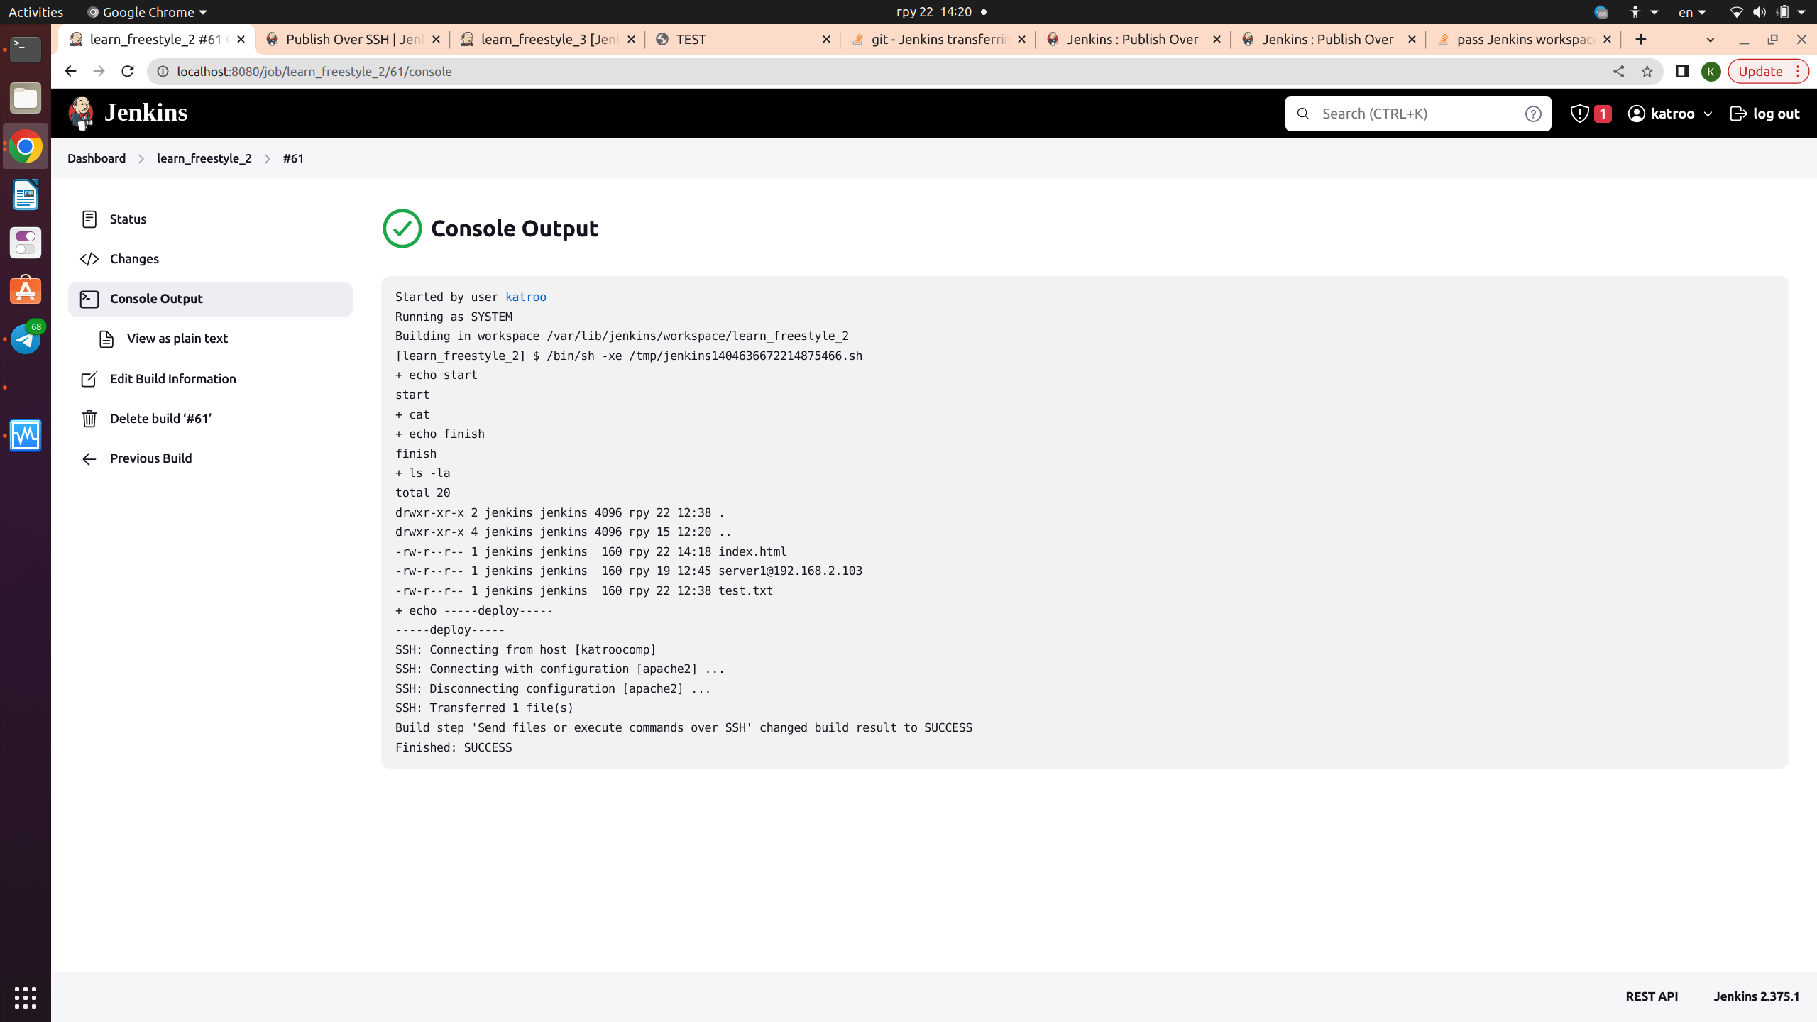
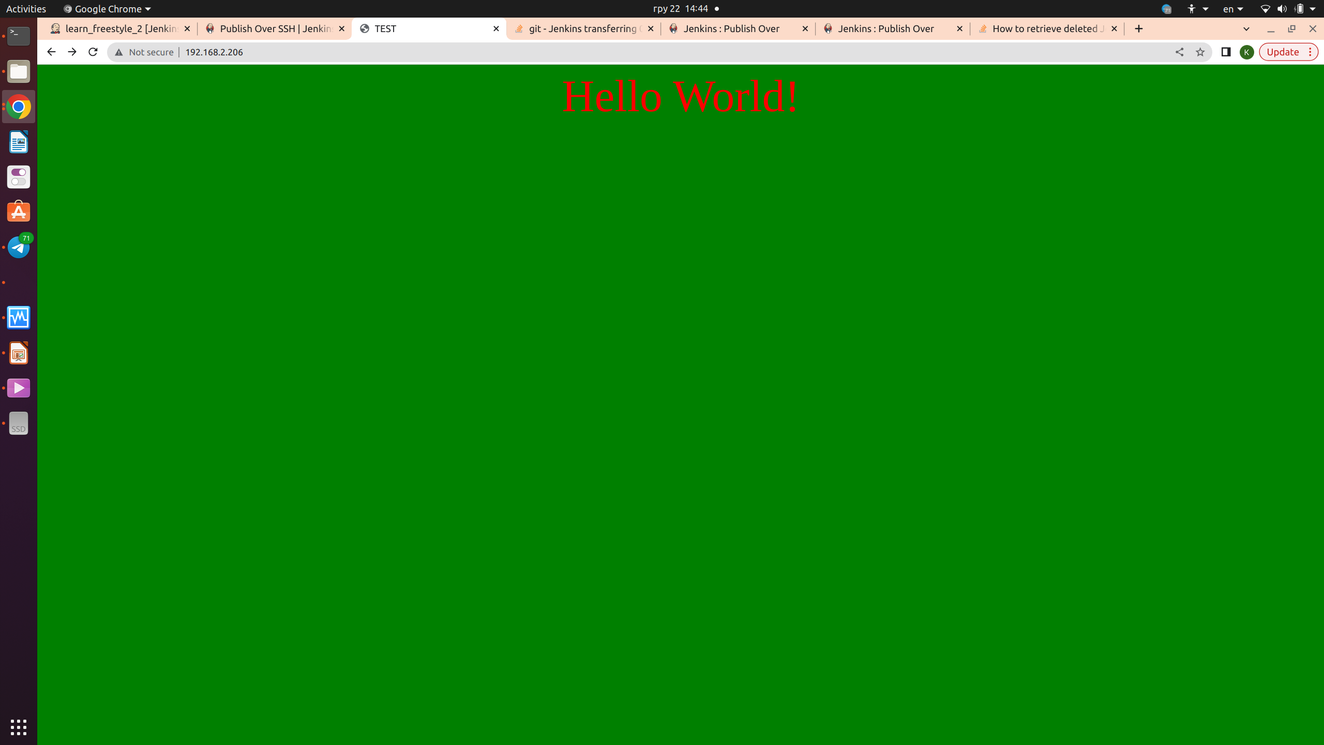
The problem was that Ubuntu 22 has new standarts to use SSH keys, not working with elder versions that Jenkins works with. It worked with Ubuntu 20

Slide 8
Simple pipeline

Slide 10
next

