Slide 1
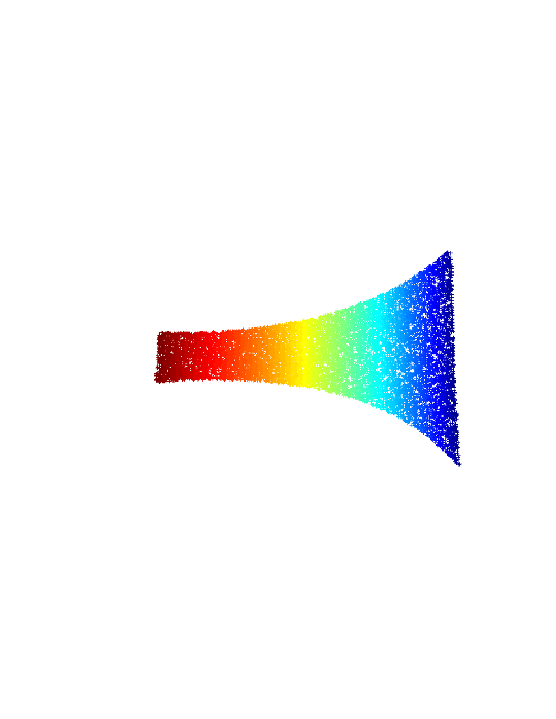
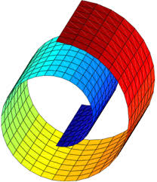
NonLinear Dimensionality Reduction in Pattern Recognition Applications
Elaboration: Katsileros Petros
Supervision: Nikolaos Pitsianis, Nikos Sismanis

Slide 2
Introduction
Introduction about Dimensionality Reduction
Presentation sections
    Why we need information compression
    Dimensionality Reduction Algorithms (PCA, SVD, ISOMAP, Laplassian Eigenmaps, LLE)
    The Locally Linear Embeddings Algorithm (LLE)
    Surpass LLE limitations with two new variations of LLE algorithm
    Experiments using native LLE and the two new methods
        Datasets: MNIST, SVHN, Arcene
    Results visualization and explanation
    Future work
    Conclusion

Slide 3
Why we need information compression
Example: Image with size [480,640]
    That is equal to a vector with size: 480x640 = 307200.
    For a “small” dataset, N = 100K we have a matrix of size: 100.000 x 307200
Very large Computational complexity
Very large memory requirements
A large amount of these pixels are just Noise, affecting negative machine learning or image processing algorithms.
Why dont we just simulate the Human brain …
How? Using keypoints into each image
    Features like SIFT, HoG, PFH etc …
    Find out which pixels have meaningful information
Dimensionality reduction techniques are able to extract d (ex. 8<d<256, from 480x640) meaningful key points

Slide 4
Dimensionality Reduction Algorithms
Linear:
  Principal Component Analysis (PCA)
    Minimize a mean square error equation (sum of eigenvalues)
    Produces statistical independent features
  Multi Dimensional Scaling (MDS)
  Singular Value Decomposition (SVD)
    Solving the equation:
Non-Linear:
  Isometric Mapping (ISOMAP)
  Laplassian-Eigenmaps
  Locally Linear Embeddings

Slide 5
NonLinear Dimensionality Reduction – Locally Linear Embeddings
Step-1: Find K-Nearest Neighbors for each data (Adjacency matrix)
  Executed in CUDA
Step-2: Find Weighs matrix (W)
  Minimize cost function:
    E =
    Gram matrix:
    Solve the system:

Slide 6
NonLinear Dimensionality Reduction – Locally Linear Embeddings
Step-3: Find the embedding coordinates, using the weights matrix W
  Minimize cost function:
  Find eigen-values of the square [NxN] sparse matrix
Step-4: Keep the final embedded coordinates
  Discard the eigenvalue (equal to zero)
  Keep the rest d eigen-values. The eigen-vectors are the final embedded d coordinates

Slide 7
LLE Limitations
Eigen-value decomposition step has complexity
  For sparse matrix M, solving with Lanczos algorithm
We must run LLE algorithm with both train and test datasets as input data
  Dimensionality reduction on train and separate on test produces spaces with different base vectors
  We cannot find any realation between the low dimensional test and train data

Slide 8
Method-1: LLE with Test-Projection
Apply LLE dimensionality reduction on Train dataset [DxN1]
  Result: matrix Y of size [dxN1]
K-NN between Test dataset [DxN2] and Train dataset
  Result: matrix IDX of size [N2xK]
Create the adjacency zero matrix nn_graph of size [N1xN2]
For every column in nn_graph set IDX(column,1:K) elements equal to ones
Execute the matrix multiplication: Y[dxN1] x nn_graph[N1xN2]
  Result: matrix testY of size [dxN2]
Final step, execute classification algorithm (k-NN) between dimansional reduced test (testY) and train (Y) datasets

Slide 9
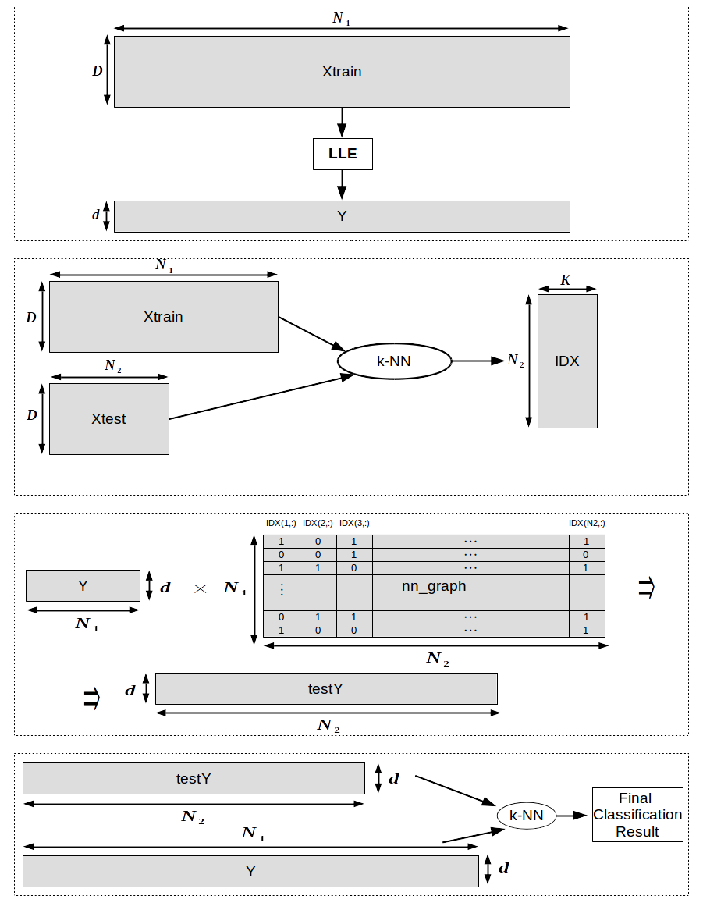
Method-1: LLE with Test-Projection

Slide 10
Method-2: LLE with SubSpace Voting
Split Train dataset into sub-sets
  Sub-sets MUST contain equal information for every class
Execute dimensions reduction using LLE on every sub-set
  Method-1 can be used, in order to avoid including Test data into each sub-dataset
Execute classification process (k-NN) for every Test data
The final classification result depends from the majority class after each sub-space voting

Slide 11
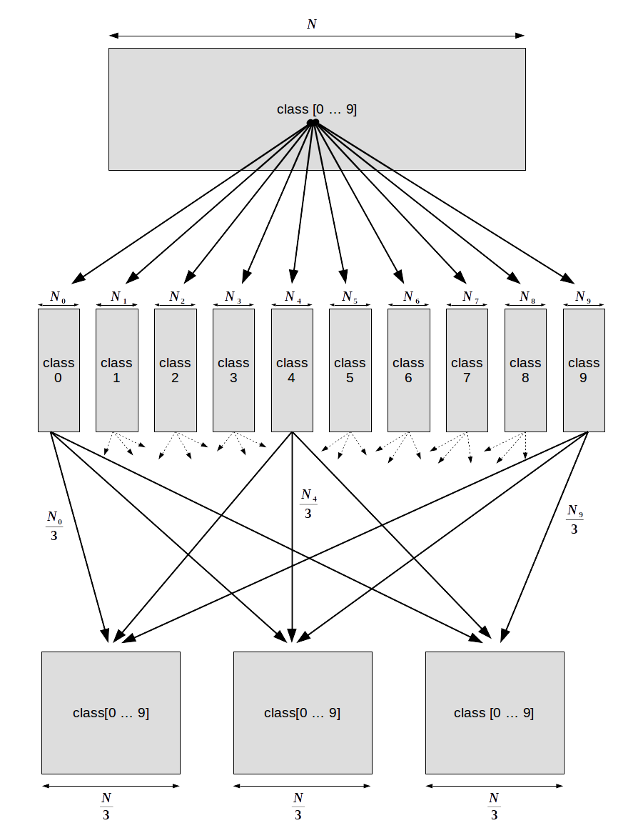
Method-2: LLE with SubSpace Voting

Slide 12
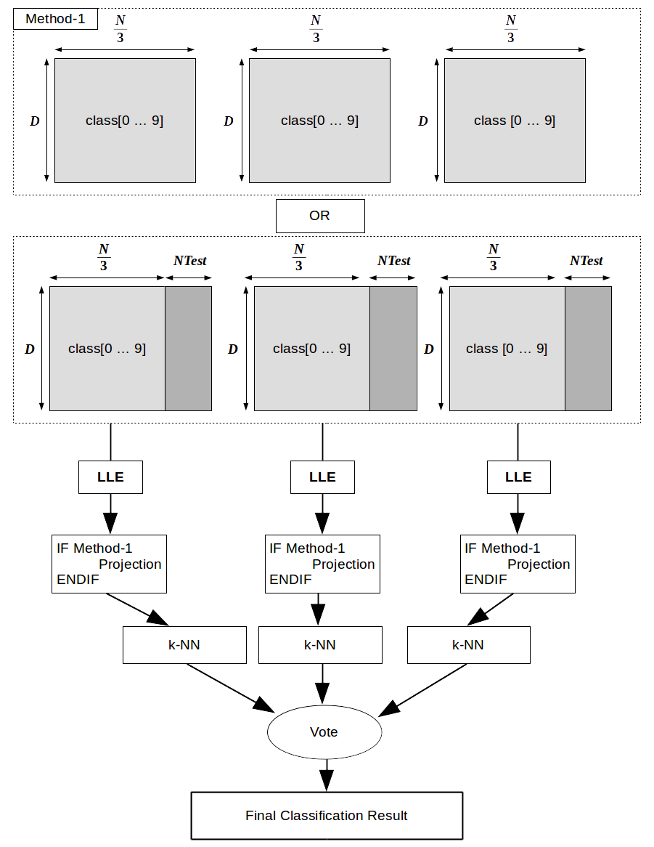
Method-2: LLE with SubSpace Voting

Slide 13
Experiments
Datasets: MNIST, SVHN, ARCENE
  MNIST: Gray scale images of handwritten digits.
    60K Train data, 10K Test data, D=[28x28]
  SVHN: Google street view house numbers [32x32] RGB images.
    73257 Train data, 26032 Test data, D=[32x32] (531131 additional, somewhat less difficult Train data)
  Arcene: Cancer dataset with a large number of predefined features for each patient.
    200 Train data, 700 Test data, D = 10K.
Classification algorithm: k-NearestNeighbors
Classification metric: Mean average % error

Slide 14
MNIST Experiments
LLE parameters k, d. Method-2 parameter: batch_size
  1st-Exp: K = [6, 7, 8, 9, 10, 12, 16, 20, 24, 32, 64], d = [10, 16, 20, 24, 32, 40, 52, 64, 96, 128, 256], subSet_size=[60000,30000,20000] of Train dataset
    Classification error using k-NN (k=2): K=12, d=128, subSet_size=60K, qual to 3.06%
    Classification error using k-NN (k=2) without dimensionality reduction: 3.5%
    This is also a VERY important result: K=8, d=10, subSet_size=60K equal to 3.31%
    From the above results, we can say that LLE algorithm can be used as a feature extraction process with great data compression ability.

Slide 15
MNIST Experiments
Method-2 results are very impressive:
  K=16, d=256, batch_size=20K. Best classification error equal to 3.27%.
  K=10, d=128, batch_size=10K. Best classification error equal to 3.31%.
  Huge reduction both in time and space. (Step-3 of LLE has complexity)
Method-1: Not impressive results, but this is the only realistic use of LLE dimensionality reduction in “Real time” application
  K=8, d=256, batch_size=60K. Best classification error equal to 3.85%.

Slide 16
SVHN Experiments
Extract HoG features due to noise and light distortions.
    Split image into sub sections and calculate the gradient of pixel intensity.
1st-Exp: K = [8, 10, 12], d = [16, 20, 32, 64, 96, 128, 164, 196, 256], 30K of SVHN Train data-set
  HoG features parameters: Kernels size: [2x2], [4x4], [8x8] produce features of length: 8100, 1764, 324 .
  Best parameters for SVHN dataset: K=12, d=32, kernel=[4x4].
2nd-Exp: K=12, d=32, kernel=[4x4]. Full SVHN dataset (73257 Train data, 26032 Test data)
  Classification error with LLE dimensionality reduction is equal to: 16.67%.
  Classification without dimensionality reduction (D=1024) is equal to: 17.00%.
  The above classification results came from k-NN Classification algorithm and k=8.

Slide 17
SVHN Experiments
3rd-Exp Method-1: LLE parameters: K=12, d=32, kernel=[4x4]. 42K of SVHN Train dataset
  Classification error with LLE dimensionality reduction on Train data and projection for Test data is equal to 18.34%
  Classification error with LLE dimensionality reduction on Train+Test data is equal to 16.67%
  Classification error without dimensionality reduction is equal to 17.00%
4th-Exp Method-2: LLE parameters: K=12, d=32, kernel=[4x4]. 30K of SVHN Train dataset. Method-2 parameters: 3 subspaces
  Classification results for each of 3 subspaces: 20.19%, 19.05%, 19.97%
  Classification after subspace voting: 18.30%

Slide 18
SVHN Experiments
5th-Exp Method-2: LLE parameters: K=12, d=32, kernel=[4x4]. 30K of SVHN Train dataset. Method-2 parameters: 5 subspaces
  Classification results for each of 5 subspaces: 20.28%, 21.11%, 20.93%, 20.92%, 21.11%
  Classification error after subspace voting: 18.37%
  Classification error for 3 subspaces (4th-Exp) is equal to 18.30%
6th-Exp Method-2: LLE parameters: K=12, d=32, kernel=[4x4]. 30K of SVHN Train dataset. Method-2 parameters: 10 subspaces
  Classification error after subspace voting: 18.58%
7th-Exp Method-2: LLE parameters: K=12, d=32, kernel=[4x4]. 30K of SVHN Train dataset. Method-2 parameters: 20 subspaces
  Classification error after subspace voting: 19.13%

Slide 19
ARCENE Experiments
1st-Exp: K = [10, 12, 16, 20, 24, 32, 64], d = [10,16, 20, 24, 32, 40, 52, 64, 96, 128]
  Lack of test labels. 150 Train patients and 50 Test patients and 10K features for each one.
  For every K and d (<=96) combinations, classification error after LLE dimensionality reduction is by far better than the D=10K dimensional space
  Best classification error for parameters (K=10, d=10), (K=10, d=52), (K=12, d=128) equal to 10%
  Classification error without dimensionality reduction (D=10K) equal to 76%.
  With 10 of 10K features, we gain a boost of 14% classification accuracy.
  Accurate classification result with 90% probability

Slide 20
Future Work
Parallelization: Even though k-NN algorithm both in LLE and in Classification process is executed in CUDA, further parallelization can be achieved from sub-set splitting into threads.
Extend to large datasets and invest the behaviour of subspace voting
Find the cutting edge between number of subsets-Train dataset size and Test data size
Maybe a very accurate dimensionality reduction algorithm for Medical image retreival.

Slide 21
Conclusion
LLE produces impressive results after huge dimensionality reduction.
Huge space and time savings at Final Classification Step
Method-1 can give as real time Classification into the low dimensional Train and Test spaces
Method-2 achieves dramatically reduction on execution sources. Both space and time.
Method-1 and Method-2 makes the execution of LLE algorithm available for normal PCs.
LLE algorithm can be used both as feature extraction and feature selection process.
LLE has the ability to remove noise-data, producing very accurate classification results

Slide 22
Thank You

