Slide 1
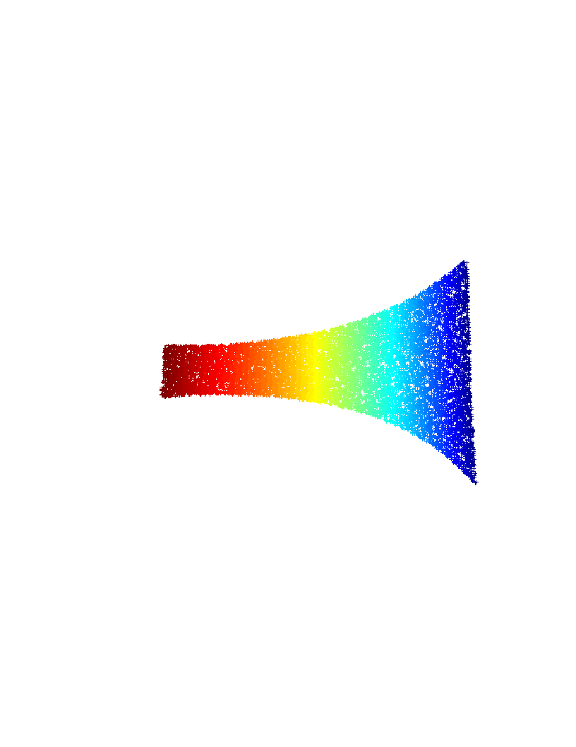
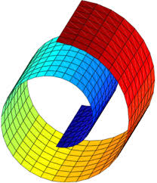
Locally Linear Embeddings in Pattern Recognition
  Elaboration: Katsileros Petros
  Supervision: Nikolaos Pitsianis

Slide 2
Introduction
    Why we need information compression
    Dimensionality Reduction Algorithms (PCA, SVD, ISOMAP, Laplassian Eigenmaps, LLE)
    The Locally Linear Embeddings Algorithm (LLE)
    Surpass LLE limitations with two new variations of LLE algorithm
    Experiments using native LLE and the two new methods
        Datasets: MNIST, SVHN, Arcene
    Results analysis
    Future work
    Conclusion

Slide 3
Dimensionality Reduction Algorithms
Linear:
  Principal Component Analysis (PCA)
  Multi Dimensional Scaling (MDS)
  Singular Value Decomposition (SVD)

Slide 4
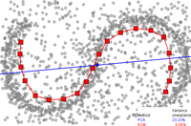
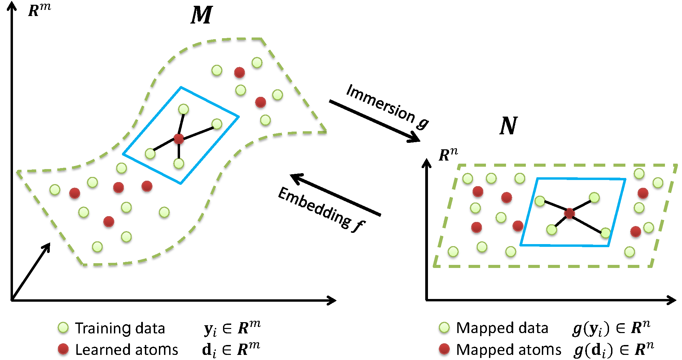
Dimensionality Reduction Algorithms
Non-Linear:
  Isometric Mapping (ISOMAP)
  Laplassian-Eigenmaps
  Locally Linear Embeddings

Slide 5
Locally Linear Embeddings
Step-1: Find K-Nearest Neighbors for each data (Adjacency matrix)
  Executed in CUDA
Step-2: Linear prediction for every point using it’s neighbors. Find Weight matrix (W).
  Minimize cost function:
  Weights W must follow these two restrictions:
    W(i,j) = 0, if j and i are not neighbors
    Following these restrictions we have Translation, Rotation and Scaling independence.

Slide 6
Locally Linear Embeddings
Step-3: Find the embedding coordinates, using the weights matrix W
  Minimize cost function:
  Find eigen-values of the square [NxN] sparse matrix
Step-4: Keep the final embedded coordinates
  Discard the eigenvalue (equal to zero)
  Keep the rest d eigen-values. Their eigen-vectors are the final d embedded coordinates

Slide 7
LLE Limitations
Eigen-value decomposition step has complexity
  For sparse matrix M, solving with Lanczos algorithm
We must run LLE algorithm with both train and test datasets as input data
  Dimensionality reduction on train and separate on test produces spaces with different base vectors
  We cannot find any realation between the low dimensional test and train data
Solutions:
  Method-1 will solve 2nd limitation
    Execute LLE on Train+Test data
  Method-2 will solve 1st limitation
    Runtime algorithm complexity

Slide 8
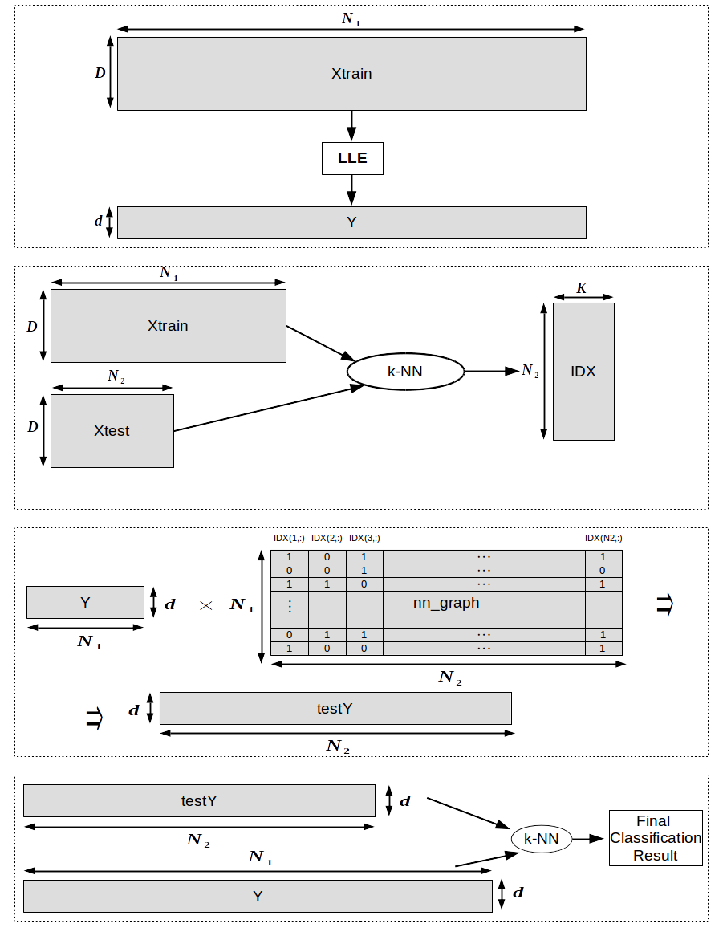
Method-1: LLE with Test-Projection

Slide 9
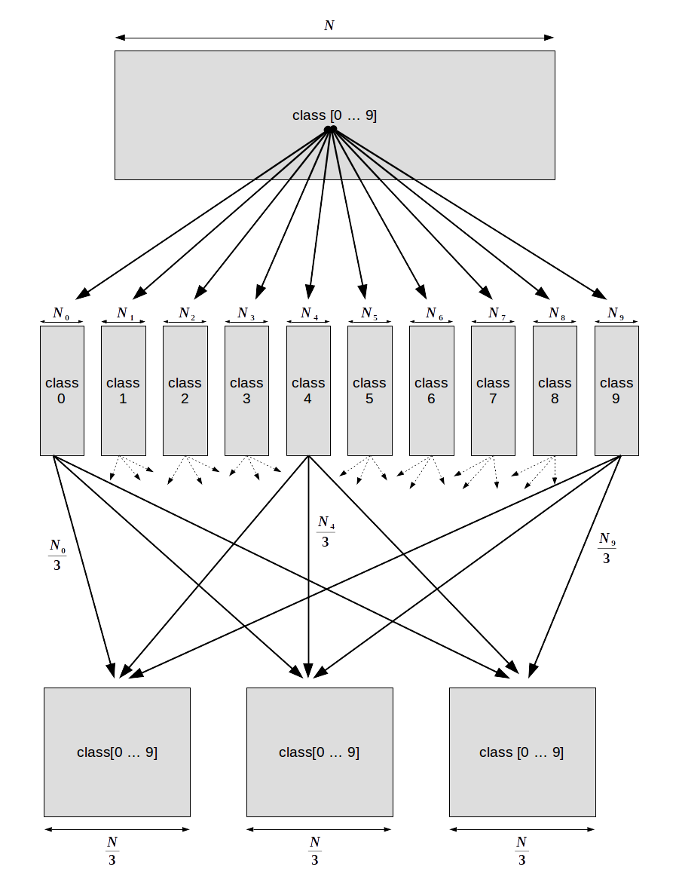
Method-2: Sub-set Majority Voting LLE

Slide 10
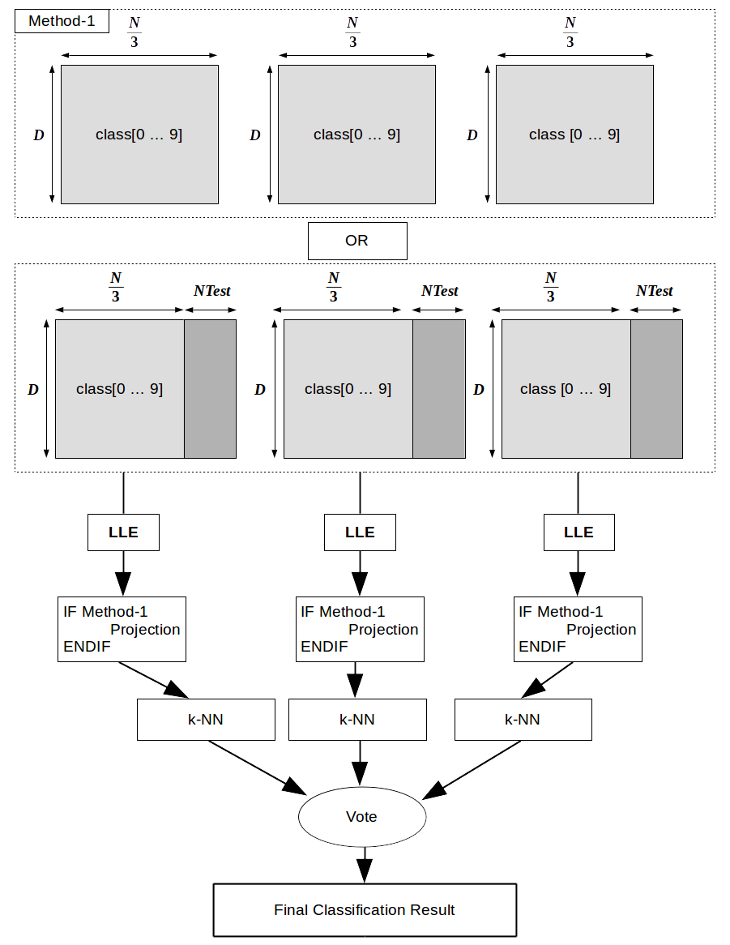
Method-2: Sub-set Majority Voting LLE

Slide 11
Experiments
Datasets: MNIST, SVHN, ARCENE
  MNIST: Gray scale images of handwritten digits.
    60K Train data, 10K Test data, D=[28x28]
  SVHN: Google street view house numbers RGB images.
    73257 Train data, 26032 Test data, D=[32x32]
  Arcene: Cancer dataset with a large number of predefined features for each patient.
    200 Train data, 700 Test data, D = 10K.
Classification algorithm: k-NearestNeighbors
Classification metric: Mean average % error
  Acuuracy from every class / number of classes

Slide 12
MNIST Experiments
Invest how LLE parameters (k, d) affect the classification process. Also find out if sub-sampling (Method-2) can lead to acceptable results.
  K = [6, 7, 8, 9, 10, 12, 16, 20, 24, 32, 64], d = [10, 16, 20, 24, 32, 40, 52, 64, 96, 128, 256], subSet_size=[60000,20000,10000] of Train dataset
    Classification error using k-NN (k=2) without dimensionality reduction (D=784): 3.5%
    Classification error using k-NN (k=2): K=12, d=128, subSet_size=60K, qual to 3.06%
    Classification error using k-NN (k=2): K=8, d=10, subSet_size=60K equal to 3.31%
    From the above results, we can say that LLE algorithm can be used as a feature extraction process with a great data compression ability.

Slide 13
MNIST Experiments
Method-2 results:
  K=16, d=256, batch_size=20K. Best classification error equal to 3.27%.
  K=10, d=128, batch_size=10K. Best classification error equal to 3.31%.
  Huge reduction both in time and space. (Step-3 of LLE has complexity)
Method-1: Use of LLE dimensionality reduction in “Real time” applications
  K=8, d=256, batch_size=60K. Best classification error equal to 3.85%.

Slide 14
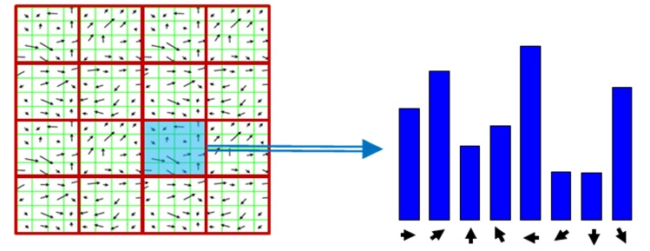
SVHN Experiments
Extract HoG features due to noise and light distortions.
    Split image into sub sections and calculate the gradient of pixel intensity.

Slide 15
SVHN Experiments
1st-Exp: Investigate LLE behaviour to this dataset. Also find out the best HoG kernel size.
  K = [8, 10, 12], d = [16, 20, 32, 64, 96, 128, 164, 196, 256], 30K of SVHN Train data-set
  HoG Kernel size: [2x2], [4x4], [8x8] produce features of length: 8100, 1764, 324 .
  Best parameters for SVHN dataset: K=12, d=32, kernel=[4x4].
2nd -Exp Method-1: Find out if Method-1 can lead to acceptable results.
  K=12, d=32, kernel=[4x4]. 42K of SVHN Train dataset
  Classification error with LLE dimensionality reduction on Train data and projection for Test data is equal to 18.34%
  Classification error without dimensionality reduction is equal to 18.07%

Slide 16
SVHN Full Dataset Experiment
3rd-Exp: Classification result with vs without LLE dimensionality reduction.
  K=12, d=32, kernel=[4x4]. Full SVHN dataset (73257 Train data, 26032 Test data)

Slide 17
SVHN Method-2 Experiments

Slide 18
SVHN Method-2 Experiments

Slide 19
ARCENE Experiments
Investigate LLE dimensionality reduction as feature selection/extraction algorithm.
 | K=10 | K=12 | K=16 | K=20 | K=24 | K=32 | K=64
d=10 | 10 | 12 | 18 | 18 | 20 | 18 | 18
d=16 | 14 | 22 | 16 | 22 | 18 | 18 | 18
d=20 | 16 | 18 | 16 | 16 | 22 | 16 | 16
d=24 | 14 | 14 | 18 | 20 | 18 | 18 | 16
d=32 | 14 | 20 | 24 | 18 | 20 | 18 | 18
d=40 | 16 | 14 | 14 | 16 | 16 | 22 | 18
d=52 | 10 | 16 | 14 | 14 | 16 | 16 | 14
d=64 | 14 | 16 | 22 | 20 | 22 | 18 | 14
d=96 | 22 | 22 | 22 | 18 | 12 | 16 | 22
d=128 | 24 | 10 | 26 | 14 | 28 | 28 | 26
D=10.000 | 24
Classification Accuracy Error using k-NN Algorithm

Slide 20
Future Work
Parallelization: Even though k-NN algorithm both in LLE and in Classification process is executed in CUDA, further parallelization can be achieved espessially in Method-2.
Extend to large datasets and invest the behaviour of subspace average voting. (SVHN extra data)
Find the best fit between size of Train dataset subsets and Test data.

Slide 21
Conclusion
LLE produces very accurate results after huge dimensionality reduction.
LLE algorithm can be used both as feature extraction and feature selection algorithm.
LLE has the ability to remove noise-data, producing very accurate classification results.
Huge space and time savings at Final Classification Step (d << D).
Method-1 can lead to real time Classification results. Using LLE on Train Data, Classification process can be executed for low dimensional data.
Method-2 achieves huge reduction both in space and time, without or with minimal information loss.
Method-1 and Method-2 make the execution of LLE algorithm available for normal PCs.

Slide 22
Thank You

