Slide 1
Sales Trend Analysis (2025)
Monthly Revenue and Order Volume Report

Slide 2
SQL Script
SQL: Monthly Revenue and Order Volume Analysis for Full Year (2025)
SELECT
EXTRACT(YEAR FROM order_date) AS year,
EXTRACT(MONTH FROM order_date) AS month,
SUM(amount) AS monthly_revenue,
COUNT(DISTINCT order_id) AS order_volume
FROM
orders
GROUP BY
EXTRACT(YEAR FROM order_date),
EXTRACT(MONTH FROM order_date)
ORDER BY
year,
month;

Slide 3
Monthly Sales Results (2025)
Sales Trend Analysis Results (Full Year 2025)
Year Month Monthly Revenue Order Volume
-------------------------------------------------------
2025 1 77876 100
2025 2 79586 100
2025 3 76109 100
2025 4 136402 200
2025 5 79360 100
2025 6 81068 100
2025 7 77654 100
2025 8 81642 100
2025 9 85810 100
2025 10 79133 100
2025 11 77653 100
2025 12 78654 100

Slide 4
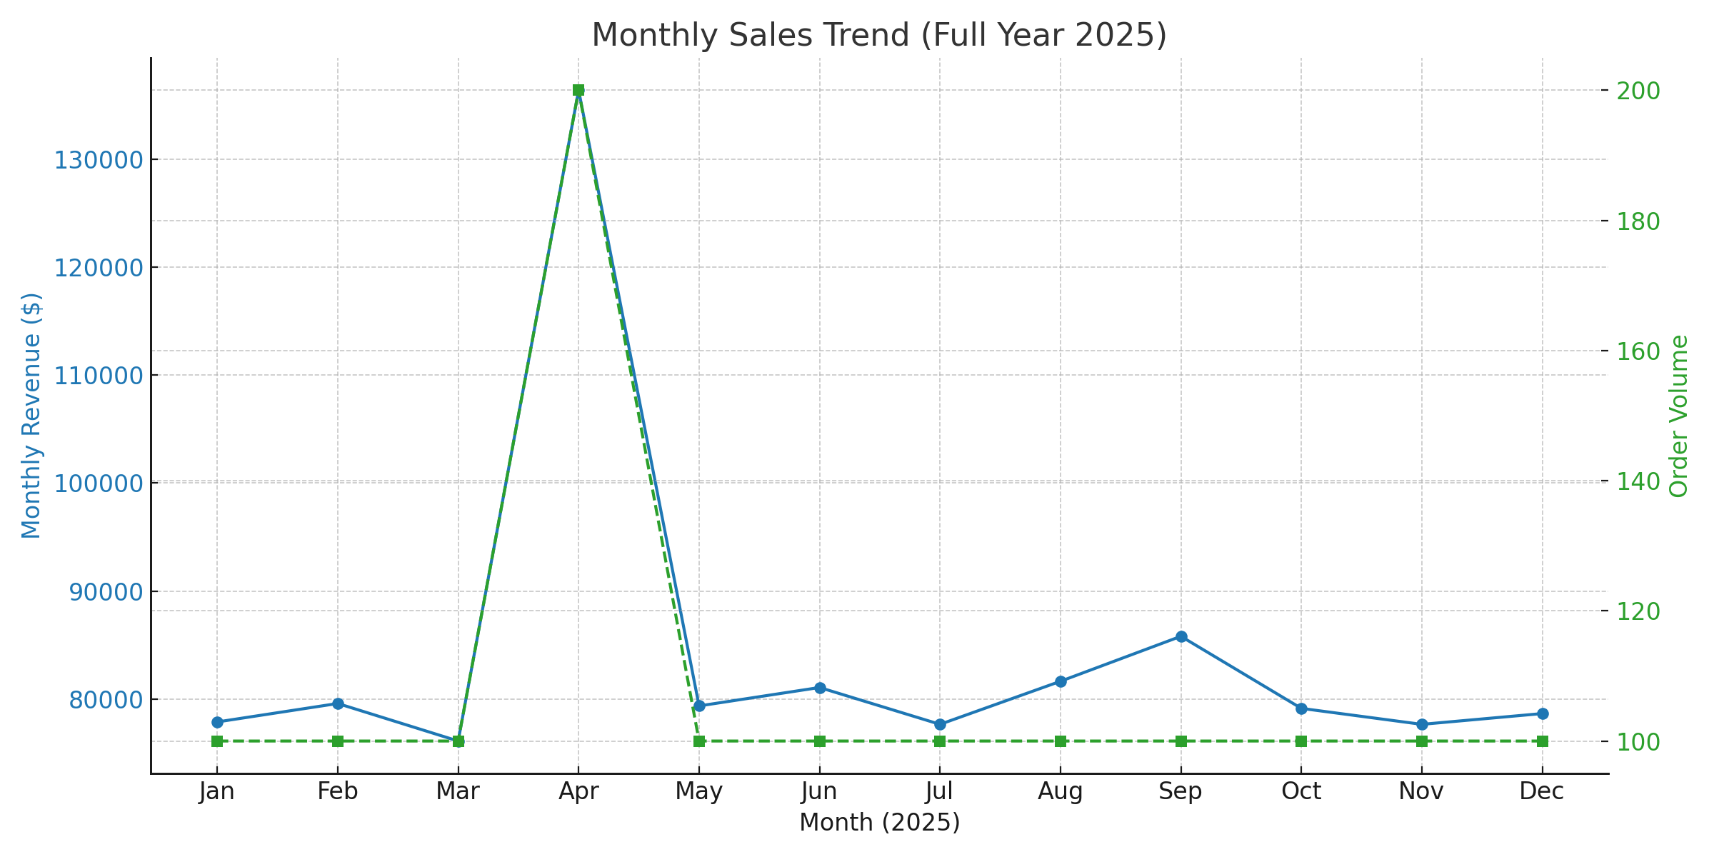
Monthly Sales Trend Chart (2025)

