Slide 1
Retail Sales Analysis
Insights from Sales, Profit, and Inventory Data

Slide 2
Dataset Overview
This dataset includes 1,000 retail orders with the following key attributes:
- Sales, Quantity, Discount, Profit
- Inventory Stock and Turnover
- Product Category and Region
- Seasonal Sales Information

Slide 3
Sales by Category

Slide 4
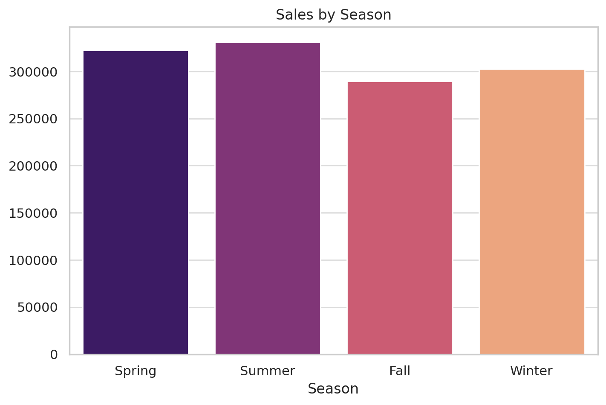
Seasonal sales

Slide 5
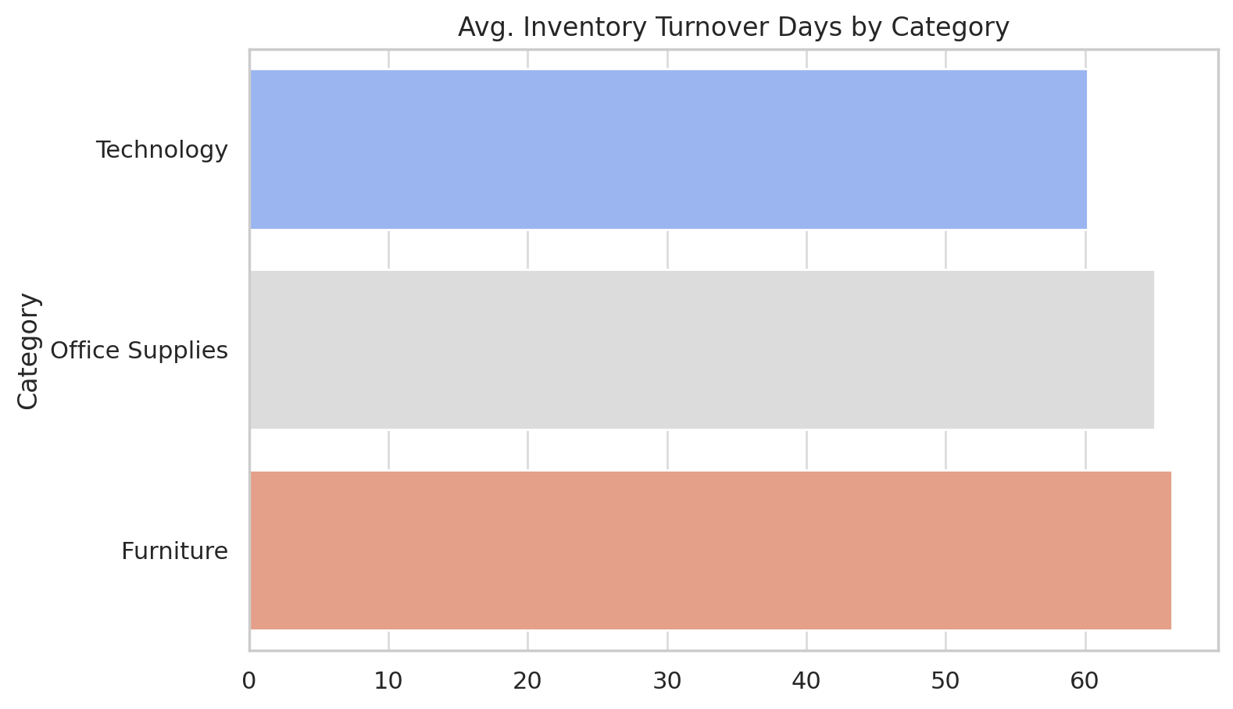
Inventory Turnover

Slide 6
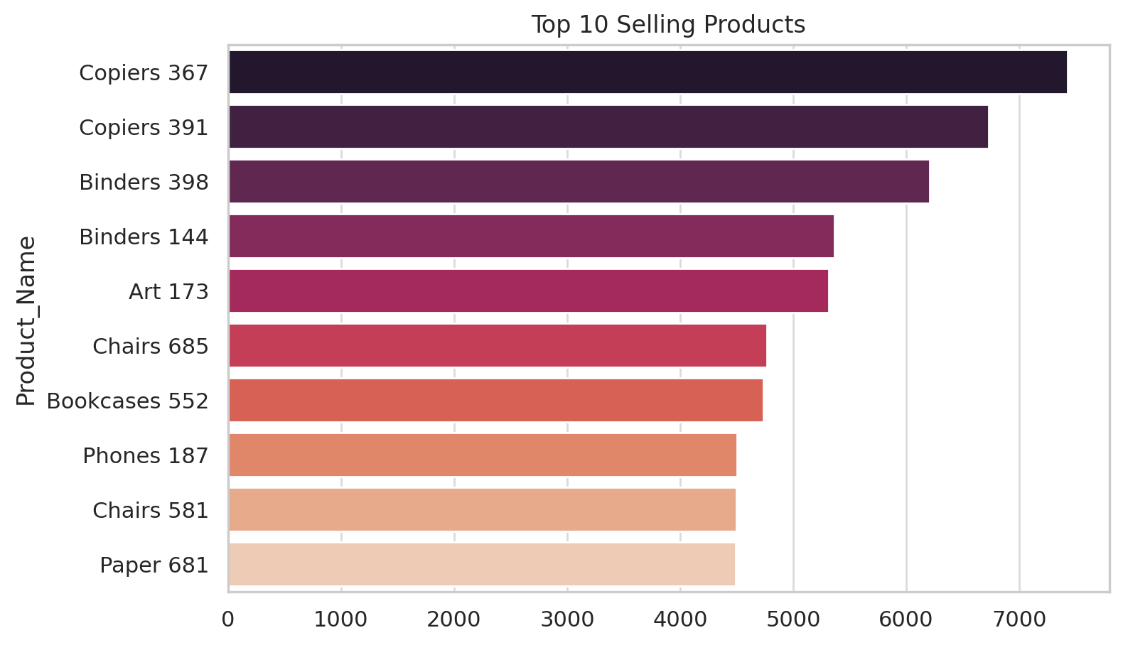
Top 10 Selling Products

Slide 7
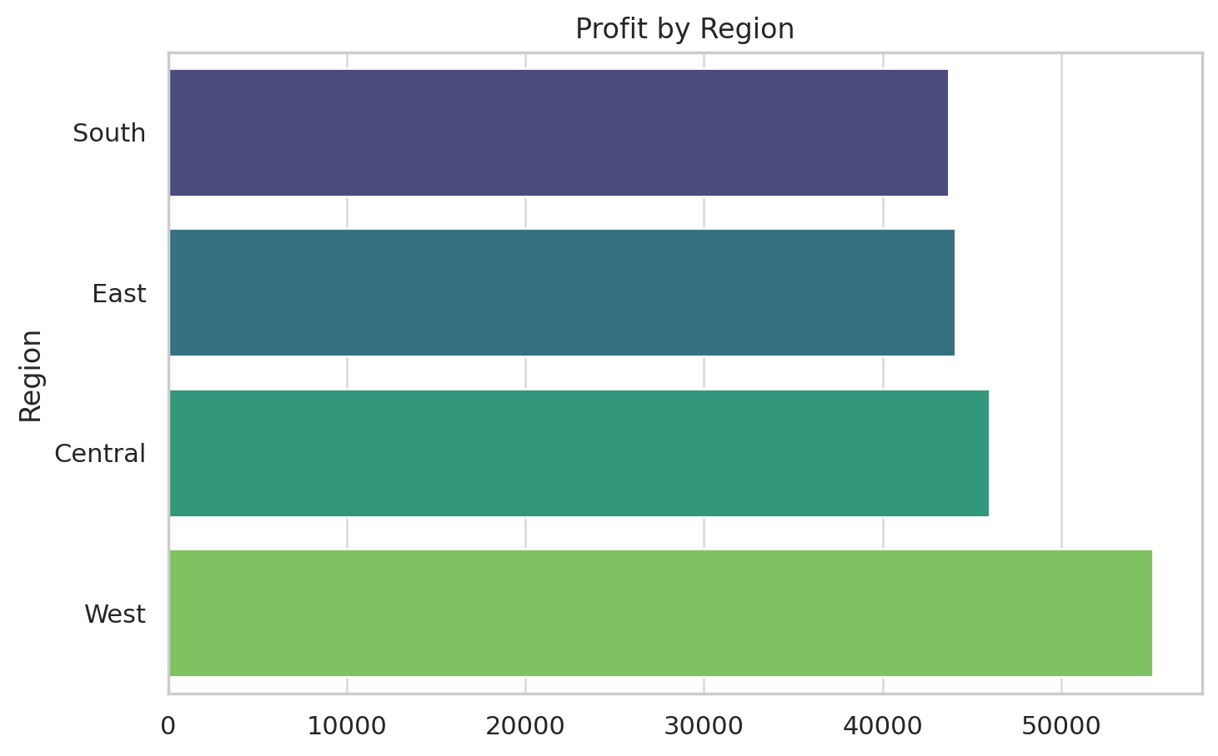
Profit by Region

