Slide 1
Text-to-Video Generation with AI
A walkthrough of creating videos from prompts using Gemini and Stable Diffusion.

Slide 2
The Goal: What are we building?
We're creating a Python script that automatically converts a simple text description (a "prompt") into a short, narrated video. The idea is to go from a single sentence to a complete video with visuals and a voiceover, all generated by AI.

Slide 3
The Overall Process: The AI Assembly Line
Our script follows a clear, multi-step pipeline:
AI Storyboard (Gemini): Takes the user's prompt and breaks the scene into 10 steps.
AI Image Generation (Stable Diffusion): Creates a picture for each of the 10 steps.
AI Narration (Google TTS): Creates a voiceover from the text of the steps.
Video Assembly (MoviePy): Stitches the images, text captions, and audio together into a final video.

Slide 4
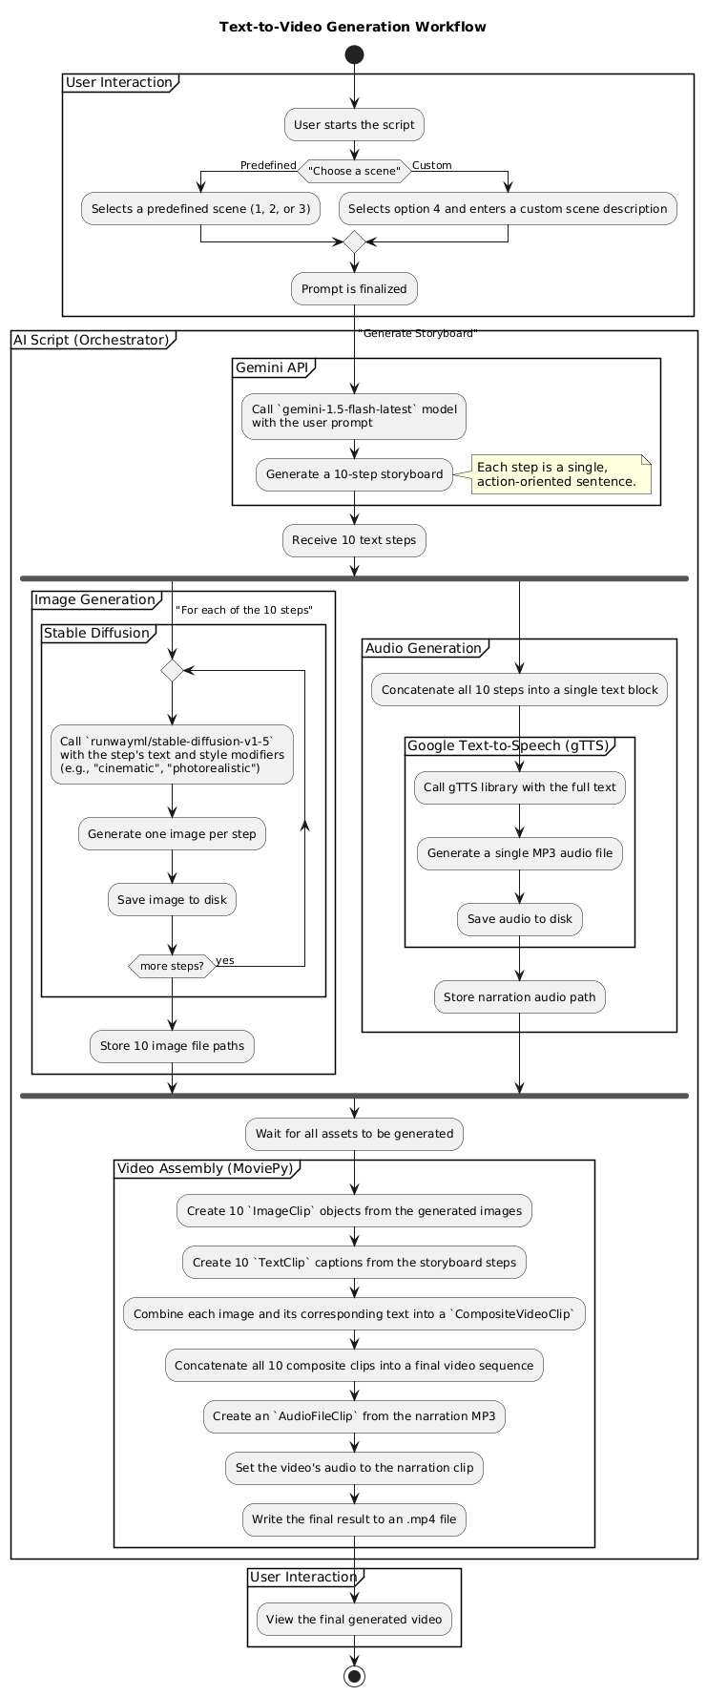

Slide 5
Generating the Narrative
First, we need a story. We use the Gemini language model (gemini-1.5-flash-latest) to act as a director.
Input: The user's simple scene description.
Action: We instruct Gemini to break the scene down into exactly 10 distinct, action-oriented steps.
Output: A list of sentences that will form the video's narrative and captions.

Slide 6
Visualizing the Story
With the storyboard ready, we create the visuals.
Input: Each individual step from the storyboard.
Action: We feed each step into Stable Diffusion (runwayml/stable-diffusion-v1-5), adding keywords like "cinematic style" and "photorealistic" to improve the result.
Output: A unique image for each of the 10 steps.

Slide 7
Adding a Voice
Next, we generate the voiceover.
Input: The complete list of 10 storyboard steps.
Action: The steps are joined into a single block of text and processed by Google's Text-to-Speech (gTTS) library.
Output: A single MP3 audio file containing the spoken narration.

Slide 8
The Final Edit
This is where all the AI-generated assets come together using the MoviePy library.
Process: MoviePy turns each image into a video clip, overlays the text caption, concatenates all the clips, and adds the final audio track.
Output: A finished .mp4 video file.

Slide 9
Key Technologies Used
Gemini 1.5 Flash: For natural language processing and storyboard generation.
Stable Diffusion v1.5: For high-quality text-to-image synthesis.
gTTS (Google Text-to-Speech): For creating the audio narration.
MoviePy: For all programmatic video editing and assembly.
Python & Google Colab: The environment that brings it all together.

Slide 10
Conclusion
This project provides a framework for turning an idea into a multimedia presentation by orchestrating language, image, and speech models.

Slide 11
Future Enhancements
Use a true text-to-video model for dynamic motion.
Integrate another AI to generate background music.
Add more user controls for style, pacing, and voice.
Include scene transitions for a more polished look.

