Slide 1

EXPLORATORY DATA ANALYSIS ON HOUSE SUGGESTIONS IN HYDERABAD

Slide 2
About Me
Background : B-Tech
Why Data Science? : I want to study data science because it allows me to turn data into valuable insights, solve real-world problems, and drive innovation. It's a field that combines my love for analytical thinking with practical impact.
Work Experience : Working in TCS since 2022 as a assistant system engineer trainee.
LinkedIn Profile : www.linkedin.com/in/maneendrareddykatukuri
GitHub URL : https://github.com/KatukuriManeendraReddy

Slide 3
OBJECTIVE
Analyzing insights on house suggestions across Hyderabad through data analysis methods.

Slide 4
Agenda
Exploratory Data Analysis on House Suggestions in Hyderabad
Introduction to Hyderabad Real Estate Market
Provide an overview of the real estate landscape in Hyderabad, including market trends and key players.
Data Collection and Preparation
Discuss the process of gathering and organizing data for analysis, highlighting the importance of data quality.
Univariate Analysis
Explain the concept of univariate analysis and its application in understanding individual variables' characteristics.
Bivariate Analysis
Explore the relationship between two variables through bivariate analysis to uncover correlations and patterns.
1
2
3
4
Multivariate Analysis
Delve into multivariate analysis methods to study interactions among multiple variables for comprehensive insights.
Key Business Questions
Strategic inquiries that help a business understand its performance and opportunities, guiding decision-making.
Key Findings and Recommendations
Present significant findings from the analysis and provide actionable recommendations based on the insights.
Q&A Session
Engage the audience in a question and answer session to address queries and foster discussion on the analysis outcomes.
5
6
7
8

Slide 5




Introduction to Hyderabad Real Estate Market
Exploring the Growth and Demand in Hyderabad Real Estate
Key
Neighborhoods
Prominent areas like Jubilee Hills, Madhapur, Kondapur, and Gachibowli stand out as sought-after locations.
Housing
Demand
Growing interest in a variety of housing options ranging from 1 BHK to 5 BHK and 1 RK signifies diverse preferences and needs.
IT Industry
Influence
The expanding IT sector plays a pivotal role in propelling the real estate market's rapid development and expansion.
Investment
Potential
Hyderabad's real estate market offers promising investment opportunities due to the city's growth trajectory and increasing demand.

Slide 6

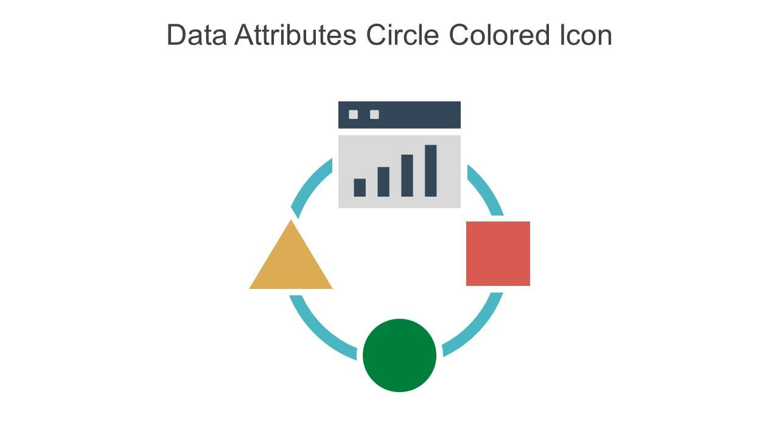

Data Collection and Preparation
Understanding and Preparing Real Estate Data for Analysis
Web Scrapping
Data collected from housing website and data was extracted from the the website using Selenium automation for the process.
Key Data Attributes
Important attributes include house type, property type, price, brokerage details, location, furnishing status, area in sq.ft, and number of bathrooms.
Data Cleaning Process
Cleaning involves standardizing data types, and addressing outliers to ensure data quality and accuracy.

Slide 7
Univariate Analysis: Price
Analyzing house prices in Hyderabad for effective suggestions.
35000/-
Average Price
The average price of houses in Hyderabad is ₹35,000, indicating the general pricing trend in the housing market.
28000/-
Median Price
The median price of ₹28,000 suggests that half of the houses in Hyderabad are priced below this value, giving a central point of reference for pricing.
28000/-
Mode Price
With the mode price also at ₹28,000, it indicates a significant concentration of houses priced at this value in Hyderabad, highlighting a common price point.
25000/-
Standard Deviation
(10000 – 250000)/-
Price Range
The price range of ₹10,000 to ₹60,000 showcases the diversity in house prices in Hyderabad, catering to various budget preferences of potential buyers.
With a standard deviation of ₹25,412, there is a notable dispersion in house prices around the average, signifying the variability in pricing data points.

Slide 8
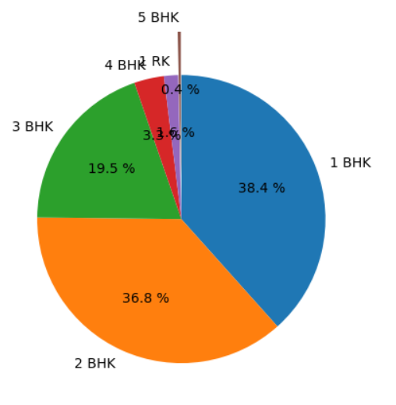
Univariate Analysis: Distribution of House Types
Distribution of House Types in Hyderabad
House Type | Percentage
1 BHK | 38%
2 BHK | 36%
3 BHK | 20%
4BHK | 3%
5 BHK | 0.4%
1 RK | 1.6%

Slide 9
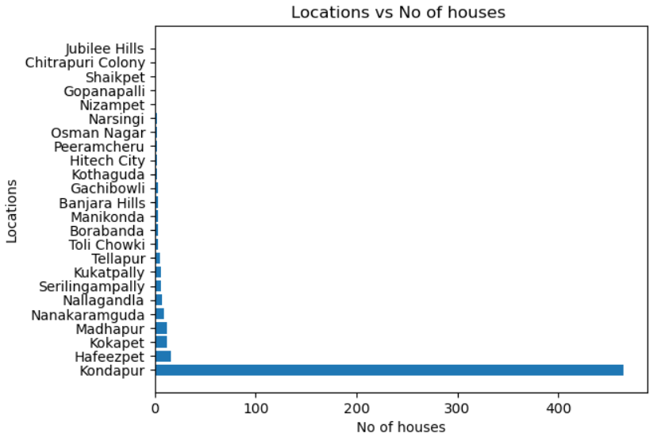
Location Analysis: House Distribution
Distribution of Houses in Different Locations in Hyderabad
Location | No of Houses
Kondapur | 465
Hafeezpet | 16
Kokapet | 12
Madhapur | 12
Nanakaramguda | 9
Nallagandla | 7
Kukatpally | 6

Slide 10
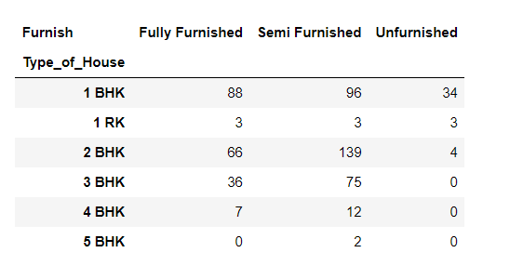
Bivariate Analysis: Furnish vs. Type of House
Distribution of House Furnishing Types
Semi furnished are most 2BHK followed by 1BHK then followed by 3BHK.
Fully Furnished are most 1BHK followed by 2BHK.
Very less 2BHK are not furnished.
None of 3BHK, 4BHK, 5BHK flats remained unfurnished.

Slide 11
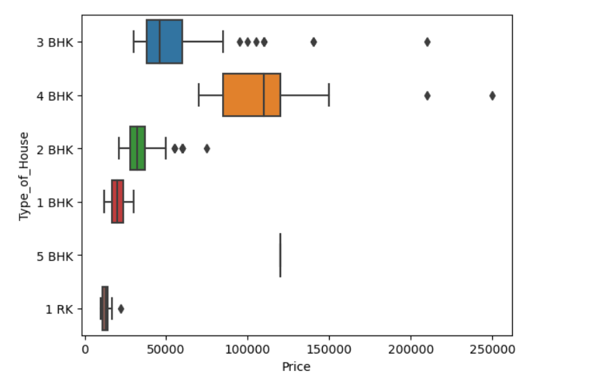
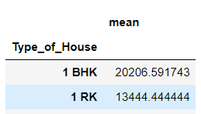
Bivariate Analysis: Price vs. Type of House
Comparison of Mean and Median Prices for Different House Types in Hyderabad
The price data of 5BHK is symmetric and 1BHK is approximately symmetric but 3BHK, 2BHK, 4BHK 's price data is highly positve skewed. So there may be chance of outliers in 3BHK, 2BHK and 4BHK.
Only 4BHK,3BHK and 5BHK flats prices are more than 1,00,000/- and almost are only 4BHK flats.
Spread of price data is moderate in each type
of house.
1 BHK and 1 RK flats have low mean price
compared to other type of houses.

Slide 12
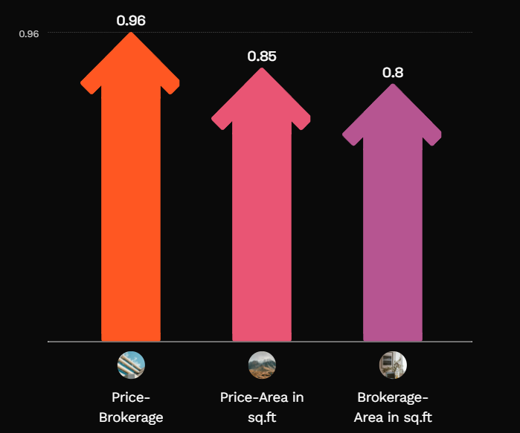
Multivariate Analysis: Correlation Matrix
Correlation between Price, Brokerage, and Area in sq.ft
Area_in_sqft is impacting greatly on Price of the house.They have strong relation.
Price of the house is reflecting on brokerage.They both have strong relation between them almost linear relationship.

Slide 13
Key Business Questions
Pricing Strategy
Question : What is the most common price point for houses in Hyderabad?
Answer : The most common price point is around ₹25,000, with the average price being approximately ₹35,000.
Question : Are there any outliers in house pricing, and how do they affect the overall market?
Answer : Yes, there are outliers on the positive side, as indicated by the mean being higher than the median, suggesting a few houses are priced significantly higher.
Market Segmentation
Question : Which BHK configuration is most popular among buyers?
Answer : 1BHK flats are the most popular, making up 38% of the market, followed closely by 2BHK flats at 36%.
Question : Where should we focus our marketing efforts for luxury housing?
Answer : Focus on Tellapur for 5BHK flats, as it's the only location offering this configuration, and on areas like Shaikpet and Narsingi, where prices are higher.

Slide 14
Location Analysis
Question: Which area has the highest concentration of available houses?
Answer: Kondapur has the highest concentration of houses, including various types of BHK configurations.
Question: Which locations are underrepresented in the housing market?
Answer: Locations like Shaikpet, Jubilee Hills, Nizampet, and Gopanapalli have very few available houses, making them underrepresented.
Furnishing Preferences
Question: What is the most preferred furnishing type among house buyers?
Answer: Semi-furnished houses are the most preferred, accounting for 58% of the market.
Question: How does furnishing impact the price of houses?
Answer: Fully furnished houses have a higher average price, around ₹40,000, and the price generally increases with the level of furnishing.

Slide 15


Key Findings: Best Locations for Different Budgets
Comparing Prices of Budget-Friendly, Premium, and Mid-Range Locations in Hyderabad
Shaikpet: Mean price ₹210,000
Narsingi: Mean price ₹162,500
Hafeezpet: Mean price ₹25,024

Slide 16
Shaikpet has the highest mean price
With an average of ₹210,000, Shaikpet stands out as one of the most expensive areas for house prices.

Slide 17
Recommendations
Optimal Housing Choices in Hyderabad Based on Budget
Hafeezpet and Kondapur - Ideal for budget buyers due to affordability and decent amenities. Good options available for furnished
houses of various sizes.
Kukatpally and Madhapur - Suitable for mid-range buyers seeking a balance between cost and quality. Close to essential facilities and
diverse housing options.
Shaikpet and Narsingi - Luxurious choices for premium buyers looking for upscale living. Spacious, well-furnished homes with
premium amenities.
Factors to Consider - Evaluate furnishing quality, distance to amenities, house size, and type for a well-informed decision
tailored to your needs.

Slide 18


Slide 19
Challenges working on Web Scraping-Data Analysis Project
Handling Dynamic Content: A significant challenge was managing dynamically loaded content, which required ensuring all data was fully visible before extraction.
Security Measures: Encountering security protocols on the website sometimes interrupted the scraping process, necessitating adjustments to avoid detection or blocks.
Data Cleaning: Extracted data often required thorough cleaning and formatting to be useful for analysis.
Scalability Issues: Ensuring the scraping tool could handle large volumes of data without performance degradation was essential.
Data Quality and Consistency: Ensuring that the data scraped from various sources is clean, consistent, and accurate can be challenging. Different websites may have varying formats and structures, leading to issues with data uniformity and completeness.

Slide 20

Thank You
Let us help you find your dream home in Hyderabad!

