Slide 1


Marine Biology and Underwater Imaging
DSA0205
COMPUTER VISION WITH OPENCV
Presented By:
Katuku Sumanth 192324232
Under the Guidance of :
Dr. A. NARENTHIRAKUMAR

Slide 2


ABSTRACT
This assignment maps out how a computer vision system would work for Marine Biology and Underwater Imaging. It shows, step by step, how an underwater picture goes from being captured to becoming useful information for scientists.
First, two sensors collect data: a camera (or ROV) for regular images, and sonar for measuring distance using sound, since cameras alone struggle underwater where the water is murky. The captured image then goes through some cleanup steps. It gets sampled and converted into digital pixels, and its colours are corrected because water absorbs certain colours (like red) the deeper you go. Noise from tiny floating particles is also removed to make the picture clearer.
After cleanup, the image goes through three levels of processing. Low-level processing removes noise and improves contrast. Mid-level processing finds edges and separates objects in the picture, like telling a fish apart from the coral around it. High-level processing then identifies what the object actually is, such as recognizing it as a fish or a piece of coral.
Every step in this process has a real challenge attached to it. For example, cleaning up noise too much can blur small details, and using bigger, smarter models needs more battery power, which is limited on underwater robots.

Slide 3



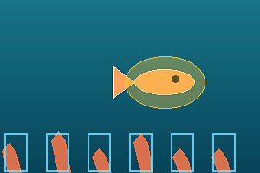
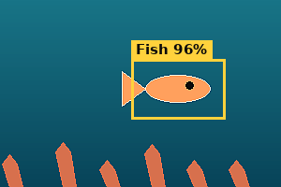









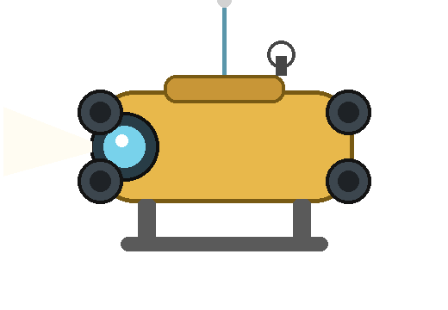

MARINE BIOLOGY & UNDERWATER IMAGING — CV PERCEPTION ARCHITECTURE
INPUT SENSORS
IMAGE PROCESSING PIPELINE
APPLICATION OUTPUTS
1. IMAGE ACQUISITION & PREPROCESSING
Camera / ROV
Coral Reef Health
Optical image frames
High-res vs. limited bandwidth
Raw Frame (Image Sensing)
Colour Corrected (Sampling)
Denoised (Quantization)
Segmented (Mid-Level)
Classified (High-Level)
Fish Species ID
Sonar
Limitation across every stage: light absorption & backscatter force active haze / colour compensation absent from terrestrial CV pipelines.
Motion blur affects counts
Acoustic range & depth
2. LEVELS OF PROCESSING
Robotics Navigation
Speed vs. detection precision
Both sensors are hull-mounted on the ROV platform (see bottom). Camera feeds optical frames; sonar supplies range data where turbidity blinds the lens.
LOW-LEVEL
MID-LEVEL
HIGH-LEVEL
Noise filtering &
contrast enhancement
Edge detection,
segmentation & features
Object recognition &
scene understanding
Pollution / Debris
Trade-offs: denoise strength vs. edge detail • segmentation depth vs. real-time compute • deeper models improve accuracy but drain battery-limited ROV power.
Visual clash with biofouling
SYSTEM OUTCOME
LEGEND
Sensing
Sampling / Quantization
Representation
Processing (L/M/H)
Application Output
Reef Health
Monitored
Species
Logged
Safe
Navigation
Pollution
Flagged
Ecosystem
Safeguarded
Sensor → ROV data feed
ROV PLATFORM
Camera + sonar mounted on-board; tether relays frames topside for the CV pipeline.

