Slide 1
How to write testable web applications
Jiří Tomek
jiri.tomek@solarwinds.com

Slide 2
Maybe not what you expected
ASP.NET WebApi2 a AngularJS
ASP.NET Core 2.0 WebApi and Angular 5
Let’s use modern technologies
AngularJS is so 2016
.NET Core is a bright future
5
Core 2.0

Slide 3
Agenda
Testing? Why should I care?
Test pyramid
Different kinds of tests
Unit tests
Integration tests
End to end tests
Sample application
Angular 5, ASP.NET Core 2.0 WebApi
Server part
code walkthrough
tests walkthrough
Client part
code walkthrough
tests walkthrough

Slide 4
Why testing?
Tests define the behavior of application
Allow safe changes and refactoring
Simplify debugging
Debugging against unit test is much cheaper than against live application
Improve code quality
What to test?
Consider gain/price ratio
Parts that have high impact on functionality bring more benefit

Slide 5
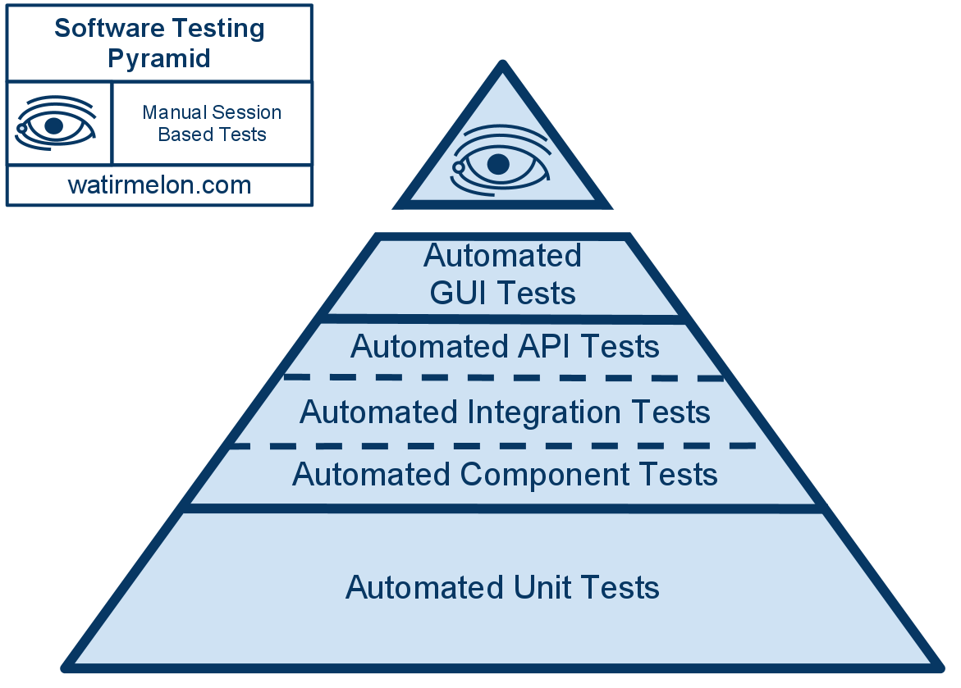
Test pyramid
To the top:
- less reliable
- higher price
- slower feedback

Slide 6
Unit tests
Unit test is code as any other
Needs to be maintained
Can be debugged
Tests just one class/component
Should be:
Easy to write
Readable
Reliable
Fast
Independent
Deterministic
No need for special test code
It’s cheapest kind of test

Slide 7
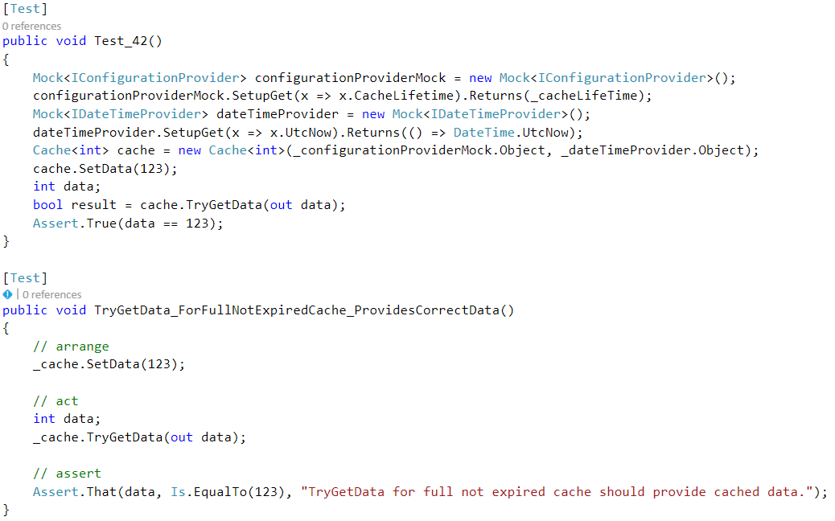
Readable
Name of the test clearly says what it does
Code is clean and easily understandable

Slide 8
Enemies of testable code
Static classes/methods
You can’t replace them with custom logic for testing
DateTime.Now
Singleton
Only one instance holding the state
Can’t parallelize tests
Can’t reset to default state without special test-only code
Global state
Environment variables
Configuration files

Slide 9
SOLID
SOLID principles
Single responsibility principle
Class does just one thing
Open/Closed principle
Class is opened for extension but closed for changes
Easy to add new functionality without need to touch existing code
Liskov substitution principle
Class can be replaced by its subclass without affecting functionality
Interface segregation
Interface should be small and focused
Dependency Inversion
Concrete classes depend on abstract interfaces, not vice versa

Slide 10
Integration tests
Test more classes or components together
Focused on component integration
Correct use of API
Good to use when
Testing component alone is too complex to setup
Component integration is not trivial
To test complex workflows
More expensive than unit tests but still good
Slower
Harder to maintain

Slide 11
End-to-end tests
Run against live application
Test whole application or its major part
Use public interface of application
API
UI
Most expensive
Time to setup the test
Time to setup the environment
Execution time
Protractor - http://www.protractortest.org/

Slide 12
UI tests
Test UI behavior
Without real backend
Mock API
Protractor HTTP mock - https://www.npmjs.com/package/protractor-xmlhttprequest-mock

Slide 13
Sample application

Slide 14
Web application
Presentation layer
Web browser
TypeScript, Angular 5, HTML, CSS
Business layer
Web server
ASP.NET Core 2.0 WebApi, C#
Data layer
Entity framework
SQL database
Angular 5, TS, HTML, CSS
ASP.NET Core 2.0 WebApi
SQL DB

Slide 15
Testable?
Covered by automated tests
End-to-end tests
UI behavior
Client logic
WebApi
Backend
DB
Unit tests
Integration tests

Slide 16

Switch to VS

Slide 17
Useful links
ASP.NET Core - https://docs.microsoft.com/en-us/aspnet/core/
TypeScript - https://www.typescriptlang.org/
Moq - https://github.com/Moq/moq4/wiki/Quickstart
Fluent Assertions - https://fluentassertions.com/
Angular – https://angular.io
Jasmine - https://jasmine.github.io/
Protractor - http://www.protractortest.org/
Effort - http://entityframework-effort.net

Slide 18

SolarWinds
30+ products for IT Management
Microsoft stack: C#, MS SQL, Angular
Brno office – SolarWinds R&D center
https://www.solarwindsmeetup.com/
Career opportunities
http://solarwinds.jobs/

