Slide 1
Discovering Laws Behind Real-World Data Using the Least Squares Method
Prem Bahadur Katuwal
Student ID: 202424080129
Numerical Analysis (PhD Level)

Slide 2
Introduction
• The least squares method is a fundamental technique for discovering patterns in data
• Developed by Gauss and Legendre in the early 19th century
• Minimizes the sum of squared differences between observed and predicted values
• Applications: physics, engineering, economics, social sciences, etc.
• This presentation demonstrates its application to real-world data

Slide 3
Theoretical Foundation
• Mathematical Formulation:
S(β) = Σ[yi - f(xi; β)]²
• Matrix Approach for Linear Models:
S(β) = ||y - Xβ||²
• Normal Equations:
X^T X β = X^T y
• Solution:
β = (X^T X)^(-1) X^T y

Slide 4
Linear Least Squares: House Size vs. Price
• Dataset: House sizes (sqft) and prices ($1000s)
• Linear model: Price = m × Size + c
• Best-fit parameters:
- Slope (m): 0.0991
- Intercept (c): 1.9382
• Discovered Law:
Price = 0.0991 × Size + 1.9382 ($1000s)
• R² = 0.9980 (99.8% of variance explained)

Slide 5
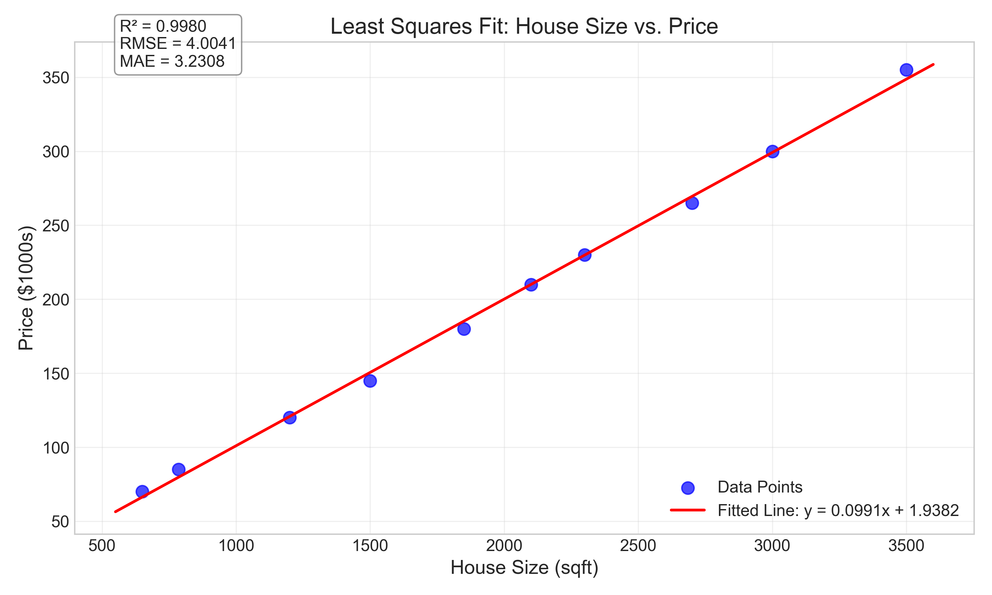
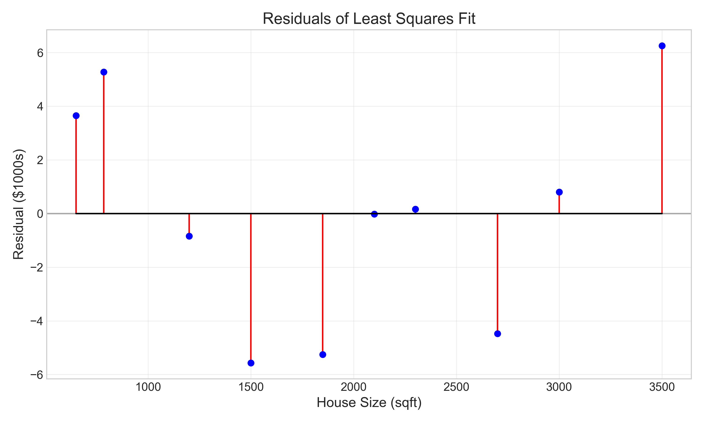
Linear Least Squares: Visualization
Fitted Line (R² = 0.9980)
Residuals Analysis

Slide 6
Polynomial Least Squares: Temperature Data
• Dataset: Monthly temperatures in northern hemisphere
• Polynomial model: T = β₀ + β₁x + β₂x² + ... + βₚxᵖ
• Best-fit (4th degree):
T = 0.021x⁴ - 0.595x³ + 4.900x² - 9.137x - 0.417
• R² = 0.9984 (99.84% of variance explained)
• Captures seasonal temperature variations

Slide 7
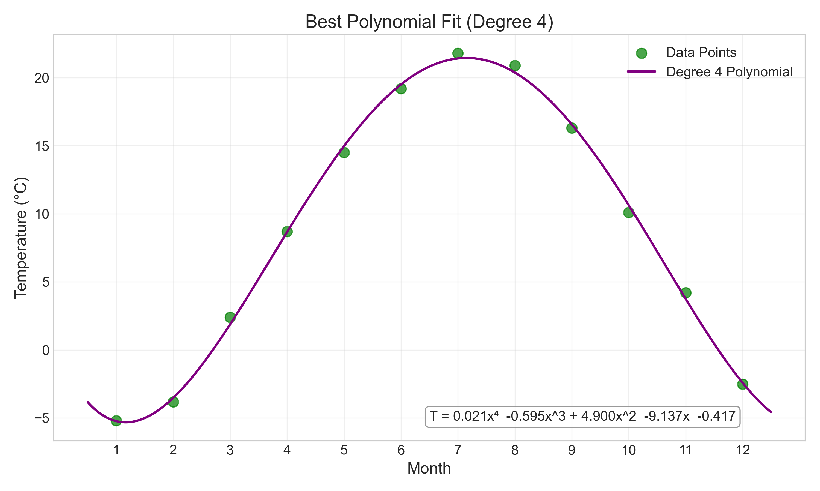
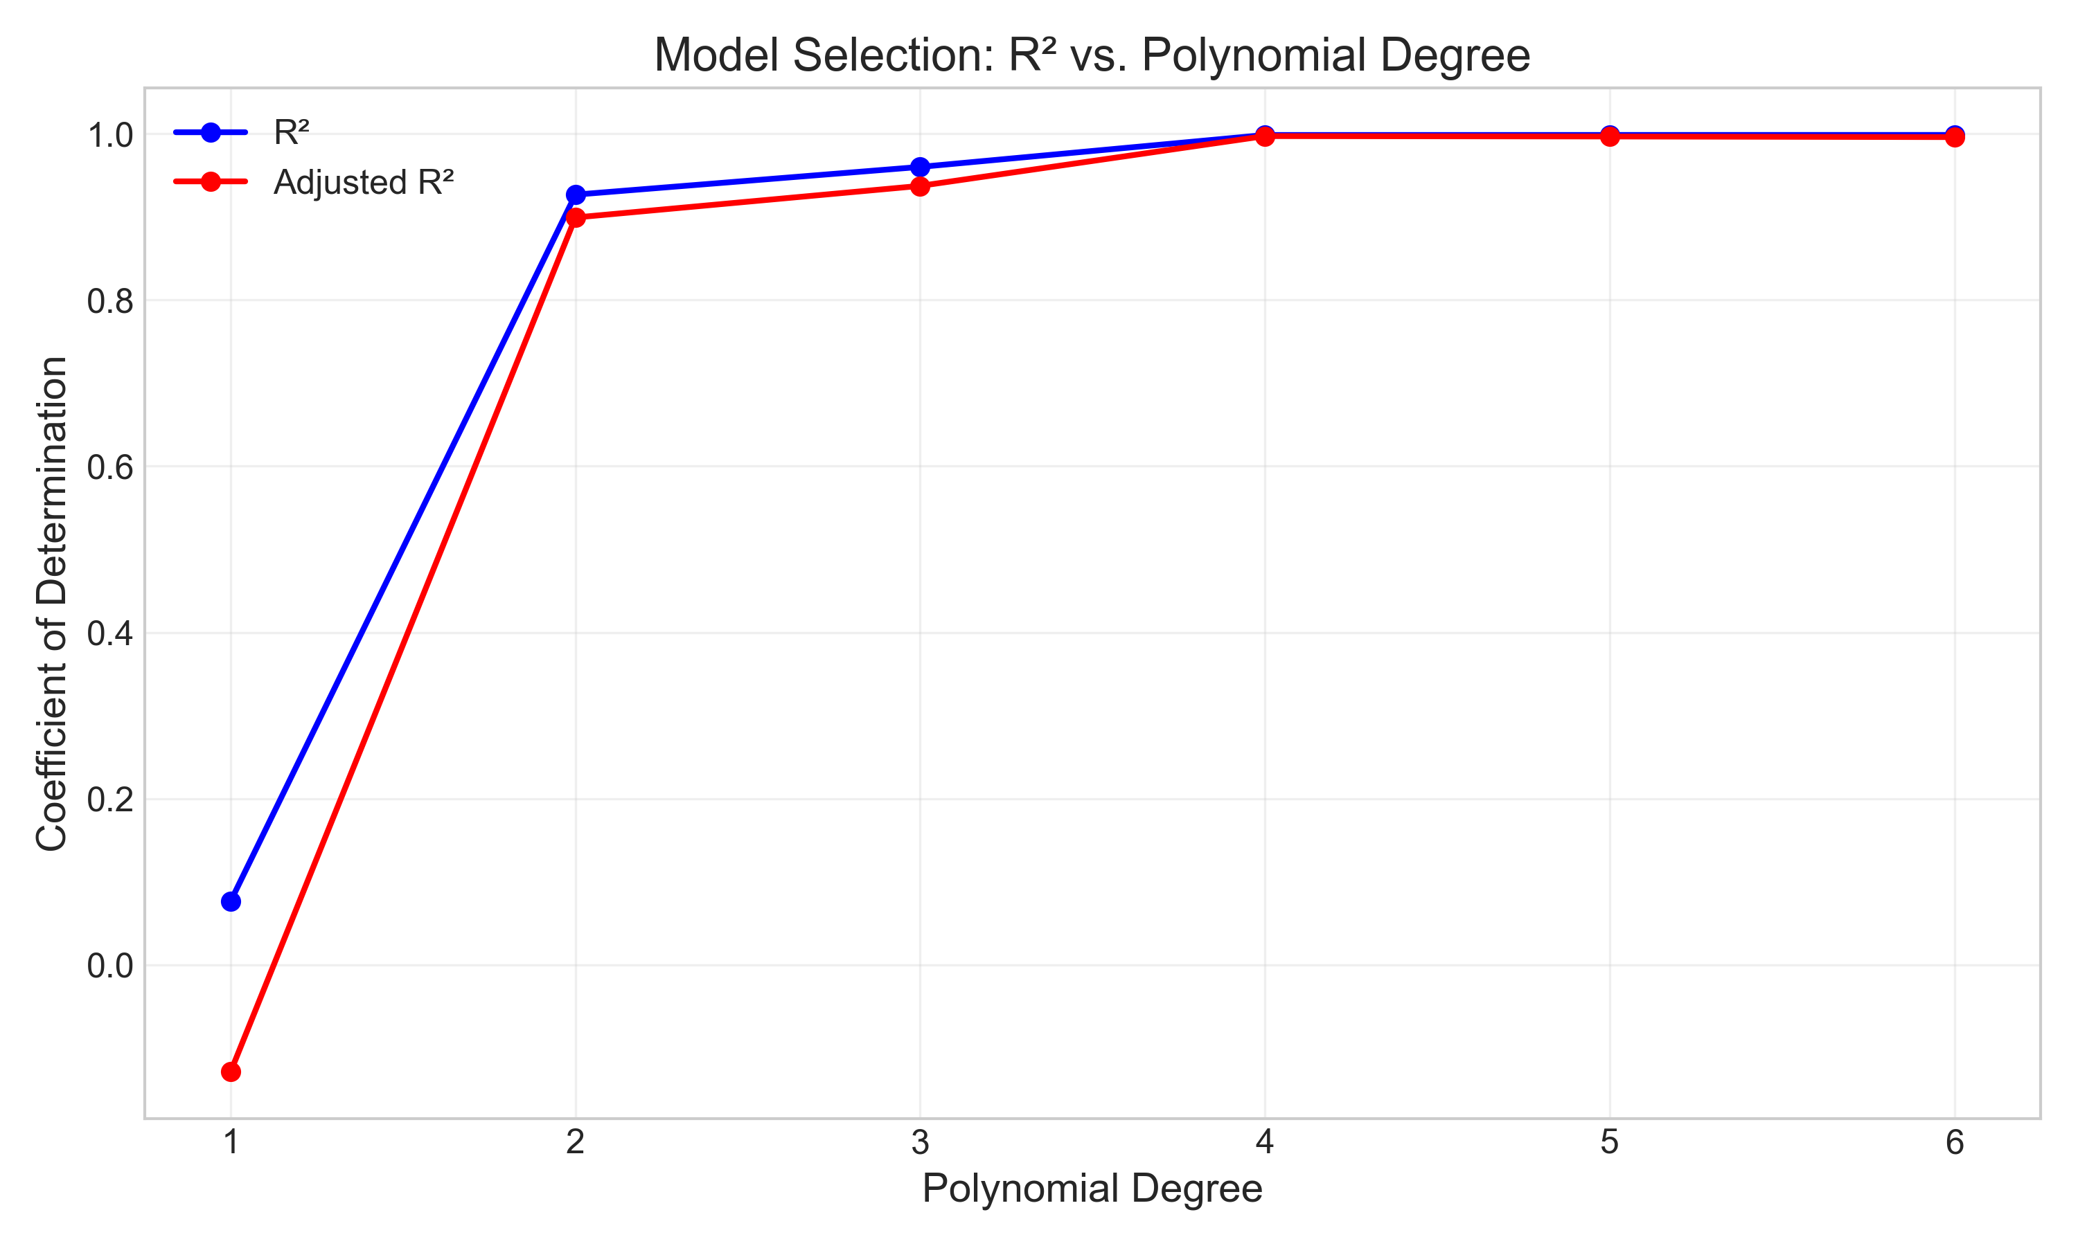
Polynomial Least Squares: Visualization
4th Degree Polynomial Fit
Model Selection: R² vs. Degree

Slide 8
Non-Linear Least Squares: Population Growth
• Dataset: World population from 1900 to 2020
• Exponential model: P(t) = P₀e^(rt)
• Two approaches:
1. Linearization: ln(P) = ln(P₀) + rt
2. Direct non-linear fitting
• Discovered Law:
P(t) = 1.69e^(0.013t), where t = years since 1900
• Growth rate: ~1.3% per year (doubling time: ~54 years)

Slide 9
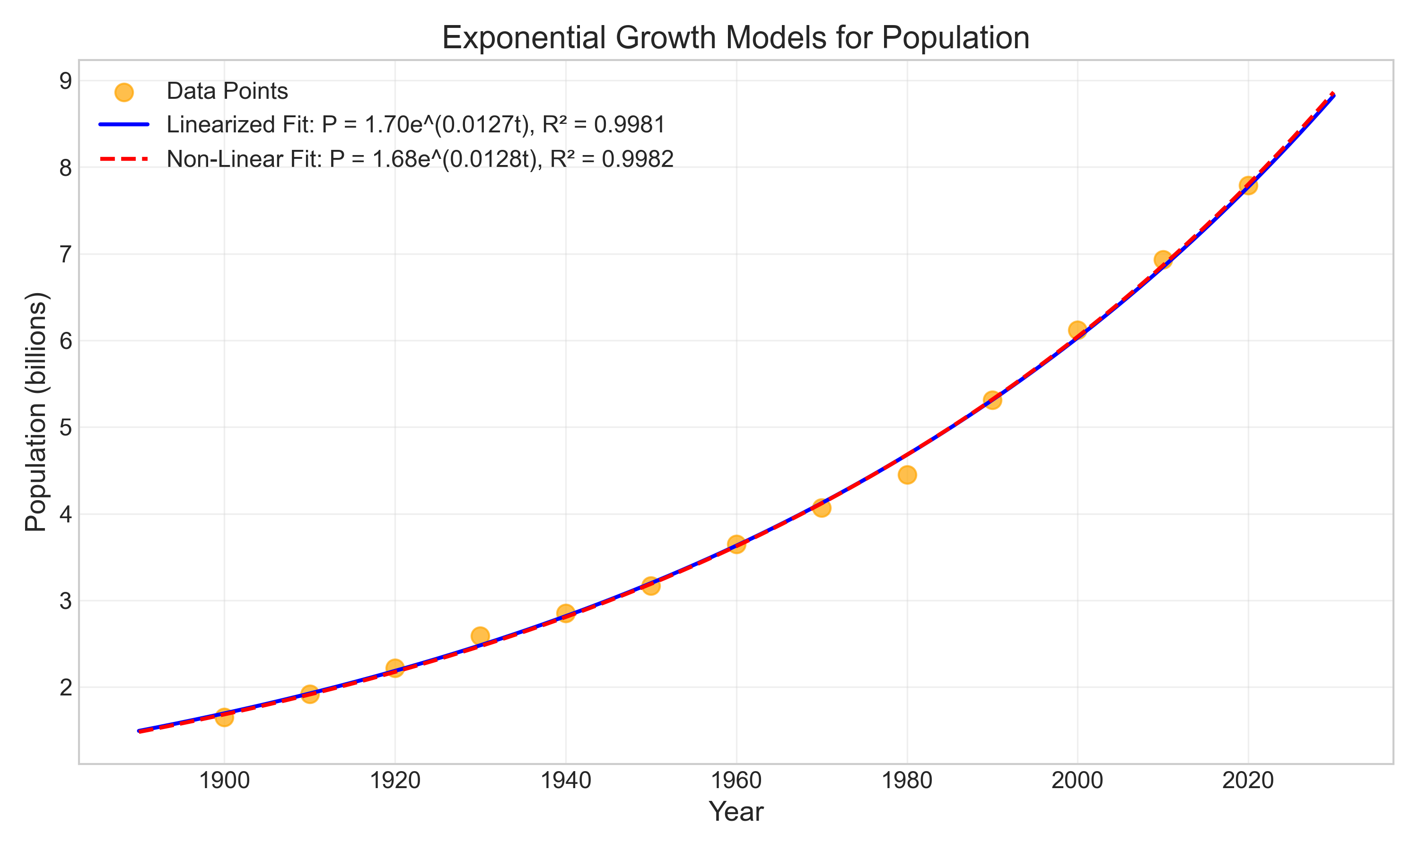
Non-Linear Least Squares: Visualization
Exponential Growth Models

Slide 10
Advanced Analysis
• Residual Analysis:
- Random scatter around zero
- No obvious patterns
- No extreme outliers
• Confidence Intervals:
- Quantify uncertainty in predictions
- Wider at extremes of data range
• Goodness of Fit Metrics:
- R² (coefficient of determination)
- RMSE (root mean square error)
- MAE (mean absolute error)

Slide 11
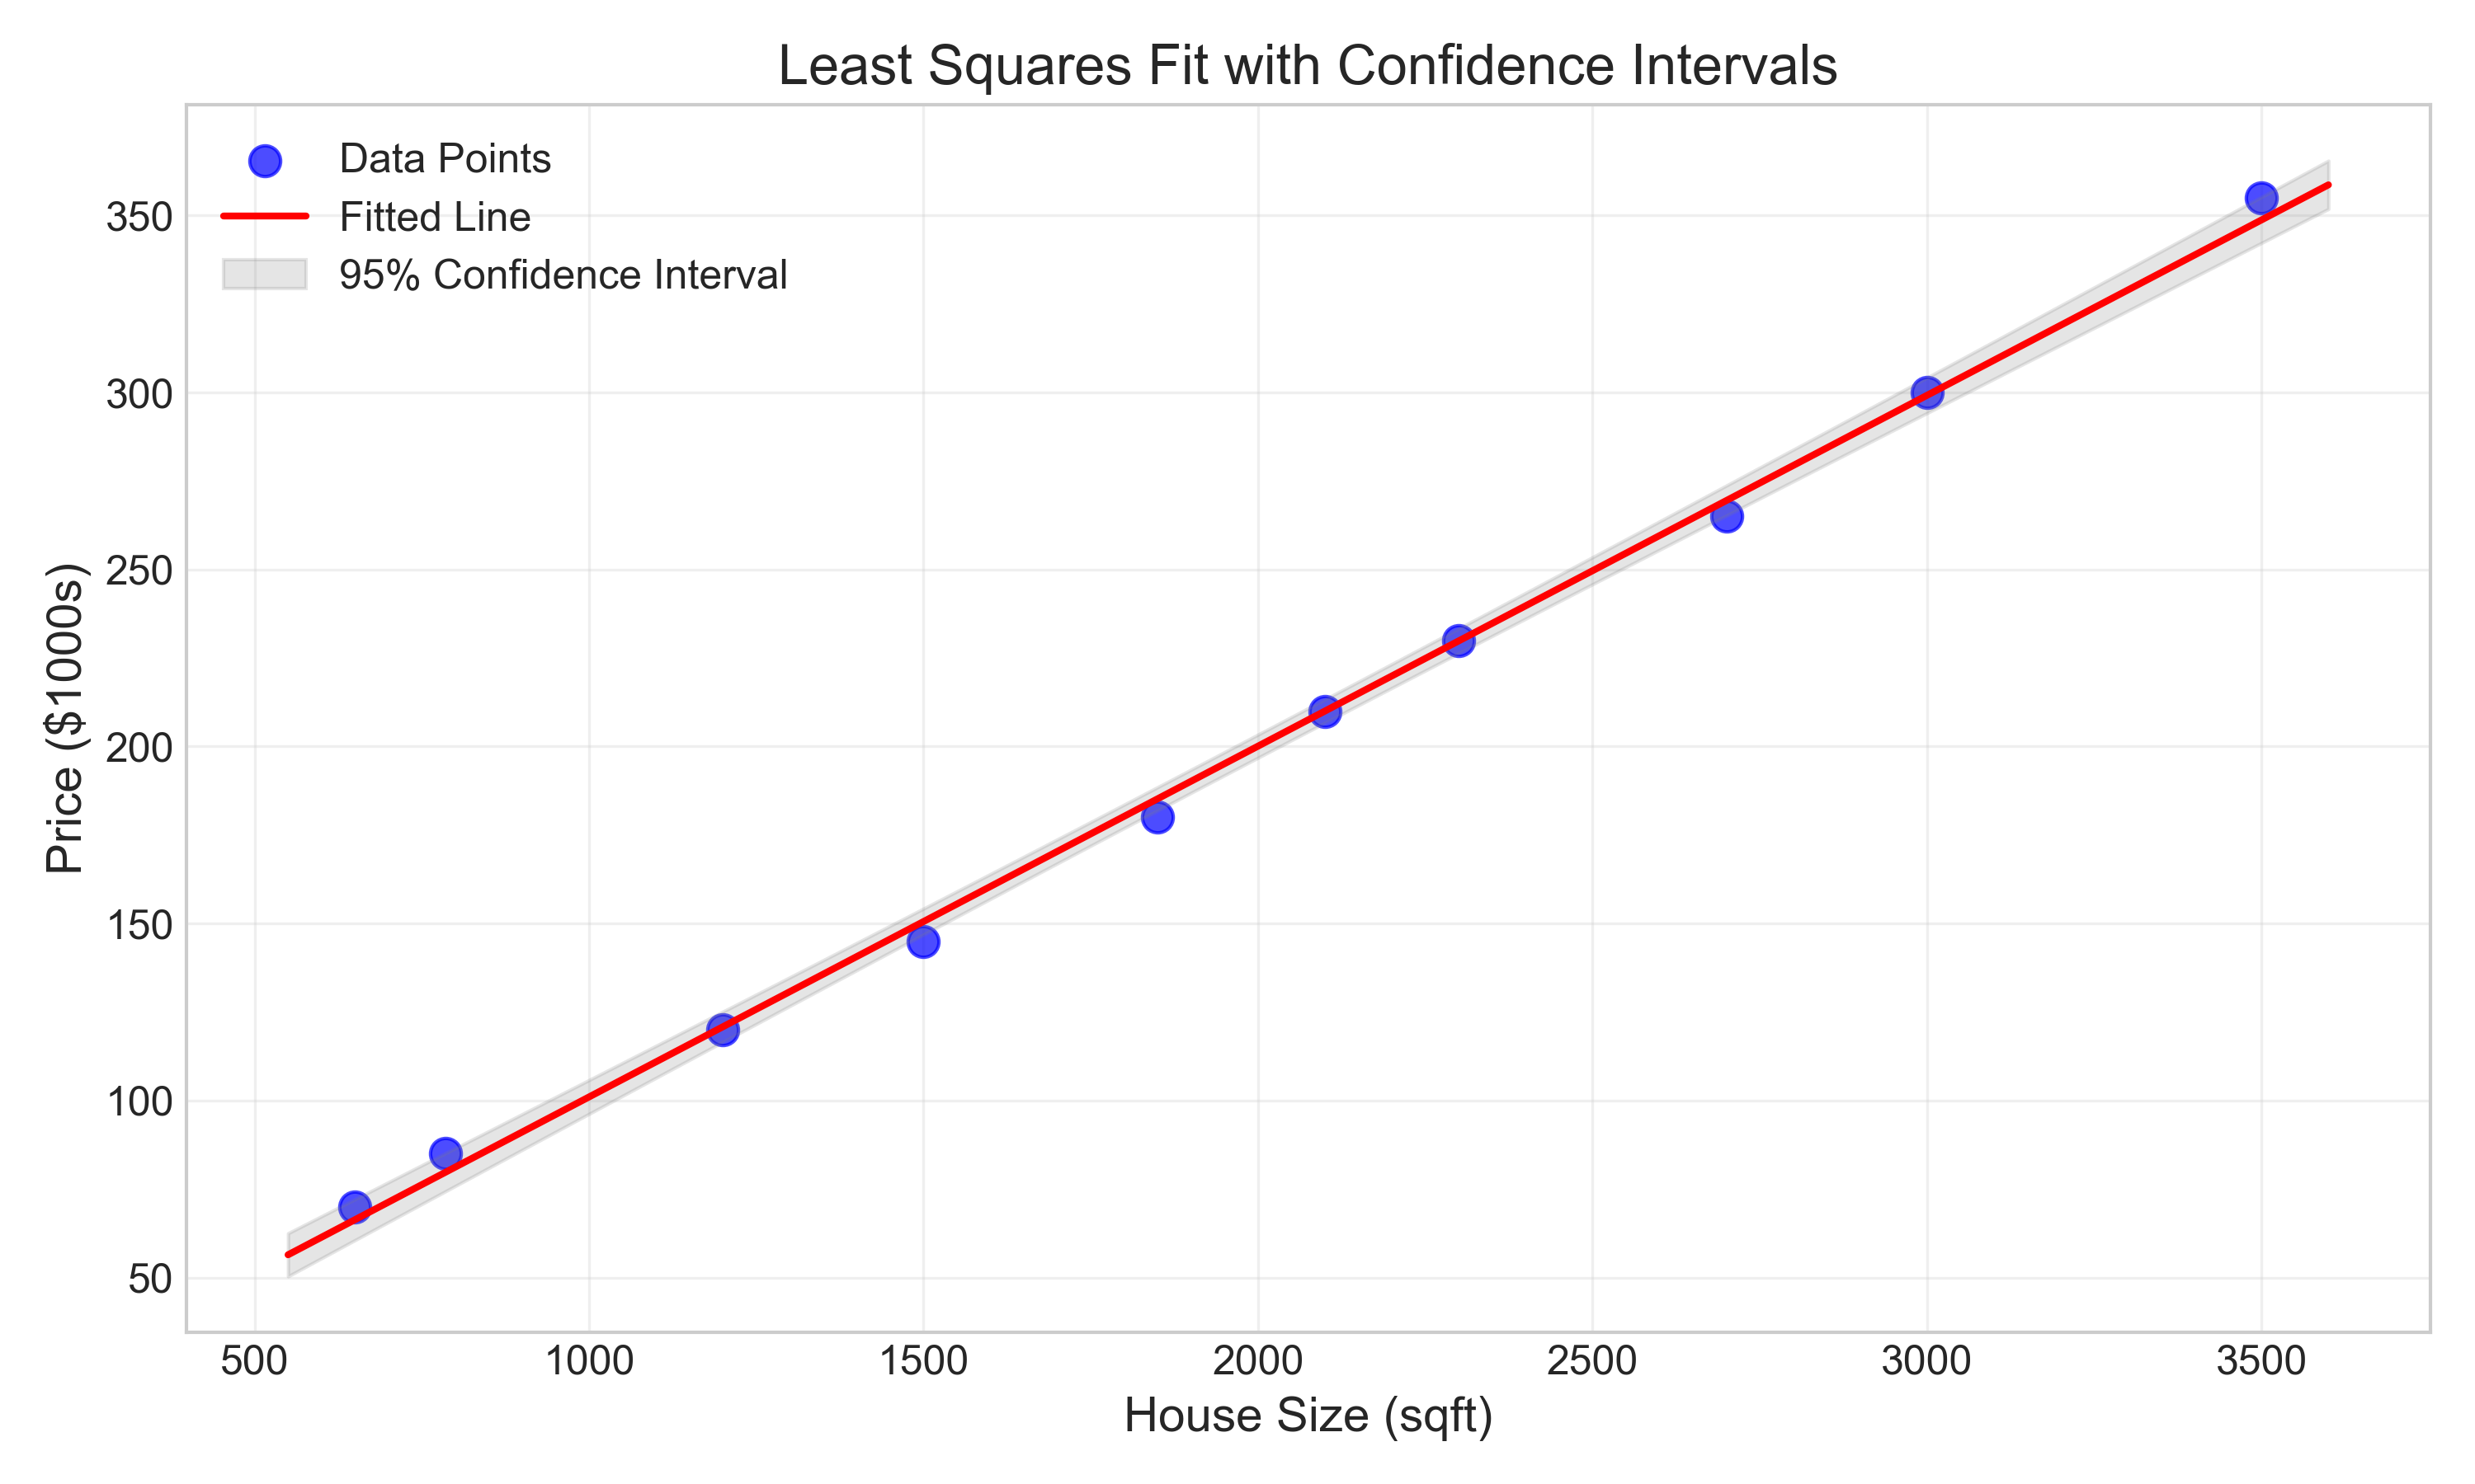
Confidence Intervals
95% Confidence Intervals for Predictions

Slide 12
Comparison with Other Methods
• Robust Regression:
- Less sensitive to outliers
- Uses Huber loss or Tukey's bisquare
• Ridge Regression:
- Adds penalty term to handle multicollinearity
- Minimizes Σ[yi - f(xi; β)]² + λΣβj²
• LASSO Regression:
- Encourages sparse solutions
- Minimizes Σ[yi - f(xi; β)]² + λΣ|βj|
• Orthogonal Distance Regression:
- Accounts for errors in both variables

Slide 13
Conclusion
• The least squares method is powerful for discovering laws in data
• Key findings from our analysis:
- House price follows a linear law: Price ≈ 0.10 × Size + 1.94 ($1000s)
- Monthly temperatures follow a 4th-degree polynomial pattern
- Population growth follows an exponential law: P(t) = 1.69e^(0.013t)
• Applications:
- Prediction and forecasting
- Understanding relationships
- Testing hypotheses
- Decision-making

Slide 14
Thank You!
Prem Bahadur Katuwal Student ID: 202424080129 Numerical Analysis (PhD Level)

