Slide 1
Shelter Animals Outcomes
By Ekaterina Tcareva

Slide 2
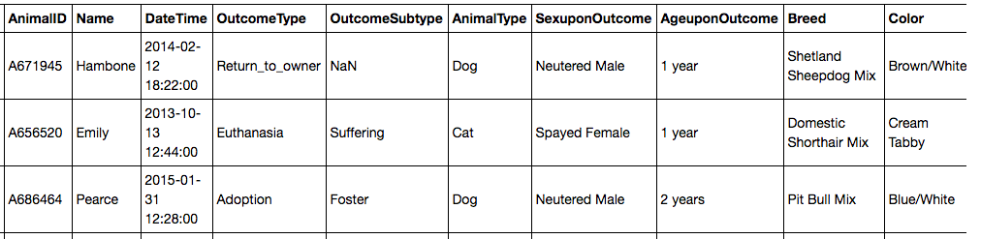
The Goal: to predict the outcome for the animals from an Animal Center.
We have the dataset with 26 729 rows:

Slide 3
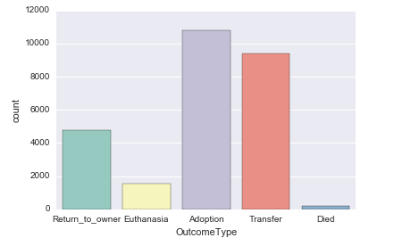
Outcomes
The most common outcome is “Adoption”
Then we have:
Transfer
Return to owner
Euthanasia
Died

Slide 4
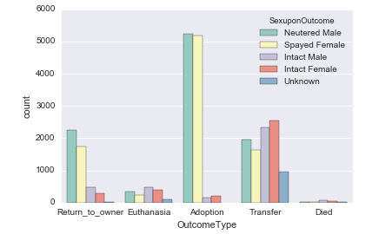
Sex of Animals
I realized that “Sex” is a very important.
Neutered Male and Spayed Female are much
more likely to be adopted.

Slide 5
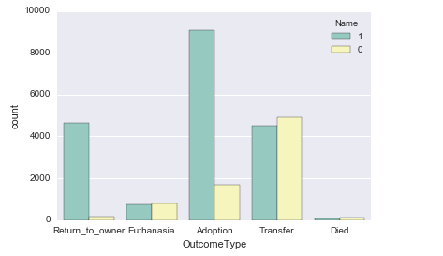
Name
Some animals in the data set have name
and some of them do not.
The animals with known name are more likely
to returnee home since we can suggest that these
animals has an ID tag.
I replaced known name by 1 and unknown name by 0.

Slide 6
Other features
I converted the age into the float (animals had age as the number of day, month, or year)
We have 1380 different breeds. I decided to divide animals into “pure breed” and “mix”

Slide 7
My Feature Set
Name 1/0 - known or unknown
Animal type 1/0 - cat or dog
Age (float)
Breed 1/0 - pure or mix
Sex - I created 5 columns and used dummy

Slide 8
I used Log Loss to compare the results
Algorithm | Result on training set | submission
Logistic Regression | 0.923281657861 | 0.92871
RandomForestClassifier | 1.3158599187
KNeighborsClassifier | 5.45209963778
AdaBoostClassifier | 1.55620463157
GaussianNB | 3.50978740871
DecisionTreeClassifier | 1.50795704995
CalibratedClassifierCV | 0.928656027396 | 0.93516
VotingClassifier (LogisticReg + CalCl) | 0.924870249657 | 0.93881
VotingClassifier (LogisticReg + CalCl + RanFor) | 0.883503953166 | 0.92197
VotingClassifier (LogisticReg +CalCl+RanFor+ DT) | 0.873725006634 | 0.93881
VotingClassifier (LogReg + CalCl + RanFor + DT+Ada) | 0.936490811067
SVM | 0.926946428869

Slide 9
My Next Step will be feature engineering
We can use “Day Time”: I am going to create “Day_of_Week” and “Time” features
We have 1380 breeds. I am going to find the most common breads and use them
I also think we can use different algorithm for cats and dogs since they could have different patterns in the adoption.

Slide 10
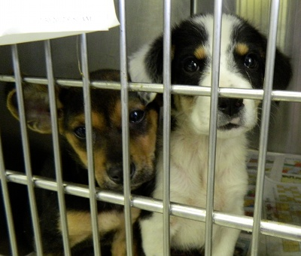
Thanks!
Ekaterina Tcareva
ek.tcareva@gmail.com
https://www.linkedin.com/in/ekaterina-tcareva-b1879a87
https://github.com/Katy-katy
http://oakridgetoday.com/wp-content/uploads/2012/08/dogs-at-animal-shelter.jpg

